Slide 1
Do Gluons Carry Proton Spin? – toward resolving the “Spin Crisis”
Alexander Bazilevsky
Physics Department, BNL
Brookhaven Lecture
January 21, 2009

Slide 2
Outline
Why Spin
  Role of the Spin
  Proton Spin Structure and Spin Crisis
Why Gluons
  Role of Gluons
  Probing Gluon Spin Contribution
What’s next

Slide 3





Spin
Fundamental Concept in Physics
Appears in all levels: from galaxies to elementary particles

Slide 4
Spin
Spin is a fundamental quantum mechanical property of elementary particles (like mass, charge)
  Carries the same mathematical meaning as angular momentum (rotational motion in classical mechanics)
  Spin in quantum mechanics is quantized in units of Planck’s constant h, and can be either integer (0, 1, 2 etc) or half-integer (1/2, 3/2 etc);
  Proton, neutron and electron are spin-1/2 particles
Spin plays central role in theory of strong interaction, Quantum Chromodynamics (QCD)

Slide 5
Spin and particle internal structure
S
Associated with particle spin is magnetic moment
(like rotating electrically charged body)
e – electric charge
m – mass
S - spin
N
From quantum theory (Dirac equation):
g~2 for elementary (point-like) ½-spin particle
Confirmed in the experiment for electrons and muons
Triumph of quantum theory!
Proton: g ≠ 2 !
Neutron: non-zero magnetic moment for electrically neutral particle!
Compositeness of proton and neutron!

Slide 6
Nucleon Spin
Nucleons ≡ protons and neutrons
Quark Model: proton and neutron are made of three quarks
p = (uud)
n = (ddu)
 | Charge | Spin
u | +2/3e | 1/2
d | -1/3e | 1/2
 | Charge | Spin
p | +e | 1/2
n | 0 | 1/2

Compute proton (neutron) magnetic moment in terms of quark magnetic moments
Measurements:
⎫
⎬ ⇒
⎭
In very good agreement with experimental data !
Another triumph?
So, quarks carry nucleon spin ?!

Slide 7
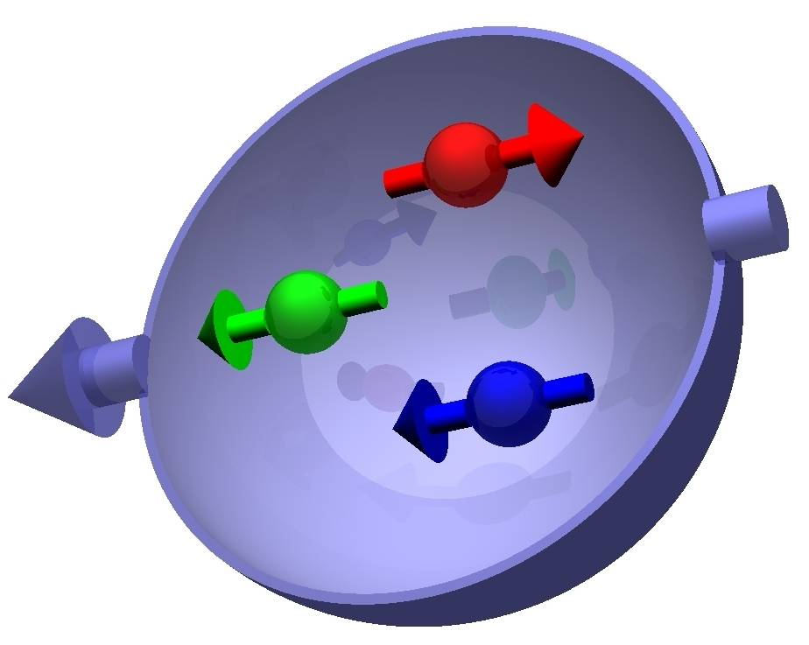
… Proton Spin Crisis
EMC (CERN) experiment:
Deep Inelastic Scattering (DIS) of high energy polarized muons on polarized protons
Quark (and anti-quark) contribution to proton spin is small:
ΔΣ=12 ±9(stat) ±14(syst) %
Nucl. Phys. B328, 1-35 (1989) – one of the most cited papers! >1200 citations
What carries the proton spin ?!

Slide 8
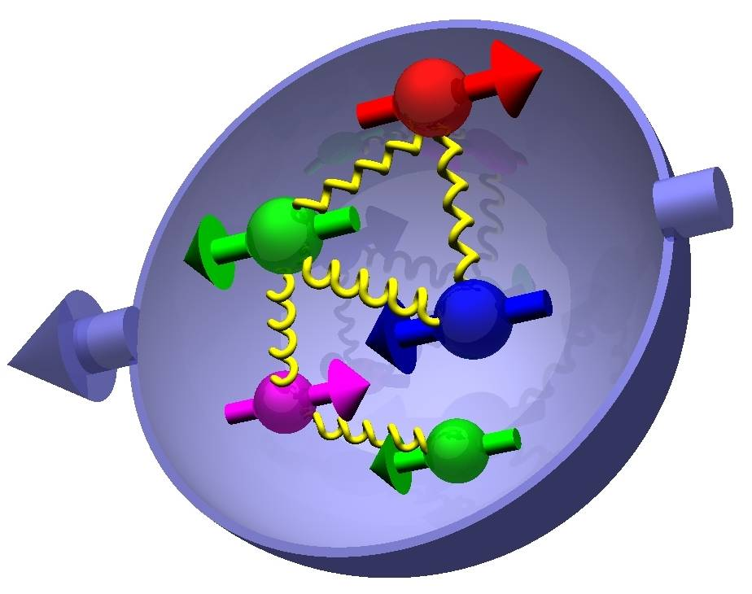
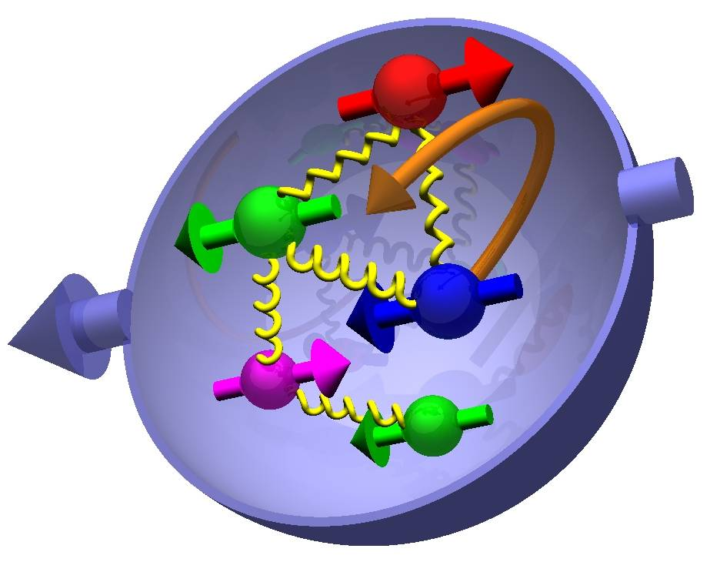
Proton Spin Structure
Partons ≡ (anti)quarks and gluons
Naïve quark model
(only valence quarks):
+ gluons
  strong force carrier
+ sea quarks
  Quantum mechanical fluctuations
For complete description
include parton orbital angular momentum L_{Z}:
Quark contribution is small
⇒ Spin Crisis
Determination of ΔG and Δq is the main goal of the RHIC spin program

Slide 9
Probing Proton Structure
Proton
e’
Virtuality (4-momentum transfer²) Q² gives the distance scale r at which the proton is probed.
γ*(Q²)
~1.5 fm
e
r
r ≈ hc/Q = 0.2fm/Q[GeV]
HERA ep collider: r_{min}≈ 1/1000 proton diameter
E_{e}=27.5 GeV, E_{p}=920 GeV

Slide 10
Parton Distribution Functions (PDF) or parton densities
Proton
x_{k} – fraction of proton momentum
  carried by parton k; so 0< x_{k} <1
•
x₁P
•
•
•
•
x_{k}P
•
Momentum Sum Rule:
(Gluons carry ~1/2 of the proton momentum)
P
•
•
•
•
•
x_{n}P
•
•
f(x) - Parton Distribution Function (PDF):
probability for a parton to carry fraction x of the proton momentum
Higher probe Q² – better resolution
  Start resolving more virtual (short life) stuff, sea quarks and gluons with lower x
So, different Q² probes see proton structure differently: f(x) → f(x,Q²)
Once f(x,Q²) is known at some Q₀² scale, it can be calculated for any other Q²

Slide 11
Polarized PDF
q = u,d,s …
Proton
spin
Quark
spin
helicity (longitudinal spin) distribution
Δq(x,Q²)=
Quarks
unpolarised distribution
q(x,Q²) =
helicity (longitudinal spin) distribution
Δg(x,Q²)=
Gluons
unpolarised distribution
g(x,Q²) =

Slide 12
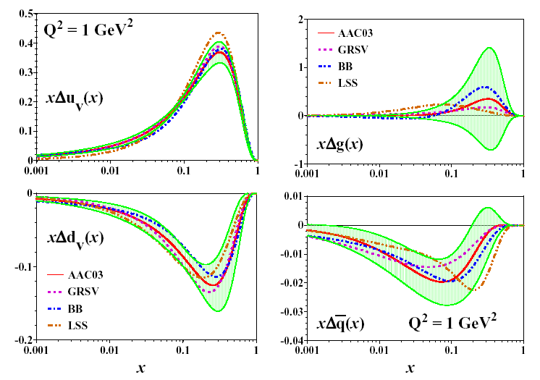
Polarized PDF from DIS
Asymmetry Analysis Collaboration
M. Hirai, S. Kumano and N. Saito, PRD69, 054021 (2004)
Valence distributions well determined
Sea Distribution poorly constrained
Gluon very poorly constrained: can be either positive, 0, negative!

Slide 13
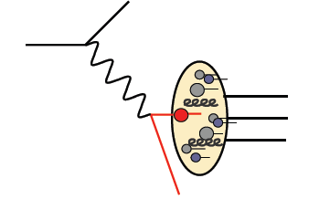
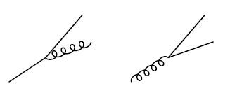
From inclusive polarized DIS …
Utilizes virtual photon to probe nucleon spin structure
  Only information about input and scattered lepton (e, μ) is recorded
    x and Q² reconstructed from kinematics
  Does not distinguish quark and antiquark
    Scattering ~charge²
  Do not have direct access to gluon
    Probe it through scaling violation (Q² dependence of quark PDFs) - with very poor precision currently
e (μ)
e’ (μ’)
γ*
Change in Δq vs Q² is defined by the probability that quark and gluon radiate quark
g
g

Slide 14
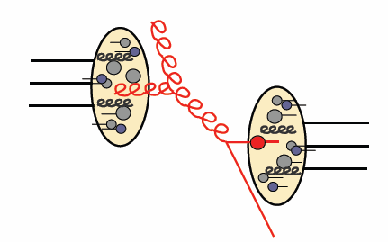
… To polarized pp collider
Utilizes strongly interacting probes
Probes gluon directly
Higher energies ⇒ clean pQCD interpretation
  100 GeV protons on fixed target: √s=14 GeV
  100 GeV + 100 GeV protons at a collider: √s=200 GeV
Elegant way to explore quark and anti-quark polarizations through W production
g
Polarized Gluon Distribution Measurements (ΔG):
    Use a variety of probes
      Access to different gluon momentum fraction x
      Different probes – different systematics
    Use different beam energies
      Access to different gluon momentum fraction x

Slide 15
RHIC as polarized proton collider
Absolute Polarimeter
(H jet)
RHIC pC Polarimeters
BRAHMS & PP2PP (p)
PHENIX (p)
STAR (p)
Siberian Snakes
Spin Rotators
2 × 10¹¹ Pol. Protons / Bunch
ε = 20 π mm mrad
Partial Siberian Snake
LINAC
BOOSTER
Pol. Proton Source
500 μA, 300 μs
AGS
200 MeV Polarimeter
AGS Internal Polarimeter
Rf Dipoles

Slide 16
RHIC Progress
Parameter | Unit | 2002 | 2003 | 2004 | 2005 | 2006
No. of Bunches | -- | 55 | 55 | 56 | 106 | 111
Bunch Intensity | 10¹¹ | 0.7 | 0.7 | 0.7 | 0.9 | 1.3
Store Energy | GeV | 100 | 100 | 100 | 100 | 100
β* | m | 3 | 1 | 1 | 1 | 1
Peak Luminosity | 10³⁰cm⁻²s⁻¹ | 2 | 6 | 6 | 10 | 35
Average Luminosity | 10³⁰cm⁻²s⁻¹ | 1 | 4 | 4 | 6 | 20
Collision points | -- | 4 | 4 | 4 | 3 | 2
Time in store | % | 30 | 41 | 38 | 56 | 46
Average Polarization, store | % | 15 | 35 | 46 | 50 | 60

Slide 17
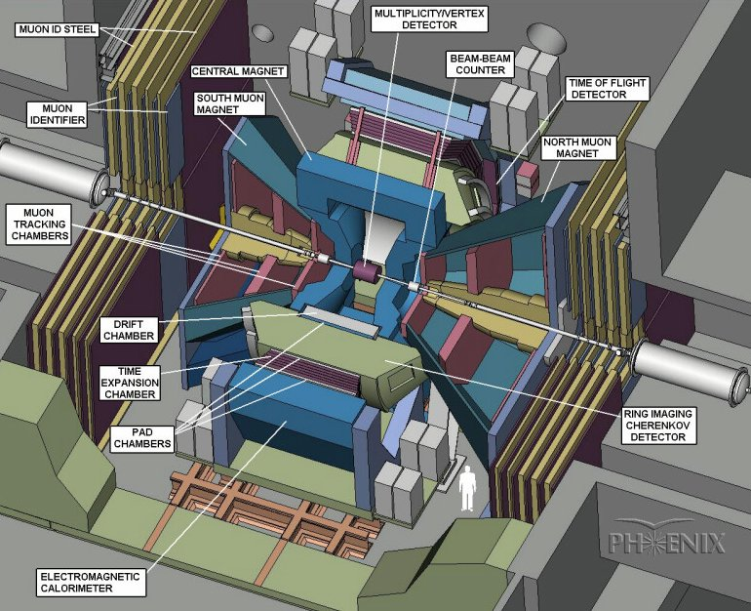

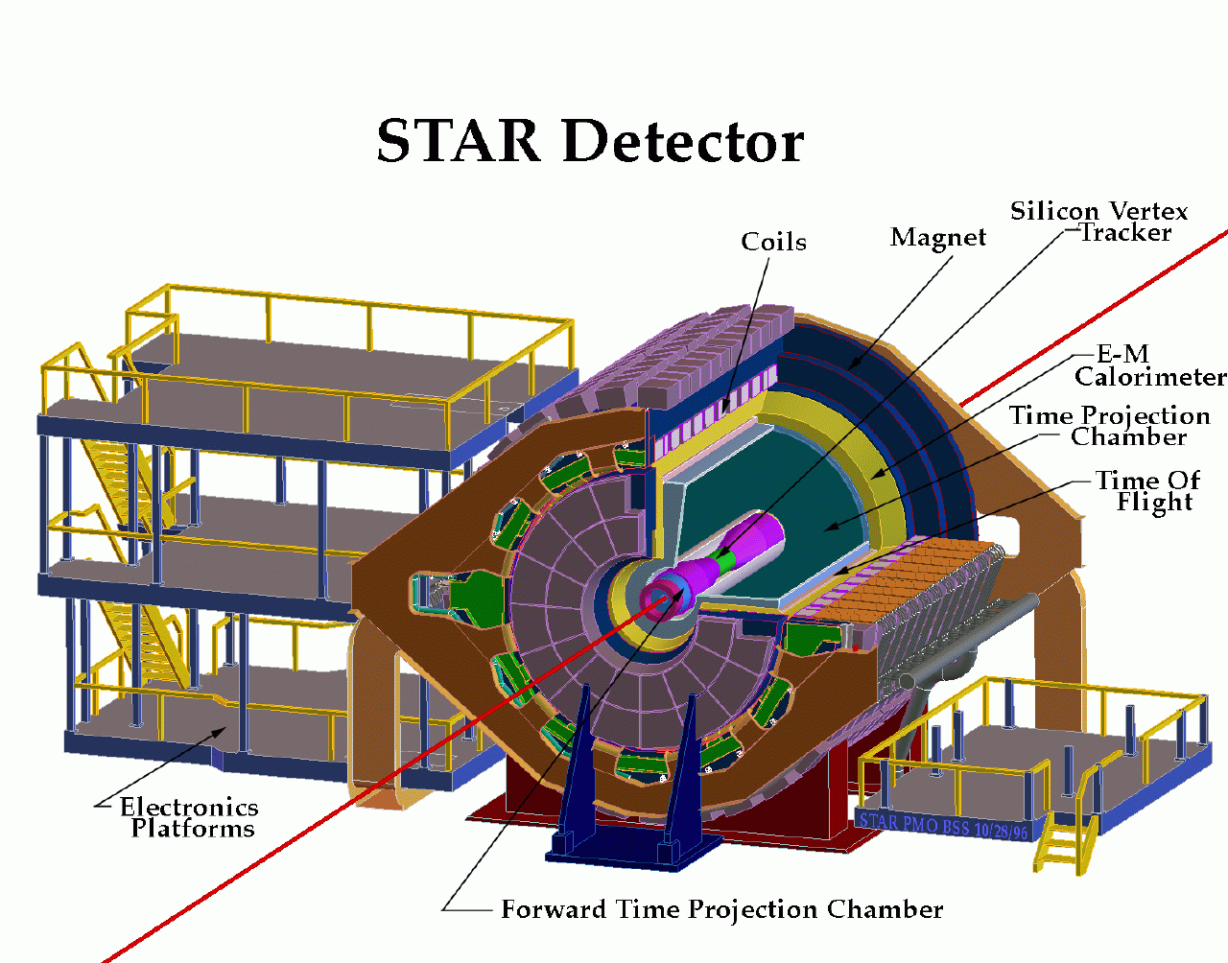
PHENIX and STAR
PHENIX:
High rate capability
High granularity
Good mass resolution and PID
Limited acceptance
STAR
STAR:
Large acceptance with azimuthal symmetry
Good tracking and PID
Central and forward calorimetry

Slide 18
Observables
High Energy Proton scattering can be seen as a scattering of constituent partons: gg, qg, qq
Quarks and gluons are not seen directly
They are locked within hadrons (confinement): baryons (protons, neutrons etc.) and mesons (pions, kaons etc)
Partons from hard scattering evolve via radiation and hadronization (fragmentation) processes to form “sprays” of nearly collinear hadrons - Jet
Detector
π,K,p…
D
f
x_{a}
x_{b}
f
p
σ
p
D
π,K,p…
Detector
Observable:
  Either the whole Jet or its “fragments” (hadrons)

Slide 19
RHIC Spin Measurements
Check theory (pQCD) works
q
g
Other exp.
This exp.
Theory
p
p
Jet
Extract polarized PDF from spin asymmetries using pQCD
This exp.
Other exp.
Theory
Jet Yield Spin
Asymmetry
Extract!

Slide 20
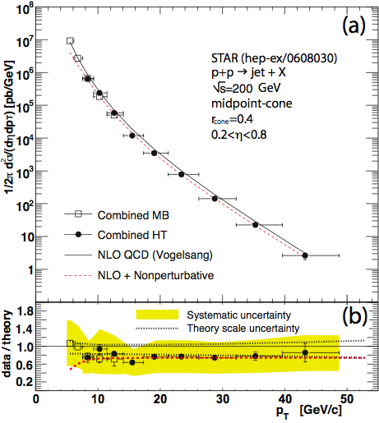
Particle Yield in pp
PHENIX: pp→π0 X
PRD 76, 051106 (R)
STAR: pp→jet X
PRL 97, 252001
|η|<0.35
Good agreement between theory (pQCD) calculations and data ⇒ confirmation that pQCD can be used to extract spin dependent pdf’s from RHIC data.
  Same comparison fails at lower energies

Slide 21
Probing ΔG in pol. pp collisions
σ⁺⁺ - particle production from beam with the same helicity
σ⁺⁻ - particle production from beam with the opposite helicity
For inclusive Jet or hadron production:
Double longitudinal spin asymmetry A_{LL} is sensitive to ΔG
  As a quadratic function

Slide 22
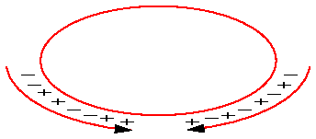
Measuring A_{LL}
(N) Yield
(R) Relative Luminosity
(collision rate)
(P) Polarization
RHIC
Bunch spin configuration (+ or − helicity) alternates every 106 ns
Data for all bunch spin configurations are collected at the same time
⇒ Possibility for false asymmetries is greatly reduced

Slide 23
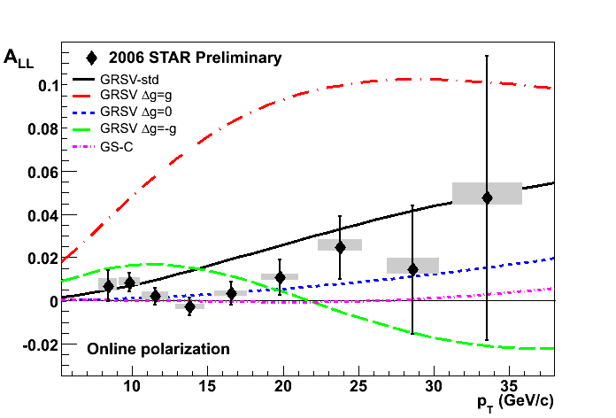
A_{LL}: jets
STAR Preliminary Run2006 (√s=200 GeV)
GRSV Models:
“ΔG = G”: ΔG(Q²=1GeV²)= 1.9
“ΔG = -G”: ΔG(Q²=1GeV²)= –1.8
“ΔG = 0”: ΔG(Q²=1GeV²)=0.1
“ΔG = std”: ΔG(Q²=1GeV²)=0.4
Large and modest gluon polarization scenarios are not consistent with data
Run2003&2004: PRL 97, 252001
Run2005: PRL 100, 232003

Slide 24
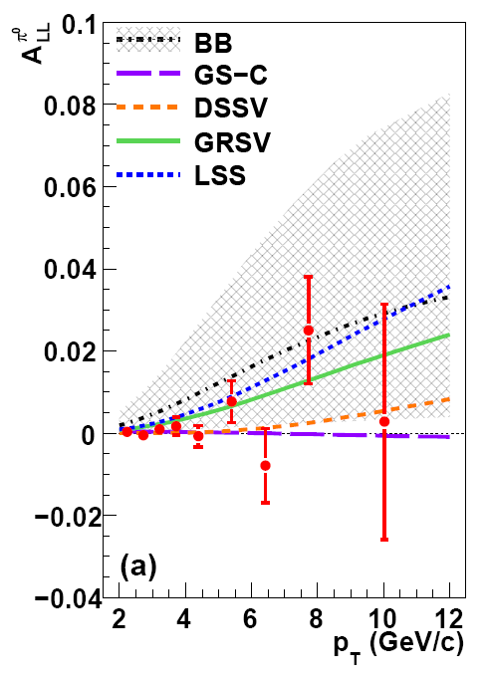
A_{LL}: π0
PHENIX Run2006 (√s=200 GeV)
arXiv:0810.0694
Uncertainty from DIS data
Statistical precision of RHIC A_{LL} data started to dominate in ΔG constraint
Run3,4,5: PRL 93, 202002; PRD 73, 091102;
PRD 76, 051106 (R)

Slide 25
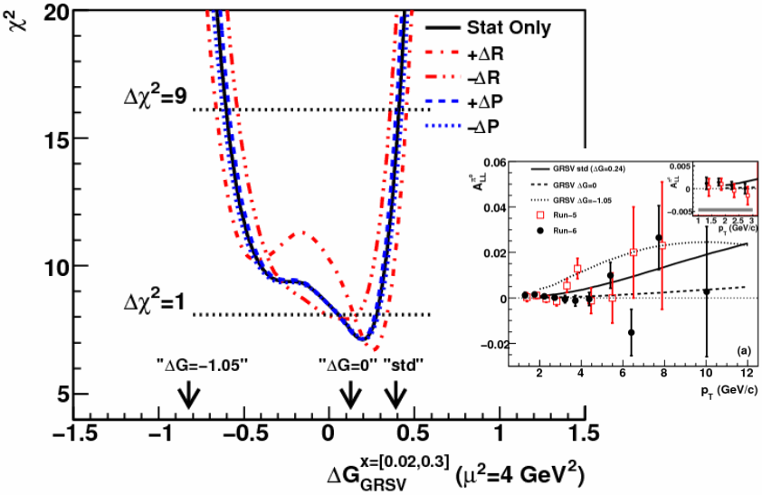
From A_{LL}(p_{T}) to Δg(x_{gluon})
Generate Δg(x) curves for different
Calculate A_{LL}(p_{T}) for each ΔG
Compare A_{LL} data to curves (produce χ² vs ΔG):
χ²(ΔG)
From pQCD:
  p_{T} = 2−12 GeV/c →
  x_{gluon} = 0.02 − 0.3

Slide 26
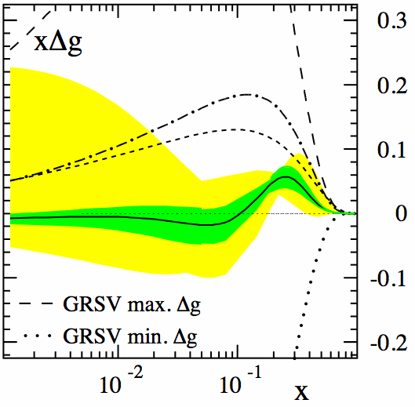
ΔG: Global Fit
Daniel de Florian
Rodolfo Sassot
Marco Stratmann
Werner Vogelsang
PRL 101, 072001(2008)
First truly global analysis of polarized DIS, SIDIS and RHIC results
Uncertainty estimation:
  Δχ²=1 (optimistic)
  Δχ²/χ²=2% (conservative)
  … Truth is in between
Δχ²/χ²=2%

Slide 27
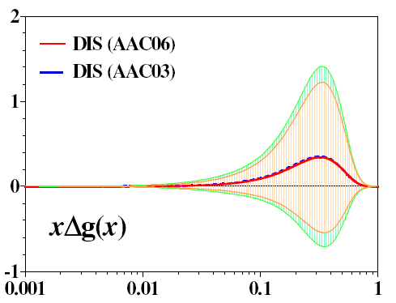
ΔG: From DIS to RHIC
DIS: AAC-2004
DIS+RHIC: DSSV-2008
RHIC data constrains ΔG at 0.02<x<0.3
“Optimistic” error estimation: Δχ²=1
“Conservative” error estimation: Δχ² /Δχ²=2%
Δχ²/χ²=2%
Considerable improvement in ΔG determination
(a lot of work still needed for correct error estimation)

Slide 28
So, the Proton Spin
Proton
Spin
(Anti)quark
Contribution:
0.10–0.15
Gluon
Contribution:
~0?
Parton Orbital
Momentum:
???
Spin Crisis
Spin Crisis II?
Data are sensitive to at 0.02<x<0.3
  Need to extend x range
  …Spin Crisis arose after getting access to lower x
Data are not sensitive to the shape of Δg(x)
  Need back-to-back processes

Slide 29
ΔG at RHIC: what’s next
Improve exp. uncertainties and move to higher p_{T} (higher x)
Different channels
  Different systematics
  Different x
  gq→gγ sensitive to ΔG sign
pp → γ + jet and pp → jet + jet
  Map Δg vs x
Different √s (colliding beam energy)
  Different x
  Important cross check: measurements for the same x at different Q²

Slide 30
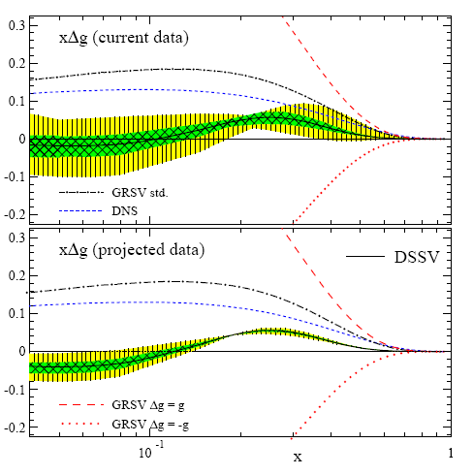
Improve exp. uncertainties
Need more FOM=P^{4 ⋅}L (stat. uncertainty ~ 1/√FOM)
A factor of 3-4 reduction in stat. errors expected in next √s=200 GeV RHIC Run (2009 or 2010)
xΔg(x)

Slide 31
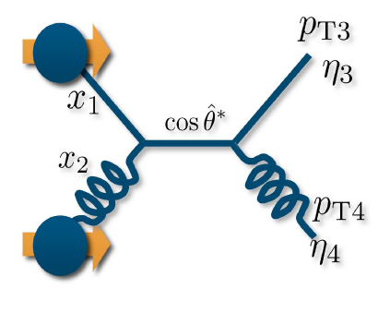
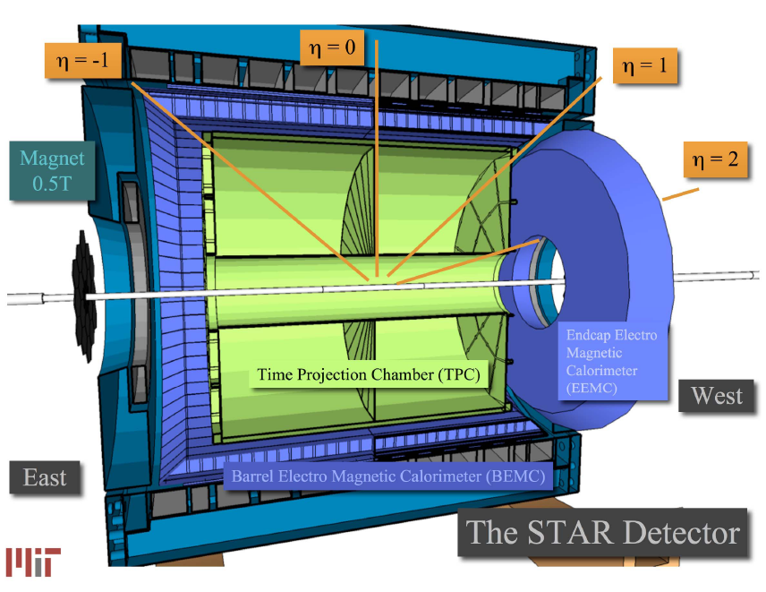
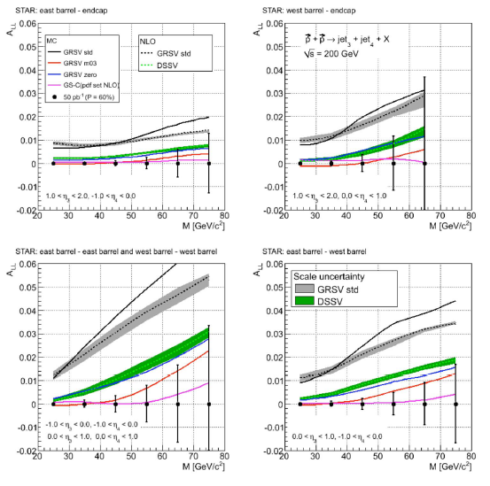
pp → jet + jet
A_{LL}
η₃≈1.5 η₄≈-0.5
η₃≈1.5 η₄≈0.5
Parton kinematics (x_{gluon}) is well constrained
    Sensitivity not only to the integral ΔG but also to the shape Δg(x)
Better sensitivity to ΔG compared to inclusive jet measurements pp→jet+X
  Higher x asymmetries are not diluted by low x asymmetries as in inclusive measurements
  More exclusive triggering (smaller background)
η₃≈0.5 η₄≈0.5
η₃≈-0.5 η₄≈-0.5
η₃≈0.5 η₄≈-0.5
M_{Jet-Jet}

Slide 32
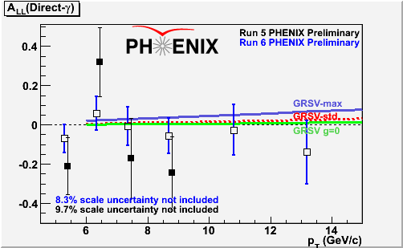
pp → γ +X
(Anti)quark polarization from DIS
Partonic level asymmetry from theory
Expectations
Golden channel:
  Theoretically clean
  Small contamination (~15% from qq-bar annihilation
  Linear in ΔG ⇒ sign of ΔG
  Rare probe (needs a lot of luminosity)

Slide 33
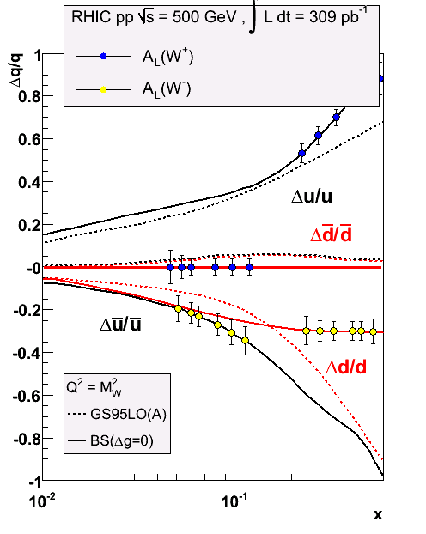
Flavor decomposition
Fixes (anti)quark flavor and its spin direction
Measured through longitudinal single spin asymmetry A_{L} in W± production at √s=500 GeV
First data expected in a few weeks!

Slide 34
eRHIC
Electron – Proton (and Ion) Collider
e-cooling (RHIC II)
Precise imaging gluon and sea quarks in the proton
Get access to parton orbital momentum
PHENIX
Main ERL (3.9 GeV per pass)
STAR
e⁺ storage ring
5 GeV - 1/4 RHIC circumference
Four e-beam passes
  Electron energy range from 3 to 20 GeV
  Peak luminosity of 2.6 × 10³³ cm⁻²s⁻
  High electron beam polarization (~80%)

Slide 35
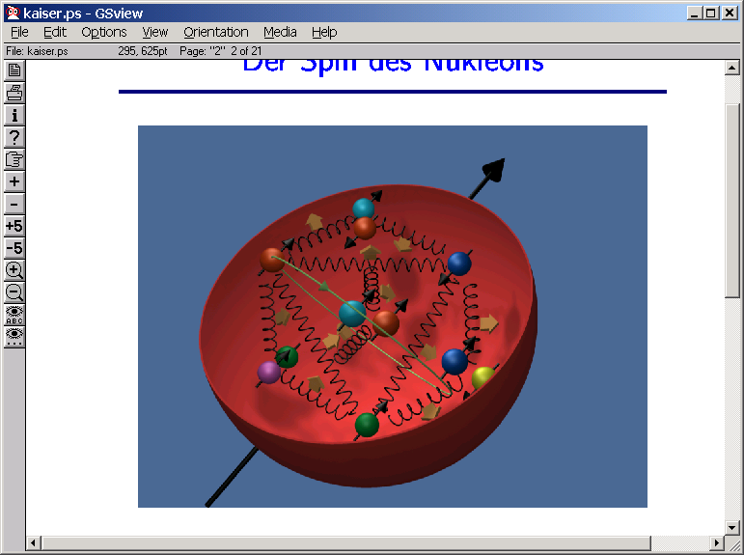
Summary
Proton
Spin
(Anti)quark
Contribution:
0.10–0.15
Gluon
Contribution:
~0?
Parton Orbital
Momentum:
???
So, Do Gluons Carry Proton Spin? –
  Current data indicate on small or zero contribution
  Higher precision and extended x range measurements of ΔG are necessary (RHIC, eRHIC etc.)
  World wide quest in determining the parton orbital angular momentum contribution (JLab, eRHIC etc.)

Slide 36

The Story of Spin
Sin-Itiro Tomonaga
It is a mysterious beast, and yet its practical effect prevail the whole of science. The existence of spin, and statistics associated with it, is the most subtle and ingenious design of Nature – without it the whole universe would collapse.

