Slide 1

Coordinated use of targeted observations to improve tropical cyclone track forecasts
Sharan Majumdar (RSMAS/UM)
Sim Aberson (NOAA/AOML/HRD), Jim Doyle (NRL), Pat Harr (NPS), Sarah Jones (Univ. Karlsruhe), Rolf Langland (NRL), Tetsuo Nakazawa (MRI Japan), Melinda Peng (NRL), Carolyn Reynolds (NRL), David Richardson (ECMWF), Chris Velden (CIMSS/UW), Martin Weissmann (DLR Oberpfaffenhofen), Chun-Chieh Wu (National Taiwan University), Munehiko Yamaguchi (JMA / RSMAS/UM)
63rd IHC, St Petersburg, FL. 3/3/09

Slide 2
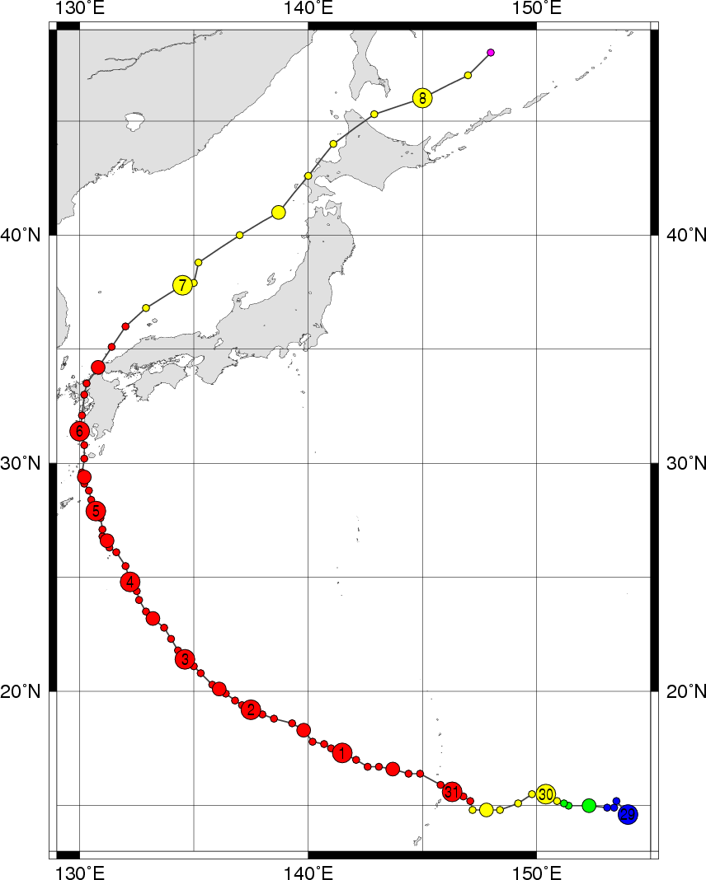

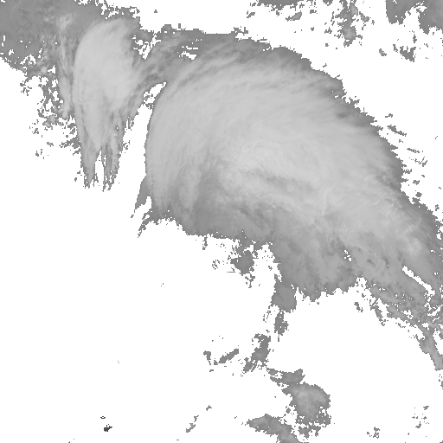
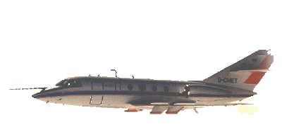

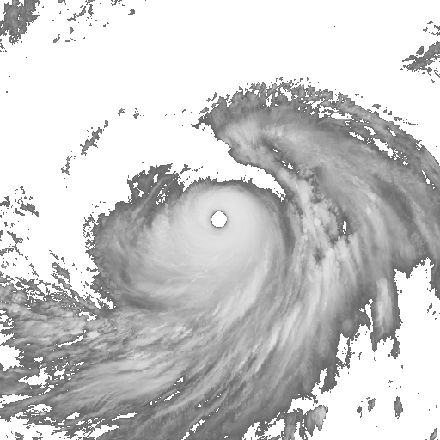
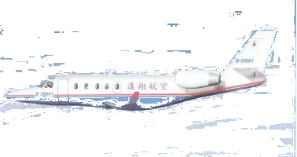
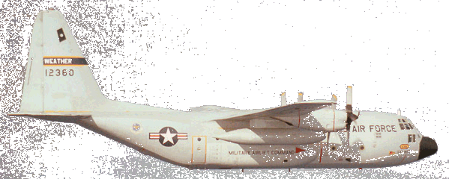
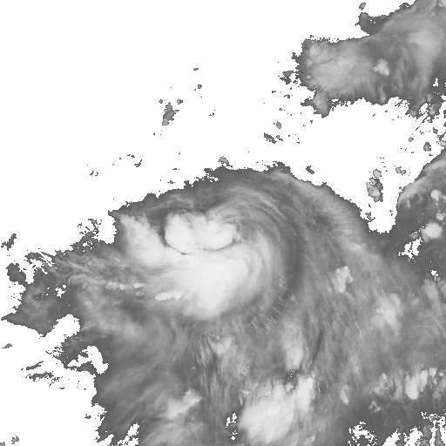
THORPEX Pacific Asian Regional Campaign (T-PARC)
Midlatitude operating region
NRL P-3, FALCON
Extratropical Transition (ET – recurvature),
Downstream Impacts
Japan, Atsugi, NAF
ET characteristics, forcing of downstream impacts, tropical/midlatitude interactions, extratropical cyclogenesis
Subtropical operating region
NRL P-3, DOTSTAR, WC-130, FALCON
TC Intensification and structure change
Recurvature, initiation of ET
TC track characteristics, tropical/midlatitude interaction
Tropical operating region
Driftsonde, NRL P-3,
DOTSTAR, WC-130
Okinawa,
Kadena AFB
Tropical Measurements
Large-scale circulation,
deep convection, monsoon depressions, tropical waves, TC formation
Guam, Andersen AFB

Slide 3
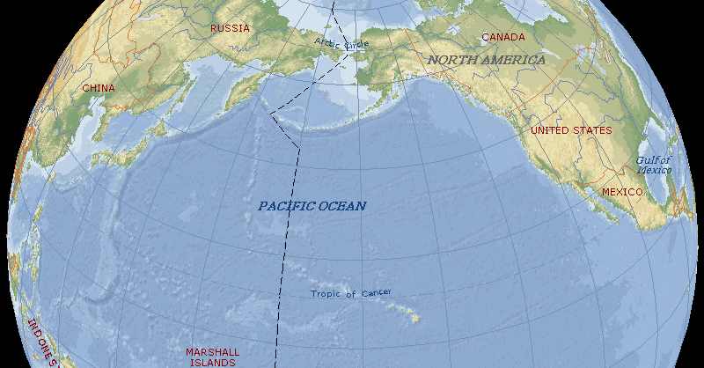
Field Operations: 1 August – 30 September 2008
Okinawa
Japan
Driftsonde center,
Operations center,
Monterey, CA
Taiwan
Aircraft locations, and
aircraft operations centers
Driftsonde release,
Hawaii
Guam
First systematic targeting operation in the WPAC
  Multiple aircraft (up to 2 for targeting + 2 for structure missions)
  Comparison of several targeting methods from a variety of operational and research organizations
  ECMWF/UKMO Data Targeting System

Slide 4
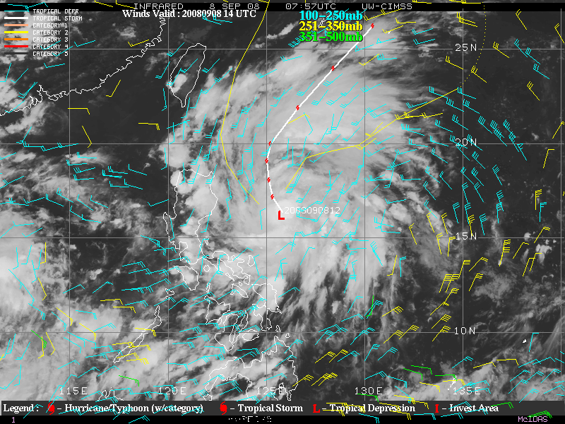
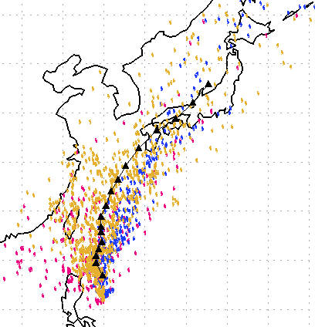
Sinlaku. Concept for Targeting Operations. 21 UTC, 20080908
  Potential threat of TC to land
  Uncertainty in ensemble track forecasts
GFS (20)
ECMWF (50)
CMC (16)
Courtesy CIMSS/U.Wisconsin
Uncertainty about strength of steering flow, and landfall location (if any)

Slide 5
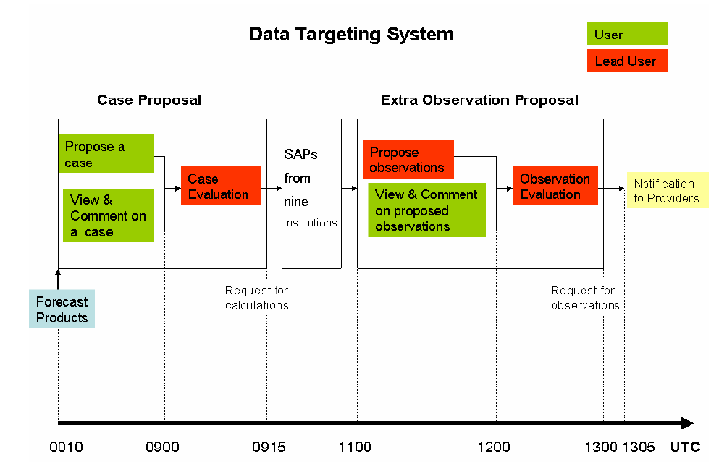
  Where should we collect targeted observations 1-2 days from now to improve the TC forecast?
ECMWF, UKMet, UMiami/NCEP, U.Washington, NRL Monterey x2, JMA, National Taiwan U, Yonsei U

Slide 6
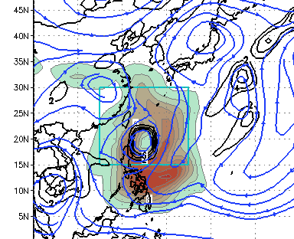
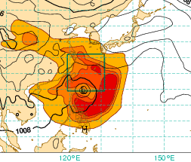
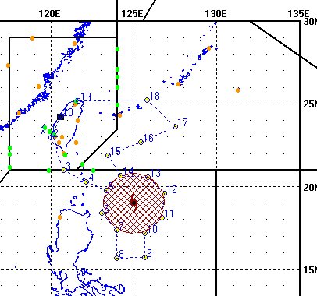
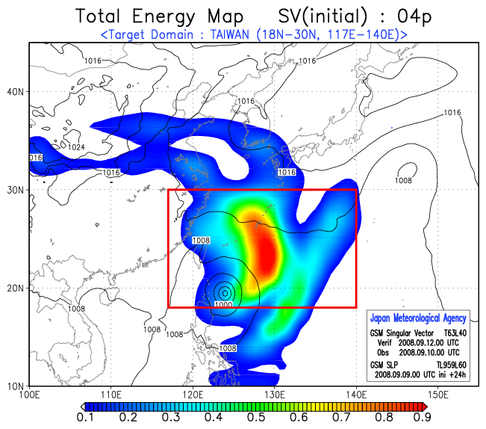
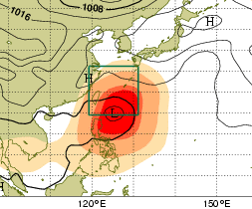
Proposed Flight Mission: 00 UTC Sept 10th 2008
DOTSTAR Flight Plan
ECMWF SV
NOGAPS SV
UM ETKF
JMA SV
Obs. Points cover sensitive regions proposed by guidance
Area surrounded by black line is also sensitive

Slide 7
Tentative Plan: next 3 days
00 UTC 10th
  DOTSTAR targeting mission
  C-130 structure / sat val mission
00 UTC 11th
  DOTSTAR targeting mission
  FALCON targeting mission
  C-130 and P-3 structure missions
00 UTC 12th
  DOTSTAR + other missions? Need a rest?
12 UTC 10th – ?
  MTSAT Rapid-Scan Activation; extra Japanese rawinsonde launches (3-hourly; ships)

Slide 8
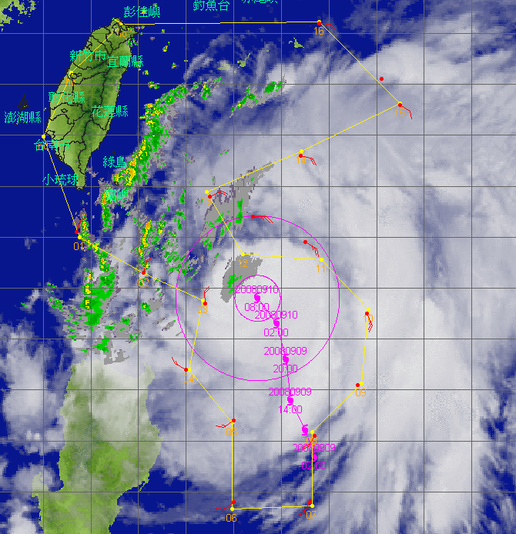

Slide 9
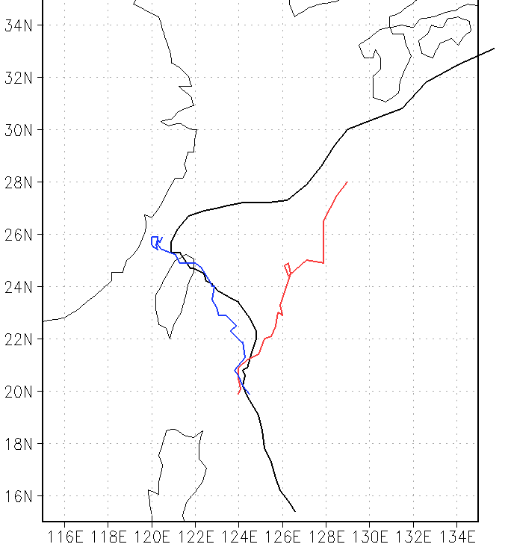
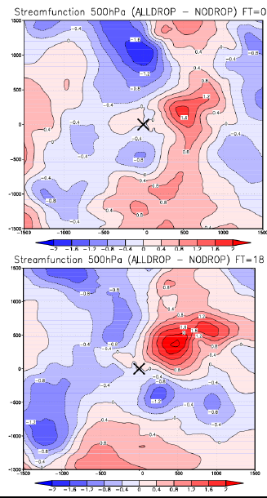
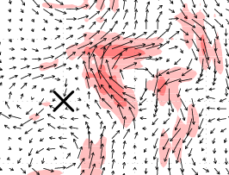
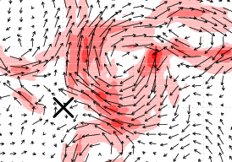
Preliminary Results: Sinlaku
NCEP GFS initialized 00 UTC 10th Sept
500 hPa ASYMMETRIC STREAMF’N DIFF
500 hPa ASYMMETRIC WIND DIFF
+00 h
+00 h
JMA BEST TRACK
+18 h
+18 h
WITH DROPS
WITHOUT DROPS
Effect of drops:
Strengthened vortex, decreased RMW
Strengthened subtropical ridge, inducing northwestward flow

Slide 10
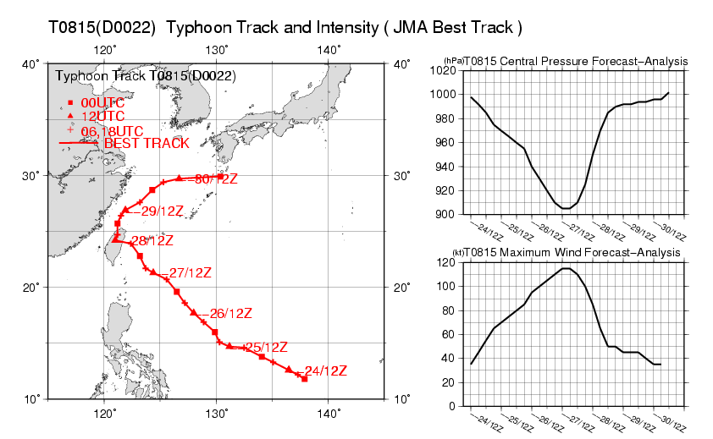
JMA RESULTS: Observations targeted for JANGMI
Yoichiro Ohta, Koji Yamashita (JMA)
and Tetsuo Nakazawa (MRI)
Notes:
This is an observed track of typhoon JANGMI. ( JANGMI was formed around the west of Mariana islands on 12UTC 24th September 2008. It developed rapidly and moved northwestward. After landing on Taiwan island, it recurved to northward and northeastward, and transformed to an extra-tropical cyclone south of Kyushu island on 00UTC 1st October 2008. )
And, these plots are the special observations targeted for JANGMI. Blue marks are observations conducted before the recurvature. And, green marks are these conducted after the recurvature. Circles denote dropwindsonde observations, triangles denote special upper sounding observations from research vessels, and stars denote upper sounding observations from JMA observatories.

Slide 11
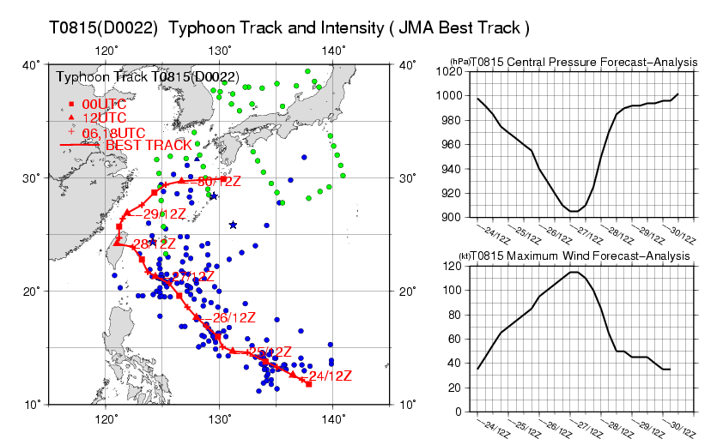
JMA RESULTS: Observations targeted for JANGMI
Blue：Before recurvature（to 18UTC 28th Sep.）
Green：After recurvature（from 00UTC 29th Sep.）
Yoichiro Ohta, Koji Yamashita (JMA)
and Tetsuo Nakazawa (MRI)
●：Dropsonde ▲：Ship ★：Observatory
Notes:
This is an observed track of typhoon JANGMI. ( JANGMI was formed around the west of Mariana islands on 12UTC 24th September 2008. It developed rapidly and moved northwestward. After landing on Taiwan island, it recurved to northward and northeastward, and transformed to an extra-tropical cyclone south of Kyushu island on 00UTC 1st October 2008. )
And, these plots are the special observations targeted for JANGMI. Blue marks are observations conducted before the recurvature. And, green marks are these conducted after the recurvature. Circles denote dropwindsonde observations, triangles denote special upper sounding observations from research vessels, and stars denote upper sounding observations from JMA observatories.

Slide 12
JMA RESULTS – Track Forecast Errors for JANGMI
Improvement in track forecast error through 0-84h is 25%
Comparison of track forecast error for JANGMI at before-recurvature stage Red : No drops or special soundings, Blue : With drops and special soundings. Green triangle marks show statistically significant improvements on 95% confidence level.
36% Improvement
at 12h forecast
Yoichiro Ohta, Koji Yamashita (JMA)
and Tetsuo Nakazawa (MRI)
Notes:
Here is a result for this experiment.
This graph shows the track forecast error of JANGMI at the before-recurvature stage.
Red line denotes experiment without special observations and blue line denotes experiment with special observations.
Special observations improved the track forecast thorough out 84 hour forecasts.
Mean improvement rate is 25%, and max improvement rate is 36% at 12 hour forecast.

Slide 13
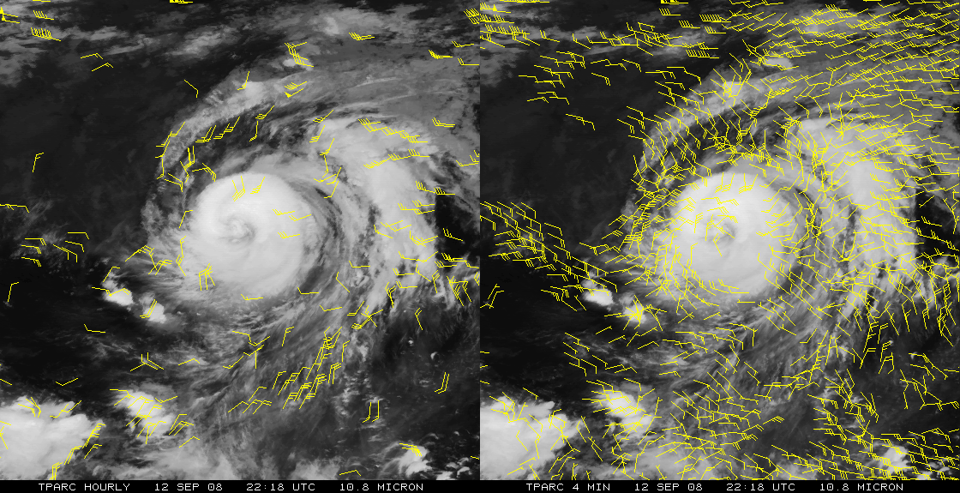
Future Plans
Evaluate impact of assimilating hourly and rapid-scan satellite-derived atmospheric motion vectors
(Chris Velden, CIMSS/U.Wisconsin)
Evaluate impact of observations in different target areas (following Yamaguchi et al. MWR 2009)
Understand differences in results between models

Slide 14
Long-term goals
Demonstrate utility of targeted observations
Observation types: manned and unmanned aircraft, adaptive targeting/thinning of satellite winds and radiances, off-time rawinsondes, WISDOM, others…
Develop centralized, coordinated data targeting system for Hurricanes, Winter Storms, others…?
Multi-agency, multi-national.
Saves time and human error; allows for archiving and evaluation.
Extend to 3-7 day track forecasts; intensity prediction

