Slide 1
Grid, Storage and SRM
Jan. 29-31, 2008

Slide 2
Introduction

Slide 3
Storage and Grid
Grid applications need to reserve and schedule
  Compute resources
  Network resources
  Storage resources
Furthermore, they need
  Monitor progress status
  Release resource usage when done
For storage resources, they need
  To put/get files into/from storage spaces
  Unlike compute/network resources, storage resources are not available when jobs are done
  files in spaces need to be managed as well
    Shared, removed, or garbage collected

Slide 4
Motivation & Requirements (1)
Suppose you want to run a job on your local machine
  Need to allocate space
  Need to bring all input files
  Need to ensure correctness of files transferred
  Need to monitor and recover from errors
  What if files don’t fit space?
    Need to manage file streaming
  Need to remove files to make space for more files

Slide 5
Motivation & Requirements (2)
Now, suppose that the machine and storage space is a shared resource
  Need to do the above for many users
  Need to enforce quotas
  Need to ensure fairness of space allocation and scheduling

Slide 6
Motivation & Requirements (3)
Now, suppose you want to run a job on a Grid
  Need to access a variety of storage systems
  mostly remote systems, need to have access permission
  Need to have special software to access mass storage systems

Slide 7
Motivation & Requirements (4)
Now, suppose you want to run distributed jobs on the Grid
  Need to allocate remote spaces
  Need to move files to remote sites
  Need to manage file outputs and their movement to destination sites

Slide 8
Storage Resource Managers

Slide 9
What is SRM?
Storage Resource Managers (SRMs) are middleware components
  whose function is to provide
    dynamic space allocation
    file management
    on shared storage resources on the Grid
  Different implementations for underlying storage systems are based on the same SRM specification
Notes:
Brief history will follow after this slide

Slide 10
SRMs role in grid
SRMs role in the data grid architecture
  Shared storage space allocation & reservation
    important for data intensive applications
  Get/put files from/into spaces
    archived files on mass storage systems
  File transfers from/to remote sites, file replication
  Negotiate transfer protocols
  File and space management with lifetime
  support non-blocking (asynchronous) requests
  Directory management
  Interoperate with other SRMs
Notes:
Brief history will follow after this slide

Slide 11
Client and Peer-to-Peer Uniform Interface
...
Client’s site
Uniform SRM
interface
Client
(command line)
client
Client
Program
Disk
Cache
Storage
Resource
Manager
Disk
Cache
network
Storage
Resource
Manager
Storage
Resource
Manager
Storage
Resource
Manager
...
...
...
MSS
Disk
Cache
Disk
Cache
Disk
Cache
Disk
Cache
Disk
Cache
Site 1
Site 2
Site N

Slide 12
History
7 year of Storage Resource Management (SRM) activity
Experience with system implementations v.1.1 (basic SRM) – 2001
  MSS: Castor (CERN), dCache (FNAL, DESY), HPSS (LBNL, ORNL, BNL),
  JasMINE (Jlab), MSS (NCAR)
  Disk systems: dCache (FNAL), DPM (CERN), DRM (LBNL)
SRM v2.0 spec – 2003
SRM v2.2 – enhancements introduced after WLCG (the World-wide LHC Computing Grid) adopted SRM standard
  Several implementations of v2.2
  Extensive compatibility and interoperability testing
  MSS: Castor (CERN, RAL), dCache/{Enstore,TSM,OSM,HPSS} (FNAL, DESY),
  HPSS (LBNL), JasMINE (Jlab), SRB (SINICA, SDSC)
  Disk systems: BeStMan (LBNL), dCache (FNAL, DESY), DPM (CERN),
  StoRM (INFN/CNAF, ICTP/EGRID)
Open Grid Forum (OGF)
  Grid Storage Management (GSM-WG) at GGF8, June 2003
  SRM collaboration F2F meeting – Sept. 2006
  SRM v2.2 spec on OGF recommendation track – Dec. 2007

Slide 13
Who’s involved…
CERN, European Organization for Nuclear Research, Switzerland
Deutsches Elektronen-Synchrotron, DESY, Hamburg, Germany
Fermi National Accelerator Laboratory, Illinois, USA
ICTP/EGRID, Italy
INFN/CNAF, Italy
Lawrence Berkeley National Laboratory, California, USA
Rutherford Appleton Laboratory, Oxfordshire, England
Thomas Jefferson National Accelerator Facility, Virginia, USA
Notes:
This list does not include anyone in the storage component development and implementations.

Slide 14
SRM : Concepts

Slide 15
SRM: Main concepts
  Space reservations
  Dynamic space management
  Pinning file in spaces
  Support abstract concept of a file name: Site URL
  Temporary assignment of file names for transfer: Transfer URL
  Directory management and authorization
  Transfer protocol negotiation
  Support for peer to peer request
  Support for asynchronous multi-file requests
  Support abort, suspend, and resume operations
  Non-interference with local policies

Slide 16
Site URL and Transfer URL
Provide: Site URL (SURL)
  URL known externally – e.g. in Replica Catalogs
  e.g. srm://ibm.cnaf.infn.it:8444/dteam/test.10193
Get back: Transfer URL (TURL)
  Path can be different from SURL – SRM internal mapping
  Protocol chosen by SRM based on request protocol preference
  e.g. gsiftp://ibm139.cnaf.infn.it:2811//gpfs/sto1/dteam/test.10193
One SURL can have many TURLs
  Files can be replicated in multiple storage components
  Files may be in near-line and/or on-line storage
  In a light-weight SRM (a single file system on disk)
    SURL may be the same as TURL except protocol
File sharing is possible
  Same physical file, but many requests
  Needs to be managed by SRM implementation

Slide 17
Transfer protocol negotiation
Negotiation
  Client provides an ordered list of preferred transfer protocols
  SRM returns first protocol from the list it supports
  Example
    Client provided protocols list: bbftp, gridftp, ftp
    SRM returns: gridftp
Advantages
  Easy to introduce new protocols
  User controls which transfer protocol to use
How is it returned?
  The protocol of the Transfer URL (TURL)
  Example: bbftp://dm.berkeley.edu//temp/run11/File678.txt

Slide 18
Types of storage and spaces
Access latency
  On-line
    Storage where files are moved to before their use
  Near-line
    Requires latency before files can be accessed
Retention quality
  Custodial (High quality)
  Output (Middle quality)
  Replica (Low Quality)
Spaces can be reserved in these storage components
  Spaces can be reserved for a lifetime
  Space reference handle is returned to client – space token
  Total space of each type are subject to local SRM policy and/or VO policies
Assignment of files to spaces
  Files can be assigned to any space, provided that their lifetime is shorter than the remaining lifetime of the space

Slide 19
Managing spaces
Default spaces
  Files can be put into an SRM without explicit reservation
  Default spaces are not visible to client
Files already in the SRM can be moved to other spaces
  By srmChangeSpaceForFiles
Files already in the SRM can be pinned in spaces
  By requesting specific files (srmPrepareToGet)
  By pre-loading them into online space (srmBringOnline)
Updating space
  Resize for more space or release unused space
  Extend or shorten the lifetime of a space
Releasing files from space by a user
  Release all files that user brought into the space whose lifetime has not expired
  Move permanent and durable files to near-line storage if supported
  Release space that was used by user

Slide 20
Space reservation
Negotiation
  Client asks for space: Guaranteed_C, MaxDesired
  SRM return: Guaranteed_S <= Guaranteed_C,
  best effort <= MaxDesired
Types of spaces
  Specified during srmReserveSpace
  Access Latency (Online, Nearline)
  Retention Policy (Replica, Output, Custodial)
  Subject to limits per client (SRM or VO policies)
  Default: implementation and configuration specific
Lifetime
  Negotiated: Lifetime_C requested
  SRM return: Lifetime_S <= Lifetime_C
Reference handle
  SRM returns space reference handle (space token)
  Client can assign Description
  User can use srmGetSpaceTokens to recover handles on basis of ownership

Slide 21
Directory management
Usual unix semantics
  srmLs, srmMkdir, srmMv, srmRm, srmRmdir
A single directory for all spaces
  No directories for each file type
  File assignment to spaces is virtual
Access control services
  Support owner/group/world permission
    ACLs supported – can have one owner, but multiple user and group access permissions
    Can only be assigned by owner
    When file is requested from a remote site, SRM should check permission with source site

Slide 22
Advanced concepts
Composite Storage Element
  Made of multiple Storage Components
    e.g. component 1: online-replica
    component 2: nearline-custodial (with online disk cache)
    e.g. component1: online-custodial
    component 2: nearline-custodial (with online disk cache)
  srmBringOnline can be used to temporarily bring data to the online component for fast access
  When a file is put into a composite space, SRM may have (temporary) copies on any of the components.
Primary Replica
  When a file is first put into an SRM, that copy is considered as the primary replica
  A primary replica can be assigned a lifetime
  The SURL lifetime is the lifetime of the primary replica
  When other replicas are made, their lifetime cannot exceed the primary replica lifetime
  Lifetime of a primary replica can only be extended by an SURL owner.

Slide 23
SRM v2.2 Interface
Data transfer functions to get files into SRM spaces from the client's local system or from other remote storage systems, and to retrieve them
  srmPrepareToGet, srmPrepareToPut, srmBringOnline, srmCopy
Space management functions to reserve, release, and manage spaces, their types and lifetimes.
  srmReserveSpace, srmReleaseSpace, srmUpdateSpace, srmGetSpaceTokens
Lifetime management functions to manage lifetimes of space and files.
  srmReleaseFiles, srmPutDone, srmExtendFileLifeTime
Directory management functions to create/remove directories, rename files, remove files and retrieve file information.
  srmMkdir, srmRmdir, srmMv, srmRm, srmLs
Request management functions to query status of requests and manage requests
  srmStatusOf{Get,Put,Copy,BringOnline}Request, srmGetRequestSummary, srmGetRequestTokens, srmAbortRequest, srmAbortFiles, srmSuspendRequest, srmResumeRequest
Other functions include Discovery and Permission functions
  srmPing, srmGetTransferProtocols, srmCheckPermission, srmSetPermission, etc.
Notes:
After that, “then…”

Slide 24
SRM implementations

Slide 25
Berkeley Storage Manager (BeStMan)
LBNL
Java implementation
Designed to work with unix-based disk systems
As well as MSS to stage/archive from/to its own disk (currently HPSS)
Adaptable to other file systems and storages (e.g. NCAR MSS, VU L-Store, TTU Lustre, NERSC GFS)
Uses in-memory database (BerkeleyDB)
Local Policy
  Fair request processing
  File replacement in disk
  Garbage collection
Multiple transfer protocols
Space reservation
Directory management (no ACLs)
Can copy files from/to remote SRMs or GridFTP Servers
Can copy entire directory recursively
  Large scale data movement of thousands of files
  Recovers from transient failures (e.g. MSS maintenance, network down)

Slide 26
Castor-SRM
CERN and Rutherford Appleton Laboratory
CASTOR is the HSM in production at CERN
Support for multiple tape robots
  Support for Disk-only storage recently added
Designed to meet Large Hadron Collider Computing requirements
  Maximize throughput from clients to tape (e.g. LHC experiments data taking)
C++ Implementation
Reuse of CASTOR software infrastructure
  Derived SRM specific classes
Configurable number of thread pools for both front- and back-ends
ORACLE centric
Front and back ends can be distributed on multiple hosts

Slide 27
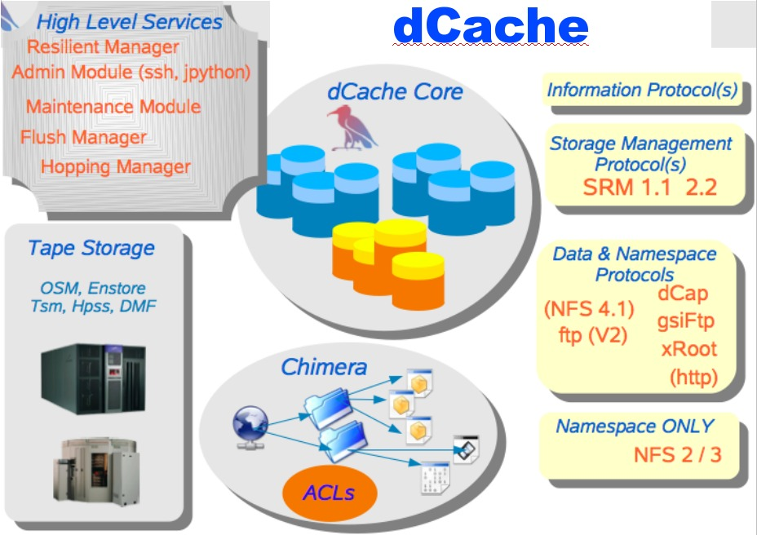
dCache-SRM
FNAL and DESY
Strict name space and data storage separation
Automatic file replication based on access patterns
HSM Connectivity (Enstore, OSM, TSM, HPSS, DMF)
Automated HSM migration and restore
Scales to Peta-byte range on 1000’s of disks
Supported protocols:
  (gsi/krb)FTP, (gsi/krb)dCap, xRoot,
  NFS 2/3
Separate I/O queues per protocol
Resilient dataset management
Command line and graphical admin interface
Variety of Authorization mechanisms including VOMS
Deployed in a large number of institutions worldwide
Support SRM 1.1 and SRM 2.2
Dynamic Space Management
Request queuing and scheduling
Load balancing
Robust replication using srmCopy functionality via SRM, (gsi)FTP and http protocols

Slide 28
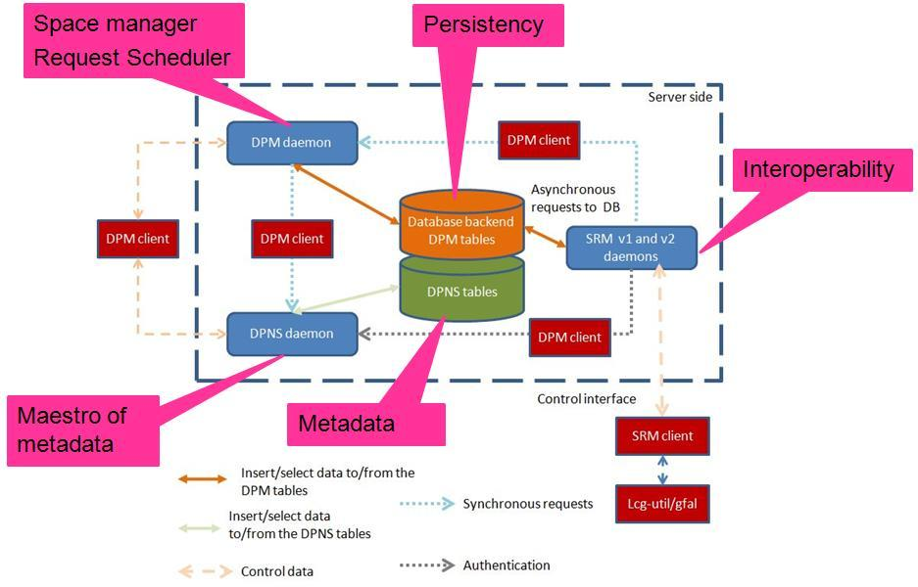
Disk Pool Manager (DPM)
CERN
Provide a reliable, secure and robust storage system
Manages storage on disks only
Security
  GSI for authentication
  VOMS for authorization
  Standard POSIX permissions + ACLs based on user’s DN and VOMS roles
Virtual ids
  Accounts created on the fly
Full SRMv2.2 implementation
Standard disk pool manager capabilities
  Garbage collector
  Replication of hot files
Transfer protocols
  GridFTP (v1 and v2)
  Secure RFIO
  https
  Xroot
Works on Linux 32/64 bits machines
Direct data transfer from/to disk server (no bottleneck)
Support DICOM backend
  Requirement from Biomed VO
  Storage of encrypted files in DPM on the fly + local decryption
  Use of GFAL/srm to get TURLs and decrypt the file
Supported database backends
  MySQL
  Oracle
High availability
  All servers can be load balanced (except the DPM one)
  Resilient: all states are kept in the DB at all times

Slide 29
Storage Resource Manager (StoRM)
INFN/CNAF - ICTP/EGRID
It's designed to leverage the advantages of high performing parallel file systems in Grid.
Different file systems supported through a driver mechanism:
  generic POSIX FS
  GPFS
  Lustre
  XFS
It provides the capability to perform local and secure access to storage resources (file:// access protocol + ACLs on data).
StoRM architecture:
Frontends: C/C++ based, expose the SRM interface
Backends: Java based, execute SRM requests.
DB: based on MySQL DBMS, stores requests data and StoRM metadata.
Each component can be replicated and instantiated on a dedicated machine.

Slide 30
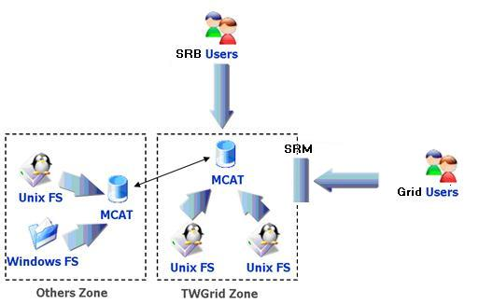
SRM on SRB
SINICA – TWGRID/EGEE
SRM as a permanent archival storage system
Finished the parts about authorizing users, web service interface and gridftp deployment, and SRB-DSI, and some functions like directory functions, permission functions, etc.
Currently focusing on the implementation of core (data transfer functions and space management)
Use LFC (with a simulated LFC host) to get SURL and use this SURL to connect to SRM server, then get TURL back
File transfer (gridftp)
User
File transfer (gridftp)
SRM API
Core
Web Service
File
catalog
Data server management
Gridftp/management API
Gridftp/management API
Cache
repository
SRB+DSI
Cache server
(+gridftp server)
SRB/gridftp
Hostname:
t-ap20.grid.sinica.edu.tw
Info:
SRB server (SRB-DSI installed)
User Interface
Gridftp
management commands
Return some information
SURL
TURL
Hostname: fct01.grid.sinica.edu.tw
The end point: httpg://fct01.grid.sinica.edu.tw:8443/axis/services/srm
Info: Cache server (gridftp server) and SRM interface

Slide 31






















Interoperability in SRM v2.2
dCache
CASTOR
Disk
BeStMan
DPM
xrootd
BNL
SLAC
LBNL
Client
User/application
SRB
(iRODS)
SDSC
SINICA
LBNL
EGEE
Notes:
One example of SRM v2.2 testing in last Super Computing.

Slide 32
SRMs at work
Europe : LCG/EGEE
  191+ deployments, managing more than 10PB
    129 DPM/SRM
    54 dCache/SRM
    7 CASTOR/SRM at CERN, CNAF, PIC, RAL, SINICA
    StoRM at ICTP/EGRID, INFN/CNAF
  SRM layer for SRB, SINICA
US
  Estimated at about 30 deployments
  OSG
    BeStMan/SRM from LBNL
    dCache/SRM from FNAL
  ESG
    DRM/SRM, HRM/SRM at LANL, LBNL, LLNL, NCAR, ORNL
  Others
    BeStMan/SRM adaptation on Lustre file system at Texas Tech
    BeStMan-Xrootd adaptation at SLAC
    JasMINE/SRM from TJNAF
    L-Store/SRM from Vanderbilt Univ.
Notes:
We don’t have a statistics in US like our European colleagues.

Slide 33
Examples of SRM usage in real production Grid projects

Slide 34
HENP STAR experiment
Data Replication from BNL to LBNL
  1TB/10K files per week on average
  In production for over 4 years
Event processing in Grid Collector
  Prototype uses SRMs and FastBit indexing embedded in STAR framework
STAR analysis framework
  Job driven data movement
    Use BeStMan/SRM to bring files into local disk from a remote file repository
    Execute jobs that access “staged in” files in local disk
    Job creates an output file on local disk
    Job uses BeStMan/SRM to moves the output file from local storage to remote archival location
    SRM cleans up local disk when transfer complete
    Can use any other SRMs implementing v2.2

Slide 35
Data Replication in STAR
Anywhere
SRM-COPY
client command
Recovers from
file transfer failures
Allocate space
on disk
Recovers from
staging failures
Make equivalent
Directory
srmCopy
(files/directories)
Recovers from
archiving failures
BNL
BROWSE
LBNL
SRM/BeStMan
GET (one file at a time)
SRM/BeStMan
(performs writes)
(performs reads)
GridFTP GET (pull mode)
RELEASE
Disk
Cache
Disk
Cache
Network transfer
archive files
stage files

Slide 36
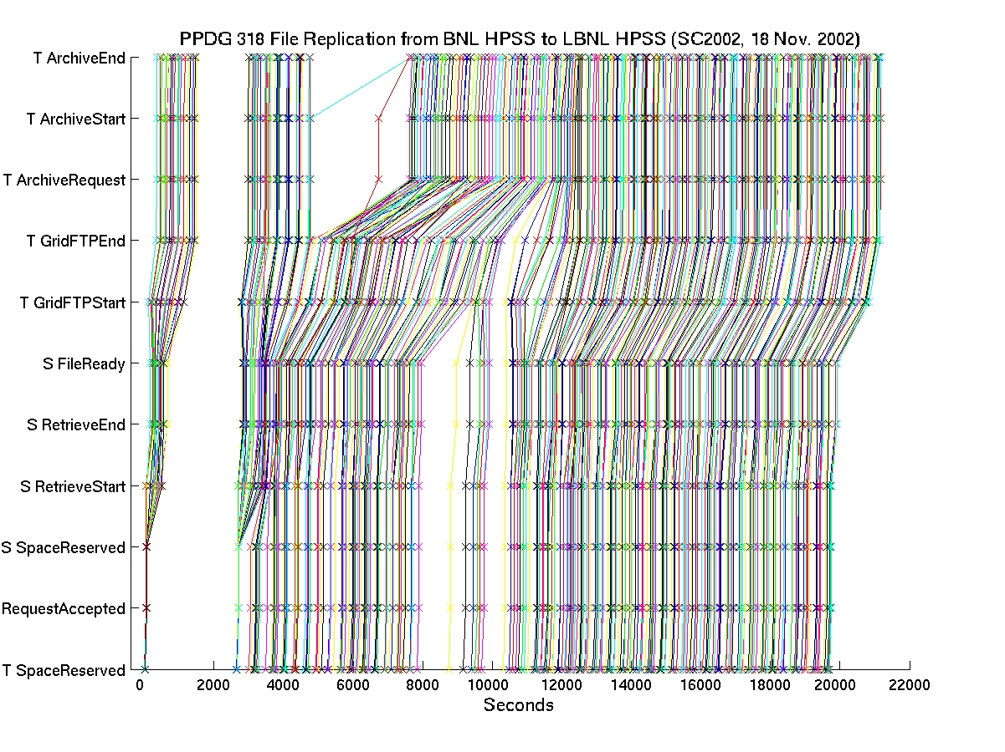
File Tracking Shows Recovery
From Transient Failures
Total:
45 GBs
Notes:
Shows recovery from the machine problem and archiving HPSS down time

Slide 37
STAR Analysis scenario (1)
Client
Job submission
Remote sites
A site
dCache/SRM
Worker Nodes
Client Job
Gate Node
Disk
GridFTP
server
Disk
Client Job
BeStMan/SRM
Disk
Disk
Client Job
Disk
DPM/SRM
Disk
Disk
Disk
Cache
DISK
CACHE
Client Job
BeStMan/SRM
Disk
Disk
Disk
Cache
Cache

Slide 38
STAR Analysis scenario (2)
SRM Job submission
Client
Client Job submission
Remote sites
A site
dCache/SRM
Worker Nodes
Client Job
Gate Node
Disk
GridFTP
server
Disk
Client Job
BeStMan/SRM
Disk
Disk
Client Job
Disk
DPM/SRM
Disk
Disk
Disk
Cache
DISK
CACHE
Client Job
BeStMan/SRM
Disk
Disk
Disk
Cache
Cache
Notes:
Dynamic SRM instantiation
BeStMan can be run with host cert, service cert and even with user proxy

Slide 39
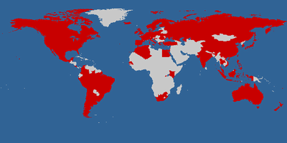
Earth System Grid
Main ESG portal
  148.53 TB of data at four locations (NCAR, LBNL, ORNL, LANL)
    965,551 files
    Includes the past 7 years of joint DOE/NSF climate modeling experiments
  4713 registered users from 28 countries
    Downloads to date: 31TB/99,938 files
IPCC AR4 ESG portal
  28 TB of data at one location
    68,400 files
    Model data from 11 countries
    Generated by a modeling campaign coordinated
    by the Intergovernmental Panel on Climate Change (IPCC)
  818 registered analysis projects from 58 countries
    Downloads to date: 123TB/543,500 files, 300 GB/day on average
    Courtesy: http://www.earthsystemgrid.org
Notes:
ESG main: Downloads to date: 31TB/99,938 files

Slide 40
SRMs in ESG
Client
Files Selection
And Request
SRM
@ LBNL
download
Disk
Disk
Cache
SRM
@ NCAR
Cache
Portal
SRM
@ LANL
Disk
Disk
Cache
Cache
SRM
@ LLNL
Disk
Disk
Disk
Cache
Cache
Cache
DISK
CACHE
NCAR
MSS
SRM
@ ORNL
Disk
Disk
Cache
Cache

Slide 41
SRM works in concert with other Grid components in ESG
LBNL
DISK
HPSS
ANL
GridFTP service
BeStMan/SRM
Storage Resource
Management
RLS
Globus Security infrastructure
GridFTP
server
NCAR
ESG Portal
RLS
ORNL
LLNL
BeStMan/SRM
Storage Resource
Management
DISK
IPCC Portal
User DB
XML
data
catalogs
ESG CA
GridFTP
server
XML data
catalogs
ESG Metadata DB
MyProxy
RLS
DISK
BeStMan/SRM
Storage Resource
Management
OPeNDAP-g
RLS
LAHFS
HPSS
GridFTP server
FTP server
GridFTP
server
BeStMan/SRM
Storage Resource
Management
ISI
LANL
DISK
MCS Metadata Cataloguing Services
RLS
RLS Replica Location Services
MSS
Mass
Torage
System
BeStMan/SRM
Storage Resource
Management
DISK
GridFTP
server
Monitoring Discovery ervices

Slide 42
Summary

Slide 43
Summary and Current Status
Storage Resource Management – essential for Grid
Multiple implementations interoperate
  Permits special purpose implementations for unique storage
  Permits interchanging one SRM implementation by another
Multiple SRM implementations exist and are in production use
  Particle Physics Data Grids
    WLCG, EGEE, OSG, …
  Earth System Grid
  More coming …
    Combustion, Fusion applications
    Medicine

Slide 44
Documents and Support
SRM Collaboration and SRM Specifications
  http://sdm.lbl.gov/srm-wg
  OGF mailing list : gsm-wg@ogf.org
  SRM developer’s mailing list: srm-devel@fnal.gov
BeStMan (Berkeley Storage Manager): http://datagrid.lbl.gov/bestman
CASTOR (CERN Advanced STORage manager): http://www.cern.ch/castor
dCache: http://www.dcache.org
DPM (Disk Pool Manager): https://twiki.cern.ch/twiki/bin/view/LCG/DpmInformation
StoRM (Storage Resource Manager): http://storm.forge.cnaf.infn.it
SRM-SRB: http://lists.grid.sinica.edu.tw/apwiki/SRM-SRB
SRB: http://www.sdsc.edu/srb
BeStMan-XrootD: http://wt2.slac.stanford.edu/xrootdfs/bestman-xrootd.html
Other support info : srm@lbl.gov

Slide 45
Credits
Alex Sim <asim@lbl.gov>
Arie Shoshani <ashoshani@lbl.gov>

