Slide 1
Enabling Carbon Flux Studies at the Regional and Ecosystem Scale
Deborah Agarwal
BWC technical team
16 July 2007

Slide 2
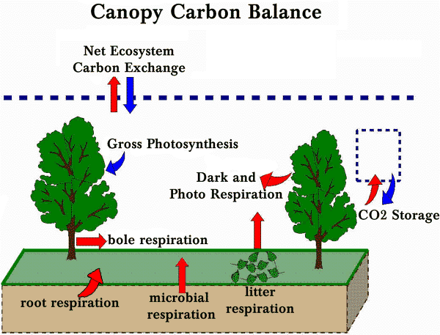
Applications of eddy covariance measurements, Part 1: Lecture on Analyzing and Interpreting CO2 Flux Measurements, Dennis Baldocchi, CarboEurope Summer Course, 2006, Namur, Belgium (http://nature.berkeley.edu/biometlab/lectures/)

Slide 3

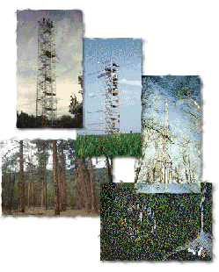
Carbon-Climate Analysis Goals
Towers measure consistent carbon flux and micrometeorological parameters
Tower researchers quality check data and then provide the data to regional archives.
Regional and global carbon-climate analysis activities rely on data from regional archives
Recent La Thuile workshop is gathering over 700 site-years of data available from over 200 sites around the world.

Slide 4
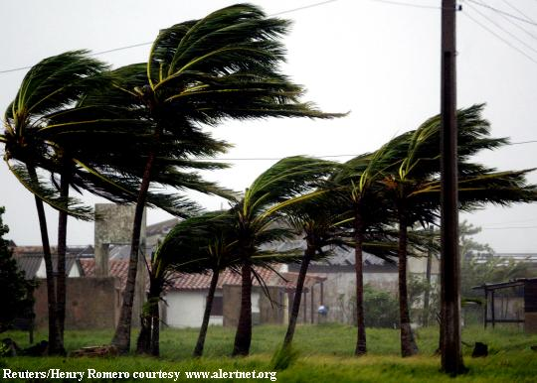
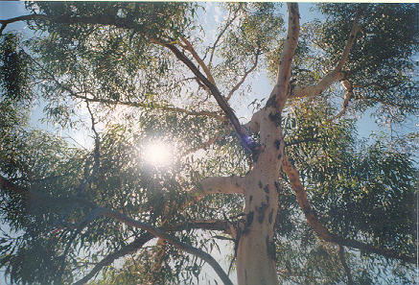
Measurements Are Often Not Simple or Complete
Gaps in the data
  Quiet nights
  Bird poop
  High winds
  ….
Difficult to make measurements
  Leaf area index
  Wood respiration
  Soil respiration
  …
Localized measurements – tower footprint
Local investigator knowledge important
PIs’ science goals are not uniform across the towers

Slide 5
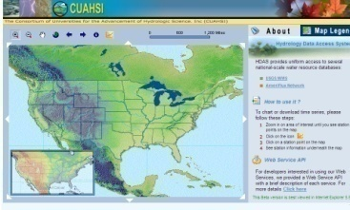
Typical Data Analysis Flow Today
Validate & Quality Check data
Perform Analysis
Identify Data Issues & Retrieve Missing Data
Retrieve Data from Source
Matlab, Excel,
S-Plus, PV-Wave, R, …
Web page, e-mail,
web service, phone,
Student, Post-doc,
Friend, . . .
Notes:
Typically each individual has their own data set that they evolve and refine for their particular calculations

Slide 6
Target Data Analysis Flow
Scientific Data Server
Validate & Quality Check data
Perform Analysis
Identify Data Issues & Obtain Missing Data
Obtain Data from Source
Track versions,
results, and
provenance

Slide 7
Scientific Data Server - Overview
Data Cubes
Databases
Data Ingest
User Interfaces

Slide 8
Database
All descriptive metadata and data held in relational databases
  Metadata is important too!
While separate databases are shown, the datasets may actually reside in a single database
  Mapping is transparent to the scientist
  Separate databases used for performance
  Unified databases used for simplicity
New metadata and data are staged with a temporary database
  Minimal quality checks applied
  All name and unit conversions
Data may be exported to flat file, copied to a private MyDb database, directly accessed programmatically, or ?

Slide 9
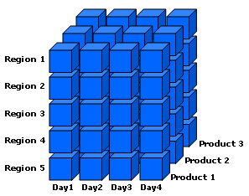
Data Cubes
A data cube is a database specifically for data mining (OLAP)
  Simple aggregations (sum, min, or max) can be pre-computed for speed
  Additional calculations can be computed dynamically or pre-computed
  Both operate along dimensions such as time, site, or datumtype
  Constructed from a relational database
  A specialized query language (MDX) is used
Client tool integration is evolving
  Excel PivotTables allow simple data viewing
  More powerful analysis and plotting using Matlab and statistics software

Slide 10
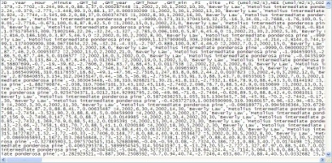
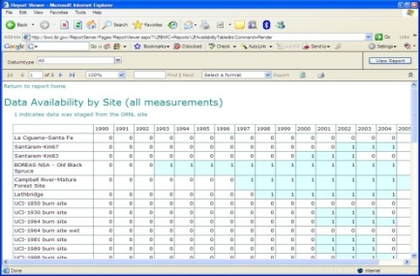
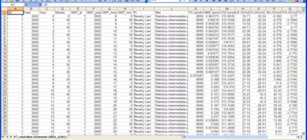
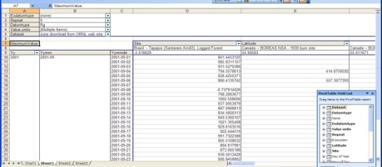
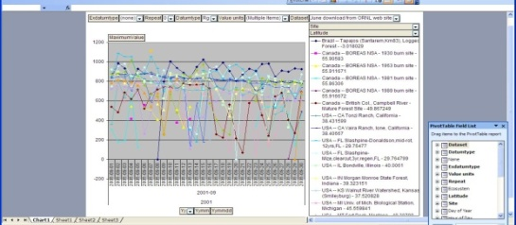
Scientific Data Server – User Interface
CSV Files
Reports, Web Services, Excel Pivot
Table and Pivot Chart
ORNL Ameriflux
Web Site
BWC SQL Server
Database
Data Cube

Slide 11
Browsing For Data Availability
Sites Reporting Data Colored by Year

Slide 12
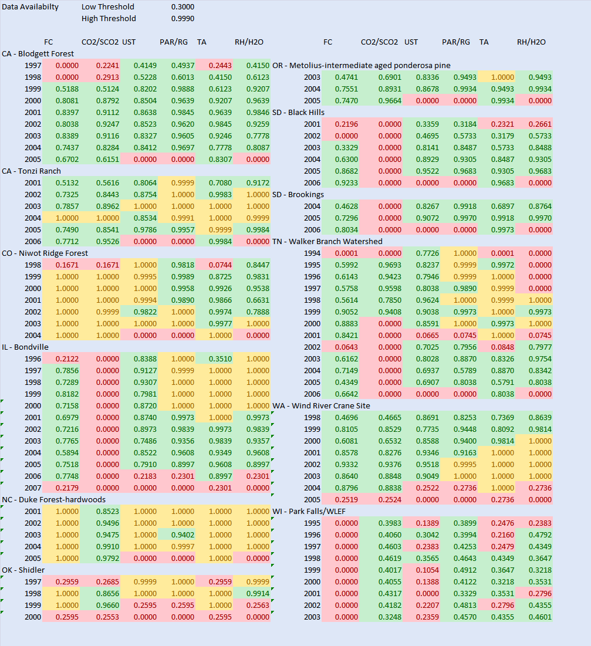
Required variable reporting by site by year
Each row corresponds to one site-year
Each cell corresponds to one site year of (FC, CO2 or SCO2, UST, PAR or Rg, TA, and Rh or H2O).
Color indicates:
  Red – likely not enough for processing - % < .3 reported (roughly less than 5K of 17.5K)
  Green – likely not enough for processing .3<%<.999
  Yellow – may not be good for processing due to gap-filling - % > .999
Red CO2 (second column) can be ignored for cropland/grassland sites
Sites shown are just a sample
Of the 285 site years with good FC, 50 site years are missing one of (UST, PAR/Rg, and TA) and 79 sites have likely gap-filled data.

Slide 13
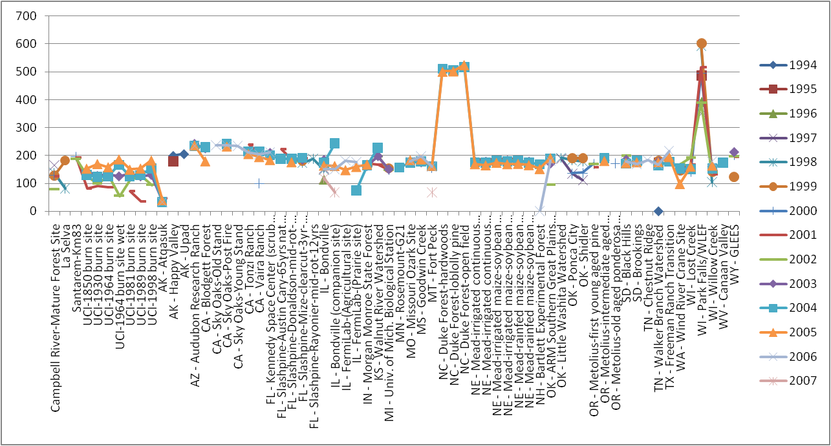
Obviously bad annual averages
Data cube used to browse average yearly Rg values across all site-years
16 additional likely problematic site-years at 5 sites
Notes:
Rg, exdatumtype = none, offset = all (or 0).
Year on column
Site on row

Slide 14
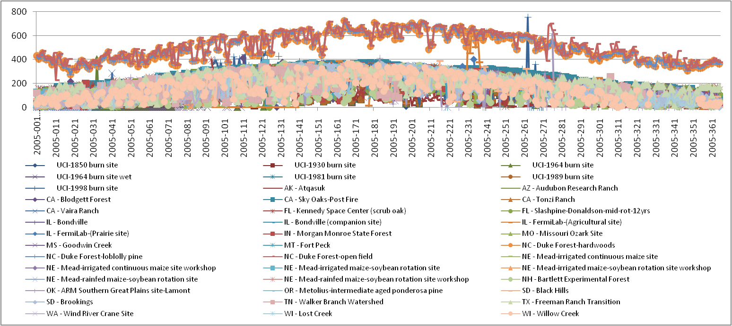
Drill down to consistent (bad) daily values
Data cube used to browse 2005 Rg values shows consistently high reporting (not just a few very large spikes) at Duke Forest sites

Slide 15
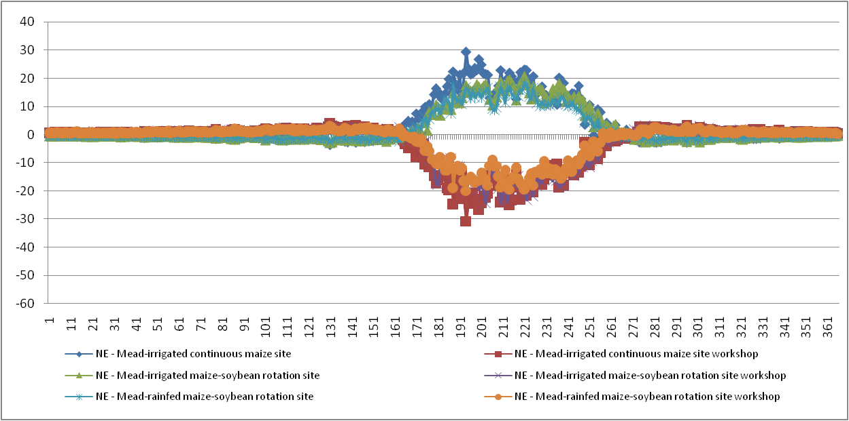
Drill down to Mead sites
Daily average FC at each site shows likely units and/or sign issues
Notes:
Drill down into obvious problem sites
Drill down showing each year….
Mead sites look like sign and/or units problem….

Slide 16
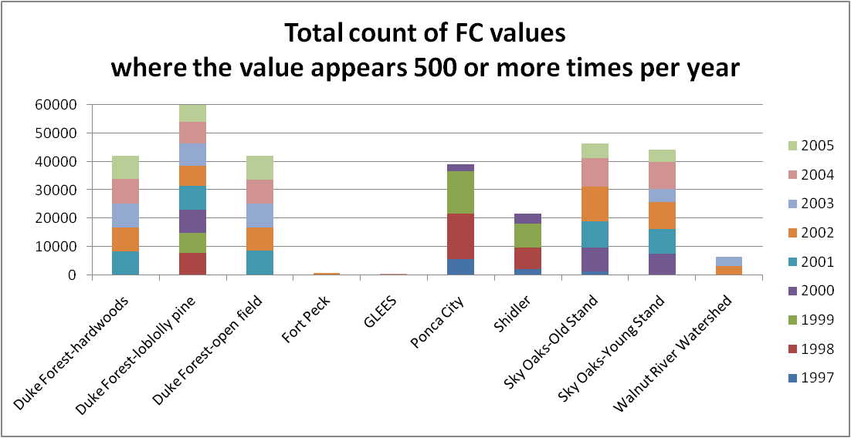
Simple check: the same FC value reported too often
Database query returns count by (site, year, value) where count >= 500
Graph shows sum of (returned counts) by site and year
Sites with high sums likely report very few unique FC values

Slide 17
Project Status
Ameriflux data
  ~145 million daily values in cube
  Advanced calculations and statistics in cube
  Methods of providing ½ hourly data access efficiently
  Data quality assessment
  Collection and incorporation of biological data
Fluxnet data
  ~210 million daily values in cube
  Waiting on gap filling and quality checking operations
  Data server, cubes, and reports will likely be the primary repository and access for researchers using the data
Russian River Data
  ~23 million values in cube
  Integration with Matlab and GIS
  Additional of data from other sources (fish, sediment size, …)

Slide 18
On-going and Future Challenges
Versioning of data and collection of data provenance
Improved performance of database and cube
Handling of biological data
Advanced plotting capabilities
Integration of collaborative tools
Automation of data ingest, cube building, and report building
MyDB and MyCube capabilities
Integration of workflow capabilities
Data server in a box
Sociological change

Slide 19
Summary
Ameriflux collaboration is adopting the Data Server architecture for the data repository
BWC Data Server will be hosting the Fluxnet dataset which is expected to be the foundation for a broad range of research investigations
Ecological measurements are often “messy”
Applying the Data Server to watersheds introduces many additional challenges

Slide 20
Acknowledgements
Berkeley Water Center, University of California, Berkeley, Lawrence Berkeley Laboratory
  Jim Hunt
  Matt Rodriguez
  Monte Good
  Rebecca Leonardson (student)
  Carolyn Remick
  Susan Hubbard
  Yoram Rubin
Microsoft
  Catharine van Ingen
  Jayant Gupchup (student)
  Nolan Li (student)
  Tony Hey
  Dan Fay
  Stuart Ozer
  SQL product team
  Jim Gray
Ameriflux Collaboration
  Dennis Baldocchi
  Beverly Law
  Tara Stiefl (student)
  Youngryel Ryu (postdoc)
  Gretchen Miller (student)
  Mattias Falk
  Tom Boden
  Bob Cook
CarboEurope Collaboration
  Dario Papale
  Markus Reichstein
*Project funded by Microsoft

