Slide 1
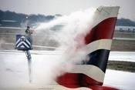
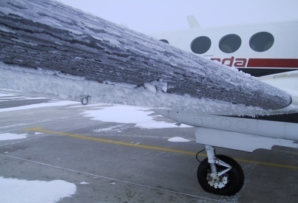

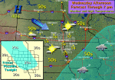
Winter Weather Hazards and
Innovative Support Services
Southwest Aviation Weather Safety Workshop II
Phoenix, Arizona
October 23rd 2008
Ken Widelski
Meteorologist

Slide 2
Presentation Agenda
A few notes on icing accidents
Icing hazards
-Warm front
-Cold front
Instructional Sounding analysis
Wintry Precipitation Types
Tools and Innovative services
The graphical age
Questions

Slide 3
Interesting Icing Stats
NWA Winter Weather and Flying: Terry Lankford-retired FAA controller
Icing affects aircraft in three ways:
flight and engine instruments
induction systems
structurally.
An erroneous assumption is that icing only affects the IFR pilot.

Slide 4
Icing affects the VFR pilot as well as the IFR pilot.
Based on total numbers, VFR pilots are involved in more icing related accidents than IFR pilots.

Slide 5
Structural icing accidents accounted for only about 40% of total accidents involving icing.
The majority of icing accidents are attributed to carburetor or induction system icing, with less than 10% involving icy runways.

Slide 6
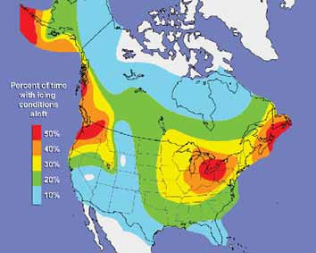
Percent of time with Icing Aloft.
Courtesy of NASA

Slide 7
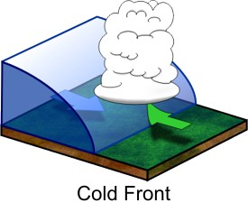
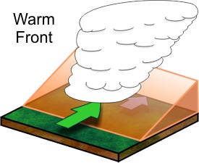
Frontal Passages

Slide 8
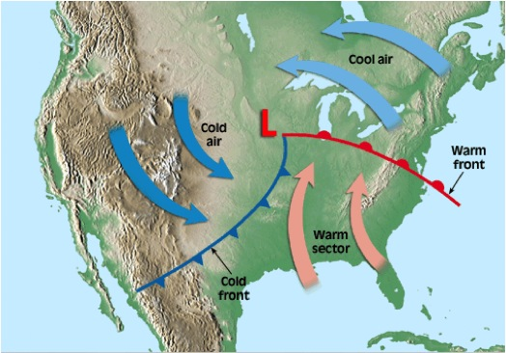

Slide 9
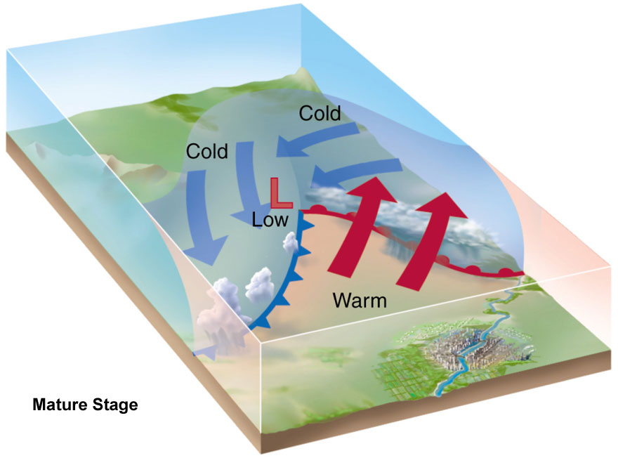

Slide 10
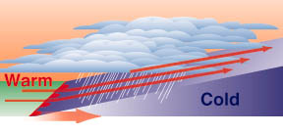
Icing hazard-Warm Front
Warm air gently slopes over cooler
surface air (Veer).

Slide 11
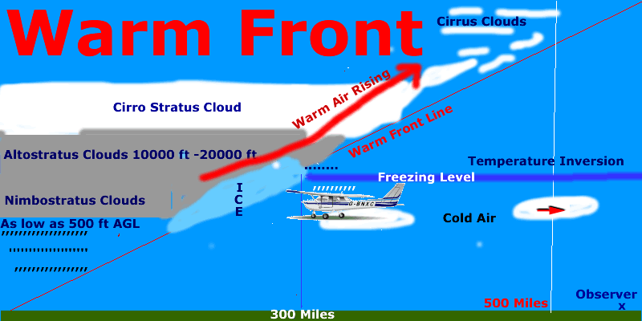
Warm Front Hazards.
Reference, Geoff Butler Flight School.
Warm air rising above the freezing level aiding in precipitation.
Rain falls through the freezing layer and freezes as super cooled water droplets.
Water droplets stick to the aircraft on contact.

Slide 12
What to do if caught in this situation?
Options:
Climb above the freezing level.
Turn around and go back, underneath the cloud.
It is therefore important before flying to gain situational awareness by assessing pre-flight tools.
The ice can cause loss of lift.

Slide 13
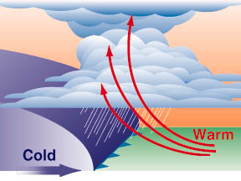
Icing Hazards: Cold Front

Slide 14
Cold Front Characteristics
Some fronts can be slow moving.
Mild conditions ahead of the boundary with cold dense air directly behind the fro-pa.
Can lead to dense stratus, sub freezing temperatures, and in some cases frozen precipitation.

Slide 15
Some cold front passages can be very quick and produce rapid drying.
However…a rapid moving front can also
provide another aviation hazard…
Strong winds and low level wind shear…

Slide 16
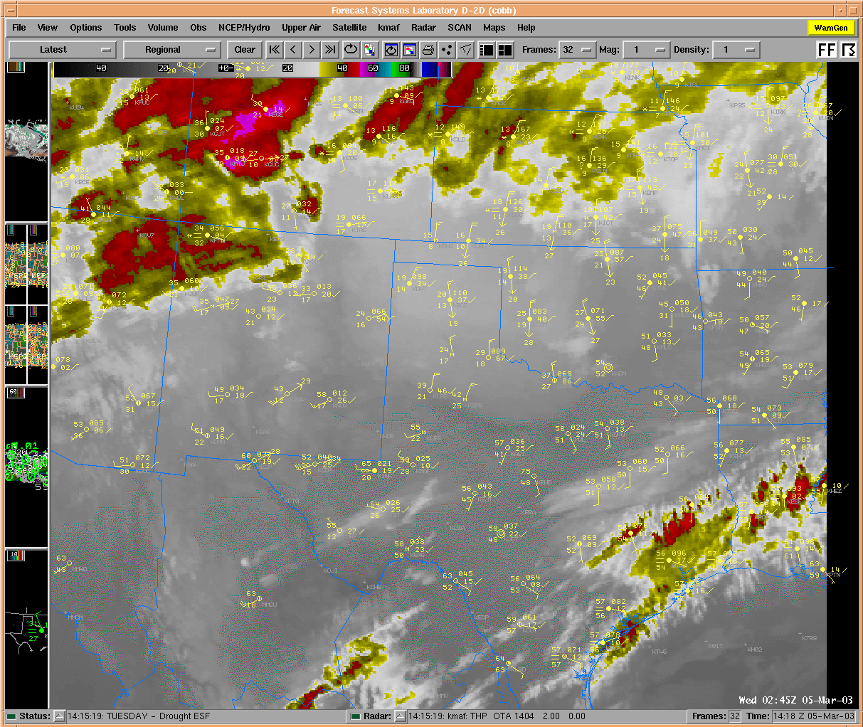

Slide 17
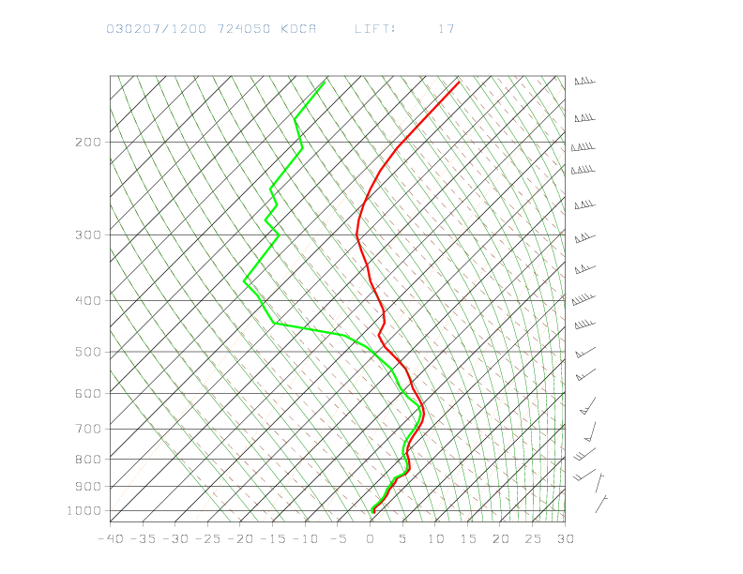
Basic Sounding Analysis
An incredibly helpful tool if you know how to use them.
Identify smooth air, wind shear, atmospheric stability
Icing hazards

Slide 18
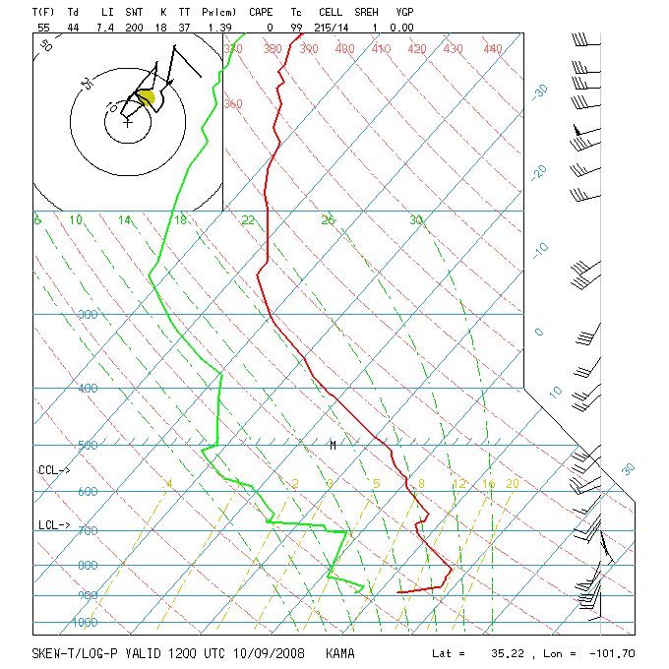
Radiosonde soundings
http://www.rap.ucar.edu/weather/upper/ama.gif
Available twice daily
At 00 Z and 12 Z
Look for temperature
inversions aloft –
Stable air is typically smooth
Temp
Dewpoint
Watch for horizontal
wind shear - note
speed AND direction

Slide 19
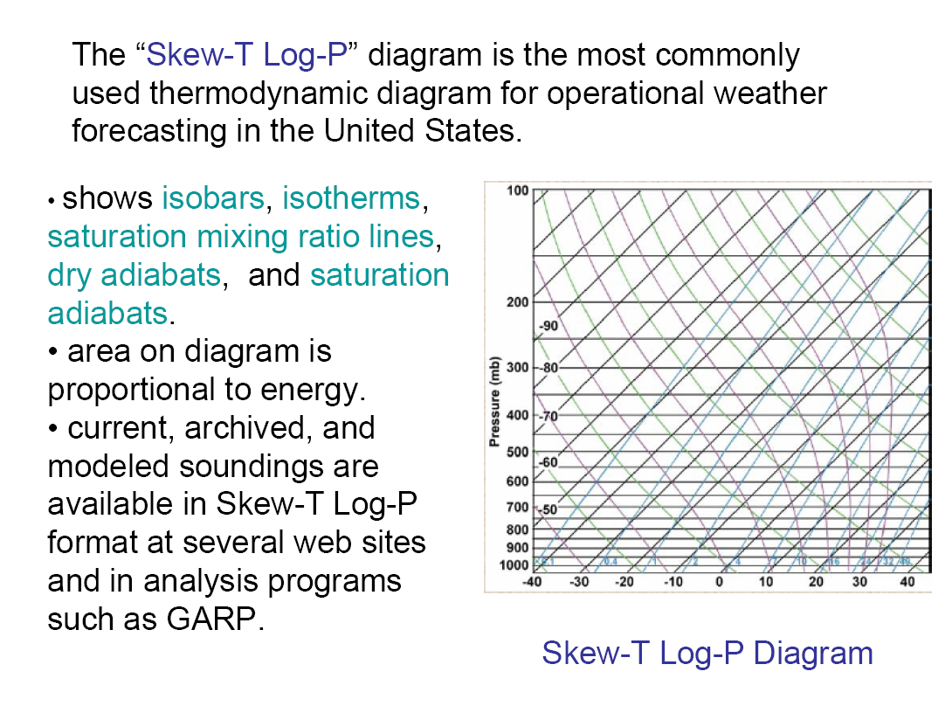
Author: Larry D. Carey

Slide 20
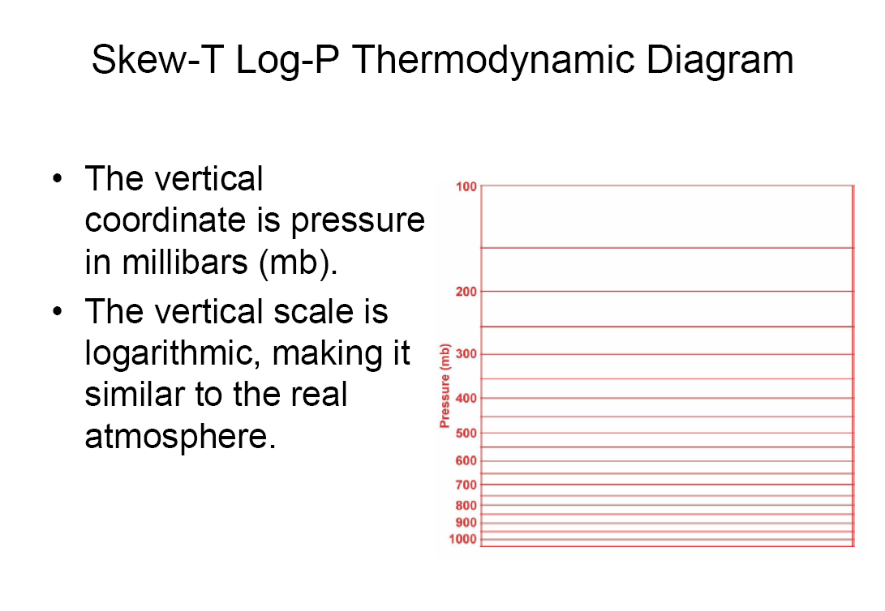
Author: Larry D. Carey

Slide 21
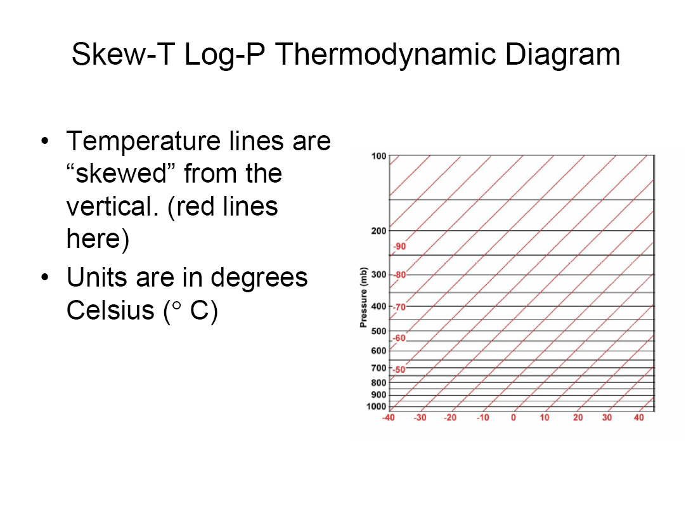
Author: Larry D. Carey

Slide 22
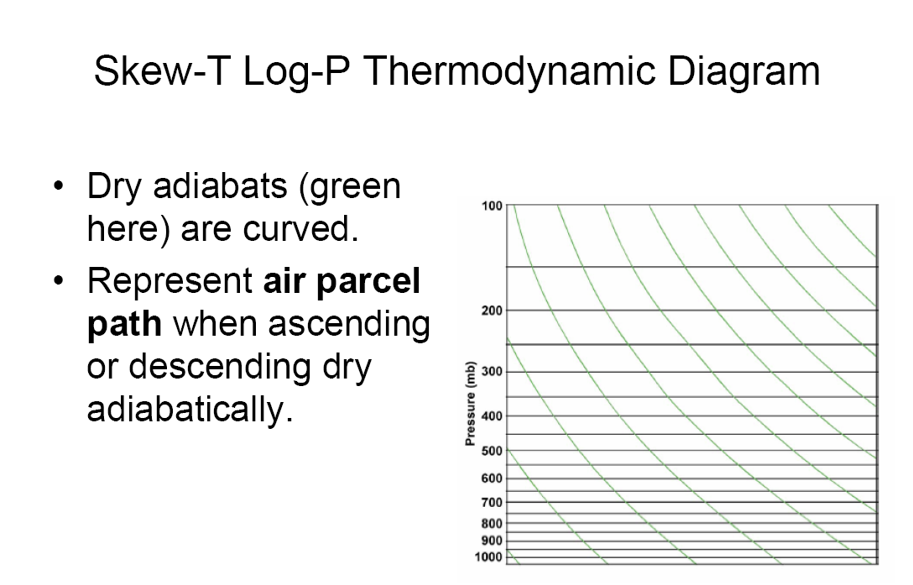
Author: Larry D. Carey

Slide 23
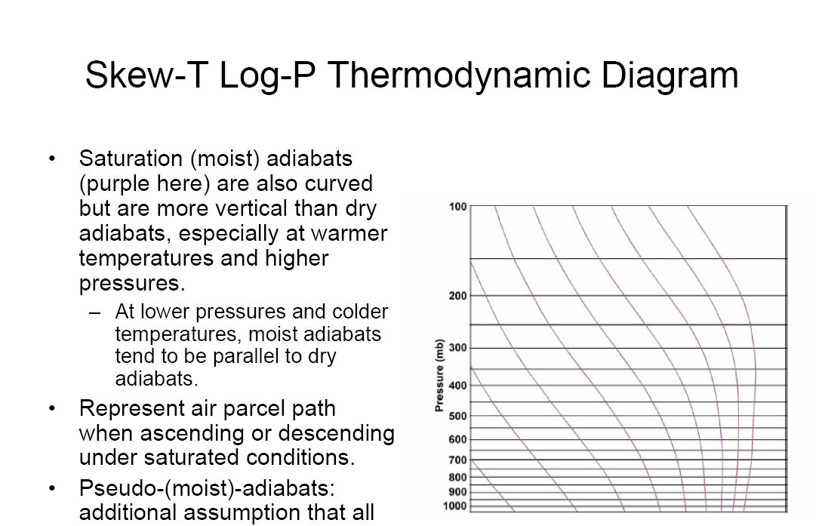
Author: Larry D. Carey

Slide 24
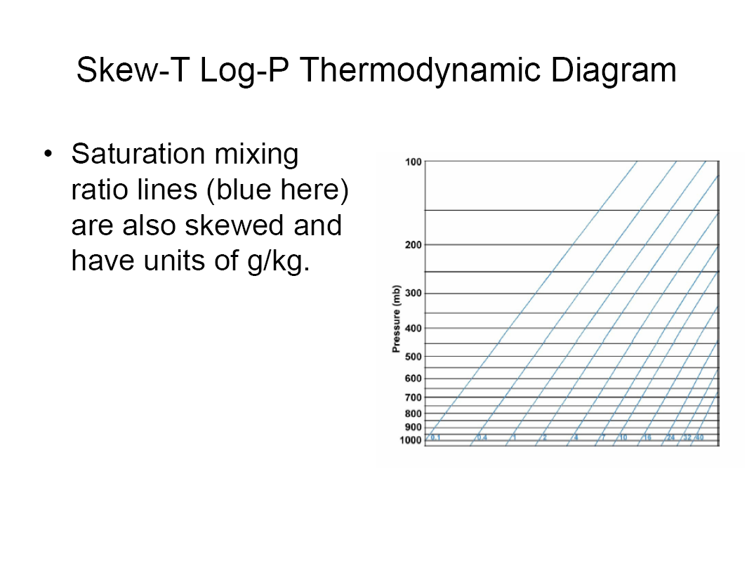
is the theoretical maximum amount of water vapor that air at a specific temperature and pressure can hold
The maximum water vapor concentration in the atmosphere for a given air temperature. The higher the air temperature, the higher the saturation mixing ratio.
Author: Larry D. Carey

Slide 25
Wintry Precipitation Types
Freezing rain
Freezing drizzle.
Sleet
Snow

Slide 26
Main question asked…
How do you know which precipitation type will fall?

Slide 27
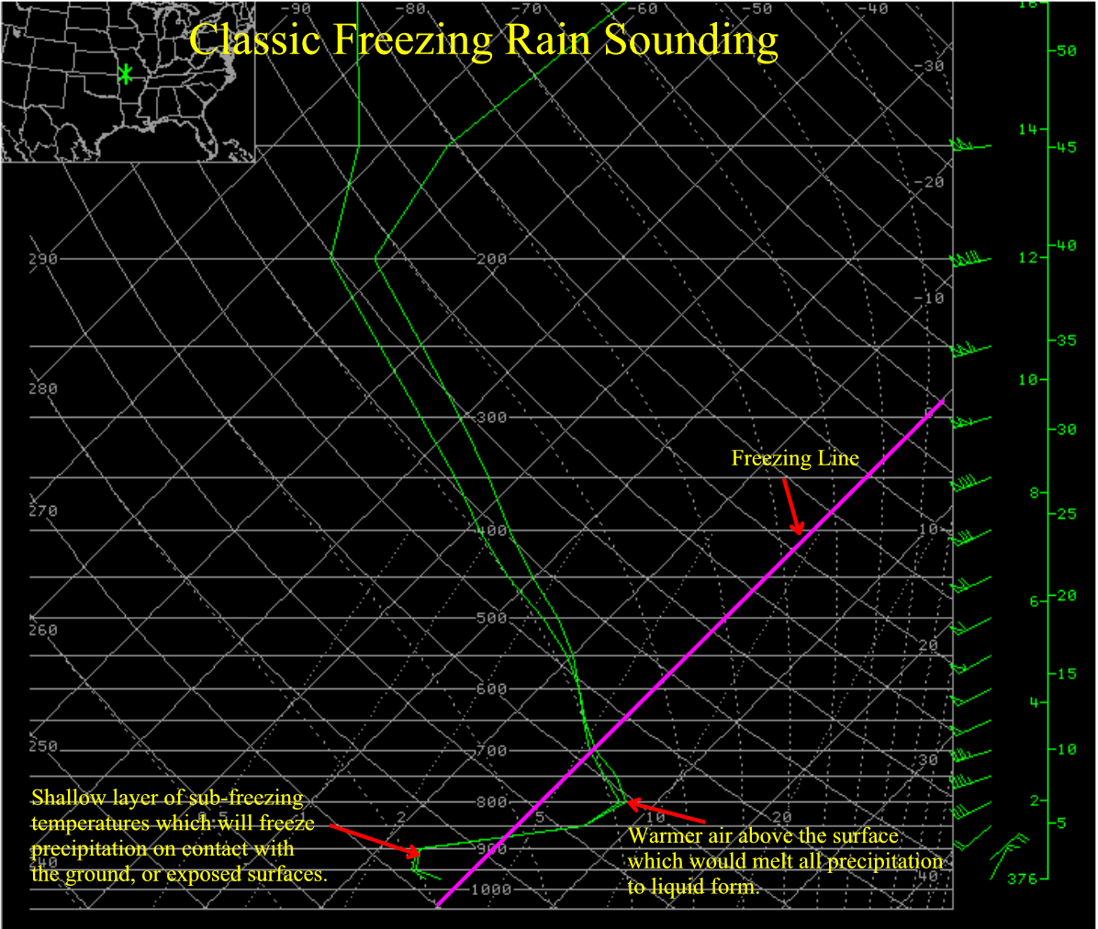
Freezing Drizzle/Freezing Rain
CR case study

Slide 28
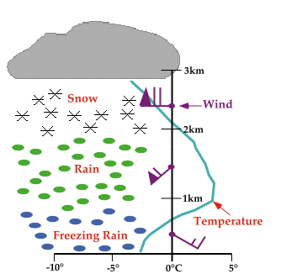
University of Illinois

Slide 29
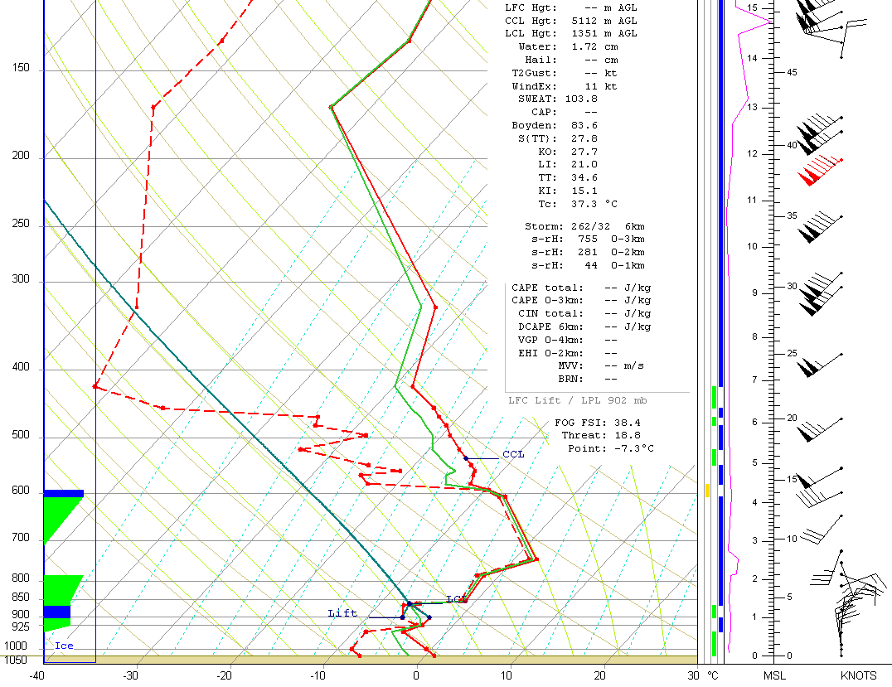
Sleet
Cold air below warm nose deep enough to refreeze into ice pellet
Warm nose

Slide 30
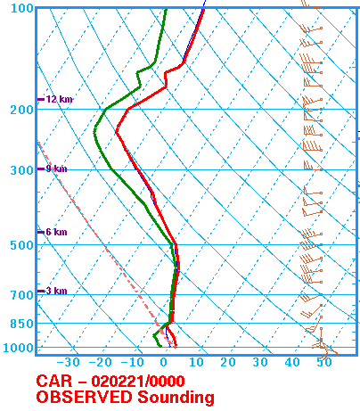
Snow

Slide 31
Another thing to remember about soundings…
Be sure to check weather conditions all across your flight path.
Checking one sounding will only provide conditions in the vicinity of that area and may not be uniform across the full flight path.

Slide 32
In addition to p-type
Soundings can help show inversions
Mixing heights
Diurnal mixing expectancies

Slide 33
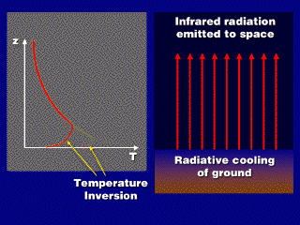

Slide 34
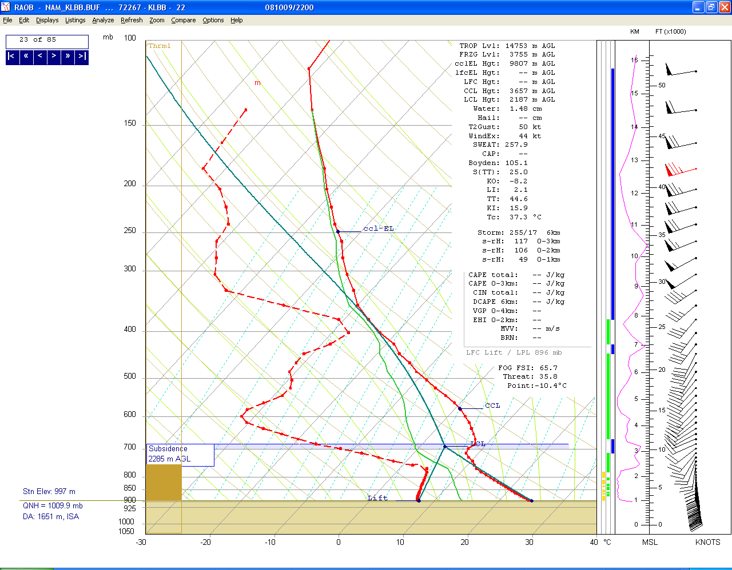
Daytime heating leads to mixing of higher momentum air aloft down to the surface. Especially if mixing heights are deep.
Temperature
Inversion
Thermal
Turbulence

Slide 35
Tools and Innovative Services
Technological advancements over the years have led to a wide variety of briefing tools for pilots.
Individual briefing methods can be established well before a go-no go decision is made.

Slide 36
NWS: Aviation Weather Center http://adds.aviationweather.gov/tafs/

Slide 37
Raw Format

Slide 38
Translated Format

Slide 39
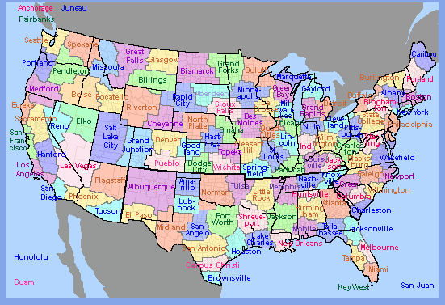
AFD Page http://aviationweather.gov/testbed/afd/

Slide 40
Purpose for the Aviation AFD
Airline Perspective
Briefly identify weather impacts which may affect the operations of an airport terminal.
Provide a reasoning behind the TAF in a non technical manner.
**Describe TAF uncertainties or items left out of the TAF but still possible**

Slide 41
Low clouds and fog
KLBB 202325Z 210024 15010KT P6SM SKC
FM0500 12007KT P6SM SKC
FM0800 15005KT 5SM BR SKC
FM1000 VRB03KT 2SM FEW010
FM1200 18010KT P6SM SKC
Discussion
Moist soil conditions from recent rainfall combined with clear skies and light winds will produce an environment favorable for areas of radiation fog. Areas on the Caprock have the best potential for strong radiational cooling. There is a moderate to high confidence that VSBY will meet MVFR criteria with a lower confidence for IFR conditions. The fog event will be short lived as mixing of drier air develops around sunrise.

Slide 42
VFR TAF with uncertainties
KLBB 202325Z 210024 05010KT P6SM SKC
FM0500 12007KT P6SM SKC
FM1200 18010KT P6SM SKC
FM1700 21015G25KT P6SM FEW250
Discussion
Low level moisture is expected to slowly increase tonight. Stratus is expected to develop across the Permian Basin and Concho Valley by 06z and slowly expand northward toward the South Plains region before sunrise. Right now…it appears that the bulk of the low cloud development is expected to remain just south of KLBB and a VFR TAF will be maintained for this issuance. There is still a possibility for SCT MVFR CIGS at KLBB and we will re-evaluate the potential for the 06z TAF.

Slide 43
TAFS are what is used for operational airline planning decisions.
The Aviation AFD is a communication mechanism that can benefit both the forecaster and the dispatcher if used correctly. (Liaison)

Slide 44
MOS: Model Output Statistic http://www.nws.noaa.gov/mdl/synop/products.shtml

Slide 45
MOS Example

Slide 47
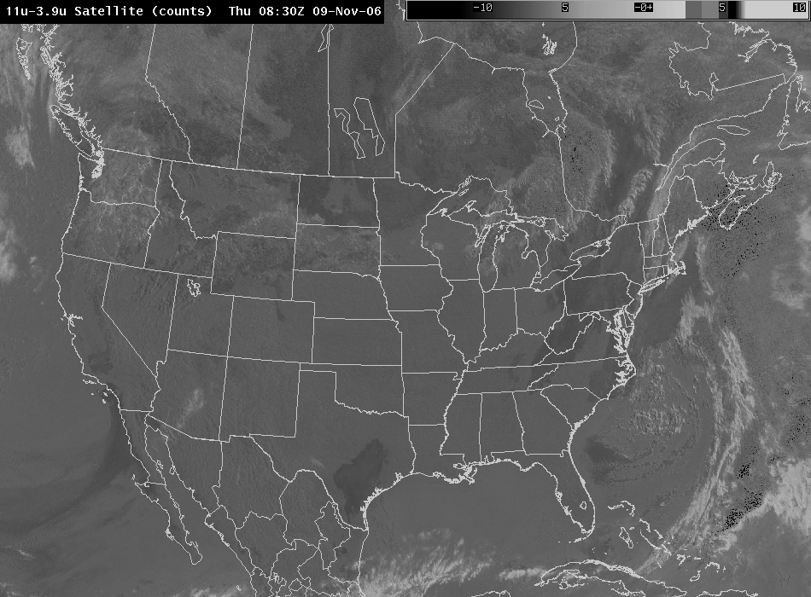
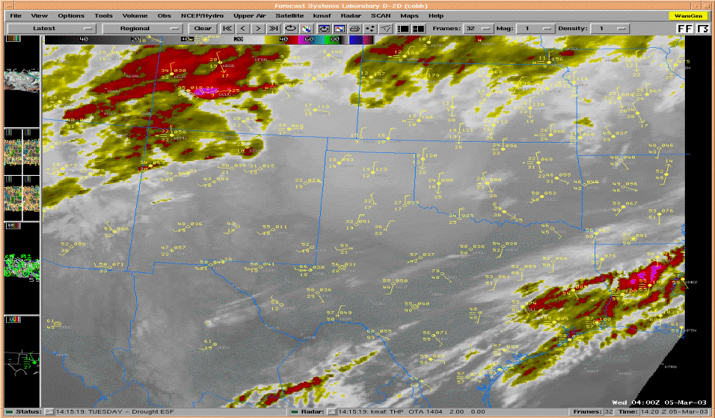
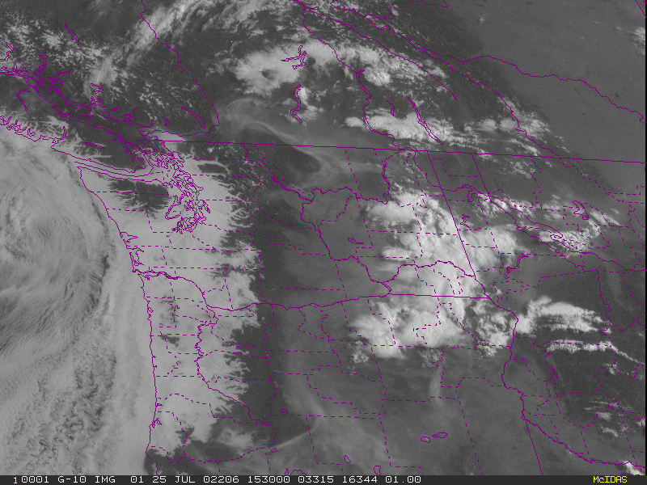
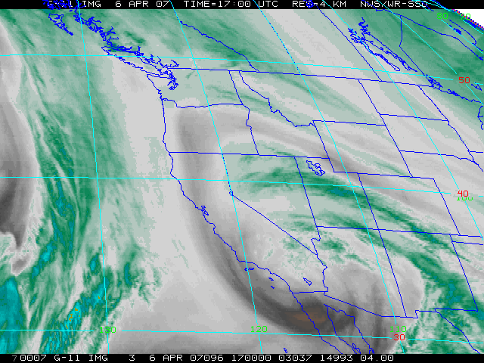
Satellite Imagery

Slide 48
The Graphical Age
Many NWS offices are developing “Graphicast’s”.
“Graphicast’s” can provide a lot of detail without the use of technical jargon.
Can give the user a picture of expected weather conditions for a specific area.

Slide 49
For Example…
Standard Area Forecast Discussion looks like this…
.DISCUSSION... LOW CLOUDS CONTINUE TO CLEAR FROM NORTH TO SOUTH THIS MORNING. CLOUDS SHOULD HOLD ON OVER SOUTHERN AND SOUTHEASTERN ZONES THROUGH MUCH OF THE MORNING AND SKY GRIDS WERE EDITED TO REFLECT THIS. OTHERWISE...GUIDANCE VALUES WERE FOLLOWED CLOSELY FOR THIS FORECAST. CONTINUED COLD ADVECTION TODAY PROGGED TO HOLD HIGH TEMPS DOWN IN THE UPPER 60S/LOW 70S DESPITE FULL SUNSHINE OVER MOST OF THE CWA. FRI MORNING EXPECT FROST IN A FEW LOW-LYING OR SHELTERED AREAS THAT CAN MANAGE TO DROP INTO THE 30S...BUT THESE AREAS SHOULD BE ISOLATED. WILL TOUCH UP THE SPS ISSUED ON THE DAY SHIFT YESTERDAY. ONCE A UPPER LEVEL SHORT WAVE MOVES THROUGH THE AREA FRI A RIDGE FOLLOWS BEHIND...WITH WARM AND DRY CONDITIONS EXPECTED THIS WEEKEND. FAIRLY GUSTY SOUTHERLY WINDS SHOULD DEVELOP BY SUN IN ADVANCE OF A COLD FRONT ON MONDAY. LITTLE CHANCE OF PRECIP WITH THIS FRONT...BUT EXPECT COOLER TEMPS NORTHERN ZONES. WINDS COME BACK AROUND TO THE SOUTH ON TUE IN ADVANCE OF THE NEXT UPPER LEVEL TROUGH. OPERATIONAL GFS/ECMWF BOTH INDICATE A HIGH AMPLITUDE TROUGH BRINGING A FAIRLY STRONG COLD FRONT SOUTHWARD ON WED. SLIGHT CHANCE/CHANCE POPS ARE IN THE FORECAST FOR TUE NIGHT/WED. NOT MUCH CONFIDENCE YET THOUGH AS SPREAD AMONG NCEP ENSEMBLE MEMBERS IS LARGE.

Slide 50
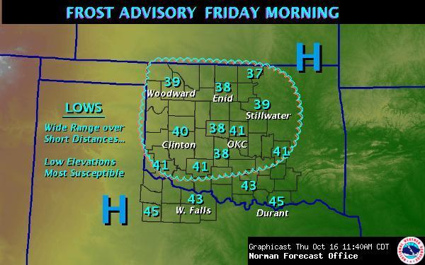
A Graphicast can sum it all up into 1 single image.

Slide 51
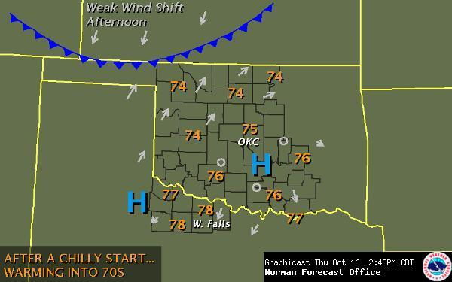
Example with wind shift

Slide 52
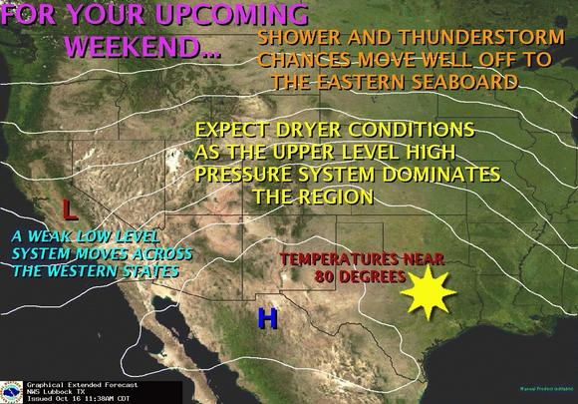
WFO Lubbock, Texas

Slide 53
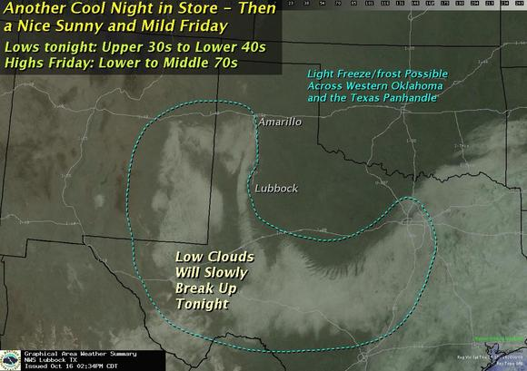
WFO Lubbock: Short Term

Slide 54
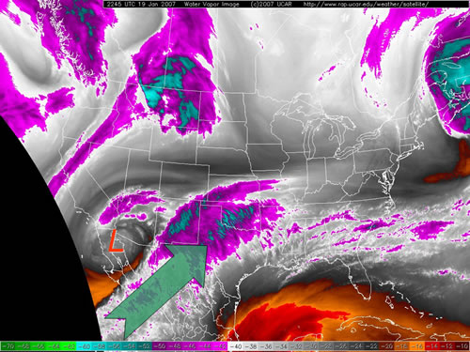
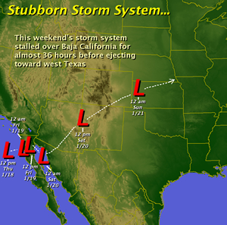
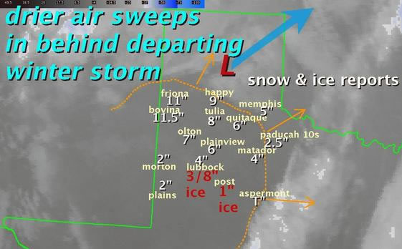
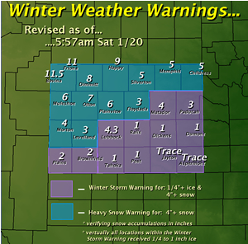

Slide 55
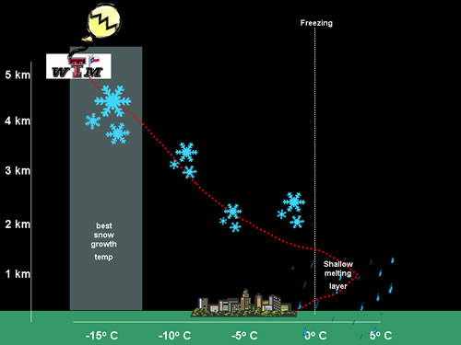

Slide 56
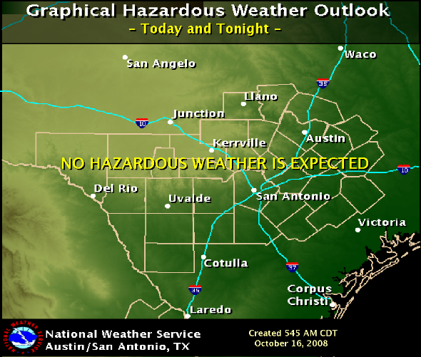
WFO Austin/ San Antonio

Slide 57
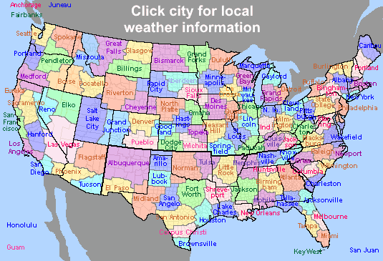
Where to find these…
www.weather.gov

Slide 58
References
NWA winter weather and flying
COMET
METED
NASA
Dr. Larry D Carey
Geoff Butler flight school
Aviationweather.gov
University of Wyoming
www.rap.ucar.edu
University of Illinois

Slide 59
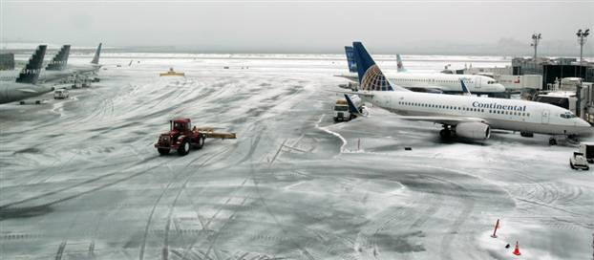
Thank you for attending!
Any Questions?

