Slide 1
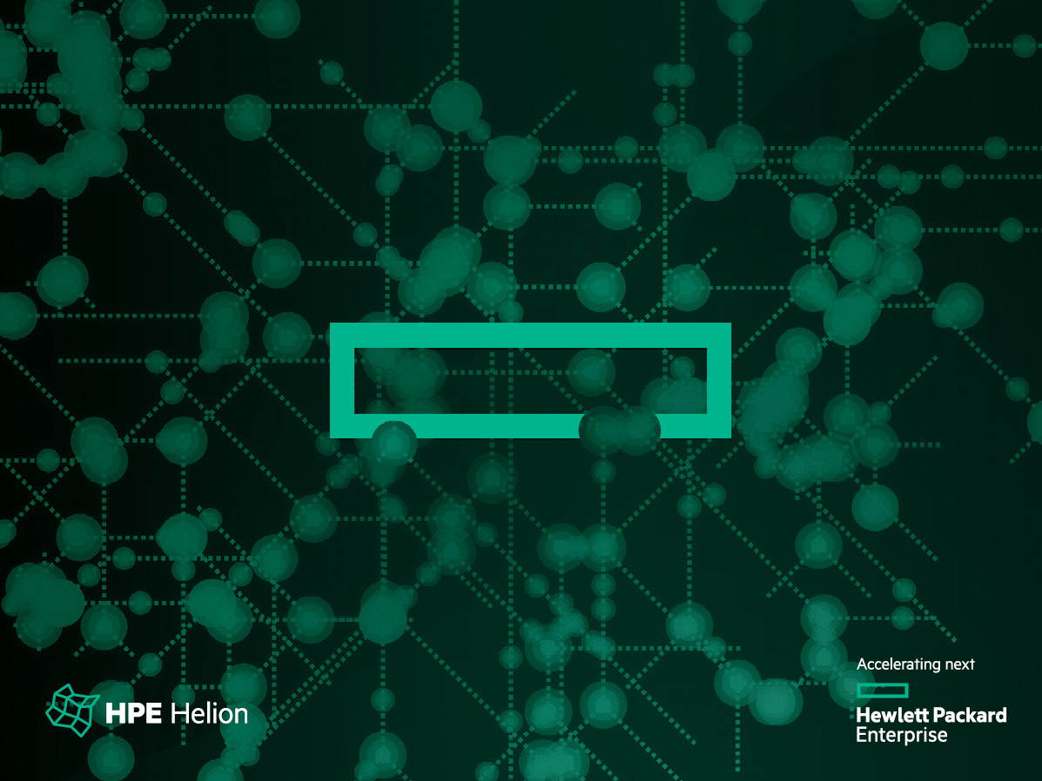
OpenStack® Summit Austin 2016
Headless NFVi for PoP, CO or MSC/MSO
Vinod Chegu
Hrushikesh Gangur

Slide 2
Agenda
Requirement Description
Can OpenStack meet these requirements?
Mitigation plans
Open items & Discussion

Slide 3
Requirement Description Problem Statement
Main DC
Telco use cases do require a multiple-tier NFVi
Point of Presence (PoP) or Central Office (CO) or Mobile Switching Center/Office (MSC/MSO) a.k.a micro DC severely constrained in:
Space
Power
Cooling
Minimal upfront cost
Control vs. Compute foot print:
Guaranteed bandwidth and latency between Main DC and the micro DC
Centralized operation/maintenance (includes Upgrades)
microDC
microDC
microDC
…~100s
CPE
CPE
CPE
CPE
… ~10K+

Slide 4
Capabilities expected from PoP/CO/MSC/MSO (micro DC)
Predictable performance.
Line rate, Low latency, Low Jitter.
High availability
Persistent data
Networking needs
reduce round trips to Main DC for FIP/L3/L2 connectivity
Examples of VNFs
vEPC use cases
vRouter
vRAN

Slide 5
Can OpenStack meet these requirements?

Slide 6
NFVi w/ CP (VIM) per micro DC : Challenges
Control plane to data plane footprint ratio is out of order
Few projects focused on virtualizing/containerizing CP to reduce footprint
Centralized maintenance (includes upgrades)
NFV-Orchestration of such discrete and many endpoints is complex
Quota, Resource management, single dashboard etc.
Overlay networks across VIMs

Slide 7
NFVi w/o CP (headless) per micro DC : Challenges
A headless micro DC has its CP in the Main DC (aka mothership DC)
Networking requirements for deployment and operations
L2 connectivity
Bandwidth (BW)
Latency
Limiting the data transfer
Image copy while launch
Chattiness between CP and computes due to inter-service communication
Block storage support over WAN
L3 or FIP connectivity through mothership DC
Logging and/or monitoring

Slide 8
Mitigation plans

Slide 9
Mitigation Plan
#1 Leveraging SDN Solution w/ OpenStack - Pre-requisites
Networking infrastructure to provide
L2 extension from mothership DC to micro DC (e.g VPLS)
BW > 2Gbps
Latency < 80 ms
Preinstalled compute nodes
Cached images on the local compute nodes
Storage array in micro DC for persistent data
HW_VTEP enabled ToR switch
Notes:
L2 connectivity is not mandatory, however due to the deployment technologies chosen – like pxe (or preinstalled compute), it needs a same broadcast domain, secondly some of the middleware components like HA of VMs, a multicast traffic is needed
Bandwidth needed for following data transfer requirements:
Images or volume from images
Log collection/monitoring
Latency
Response time between inter-service hand-shake
Posting and picking up messages from the queue
CRUD operation to the database
Preinstalled compute
Ship a preinstalled compute to reduce the install time and reconfiguration
Ideally, configured compute node in the mothership-DC
Cached images
Identified or frequently used images need to be cached on the computes to avoid transfer rate
Storage array
- Volume type relates to compute node

Slide 10
Mitigation Plans
Leveraging SDN Solution w/ OpenStack – Reference Implementation – Logical contd.
Orchestrator
NFV-O
mothershipDCn
microDCn
OpenStack
CTRL
SDN
Service Dir
Monitoring/ Logging
FIP/L3/L2 VTEP GW
CN
Storage
Array
MAN/WAN
CN
SDN
CTRL
SRIOV
vSwitch
FIP/L3/L2 VTEP GW
CN
Storage
Array
CN
CN
CN
Notes:
Availability zone to indicate scheduler to launch in MicroDC computes
vSwitch provides both switching, routing functionality including metadata proxy services
Managing upgrades boils down to upgrading of the compute nodes in the same cloud
Scale

Slide 11
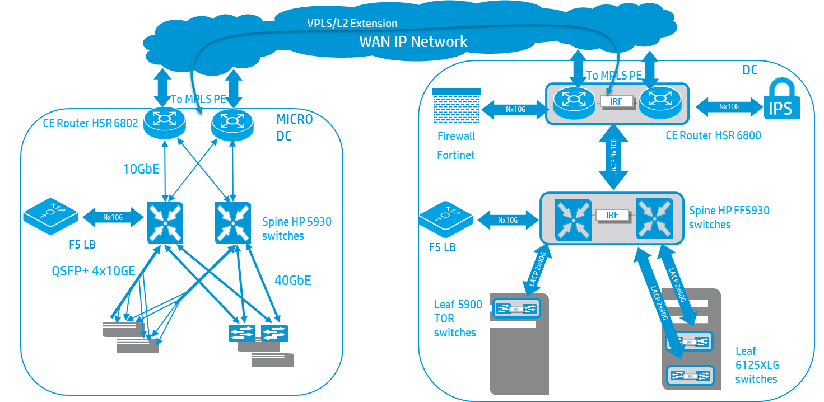
Mitigation Plans
Leveraging SDN Solution w/ OpenStack – Reference Implementation – Physical contd.
Local Compute and Storage Services
Layer 2 (VPLS,VLAN, VXLAN) Extensions between DC to provide Access to the MGMT Network of the remote DC
MICRO DC is seen as an infrastructure POD attached to the parent DC
DC Management Layer can manage Micro DC resources seamlessly

Slide 12
Mitigation Plans
#2 Co-exist OpenStack CP w/ Compute + SDN
Orchestrator
NFV-O
microDCn
mothershipDCn
FIP/L3/L2 VTEP GW
CN
SDN CTRL
OpenStack
CTRL
SDN
Service Dir
Monitoring/ Logging
CTRL w/ CN
Storage
Array
MAN/WAN
SDN
CTRL
SRIOV
vSwitch
FIP/L3/L2 VTEP GW
CN
Storage
Array
CN
CN
CN

Slide 13
Mitigation Plans
#3 Virtualized Control Plane + SDS (Storage) + SDN (Network)
Orchestrator
NFV-O
microDCn
mothershipDCn
FIP/L3/L2 VTEP GW
CN
KVM Host x3
OpenStack
CTRL
SDN
Service Dir
Monitoring/ Logging
CTRL
CN
SDS
SDN CTRL
MAN/WAN
SDN
CTRL
SRIOV
vSwitch
FIP/L3/L2 VTEP GW
CN
Storage
Array
CN
CN
CN

Slide 14
Open Items
Brainstorm on a few unaddressed problems
#1 Computes w/o CP (headless):
Deployment of compute nodes in the microDC over WAN
Low latency monitoring of VNFs
Image offload
iSCSI traffic over WAN (boot from volume use cases)
Underlay L2/L3 VPN connectivity between DCs
Limit on number of microDCs
#2,3 Computes w/ CP
Complexity of managing multiple clouds
Orchestration overhead (user, quotas, provisioning, tenant network setups) using multiple service endpoints, IPAM
Notes:
Upgrades
Logging/Monitoring consolidation
Distributed quota management
Global resource view of the tenant
Tenant level Volume/VM migration/backup
Multi-DC image import/clone/export

Slide 15
Thank you

