Slide 1
Everything you always wanted to know about scrubs but were afraid to ask

Slide 2
What are scrubs?
Ceph ensures data integrity by scrubbing at placement group (PG) granularity
Somewhat analogous to fsck on a filesystem
More analogous to LSI patrol read, ZFS scrubbing, HPSA surface scan
For each placement group, Ceph compares each primary object and its replicas
Light scrubs (daily) check the object size and attributes
Deep scrubs (weekly by default, monthly for us) read all three copies and compares checksums

Slide 3
Why do we need scrubs?
Storage is flaky, yet for RAS we need all copies of data to be consistent (and correct!)
Disk surface errors: 1 in 10^14 to 10^16 bits
Toshiba ATI, RAM, PCI bus errors, expander flakes
Failure of disk electronics, HBA misbehavior
Drives unseated due to vibration or human error
Random / spontaneous XFS corruption *
On-disk volatile cache naively enabled (LSI pdcache)
Journal hardware failure
Ceph / kernel bugs, cosmic rays
* Be afraid. Be very afraid.

Slide 4
Disk error examples
Dec 15 10:55:44 csx-ceph1-020 kernel: end_request: I/O error, dev sdh, sector 1996791104
Dec 15 10:55:44 csx-ceph1-020 kernel: end_request: I/O error, dev sdh, sector 3936989616
Dec 15 10:55:44 csx-ceph1-020 kernel: end_request: I/O error, dev sdh, sector 4001236872
Dec 15 13:00:18 csx-ceph1-020 kernel: XFS (sdh1): xfs_log_force: error 5 returned.
Dec 15 13:00:48 csx-ceph1-020 kernel: XFS (sdh1): xfs_log_force: error 5 returned.
[root@csx-ceph1-020 ~]# /opt/MegaRAID/storcli/storcli64 /c0 /eall /s9 show all | grep Error
Media Error Count = 66 # surface error
Other Error Count = 1 # electronics / HBA / expander / seating failure etc.
BBM Error Count = 0
Ignore these, which are artifacts of the empty UCS FlexFlash SD card slots
/var/log/messages-20151227:Dec 24 00:41:37 csx-ceph1-003 bash: SG_IO: bad/missing sense data, sb[]: 70 00 05 00 00 00 00 0d 00 00 00 00 20 00 00 00 00 00 00 00 00 00 00 00 00 00 00 00 00 00 00 00
/var/log/messages-20151227:Dec 24 00:41:37 csx-ceph1-003 bash: SG_IO: bad/missing sense data, sb[]: 70 00 05 00 00 00 00 0d 00 00 00 00 20 00 00 00 00 00 00 00 00 00 00 00 00 00 00 00 00 00 00 00

Slide 5
How Ceph reacts to errors
Most client data written is never read (unused OS files, logs, backups, etc)
Ceph – unlike HBA RAID, SVM, and ZFS -- only serves client reads from the lead OSD
This means that most data is only ever read during scrubs
An inconsistency in metadata or payload triggers an inconsistent PG
We resolve by removing the affected OSD, running pg_repair_all, and replacing/redeploying the disk
/var/log/ceph/ceph.log.2.gz:2016-01-19 09:10:30.403351 osd.121 10.203.1.22:6815/3987 10429 : [ERR] 20.376b shard 121: soid a0c2f76b/rbd_data.5134a9222632125.0000000000000001/head//20 candidate had a read error
/var/log/ceph/ceph.log.2.gz:2016-01-19 09:10:33.224777 osd.121 10.203.1.22:6815/3987 10430 : [ERR] 20.376b deep-scrub 0 missing, 1 inconsistent objects
/var/log/ceph/ceph.log.2.gz:2016-01-19 09:10:33.224834 osd.121 10.203.1.22:6815/3987 10431 : [ERR] 20.376b deep-scrub 1 errors
root@csx-a-ceph1-001:~# ceph -s
cluster ab84e9c8-e141-4f41-aa3f-bfe66707f388
health HEALTH_ERR 1 pgs inconsistent; 1 scrub errors
osdmap e46754: 416 osds: 416 up, 416 in
pgmap v7734947: 59416 pgs: 59409 active+clean, 1 active+clean+inconsistent, 6 active+clean+scrubbing+deep

Slide 6
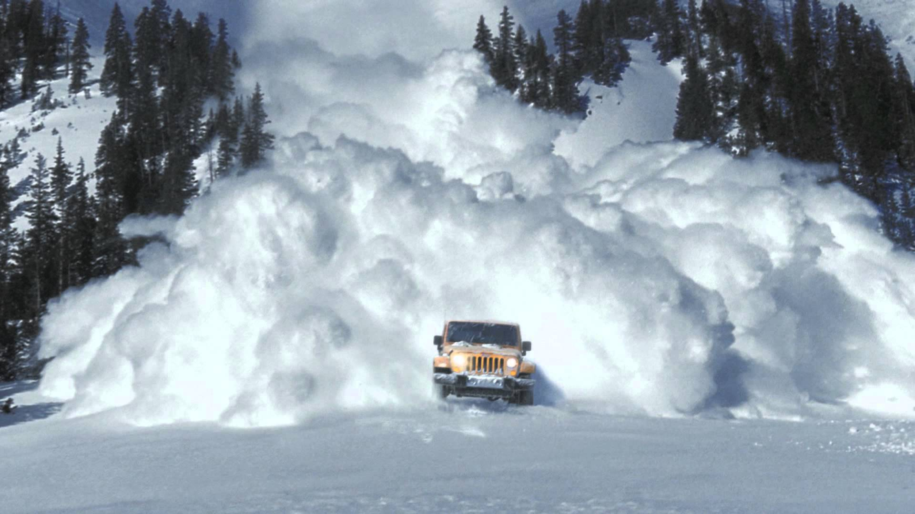
The Good, the Bad, and the Ugly
Good: Ceph enforces high data integrity
Bad: TANSTAAFL – scrubs cost
Ugly: scrub avalanche

Slide 7
By default, all PG’s are deep-scrubbed once a week
We disable scrubs during data movement (CR backfill / recovery, rebalancing, expansion) to reduce contention
When scrubs are re-enabled the backlog can hit like an avalanche
Each PG maintains a timestamp for the last light / deep scrub
If that was longer ago than osd_scrub_max_interval or osd_deep_scrub_interval, a scrub is initiated
Because Ceph is decentralized we can limit the number of scrubs run in parallel within each OSD, but not across the cluster as a whole. When there’s a backlog, dozens can run at once. We have seen client impact from 80+ deep scrubs running in parallel.
On current clusters I try to limit deep scrubs to 11 at once
Parallelism is a function of the elapsed time for each to complete: with little data each scrub on average completes quickly; as the PG’s fill the average time to complete grows and they overlap more

Slide 8
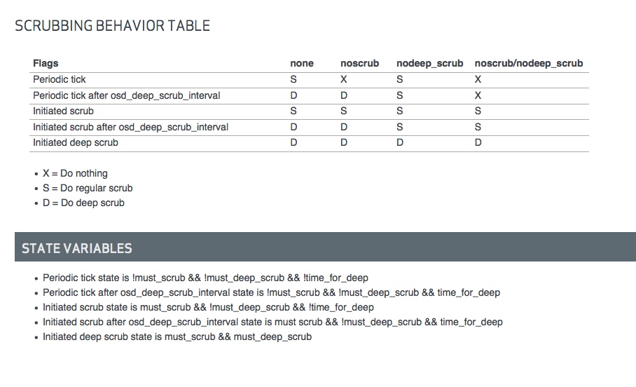
Dynamics of light / deep scrubs and Ceph flags

Slide 9
Procrastination FTW
We increase the interval from 1 week to 4
osd_deep_scrub_interval = 2419200
osd_scrub_max_interval = 2419200
With fewer scrubs per day, we accrue less backlog during maintenance; downside is we don’t check data as often
This is common practice among Ceph operators as the defaults are recognized as too aggressive
It mitigates the symptoms but not the fundamental problem of scrub scheduling
Ceph now lets us partially limit scrubs to certain times of day or times when the load average is low, but this has little value
Ceph recently added osd_scrub_interval_randomize_ratio which bears investigation

Slide 10
Scrubs tend to be clumpy
root@mel-1-csx-ceph1-001:~# for date in `ceph pg dump | grep active | awk '{print $20}'`; do date +%A -d $date; done | sort | uniq –c
dumped all in format plain
9640 Friday
5203 Monday
210 Saturday
36672 Sunday
33730 Thursday
94 Tuesday
14827 Wednesday
root@csi-a-ceph1-001:~# ceph pg dump | awk '$1 ~ /[0-9a-f]+\.[0-9a-f]+/ {print $22, $23, $1}' | sort | grep -c "2015-12-09"
dumped all in format plain
0
root@csi-a-ceph1-001:~# ceph pg dump | awk '$1 ~ /[0-9a-f]+\.[0-9a-f]+/ {print $22, $23, $1}' | sort | grep -c "2015-12-11"
dumped all in format plain
2112
root@csi-a-ceph1-001:~# ceph pg dump | awk '$1 ~ /[0-9a-f]+\.[0-9a-f]+/ {print $22, $23, $1}' | sort | grep -c "2015-12"
dumped all in format plain
23792
* The column numbers for awk vary between Dumpling and Firefly, perhaps Hammer too

Slide 11
Workaround / remediation
After eg. a week of scrubs disabled in us-internal-1, the backlog is too large to safely enable normal scrubbing
Starting with the least-recently-scrubbed PG’s, loop through issuing a new scrub every N seconds
N has to be large enough for this aggressive approach to not itself effect impactful parallelism, but small enough that we make headway
For a cluster with 60424 PG’s and a 28 day interval, we need to scrub 2158 PG’s per day just to break even
That’s 89 / hour, or one every 40 seconds on average
To erode backlog, we need to be more aggressive
Experience shows that one every 20 seconds is the limit in a 450OSD @ 70% full cluster: this results in parallelism of 8-11
Note that time to deep-scrub a given PG is a function of how full it is

Slide 12
#!/bin/bash
for i in $(ceph pg dump | awk '$1 ~ /[0-9a-f]+\.[0-9a-f]+/ {print $22, $23, $1}' | sort | awk '{print $3}’ ) ; do ceph pg deep-scrub $i ; sleep 20 ; done &
# nohup /root/bin/ceph-scrubs-firefly.sh
nohup: ignoring input and appending output to `nohup.out’
# tail –f nohup.out
instructing pg 7.312 on osd.52 to deep-scrub
instructing pg 15.6a1 on osd.92 to deep-scrub
instructing pg 7.38a on osd.92 to deep-scrub
# tail –f /var/log/ceph.log (or run ceph –w)
2015-12-14 20:48:38.355792 mon.0 [INF] pgmap v41136276: 60424 pgs: 60385 active+clean, 11 active+clean+scrubbing+deep; 305 TB data, 915 TB used
2016-01-21 23:01:53.386587 osd.285 10.203.17.40:6812/3871 874 : [INF] 3.3b88 deep-scrub ok
2016-01-21 23:02:29.398026 osd.240 10.203.17.34:6821/7257 984 : [INF] 4.1f55 deep-scrub ok
Limitations
Doesn’t adapt to the Ceph version running
As written only works for one pass through the cluster
Columns 22, 23 work for Firefly; for Hammer perhaps 23, 24

Slide 13
A better way
Centralized (gasp!) orchestration of scrubs
https://bugzilla.redhat.com/show_bug.cgi?id=1212988
Adaptively schedule light and deep scrubs across the entire cluster according to configured constraint(s), akin to the way the AMANDA planner balances full and incremental backups
Constrain to complete a cycle in a given timespan
N is constant or a function of the number of OSD’s, spindles, hosts, PG’s
Constrain to run at most / at least N light / deep scrubs in parallel
Constrain to use at most / at least N iops
Constrain to use at most / at least N KB/s
Enter HEALTH_WARN if constraints or other factors cause a cycle to not complete in the configured interval
Opportunity to us to implement and present at a conference?

Slide 14
References
http://ceph.com/planet/deep-scrub-distribution/
http://docs.ceph.com/docs/master/rados/configuration/osd-config-ref/
http://docs.ceph.com/docs/firefly/dev/osd_internals/scrub/
https://www.youtube.com/watch?v=MKGveB9kKdQ
https://www.youtube.com/watch?v=1RvE4eRglbM
http://www.enterprisestorageforum.com/storage-hardware/selecting-a-disk-drive-how-not-to-do-research-1.html
https://wiki.zmanda.com/index.php/Amanda_chapter_in_Backup_and_Recovery#Backup_scheduling
https://www.spinics.net/lists/ceph-devel/msg27293.html

