Slide 1
What is new in Mono? July 2013
miguel@gnome.org

Slide 2
Agenda
Today:
What is new in Mono-land.
Major Work-in-Progress Projects
Tomorrow:
Brainstorming session
Future of Mono and .NET

Slide 3
Mono 3.2

Slide 4
Mono 3.2
Core .NET 4.5 support
Base Class Libraries
C# 5
Available today:
Desktop
Server
Mobile
2.10.x is no longer supported

Slide 5
What is new in Mono 3.2
Vastly improved SGen GC
Now the default!
Micro-optimizations
Mobile-driven
Consume PCL binaries
Shipping OSS Microsoft frameworks
New Mono frameworks

Slide 6
SGen Garbage Collector
Our Precise, generational collector
Now the default for Mono
“mono” now runs mono –gc=sgen
libmono is Boehm
libmono-sgen is Sgen
Sgen is now faster on almost every workload
MonoDevelop/Xamarin Studio
Been using it as a default since February

Slide 7
What is new?
Major collectors:
Copy collector (old, reference code)
Mark and Sweep
Minor collectors:
Now with support for cementing
Help game developers love GC
dtrace probes

Slide 8
Mark and Sweep
Dynamic heap by default
Can specify fixed heap if desired
Allocates blocks of memory to bucket sizes
Think of the spirit to “slab” allocation
Support changes in workloads with evacuation
Concurrent Marking, Lazy Sweeping

Slide 9
Disabling Major Collector
New API on Mono.Runtime (mscorlib.dll)
if (!Mono.Runtime.SetGCAllowSynchronousMajor (false))
Console.WriteLine ("Sorry, the GC won't cooperate.");
// your low-latency code here
Mono.Runtime.SetGCAllowSynchronousMajor (true);
Exposed on Mobile.
Use System.Reflection to find it on desktop editions.

Slide 10
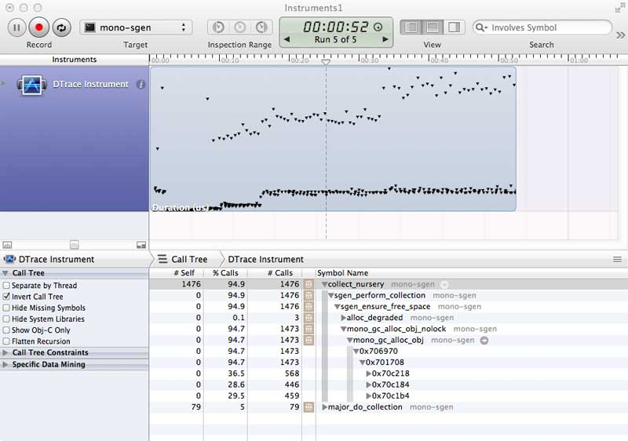
dtrace probes on MacOS
Major collections and minor collections pause times visualized
http://schani.wordpress.com/2012/11/02/sgen-and-dtrace/

Slide 11
Static Build Improvements

Slide 12
Static Compilation
For systems that don’t support JITing
Apple’s iOS devices
Consoles (PlayStation, Xbox)
Security: when not shipping IL
Limited generics support
Static analysis limitations
Some dynamisms in .NET idioms
LINQ and Value Types

Slide 13
“Attempting to JIT compile method”
System.ExecutionEngineException: Attempting to JIT compile method Foo[]:Bar`1

Slide 14
“Attempting to JIT compile method”
System.ExecutionEngineException: Attempting to JIT compile method Foo[]:Bar`1
FIXED

Slide 15
iOS Development Improvements
Improve development cycle
Incremental Builds
Disable linker (compile everything)
Cache resulting native code aggressively
Incremental Upload
Only uploads changes
Main executable, libraries or resources

Slide 16
Incremental Deployment (With Build Caching)
Deployment times can now be as short as one second.

Slide 17
Incremental Deployment (With Build Caching)
Deployment times can now be as short as one second.

Slide 18
Build Speed Improvements

Slide 19
Microsoft Open Source Code

Slide 20
Now Bundled with Mono
Reactive Extensions
Possible on iOS with new code gen changes
F# everywhere
Razor
Entity Framework
ASP.NET WebStack

Slide 21
MonoDevelop / Xamarin Studio
MonoDevelop
Xamarin Studio
Branding Add-In
Android
Mac
iOS
MonoDevelop Core
MonoDevelop Core
Open source
Commercial
Notes:
Performance, upstreamed contributions, stability, bug fixing, improved debugging

Slide 22
Cross Platform Frameworks

Slide 23
Cocos2D XNA
XNA port of the popular Cocos2D API
Over 4,000 games built with this API
Well documented, well known
MonoGame brings it everywhere
iOS, Android, Windows Phone (7 and 8)
Mac
Windows (GL, DX, , Windows Store)
Xbox360, Ouya
Play Station Mobile (PS Vita + Sony Androids)

Slide 24
Using Cocos2D XNA Today
Available as:
NuGet Packages
Templates for VS and Xamarin Studio
Source code:
http://github.com/mono/cocos2d-xna
Getting Started:
http://docs.xamarin.com/guides/cross-platform/cocos2d_xna

Slide 25
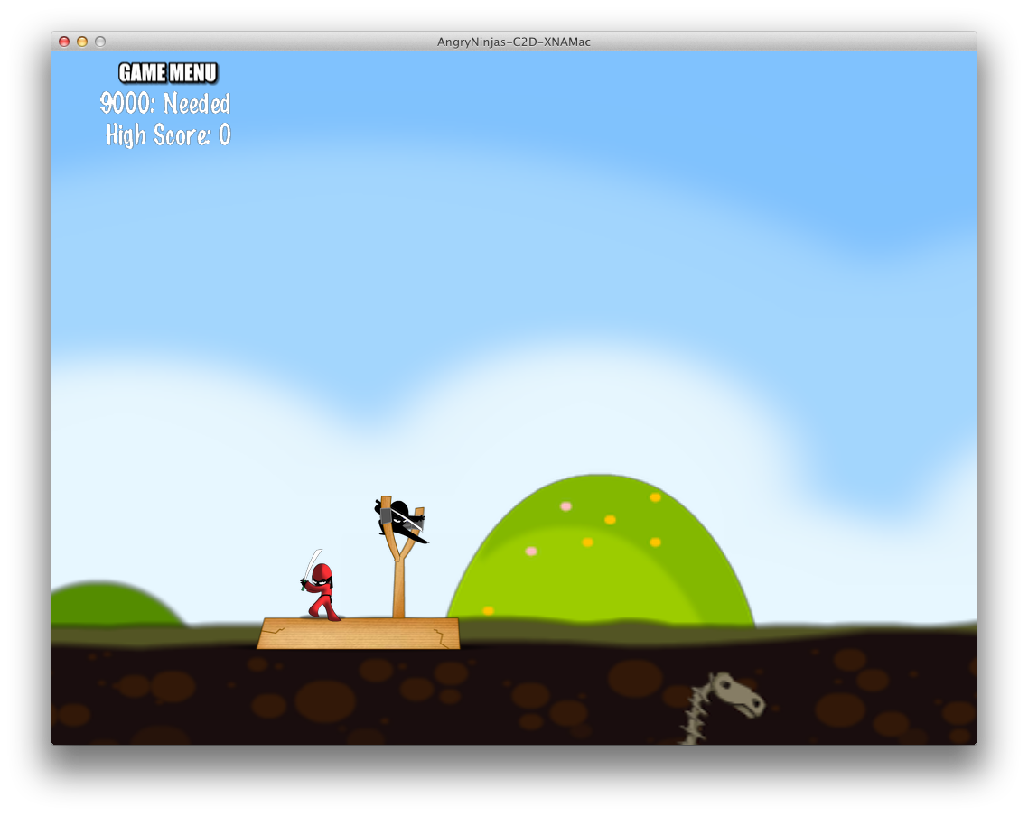
Angry Ninjas - Full Open Source Game
https://github.com/xamarin/AngryNinjas

Slide 26
Cocos2D Crash Course
Mike Bluestein’s talk tomorrow

Slide 27
Xamarin.Mobile
Base class library for mobile services
Mike Bluestein’s talk
Notes:
Geo location
Contacts
Camera

Slide 28
Xamarin.Auth
Clients for OAuth 1 and OAuth 2
Includes variations
Stores user credentials
Support non-standard auth schemes
Cross Platform

Slide 29
Xamarin.Auth
using Xamarin.Auth;
var auth = new OAuth2Authenticator (
clientId: "App ID from https://developers.facebook.com/apps",
scope: "",
authorizeUrl: new Uri ("https://m.facebook.com/dialog/oauth/"),
redirectUrl: new Uri ("http://www.facebook.com/connect/login_success.html"));
auth.Completed += (sender, eventArgs) => {
DismissViewController (true, null);
if (eventArgs.IsAuthenticated) {
// Use eventArgs.Account to do wonderful things
}
}
PresentViewController (auth.GetUI (), true, null);
// 1. Create the service

Slide 30
Xamarin.Social
Posts statuses, links, images/media to social networks
Access social network APIs using authenticated requests.
Automatically and securely store user credentials using Xamarin.Auth.
Cross Platform
Extensible, currently has support for:
App.net
Facebook
Flickr
Pinterest
Twitter

Slide 31
Using Xamarin.Social
var facebook = new FacebookService {
ClientId = MyFacebook_AppId
RedirectUrl = new System.Uri (MyRedirectUrl)
};
// 2. Create an item to share
var item = new Item { Text = "Xamarin.Social is the bomb" }; item.Links.Add (new Uri ("http://github.com/xamarin/xamarin.social"));
// 3. Present the UI on iOS
var shareController = facebook.GetShareUI (item, result => {
// result lets you know if the user shared the item or canceled
DismissViewController (true, null);
});
PresentViewController (shareController, true, null);

Slide 32
Now all Open Source
All frameworks:
Cocos2D XNA
http://github.com/mono/cocos2d-xna
Xamarin.Auth
http://github.com/xamarin/Xamarin.Auth
Xamarin.Mobile
http://github.com/xamarin/Xamarin.Mobile
Xamarin.Social
http://github.com/xamarin/Xamarin.Social
Taking patches!

Slide 33
Work in Progress

Slide 34
PlayScript

Slide 35
PlayScript
Started by Zynga
Xamarin working to integrate into Mono
Rescuing Flash Developers!
ActionScript look-alike language
Superset of ActionScript
With C# 5 features
Optional strongly-typed
Encouraged for performance

Slide 36
PlayScript Compiler
Dual Compiler
playsc foo.play
Compiles PlayScript to foo.exe
playsc bar.cs
Compiles C# to bar.exe
playsc foo.play bar.cs
Compiles PlayScript foo.play and C# bar.cs
Into foo.exe
Allows blending C# and PlayScript code in one assembly

Slide 37
PlayScript Compiler
Based on Mono’s C# compiler
Altered to accept PlayScript language
Side effects:
Compiler as a service support for PlayScript
Full Xamarin Studio integration
code completion
Docs
Project support

Slide 38
PlayScript Libraries
pscorlib
Provides core library for PlayScript/ActionScript
Flash Stage3D
GPU accelerated framework
Used by gaming frameworks

Slide 39
Ported Frameworks
Starling Framework
2D Game Engine
Powers Angry Birds
Away3D
3D Game Engine
Physics

Slide 40
PlayScript today
Compiles existing large ActionScript projects
Some missing language features
Actively working to improve language
Merging into Mono (playscript branch)
Everywhere Mono runs
On GitHub:
Project: http://github.com/playscript

Slide 41
C++ InteroP

Slide 42
Evolving Cxxi
Couple of years ago Cxxi project was launched
Used GCC-XML to parse C++ definitions
Runtime creation of C# to C++ bridges
Reflection.Emit
Pluggable VTable ABIs

Slide 43
CppSharp
New C++ binding technology from Mono
Produces C# libraries to consume C++ code
Use Clang for higher fidelity
Static compilation (to support iOS, Consoles)
Customize binding for .NET consistency
Direct calls to C++ (no intermediate glue)
Imports C++ Doxygen docs into C# docs
http://github.com/mono/CppSharp

Slide 44
Generating a binding
Foo.dll
libFoo.so
C++ Headers
C++ Source
Foo.cs
Final Library
Sources
C++ Headers
C# API Driver
Generated

Slide 45
public class Sample : ILibrary
{
public Sample(LanguageGeneratorKind kind) : base("Sample", kind) {}
public override void SetupPasses(Driver driver, PassBuilder passes)
{
passes.RenameDeclsUpperCase(RenameTargets.Any);
passes.FunctionToInstanceMethod();
}
public override void Preprocess(Driver driver, Library lib)
{
lib.SetClassAsValueType("Foo");
lib.SetNameOfFunction("FooAdd", "FooCalc");
lib.IgnoreClassField("Foo", "b");
}
static class Program
{
public static void Main(string[] args)
{
ConsoleDriver.Run(new Sample(LanguageGeneratorKind.CPlusPlusCLI));
ConsoleDriver.Run(new Sample(LanguageGeneratorKind.CSharp));
}
}

Slide 46
Native Interop
Notes:
Mono and .NET offer C and C++ bridges
Sometimes you just want to be a real man

Slide 47
Assembly in C#
Allow developers to inline assembly code
Micro-optimizations
Optimize a code path
Use arch-specific features
You can not get more native than that.

Slide 48
Assembly in C#
Allow developers to inline assembly code
Micro-optimizations
Optimize a code path
Use arch-specific features

Slide 49
Example
unsafe int Clear (IntPtr buffer, int count)
{
asm.BindIntPtr (0, buffer);
asm.BindInt (1, count);
asm.Emitx86 (@”
push %ecx
push %edi
mov %eax,%edi
mov %ebx,%ecx
xor %eax,%eax
rep stosb
mov $1,%eax
pop %edi
pop %ecx
”);
return asm.FetchInt (0);
}

Slide 50
In case there are any doubts
unsafe int Clear (IntPtr buffer, int count)
{
asm.BindIntPtr (0, buffer);
asm.BindInt (1, count);
asm.Emitx86 (@”
push %ecx
push %edi
mov %eax,%edi
mov %ebx,%ecx
xor %eax,%eax
rep stosb
mov $1,%eax
pop %edi
pop %ecx
”);
return asm.FetchInt (0);
}

Slide 51
Example
unsafe int Clear (IntPtr buffer, int count)
{
asm.BindIntPtr (0, buffer);
asm.BindInt (1, count);
asm.Emitx86 (@”
push %ecx
push %edi
mov %eax,%edi
mov %ebx,%ecx
xor %eax,%eax
rep stosb
mov $1,%eax
”);
return asm.FetchInt (0);
}
Bind Parameters
Let Mono know which parameters you will pass

Slide 52
Example
unsafe int Clear (IntPtr buffer, int count)
{
asm.BindIntPtr (0, buffer);
asm.BindInt (1, count);
asm.Emitx86 (@”
push %ecx
push %edi
mov %eax,%edi
mov %ebx,%ecx
xor %eax,%eax
rep stosb
mov $1,%eax
”);
return asm.FetchInt (0);
}
Bind Parameters
Let Mono know which parameters you will pass
Assembly code as a string
Assembled by LLVM
Mono JIT Calling conventions

Slide 53
Example
unsafe int Clear (IntPtr buffer, int count)
{
asm.BindIntPtr (0, buffer);
asm.BindInt (1, count);
asm.Emitx86 (@”
push %ecx
push %edi
mov %eax,%edi
mov %ebx,%ecx
xor %eax,%eax
rep stosb
mov $1,%eax
”);
return asm.FetchInt (0);
}
Bind Parameters
Let Mono know which parameters you will pass
Assembly code as a string
Assembled by LLVM
Mono JIT Calling conventions
Fetch result value

Slide 54
Example
unsafe int Clear (IntPtr buffer, int count)
{
asm.BindIntPtr (0, buffer);
asm.BindInt (1, count);
asm.Emitx86 (@”
push %ecx
push %edi
mov %eax,%edi
mov %ebx,%ecx
xor %eax,%eax
rep stosb
mov $1,%eax
”);
return asm.FetchInt (0);
}
Bind Parameters
Let Mono know which parameters you will pass
Assembly code as a string
Assembled by LLVM
Mono JIT Calling conventions
Fetch result value

Slide 55
Passing parameters, extracting
Input parameters:
asm.BindXXX (int incomingParameter, XXX value);
Emit assembly code:
asm.Emit (string code)
Assembled with LLVM assembler
Injected into resulting assembly
Follow Mono native rules for preserving register usage
Output parameters:
asm.FetchXXX (int resultParamter)

Slide 56
How it works
Platform.Native.dll
Contains stub methods
Allows same source to build on .NET and Mono
Follow our previous efforts:
Like SIMD
On Mono, the runtime recognizes some calls

Slide 57
EmitXxx ignored for other platforms
// Highly optimized native way of getting a native one!
unsafe int GetOneConstant ()
{
asm.Emitx86 (“mov $1,%eax”);
asm.EmitArm (“mov r0,#1”);
asm.Emitx64 (“mov $1,%rax”);
return asm.FetchInt (0);
}
For more complex code, use asm.Arch:
unsafe int GetOneConstant ()
{
if (asm.Arch == Arch.x86) {
asm.Emitx86 (“mov $1,%eax”);
return asm.FetchInt (0);
} else
return 1;
}

Slide 58
What is Next?

Slide 59
Future for Mono
Community feedback on features needed
Brainstorming session tomorrow!
Where should Mono and .NET go?
Bring your favorite feature request

