Slide 1
MERIT beam spot from optics
(update of July 16,2008 talk)
I.Efthymiopoulos – CERN, AB Dept.
MERIT, VRVS Meeting
September 25, 2008

Slide 2
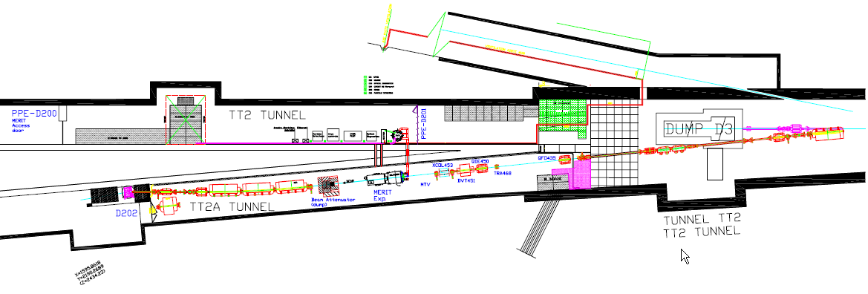
MERIT Elements – Layout
QDE.430s (de-focusing) quads
3 elements in series
QFO.415s (focusing) quads
3 elements in series

Slide 3
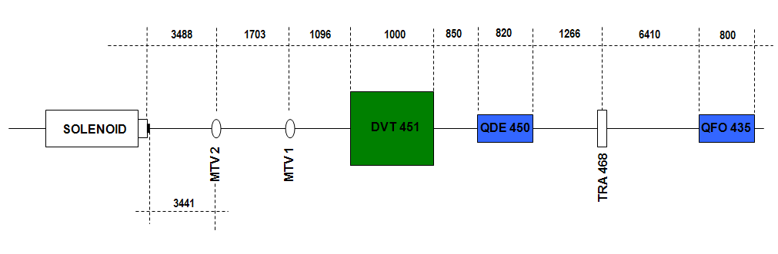
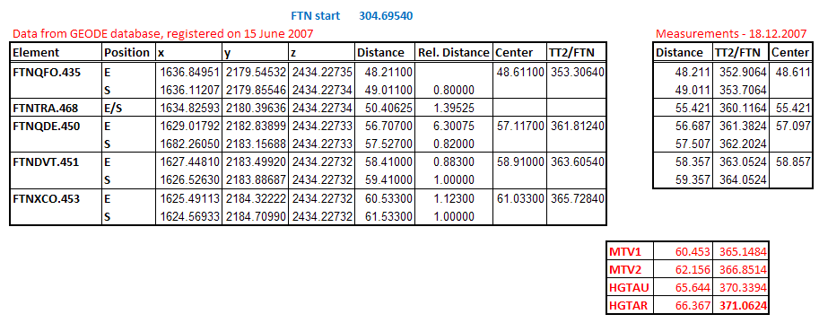
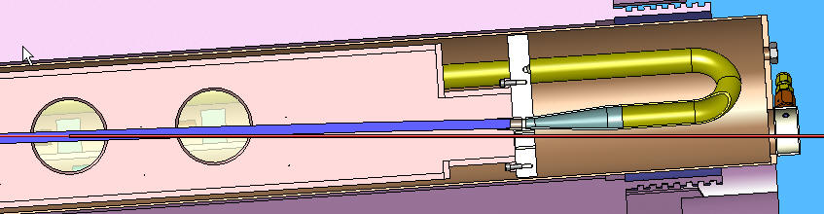
Survey data after the MERIT run – 18.12.2007
Upstream face: -72.3cm

Slide 4
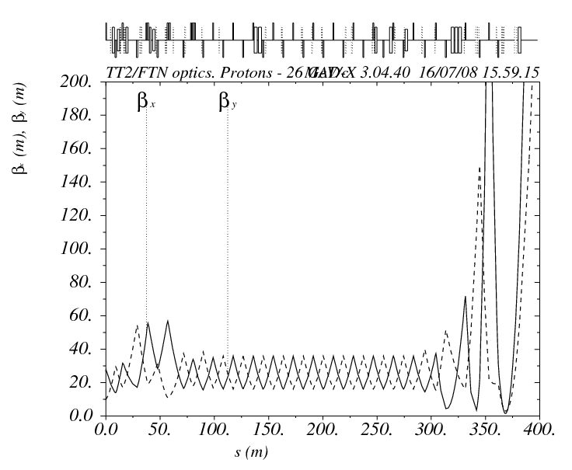
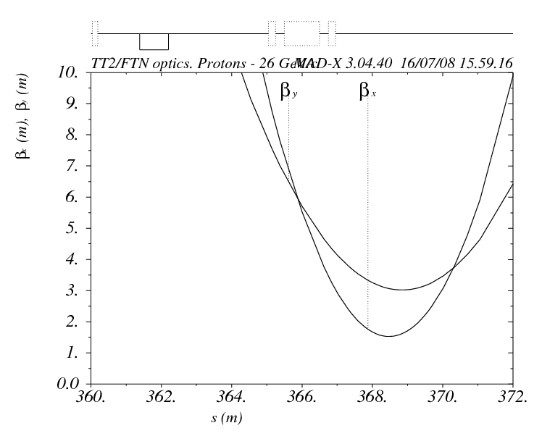
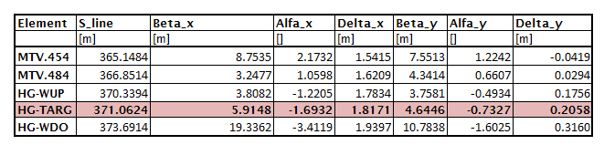
Beam optics
Fit parameters: QFO, QDO strengths and locations (within limits)

Slide 5
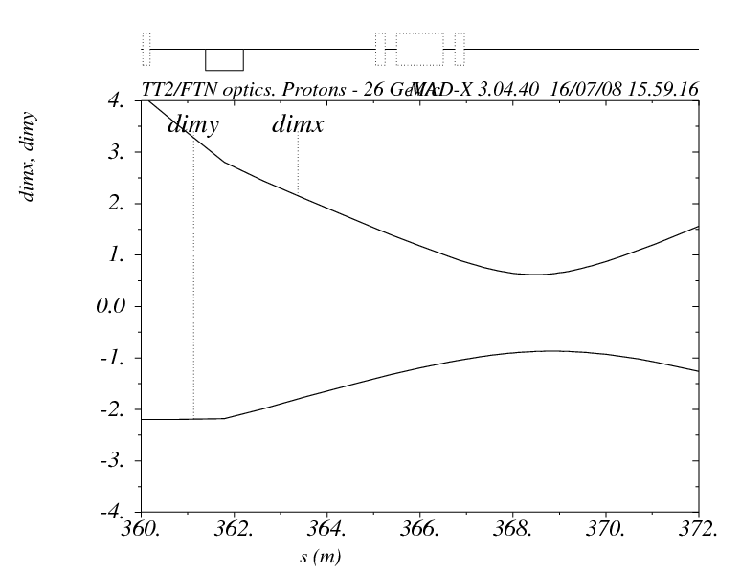
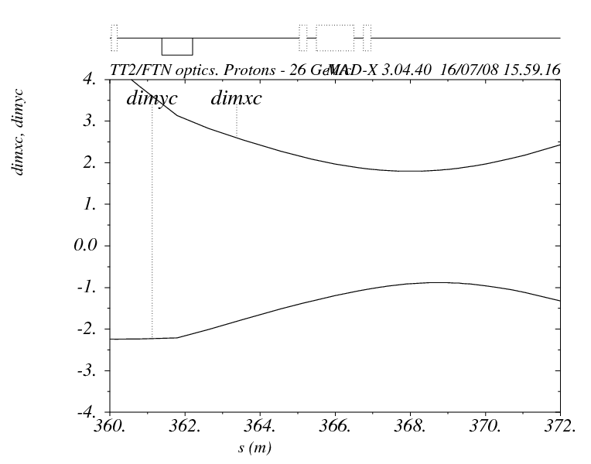
Beam envelope (1-sigma) - ε=0.25 (mm.mrad), Dp=0.1%
Without dispersion term
  σ(x) = 1.2mm , σ(y) = 1.1 mm
  238 J/gr @ 30TP
With dispersion term
  σ(x) = 2.2mm , σ(y) = 1.1 mm
  130 J/gr @ 30TP

Slide 6
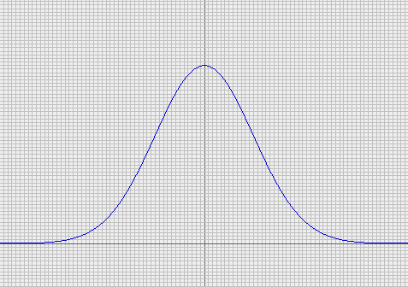
Reminder – Beam Emittance
For proton machines, the emittance is measured by measuring the beam profile in a position of known beam parameters (optics)
  The convention is to use TWO sigma value
Geometrical emittance:
Normalized emittance:
σ
P [GeV/c] | (βγ)
14.0 | 14.92
24.0 | 25.58
2 σ
Emittance
(87% of beam)
Including dispersion
What is measured in the machine:

Slide 7
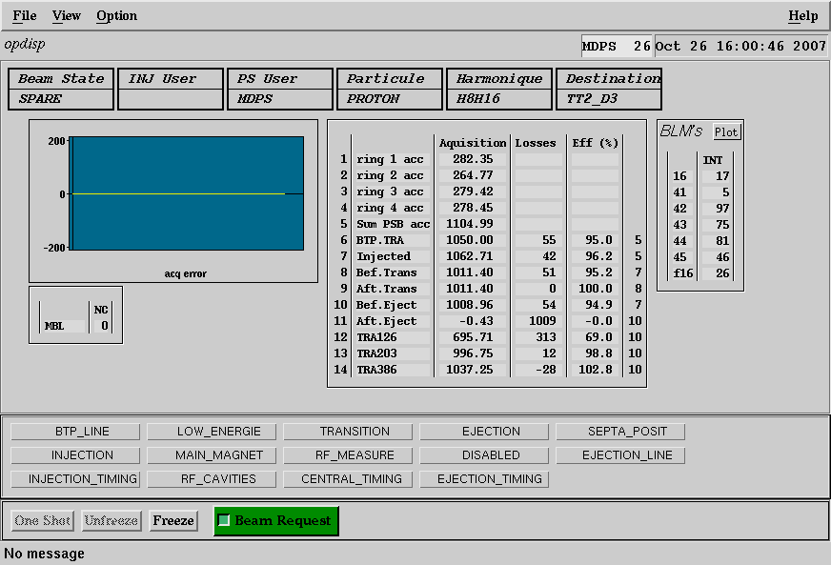
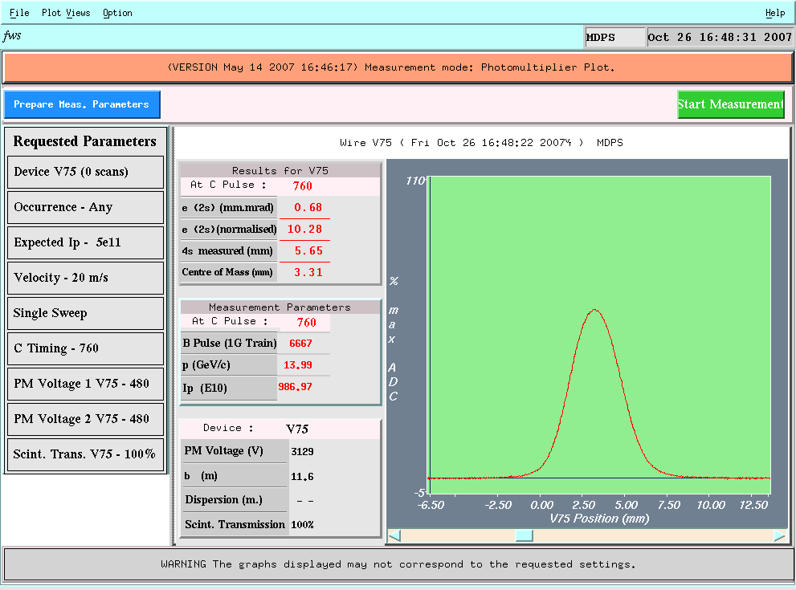
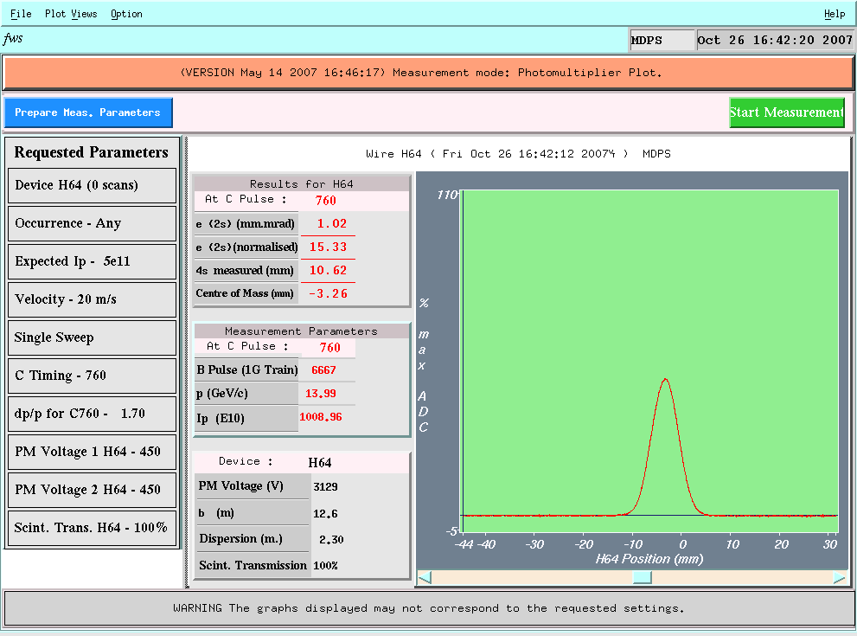
Beam Emittance measurement – 14 GeV/c
Friday 26.10@15:55
Beam intensity:
h16, 1E13

Slide 8
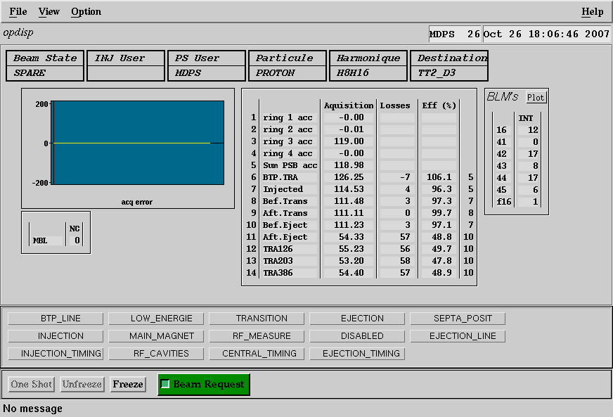
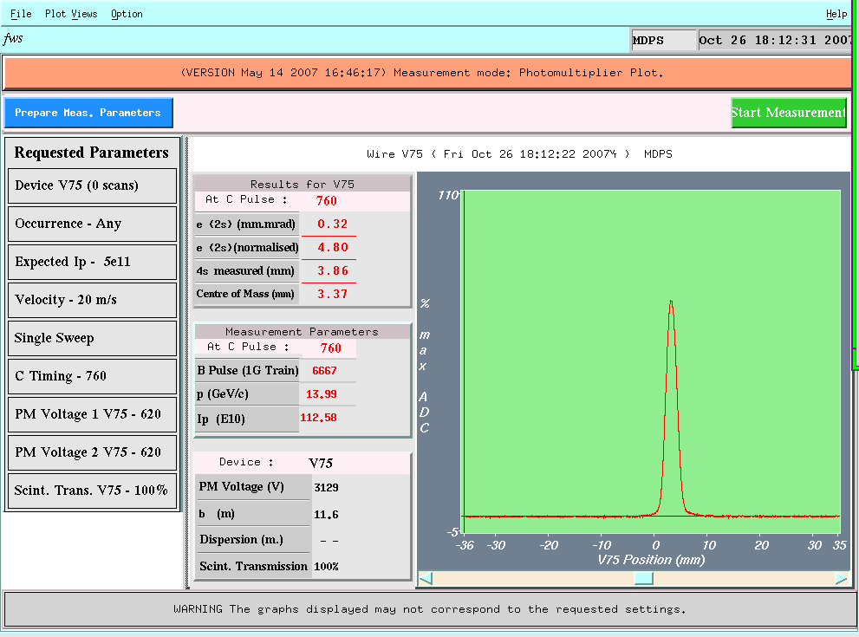
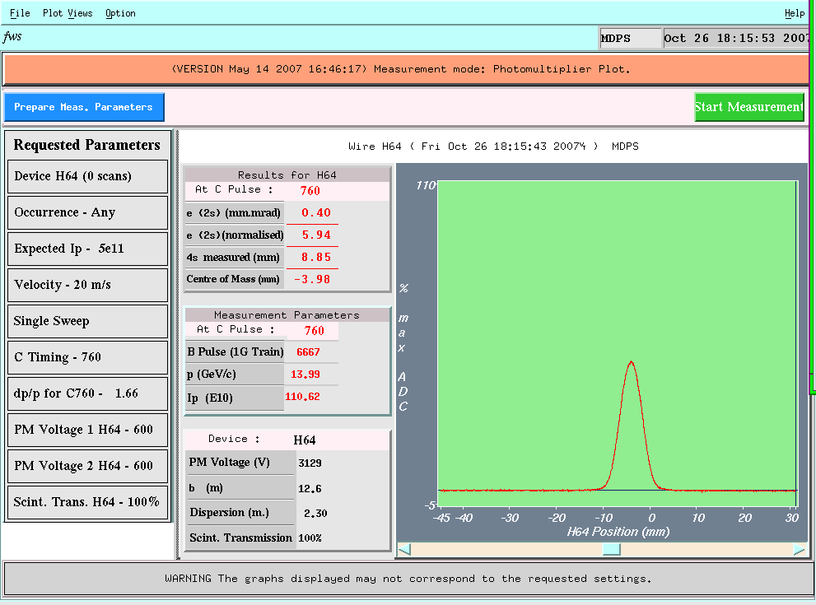
Beam Emittance measurement – 14 GeV/c
Friday 26.10@17:37
Beam intensity:
2.5E11/bunch
2 extracted bunches,
DT=1.7us

Slide 9
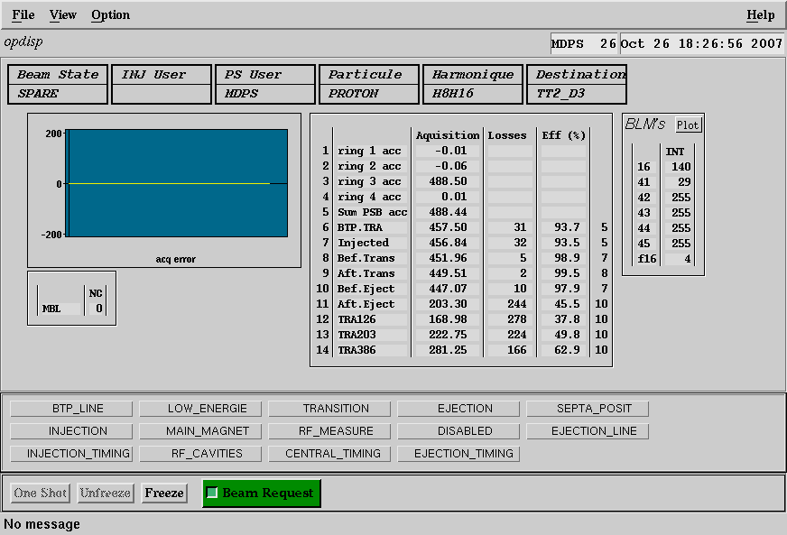

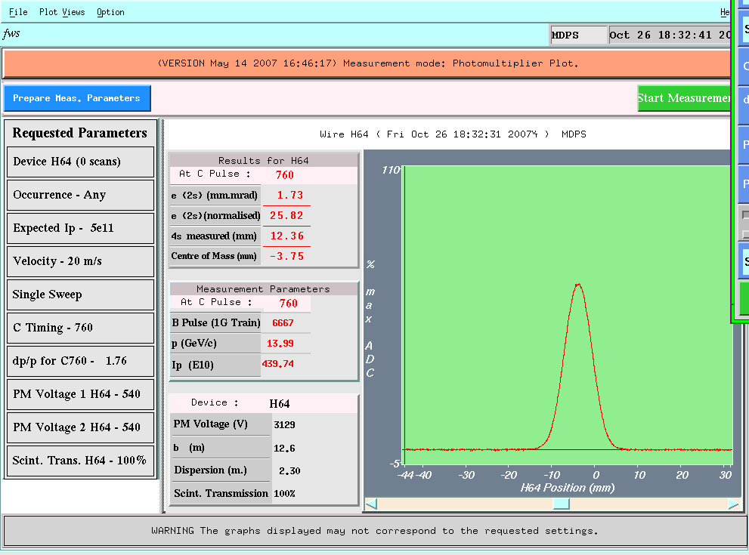
Beam Emittance measurement – 14 GeV/c
Friday 26.10@18:24
Beam intensity:
1.3E12/bunch
2 extracted bunches,
DT=1.7us

Slide 10
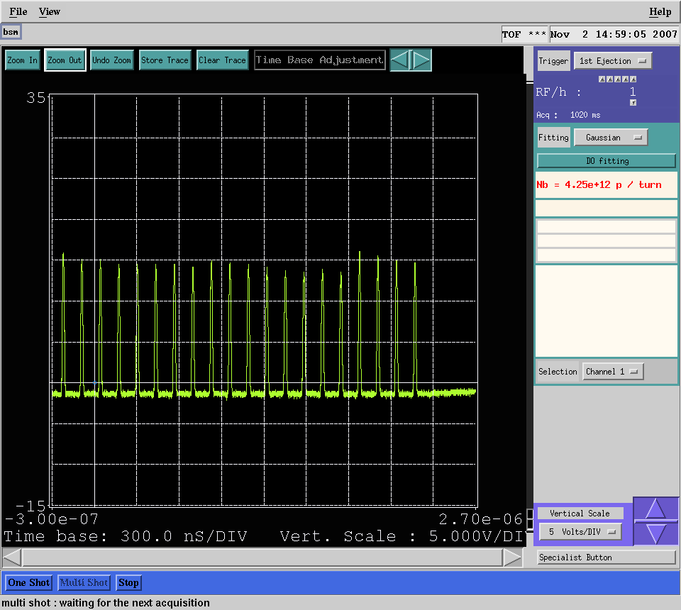
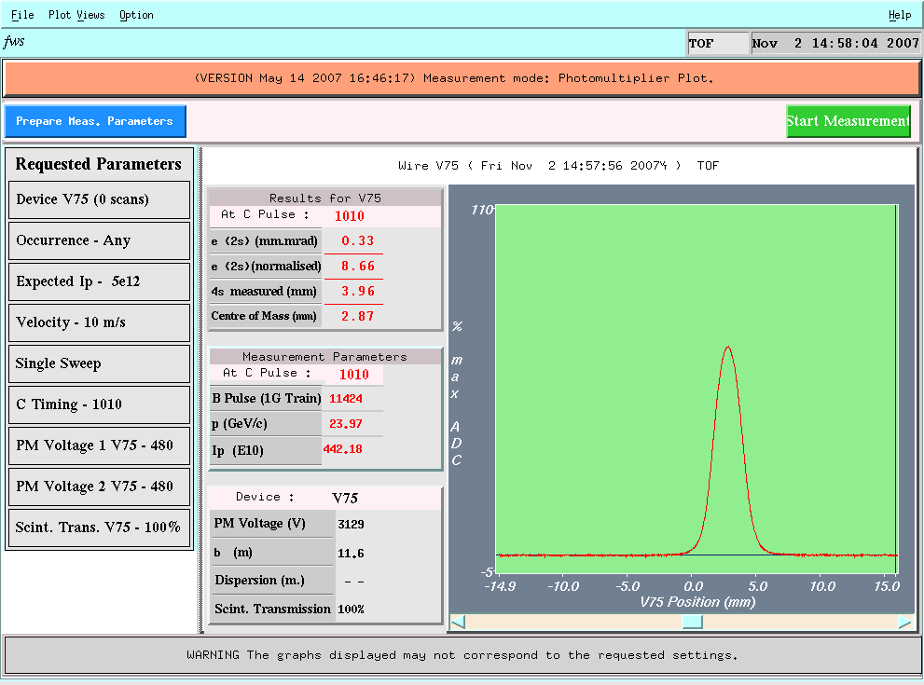
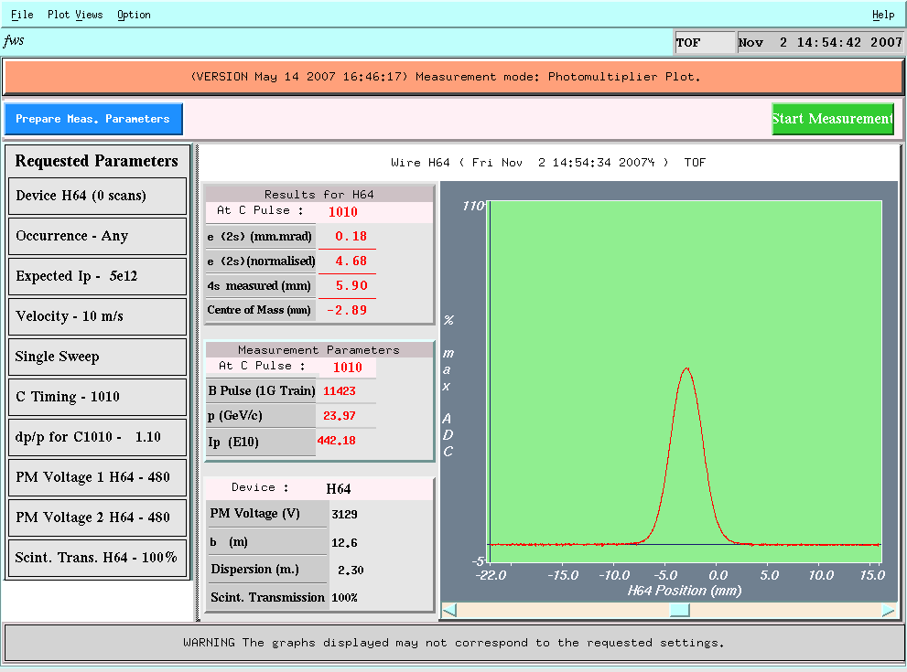
Beam Emittance measurement – 24 GeV/c
Friday 02.11@14:55PM
Beam intensity:
2.5E11/bunch
16 bunches

Slide 11
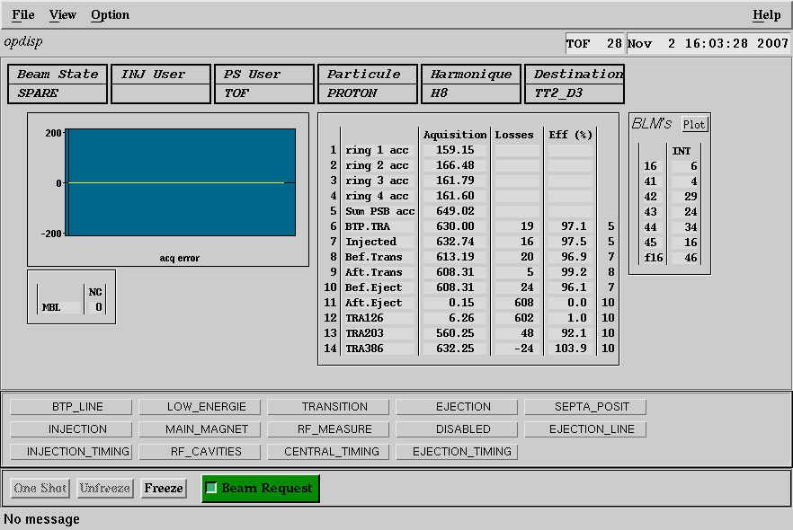
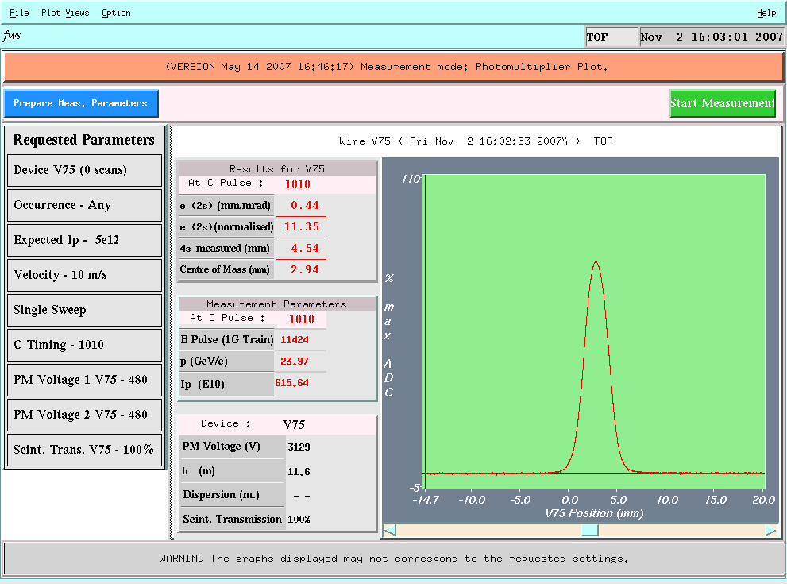

Beam Emittance measurement – 24 GeV/c
Friday 02.11@16:02PM
Beam intensity:
16 bunches,
6E12 protons

Slide 12
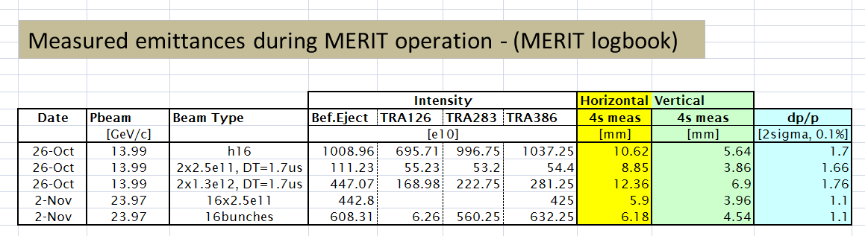
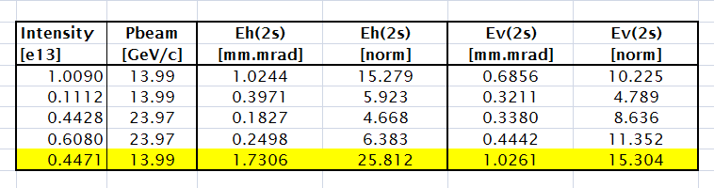
Beam Emittance measurement
Summary of measured data
Using the formulas of slide #6
  in good agreement with the online calculations

Slide 13
Emittance extrapolation

Slide 14
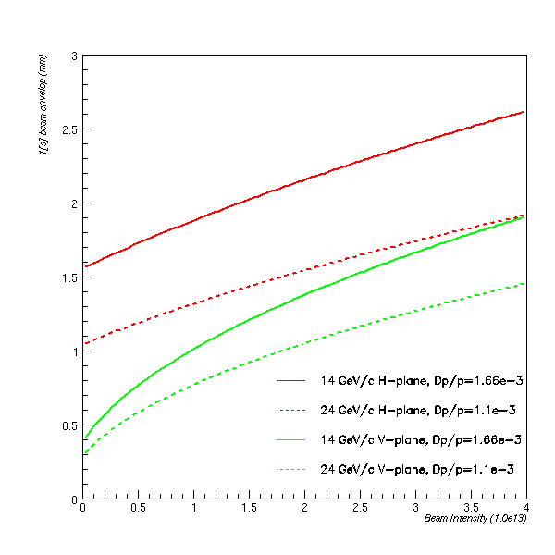
Estimated beam spot and density
Use the extrapolated emittances to estimate the beam spot and energy density at target

