Slide 1



Startups and Software Testing
http://www.testingtimes.ie
Notes:
Freelancer/ pause for effect, it’s a show.

Slide 2

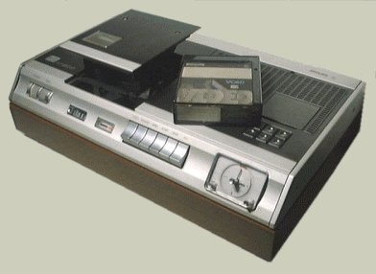
Analysis + Technology = Destiny
Notes:
Have you ever wondered what it was to get you into software testing?
Not just, It was the first job I got in a recession,
But what skills appealed to the job interviewer to take you on?
Looking back, I’ve been able to identify some inborn skills….

Slide 3

Why Startups
Big Impact
Passion
Challenge
Notes:
This is not a full time job….needs to be supplmented
Sunday Times Rich List
Example of Big Impact – MouseMonitor
Success
Very Satisfying

Slide 4
Getting the Work
Notes:
First job, network.
Repeat customers, or customers forwarding on recommendations.

Slide 5
Types of Testing
Work Breakdown

Slide 6
Types of Applications
Applications Tested

