Slide 1
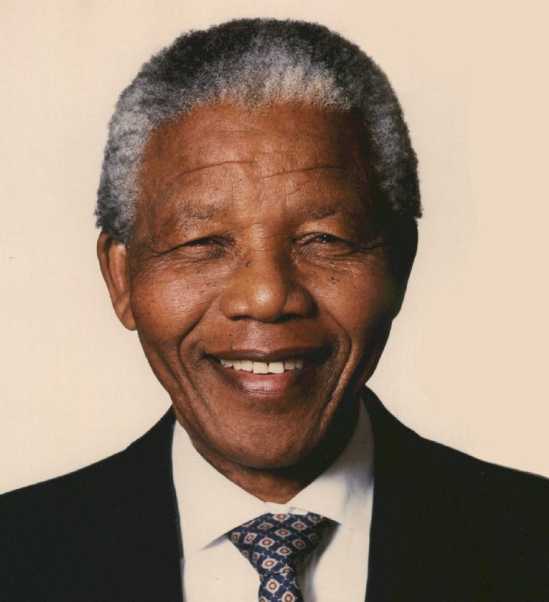
Nelson Mandela
By: Matt Perry, John Kineavy, Guillaume Viguier-Just, Jae a McAuley

Slide 2
Outline
Setting
Education
Supporters and enemies
Vision-based leadership

Slide 3
Motivation
Democratic South Africa
Anti-apartheid activist (desegregation)

Slide 4
Memorable Quote
“During my lifetime I have dedicated myself to the struggle of the African people. I have fought against white domination, and I have fought against black domination. I have cherished the ideal of a democratic and free society in which all persons live together in harmony and with equal opportunities. It is an ideal which I hope to live for and to achieve. But if needs be, it is an ideal for which I am prepared to die”

Slide 5
Influence
People of South Africa
Established first multi-racial election, which lead him to become the first African-American President of South Africa

Slide 6
Strengths
Persuasive, influential speaker
Attempting to establish equality amongst a segregated South Africa

Slide 7
Outline
Setting
Education
Supporters and enemies
Vision-based leadership

Slide 8
Outline
Setting
Education
Supporters and enemies
Vision-based leadership

Slide 9
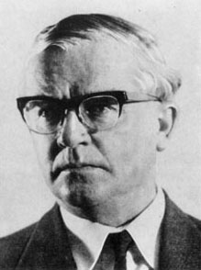
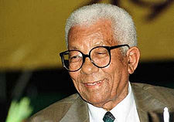
Supporters Continued
Bram Fischer - one of his main defenders during the Rivonia trial
Walter Sisulu – joined ANC and supported both Nelson and Oliver Tambo

Slide 10
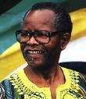
Supporters
Oliver Tambo: his main friend, and led the ANC while Mandela was in prison
Winnie: his wife, still stayed with Nelson despite him being in prison

Slide 12
Supporters
Frederik Willem de Klerk – Ended racial segregation in government and freed Mandela

Slide 13
Enemies
U.S. government – Helped arrest Mandela
P.W. Botha – South African president who wanted Mandela to turn in order to win his freedom
National Party – Old South African party that inprisoned Mandela

Slide 14
Outline
Setting
Education
Supporters and enemies
Vision-based leadership

Slide 15
Vision-based Leadership
Nelson Mandela: his vision and his communication
Vision-based Leadership explained
Advantages and drawbacks of vision-based leadership

Slide 16
Mandela's vision
Mandela's vision was about a:
Multi-racial society
Based on equality between all citizens
Mandela's vision brought:
New positive expectations for many people

Slide 17
Mandela's communication
Political speeches
Trials: Rivona trial
Sabotage: recognized acts of sabotage against the Apartheid regime
Plans for guerilla war in case sabotage was not enough
Became a symbol of his vision

Slide 18
Vision-based Leadership
Leadership is based on which vision a leader chooses and how he communicates it.

Slide 19
What the vision must be...
Must bring positive changes
Must be based on values (happiness, justice, human dignity etc...)
Must unite people and not divide them
The leader must have trust in this vision

Slide 20
How the vision must be conveyed...
Must be spoken: "non-verbal communication accounts for 93 % of the communication process" (UCLA study)
Must be communicated through speeches and actions
Must have a symbol
Must remain clear

Slide 21
Advantages of vision-based leadership
Not based on the leader but on the vision:
Everyone can be a leader
Leadership can be learned
Leadership brings positive change

Slide 22
Drawbacks of vision-based leadership
Simplistic view of leadership:
Does not take into account the settings and the followers

Slide 23
Conclusion

