Slide 1
Scott Jameson for U.S. Senate
Libertarian Party Candidate

Slide 2
The State of the Union - Health
Medicare and Medicaid are going bankrupt by 2012 (GAO forecast)
45 million Americans do not have Health Insurance
500 Billion has been paid into the Social Security Earnings Suspense Fund, then rolled into general revenue instead of being used to pay benefits

Slide 3
The State of the Union - Budget
8.5 Trillion National Debt
Trillions owed to China and other foreign powers, this is the greatest national security risk and potential for loss of sovereignty
Tax policy alone will not balance the budget nor bring it to the surplus needed to pay off the National Debt

Slide 4
State of the Union - War
Active combat in Iraq and Afghanistan
Emerging nuclear states
Military bases in 150 nations
U.N. unable to successfully use old tricks, such as trade embargos to enforce world policies

Slide 5
The Current Federal Budget – Income

Slide 6
Proposed Federal Budget – Income under Libertarian transition

Slide 7
The Current Federal Budget - Expenses

Slide 8
Proposed Federal Budget – Expenses under Libertarian transition

Slide 9
Current and Forecast Federal Deficits, National Debt, & Interest under Republican Rule

Slide 10
Proposed Federal Deficit and National Debt and Interest under Libertarian transition

Slide 11
Scott Jameson for U.S. Senate
Debate Highlights

Slide 12
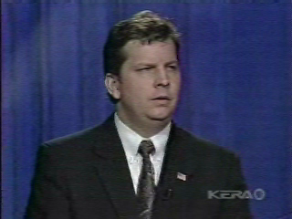
War in Iraq
Debate clip
Kay Bailey Hutchison apologized for voting to start the war in Iraq
Initial “shock and awe” military response was strategically way over the top
We need to review why we are there, separate war spending out from other appropriations, and develop a specific list of goals and objectives for the war

Slide 13
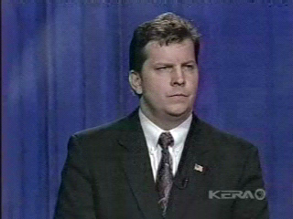
Retirement Financial Planning
Debate clip
Your Money matters
Federal government will give Texas worker with $40,000 income $1,044 a month at a retirement age of 67
Or you could invest the amount you pay in FICA taxes (SS) at 4.8% and retire on $6,600 a month

Slide 14
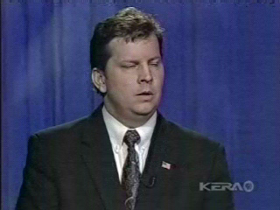
Election Reform
Debate Clip
The Texas Secretary of State must comply with the Help America Vote Act (HAVA) of 2002
Because of their lack of information about the Libertarian Party, many voters feel politically disenfranchised
Everyone besides the rich needs a financial incentive to contribute to political campaigns; I am proposing a $2,000 per taxpayer direct tax credit for political contributions

Slide 15
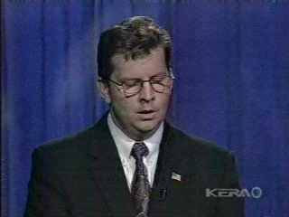
Universal Mandatory Health Care
Debate Clip
Legislative initiatives
Pass Small Business Health Plan law to allow for collective bargaining for 80% of working Americans and their dependents, this will lower the costs for everyone who currently has insurance
Long-term goal is to have a universal risk pool, with all 300 million Americans covered by the insurance company of their choice, this will lower the cost for everyone
Need standard definition of poverty to equalize usage of county hospitals across Texas
Socialized medicine will never work in this country

Slide 16
Libertarian Party Platform
Fiscally Conservative
Socially Tolerant
Constitutionally-limited federal government
Strong common defense
What does this mean?
Are you a Libertarian?

Slide 17
Republican vs. Libertarian
Republicans
Libertarians
Support minimal tax reform in attempt to appease middle class
Support building a wall to divide the north American Continent
Support dramatic tax reform to increase the wealth of all classes
Believe we need to support legal immigration with good laws and policies, not physical barriers

Slide 18
Democrat vs. Libertarian
Democrats
Libertarian
Think higher taxes will balance the federal budget and fund Social Security, Medicare and Medicaid
Government should directly financially administer health care programs, and decide on allowable treatments
Individuals are the best at making financial decisions about discretionary spending, retirement planning, and health care coverage and treatment decisions

Slide 19
Media
Commercials

Slide 20
Voter Guides
Grand Prairie Chamber of Commerce
CBS 11 News (KTVT Dallas)
Grand Prairie Chamber of Commerce
Pflugerville Pflag
Questions for Candidates
Sierra Club
For our Grandchildren
Merchants Payments Coalition
Parents Action for Children Questionnaire
Project Vote Smart National Political Awareness Test
NFIB
On TheIssues.org
Your Candidates. Your Health
Free Market Foundation
Literacy Coalition of Central Texas
Texas Alliance for Life Voters Guide
Federal Voting Assistance Program, DoD,
call 800-438-8683
Organic Consumers Fund
League of Women Voters of Texas, Voters Guide
Faith United Against Tobacco, support of S. 666
CAMR Letter
Americans for the Arts Action Fund PAC

Slide 21
Scott Jameson for U.S. Senate - Candidate Biography
Realtor with Keller Williams
Member National Association of Independent Business
Entrepreneur, Corporate and University management experience
MBA from U.T. Arlington
MS from U.T. Dallas
BBA in Finance and Economics from Baylor University
40 years old, married 12 years, one daughter

Slide 22
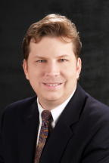
Scott Jameson for U.S. Senate
Contribute Now!
How to contribute to the campaign

