Slide 1

The Green IT
Frank Koch (Bern)
IT Architect
Microsoft Switzerland
Notes:
Green IT is a hype nowadays (summer / fall 2007). Some companies wants to show their “greenness” against their customers, while others simply want to save money. Both reasons are fine and will be addressed in this presentation.
It is important to know that Microsoft does neither offer the silver bullet right now nor in the near term future. Nevertheless we are in a unique position with our large percentage of installed systems (desktops AND servers) that we should spread the message: we are working on this topic with our partners, regardless if you want to save money or do something positive for our environment. And we have many offers to help you in all kind of areas as you will see in this presentation.

Slide 2

Agenda
Why does “Green IT” matter?
Tips for the Green Datacenter
Tips for the Green Server
Tips for the Green Desktop
Summary or lessons learned
Notes:
Depending on your interests, you might want to focus on all or just some of these topics. While we will focus on energy at the beginning, you will get additional ideas to reduce the carbon footprint in the client part.

Slide 3
Why does Green IT matter?

Slide 4





Are you switching off the lights at home?
KWh / year Costs
100 W bulb, 24h by 365 days: 876 KWh 100%
Only use from 18.00 till 24.00: 219 KWh 25%
Use energy saving bulbs (20W): 44 KWh 5%
Cost reduction (20 Rp per KWh):
Save 131,40 (166,40) CHF/ year / light bulb
Notes:
Most people save energy at home already, some for years, some started just recently. Saving energy means saving costs, too. This is becoming more and more important with increase energy costs worldwide, though Asia & Europe might see higher costs already compares with America. But nearly all people will agree that smart usage of energy is common sense today. Overall, you can reduce the saving options to 2 simple points:
Avoid energy usage (costs) whenever possible: Switch off the lights if you don’t need them. This is the easiest and most efficient way to achieve savings!
After that, you can switch to new, more efficient technology like energy saving lights or LED technology. This will add some more savings but requires some initial investments, too.
The amount you can save is noticeable for most people: one smart used light bulb saves you one dinner with your spouse per year.
Switching to a new technology will pay for itself in one year, but requires an upfront investment from you.
In IT terms: the ROI is there, but without a budget, ROI means nothing.
Regarding the calculation:
modify it to your local currency and change it to the local “kilowatt per hour” price from your regional energy supplier.
($ per KWh) x (876 – [219 or 44]) = the money you save

Slide 5

Why energy does matter (not only) in IT
Do you know what your IT energy costs are?
  Gartner: about 4% – 7% of your IT budget!
Do you think energy costs will rise or decline in the future?
  Germany: +36,6% prize increase in last 6 years
  Costs maybe double over the next 5 years?
For every $ spent on servers,
add the same for cooling and power
during lifetime!
Is “energy” a purchase criteria for your IT?
It might be for your car… but IT?
Average hardware prize vs. energy costs over 3 years
Gartner: Why “Going Green” will become essential for data centers 10/2006
Notes:
(move the discussion now over to IT):
Energy does matter, not only in IT. The reason is the associated cost with the energy needs. There are direct costs and indirect costs related to energy. We will focus on direct costs first: the energy costs needed to run the current IT environment.
Ask if the customer already measure their energy needs and have the costs in their IT budget. Nearly no IT person will be able to answer the energy cost question, as most often energy costs are within the facility group of the customers. This fact often prevents saving efforts: what cannot be measured cannot be optimized. And whom should you reward for saving efforts if the savings cannot be related to someone?
Ask your customer what they would do if they would need to cover the additional 7% in their IT budget. Ask what 7% actually would be in real currency to make the picture more realistic! Ask if they would THEN start thinking about new purchase criteria: energy consumption of IT components!
[regarding the 7%]:
The direct costs of IT can be estimated quickly: assume 3,500KWh energy needs per server per year (multiply by number of servers) and 700KWh per client (multiply by number of clients). For a midsize company (30 servers, 500 PCs), this is around 455,000 KWh a year. At 0,2 CHF per KWh, this is around 91,000 CHF per year. This estimation does not include cooling, network, storage, printers, datacenter etc. so this is the minimum prize you would pay for the energy needs. For most midsize customers, this amount (91,000 CHF) is more than 7% of the budget (which would be 1,3 Mio CHF)
(click)
Show the example of Germany: the energy market was opened 6 years ago. During this new “open market” time, the costs have increased over 36%, although the competition between the energy suppliers was now possible. And with the increasing energy needs worldwide, it is more than likely that the energy costs will raise again. Some analysts thinks it will even double in the next 5 years. Would your customer love to see the raising energy costs on their IT p&l?
[indirect costs of energy]
So far we only spoke about the direct costs. But unfortunately, you cannot just consume more and more energy according to your energy needs. There is an upper limit, defined per regional energy supplier. You cannot put unlimited energy through a dedicated power line, or even produce this unlimited energy. And the end, this could mean in best case you have to purchase a new power line to your buildings / datacenters, or in worst case you have to move to a new location offering the required energy. Who will cover these indirect costs?
(click)
Most people will be surprised to hear that there are huge difference for servers in the energy needs and efficiency. Regarding the calculation:
the average 1u (pizza box) server consumes 400W per hour: 400w x 24 x 365 = 3505 KWh / year
Energy costs with (0,2 Rp per KWh): 700 CHF or over 3 years: 2,100 CHF
This is close to the server cost: A HP Proliant DL 145 is about 1600 CHF, a DL 360 is about 2600 CHF.
Now power consumption of the server is normally only 30% of the overall energy costs in a datacenter, so the running costs might be up to 6,000 CHF for 3 years. This might be higher than your acquisition costs! So if you purchase a model which is 10% more efficient in energy, it could cost even more than 10% more than the inefficient server as energy costs are similar or even higher than acquisition costs.

Slide 6

IDC: More and more money goes to power & cooling instead to new servers
Spending
(US$B)
Installed Base
(M Units)
$120
50
New Server Spending
45
$100
40
Power and Cooling
$80
35
30
$60
25
20
$40
15
$20
10
5
$0
0
1996
1997
1998
1999
2000
2001
2002
2003
2004
2005
2006
2007
2008
2009
2010
IDC: The Impact of Power and Cooling on Data Center Infrastructure, 2006
Notes:
This IDC slide from 2006 shows where the IT budget is moving to: More and more money is spent on power and cooling year over year; while the amount for new server stays nearly flat. So each year, the operating costs will be a bigger part of the IT budget. And with increasing energy costs, this ratio will change again in the future.

Slide 7
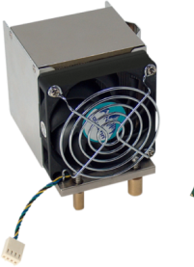
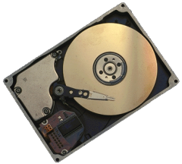
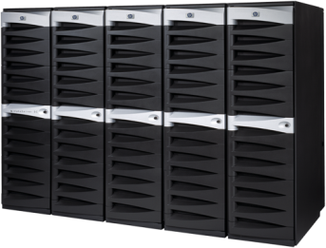
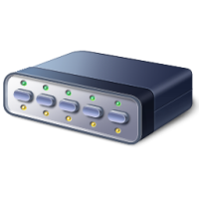

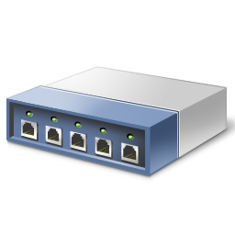
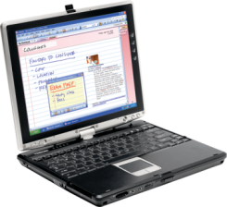
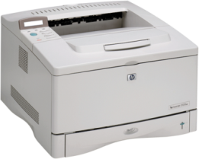
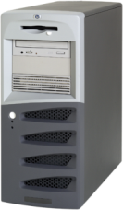
Where energy is used in IT
Storage
40 TB =
2,5 – 5,2 KWh
Datacenter server
& cooling
Network
Devices
7%
PCs and laptops
30 – 300 Wh
Printer
6%
Department server
~400 Wh
Gartner: Conceptualizing 'Green' IT and Data Center Power and Cooling Issues, 9/2007
Notes:
Depending on your customer profile, the energy will go to different areas.
Larger enterprise customers / hosting providers: the data center will take a big part of the overall energy. We will focus on datacenter in the next slides in more details
All customers: due to the huge numbers, the PCs are normally the biggest part of the energy bill. And here you can save most with “common sense” behavior: makes sure the PC don’t consume energy if they are not needed (weekends, nights etc).
Department servers are the hidden factor for your server calculations. They are different than your datacenter servers as you cannot “assign” cooling costs etc to them if they are “just in a closet” or below the desk. Nevertheless, the worldwide percentage of these servers is huge, and much higher than the number of servers going into datacenters.
Printers & network devices are currently out of scope of this discussion, mainly because I don’t have any good numbers and Microsoft is not working in this area at all. If you like, mention that most network printers have power saving settings for years (the wake-up phase we all know) and that Microsoft embedded OS offerings (like XP embedded) has the same smart energy saving features as the full OS we will cover later. Gartner estimated that printers are responsible for 6% and network components for 7% of the overall energy needs, so it’s not the biggest part of the bill.
Storage: in the recent past, new HD models dramatically decreased the amount of power needed. The new disks consume 9W instead of 18W, but still your current SAN might need a lot more energy and should be updated to newer products over time. We won’t focus on them in this presentation. There are studies listing energy needs and showing saving options for different archiving and storage products and vendors, like the “Green Archival Storage” whitepaper from Plasmon.com:
40 TB in a Netapp FAS 3020 is about 2,5 KWh (~ energy of 6 midsize server)
40 TB in an EMC Centera (mirrored) is about 5,2 KWh (~energy of 13 midsize server)
While this is noticeable energy, it is small compared to the overall server energy in an average ratio of servers / storage units.

Slide 8
Tips for
The Green Datacenter

Slide 9
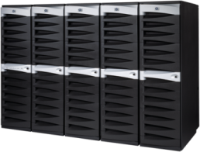

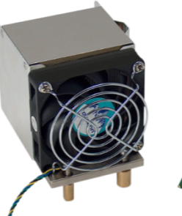

What you should know about datacenter
2006 (US): 60 Mrd KWh (1,5% of total US electricity), more than all US color TVs!
  2005 (world): 0.8% of worldwide energy
Beside servers & network, there is cooling
  Up to 2,5 times of the “IT energy” needs
Estimations, US Env. Protection Agency (EPA) report 8/2007
Notes:
Datacenter consume a lot of energy worldwide. The percentage estimations vary, but 1,5% is a good estimation average. With this value, IT is one of the biggest industry player regarding to the energy needs. Especially as large commercial datacenter from google are not in this calculation due to their specific situation (google builds their own servers from standard components so they are not counted in the worldwide server sells).
It’s estimated that google is running their services on 450,000 servers worldwide. And of course there are more internet providers, like yahoo, MSN, amazon etc. Some analysts estimates that in 2030 nearly 30% of the worldwide energy goes to datacenters. http://www.wired.com/wired/archive/14.10/cloudware_pr.html Datacenter servers “consume” more energy than standalone server due to the additional cooling and infrastructure energy needed for them, which we will see in the next slides. It’s estimated that there are 4M servers in the US in data centers. With 2M servers shipped worldwide Q2 2007, this is “just a percentage” of the overall servers. So we have to address both situations, and both in a different way.

Slide 10
Within a typical datacenter, energy goes to different components.
1: Computer room air conditioner
2: Power distribution unit
Source: the green grid, Guidelines for energy-efficient datacenters, http://www.thegreengrid.org
Notes:
You can see that only 30% of the energy is actually energy used for servers (and network components). The rest (70%) goes to infrastructure, mainly cooling etc. So any energy you save at IT equipment could be saved again twice in cooling (energy in = waste heat out). But this requires a dynamic cooling infrastructure, too! In many installations, the chillers run at 100% regardless of the cooling load needed. So in an environment like that there is no savings. Which brings up an important note: One of the best recommendations we can make to customers is to buy infrastructure that scales to demand. This includes servers, power infrastructure (UPS, PDUs, etc), and cooling.
In some regions, humidifier are not needed at all, some vendors allows 20-80%, so think if this is needed for your datacenter at all.
This comes back to the beginning with the light bulb: any energy you can save with “shutting down” is better and makes most often bigger effects than switching to new, more efficient technologies. At least this will help you at the beginning.
After you have implemented these easy steps, you can only achieve the next savings by moving to different / more efficient technology which includes upfront investments. Most often the ROI of these investments is achieved quickly!
Interesting though, the energy distribution within the datacenters have changes over time as we will see in the next slide

Slide 11
Each rack is drawing more power
Kilowatts per rack
Resulting power draws per rack have grown eightfold since 1996
Average kW per rack
  2000: 1kW
  2006: 6–8kW
  2010: 20kW+
Power density is increasing with new server form factors
  Up to 15KW per rack:
  special air cooling
  From 15KW on:
  liquid cooling needed
30
25
20
Kilowatts
15
10
5
0
1996
1998
2000
2002
2004
2006
2008
2010
Source: Why “going green” becomes essentials for data centers, Gartner 10/2006
IDC: The Impact of Power and Cooling on Data Center Infrastructure, 2006
Notes:
In 1996, the average server consumed ~100W per hour. Today, it’s more 400W per hour due to the much higher processor capabilities of the modern servers. At the same time as servers were experiencing a 4x increase in power consumption, the density of systems is also increasing by approximately 15% annually. This increase in server density is being driven by a shift in customer buying patterns — from pedestal servers that occupied nearly all of the systems sold in 1996 to rack-dense systems and the beginning of mainstream adoption of blade servers today. This drive for density is a result of customers that need to add systems to support their business workloads and want to fit those systems into their current data centers, versus having to buy or build a new one. The result is a 3x increase in server density at the rack level:
Average: 7 servers per rack in 1996
Average: 10 servers per rack in 2002
Average: 14 servers per rack 2005
Average: 20 servers per rack by 2010!!!
In 1996, customers averaged 7 servers per rack, and by 2010, blade adoption will be at a level more like 20 servers per rack, with some customers having north of 60 blades in a rack.
The result, due to this drive for density and increased power consumption on a server level, rack-level power consumption has grown by a factor of nearly 10. Customers building new data centers are planning for and demanding specifications that can power and cool over 20kW at a rack level.
This need for added power and cooling is not isolated to just a few clients either. Recent survey data published in the market shows that over 40% of all enterprise customers surveyed report power supply outstripping demand.
At the same time, the increased density is creating hot spots in the data center, leading to reliability issues in the hardware that supports key business applications. So, although on a first pass, the issue seems to be one of finding ways to help customers cut costs and increase efficiency, the addition of reliability issues leads us to conclude that power and cooling have a direct impact on IT uptime and hence have an impact on business performance. In particular, cooling limitations have been a "glass ceiling" for server blades. As a blade rack can generate 3x the heat, companies are unable to fully or near fully populate blade racks due to several reasons like
You need more power per rack but you cannot you purchase this additional amount of energy in your region due to technical limitations (power line etc).
You might need a different cooling technology (air vs. liquid) which requires initial investments and maybe even other technology which might not be “available” in your region (shared datacenter where you cannot define the overall cooling technology)

Slide 12
How to start to save energy
Remove your energy waste:
10%-30% of servers do nothing (Uptime Institute, USA)
  Use Microsoft System Center to reduce number of running servers
    Operations Manager 2007 informs you about performance monitoring over time
    Configuration Manager 2007 informs you about Installed hardware and software (incl. CAL tracking)
    Desired Configuration Monitoring helps you to keep your components and settings “green”
  Same might be true for other equipment
Notes:
So what is a good start to save energy? Coming back to the light bulb example: shut down what you don’t need. There are studies showing that 10-30% of all servers in the datacenters are doing nothing (anymore) but were not shut down (after they have been “retired”). Microsoft System Center can help you here in 3 phases:
1) Use SC to find ways to reduce the numbers of servers you have – as that’s the best way to solve the majority of the power needs
2) Use SC to find old servers that I do need – but they’re not power optimized – so I want to replace them with new Green servers. This is all about detailed inventory of components.
3) Keep your servers “green”, so monitor the desired configuration of componets and settigs.
For the first step, SC Configuration Manager as well as SC Operations Manager can search in your Active Directory as well as in your IP network for servers and devices and analyze them for you. They find information about the OS, hardware components and installed software and allows you to generate meaningful reports so you know what the machine is doing (or not doing). This allows you to make the right decisions about your servers.

Slide 13
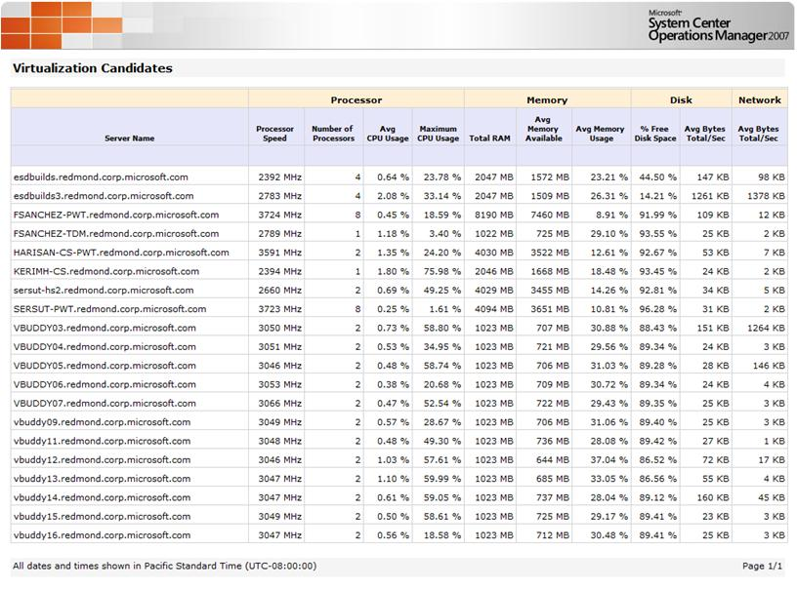
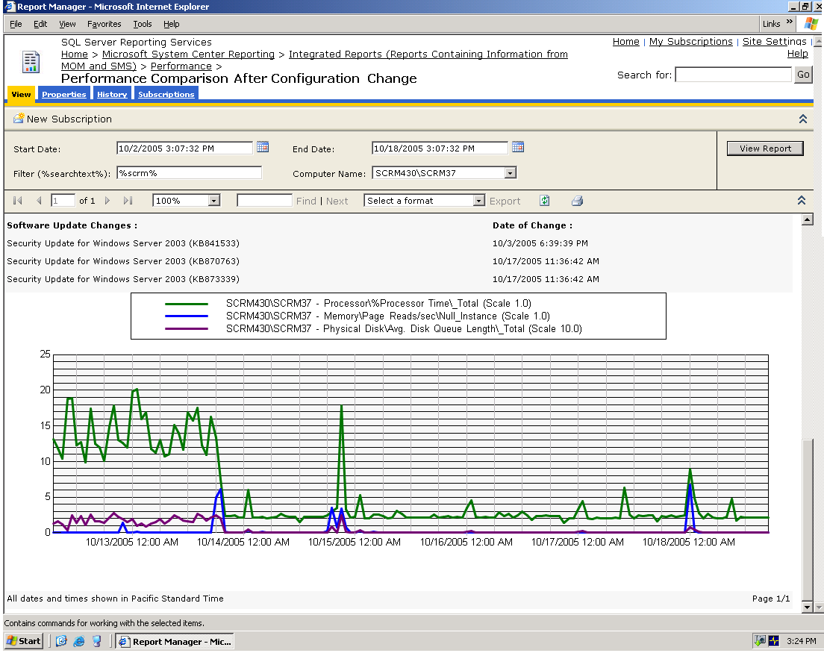
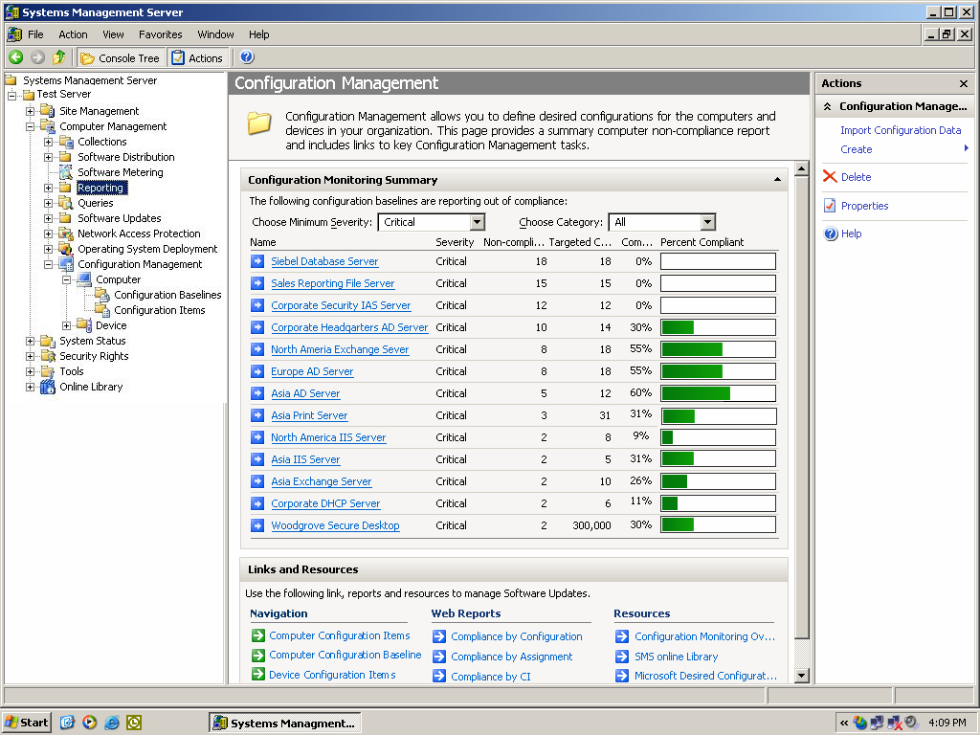
How to start to save energy
Notes:
The first screen shot shows the average server performance trend over time. This overview report, coming from SC Virtual Machine Manager (in combination with SC Operations Manager) lists you all machines which could be good candidates for consolidation, virtualization and retiring. Beside the performance information, you would take a look at the SC Config Manager information regarding the installed software and “used” CALs at these machines, too. This will give you an idea which product is installed and used when by which amount of users (CAL tracking). So a server for just 5 people might be shut down / consolidated / virtualized.
(Click)
This report shows the performance of a dedicated box over time. You see a drop of performance correlated with a machine configuration change (in this example just a hotfix installation, but it could be a software uninstall, any other machine changes (remove of shares, …) etc. This drop of performance at a certain day could be a sign that the server is doing nothing anymore (because a project has ended etc). So you might want to analyze this machine in more details with SC Config Manager (CAL tracking) to maybe shut it down completely.
(click)
The next screenshot shows some enhanced reporting capabilities of SC ConfigMan. They show the desired configuration monitoring of your servers so you know which server type looks like you have defined. This can include software AND hardware settings and will inform you about servers not using your recommended parts. DCM could use a green config template from Microsoft looking for certain software machine settings which are needed to use the energy saving features of the servers. Without these settings, no savings are possible at all, with these settings, it is at least possible from a software point of view (we will go deeper on this in a few slides). With the overview report you can easily find the servers which are not compliant with your green IT guidelines and those which are.

Slide 14
How to save more energy
Consolidate your servers where possible
  Consolidate file & print servers using the Microsoft consolidation toolkits
  Exchange scales well beyond 500 mailboxes
  Think about multiple SQL instances on one box
  Use Softgrid for terminal server applications
Do not oversize your hardware
  System Center Capacity Planner tells you what hardware you need to run MOM, Exchange or SharePoint* in your environment
  There are additional tools for SQL, ISA, SMS…
*: SC Capacity Planner 2006 released, version 2007 in Q1 2008
Notes:
After shutting down unused servers, you should focus on rightsizing the others. As it does not make sense to have a 500W light bulb in your bedroom, it probably does not make sense to have a 8way machine for your teamsite server for 4 people. At the end any watt you can avoid costs you less. In the past, consultants and IT pros tented to use bigger servers than needed “just for the case”. While this was fine as long as the hardware was cheap, the running costs of these machines have been forgotten. As we have seen they are noticeable nowadays and therefore this oversizign should be avoided as much as possible. Microsoft offers a sizing tool with the SC Capacity planner (version 2006 release, 2007 planned for Q1 2008).This tool allows you to model your application needs and will present you the right hardware needed for your scenarios. In addition you can model future requirements to find out what might be needed with the current trends so you can purchase smart. Not all products from Microsoft actually uses already Capacity Planer for sizing, so you might find different other tools like Excel spreadsheets and whitepapers to help you today with your sizing questions.
(The tools do not reflect electric power consumption of hardware right now!)
Rightsizing can also be achieved with server consolidation. Multiple older file servers could be combined on one modern server, same for print servers, websites, Exchange servers and SQL instances. Consolidation can be useful for many reasons and is one outcome of the Infrastructure Optimization service initiative from Microsoft and its partners. You find much more information about this topic at the webpage from Microsoft.
As you see, these options require normally upfront investments from you: server consolidation does not come for free but might be useful if you have many servers running at 10-20% utilization. If you have done your consolidation projects already, see if you have not forgotten the saved energy costs in your ROI calculation.

Slide 15
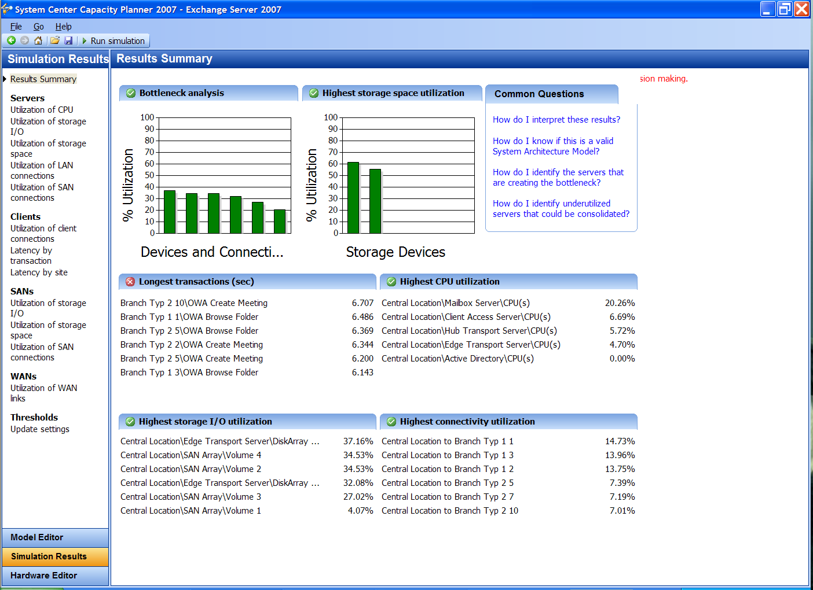
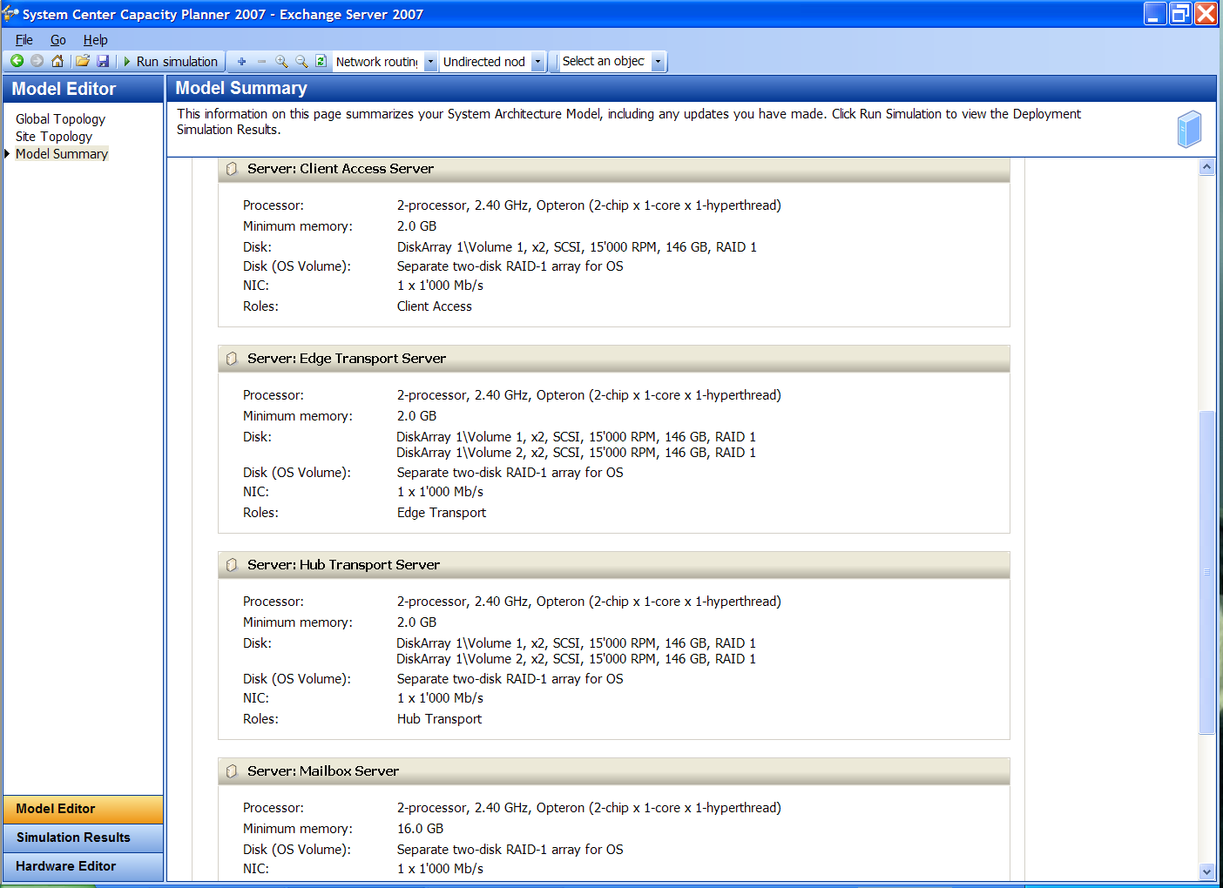
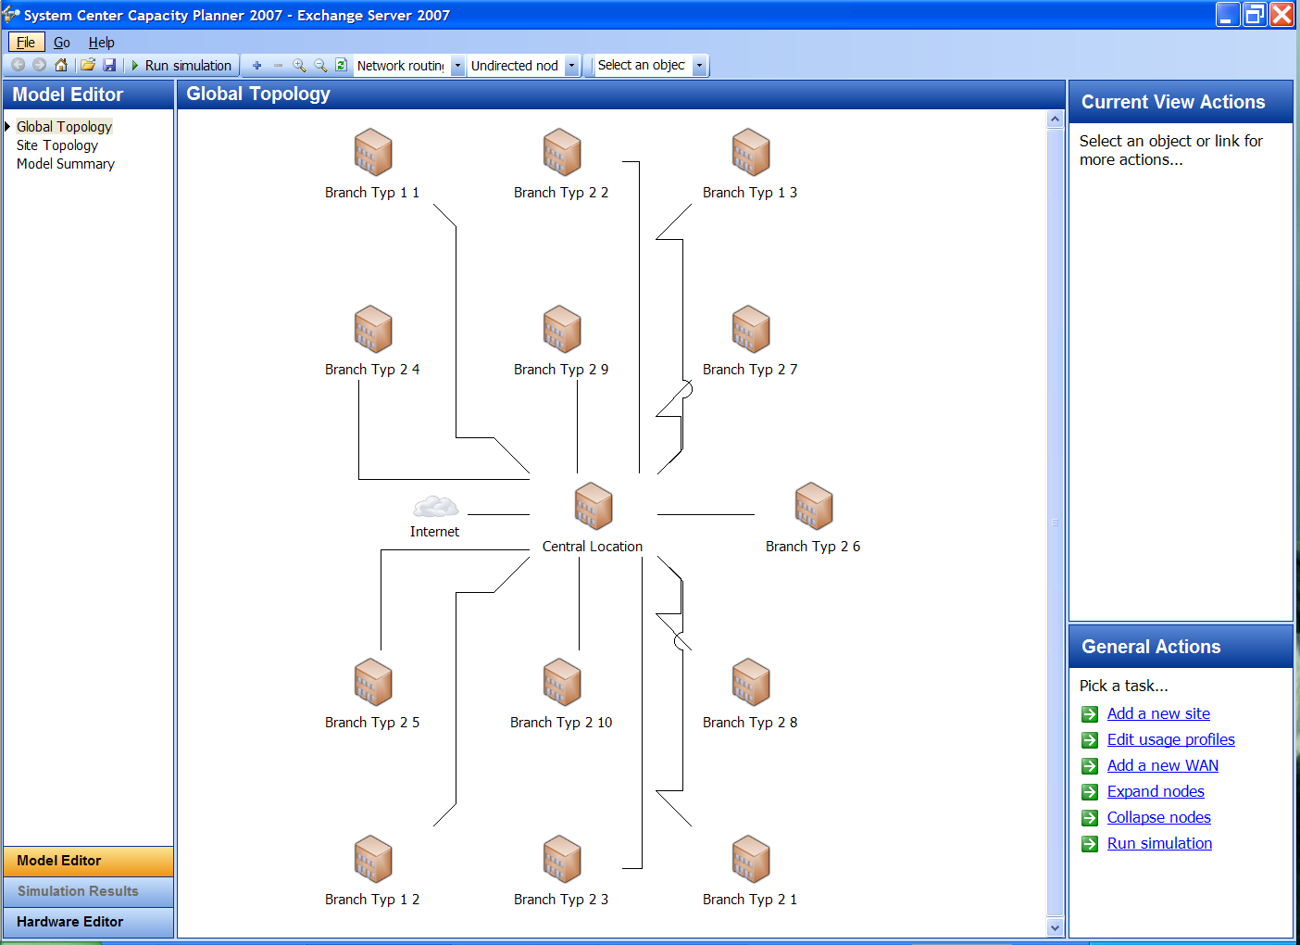
How to save more energy
*: SC Capacity Planner 2006 released, version 2007 in Q1 2008
Notes:
Screen shots of the Capacity Planner 2007 beta: modeling your exchange server environment
(click)
Create your site structure in the tool reflecting all your offices and branches
(click)
suggested hardware for your modeled environment.
(click)
Estimated utilization of the chosen hardware: you see how much oversized / room for growth your solution would be / have

Slide 16
Take advantage of virtualization
Use various virtualization technologies for enhanced consolidation efforts
  Microsoft is offering the full suite of virtualization technologies AND management
    Hardware virtualization with Virtual Server 2005 R2 or Windows Server 2008 Hypervisor technology
    Presentation virtualization with terminal server
    Application virtualization with Softgrid
  Manage your virtual servers like regular servers
    Microsoft System Center takes care about them, incl. SC Virtual Machine Manager for single point of administration
Notes:
While physical server consolidation is complex for non-trivial server loads like SQL, it’s becoming easier when you “just” virtualize the servers and run multiple low-load servers on a single box. The overall energy calculation might be positive and could be another reason for virtualization projects.
Microsoft is in a unique position within the virtualization world as it is the only company today (2007) which can offer the full range of products from a single vendor including
Server virtualization with the free Virtual Server 2003 R2 (and later on with Windows Server 2008)
client virtualization with the free Virtual PC 2007
Application Virtualization with Softgrid for desktops and Terminal Servers
desktop virtualization with Terminal Server (enhanced with softgrid for TS consolidation!)
A full management suite: System Center, ranging from Virtual Machine Manager over server monitoring, configuration management upt to backup & restore with DMP 2008

Slide 17
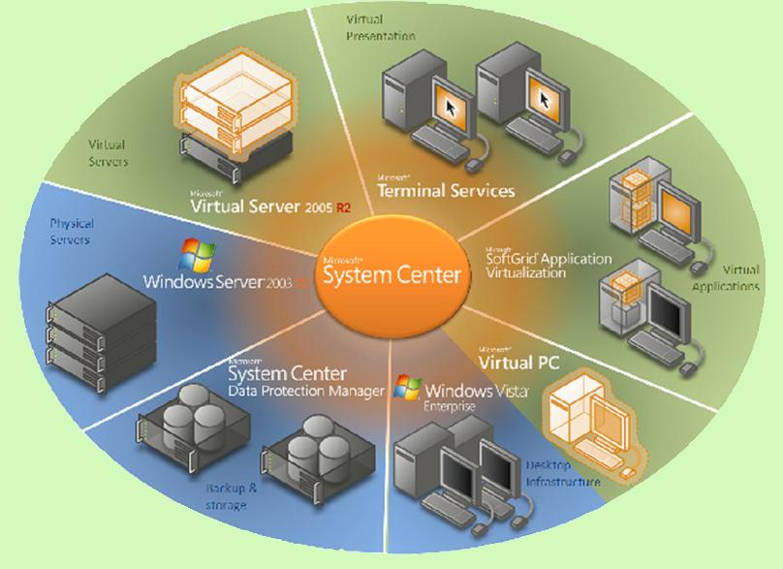
Take advantage of virtualization
Notes:
The large picture is explained best at www.microsoft.com/virtualization

Slide 18
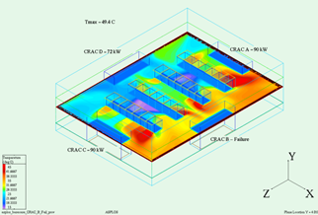
There are best practices to help you with your datacenter plannings
http://www.thegreengrid.org
Optimized Datacenter Design includes
  Floor layout, hot-/cold-aisle configurations
  Scalable & energy efficient power-, lighting- cooling equipment (humidifier really needed?)
  (Dynamic) heat-map adjusted at changes
    Changing server models
    Switching to blades
Think about “green energy”
  Is “renewable energy” an
  option for your region?
Notes:
Common sense helps best: right sizing is not only needed for your servers, but for your datacenters, too. It does not make sense to have a huge mall with a single server in. On the other hand, you cannot run too many servers in a small cabinet. Beside the well known consulting companies the customer can involve, there are some resources available at http://www.thegreengrid.org you might want to mention. Microsoft takes part in this organization as you might know. Be sure to check the download area and read the 3 whitepapers before you do the presentation.
Now, because datacenters use so much energy, there is much saving potential. A smart layout of a datacenter can easily save 50% compares with a dump design. So when you build a DC, let it be designed by experts. This includes a heat-map etc. If you later on re-purpose your DC (by exchanging servers with blades, putting in newer servers etc), make sure you update your heat-map. The overall power & heating consumption might vary dramatically and might invalidate your old design. So don’t just change servers without thinking about the side effects. Many larger IT consulting companies can help here in case this was not done so far. You can be proactive and recommend an analysis with your trusted partner.
Ask if the customer did a heat-map, and if so with whom (sometimes HP, sometimes IBM etc). Assume that these companies are the preferred IT partners for them and that these companies are selling their own monitoring solutions to the customer instead of System Center products!
Ask if they have recently switched over to blades and if they have updated their datacenter layout. Ask if they needed to change their cooling for example.

Slide 19
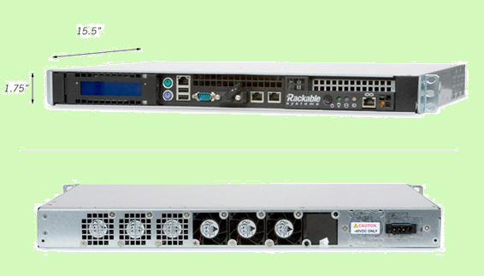
Think about using new server hardware
Beside blades, there are other smart server designs, like Rackable (1, 2 & 4u models)
1U high but only ½ of normal depth
Cables at front
Allows 80 server
per rack
Runs on AC and
DC(!) power
  AMD / Intel
http://www.rackable.com
Notes:
Now, while most people nowadays speak about blades, there are other smart server designs on the market, too. The company rackable (www.rackable.com) produces servers with the normal 1U height but just half of the depth. This means you can put twice amount of servers in the classical racks now. The cabling is done on the front side, which is a brilliant idea (anybody who did datacenter cabling will instantly agree here!). The space is the middle of the 2 servers is used as a chimney and allows smart cooling of the rack.
While this is smart already, it becomes even better: the server can run on DC directly. This “avoids” power supplies in each server as we will see on the next slide.

Slide 20
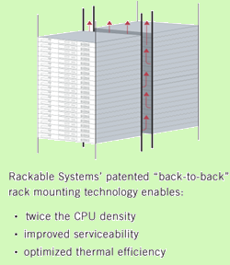
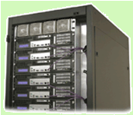
The DC power alternative
You can run server with DC instead of AC
Convert at rack (aisle or data center) level
Might save up to 30% power and 20-40% heat compares with old AC server power supplies
Less moving parts at servers
E.g. compatibility with telco
-48 VDC power (or others)
http://www.rackable.com
Notes:
With servers running on DC directly, you can use larger and better AC/DC converter for a full rack (or even aisle or the full datacenter) instead of poor converter in each server. At each server, you now just need DC-DC converter which comes without moving parts (fans) and a much higher MBF so you don’t need redundant power supplies with all their power losses. There are still fans for the processor and normally disks, too, so some moving parts will stay! This technology MIGHT saves up to 30% energy & heat due to lower energy losses during energy converting. DC voltage has different importance around the world, and beside 48VDC there are other voltages you might find in existing or planned datacenters.
But be careful: with the new blade racks and the smart power supply usage in these racks, you can achieve similar efficiency. At the end you have the choice between both technologies so you can pick the most appropriate for your needs.
(Rackable servers start at average prizes for smaller 1U servers at 1,400$ and are available with AMD and Intel processors. There are 2U and 4U servers with redundant disks available too. The average acquisition costs might be higher than standard vendors, but the overall costs over 3 years lifetime might be positive)

Slide 21
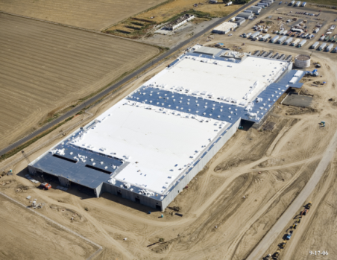
What Microsoft is doing: Quincy
Quincy is the largest
Microsoft datacenter to date
Designed to have minimal
carbon footprint
  Hydropower as primary source of energy
Uses green building technology where possible under the LEED rating system
Notes:
Increased power efficiency at data centers.
Microsoft has many data center locations throughout the world. Given the costs expected from growth in these data centers, Microsoft is focused on maximizing efficiencies. The Data Center Services team closely monitors and manages current power consumption and the design of future data centers. The largest Microsoft data center to date, in Quincy, Washington, is an example of the way the company is building for the future.
It was designed to have minimal or no carbon footprint, with hydropower as its primary source of energy. Hydropower is a clean-air and renewable resource from the Columbia River Basin.
The data center will maximize its use of green building technology under the Leadership in Energy and Environmental Design (LEED) rating system. The LEED Green Building Rating System is a voluntary, consensus-based national standard for developing high-performance, sustainable buildings.
Microsoft is also researching new energy options and technologies that will bring about even greater efficiencies. Working closely with energy companies, Microsoft is exploring a variety of power generation and transmission technologies—some that have long been used in large industrial processes but have never been applied to data centers.

Slide 22
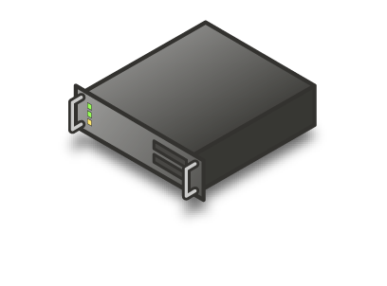
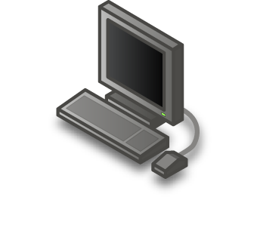
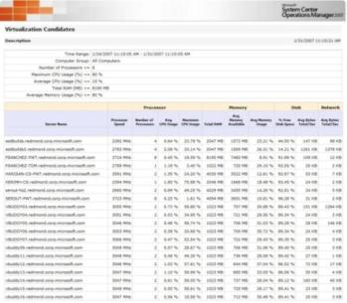





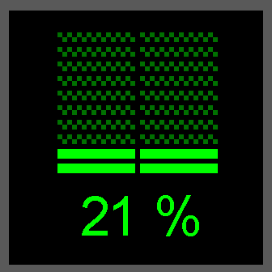
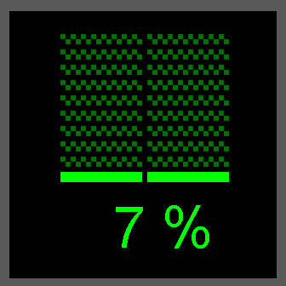
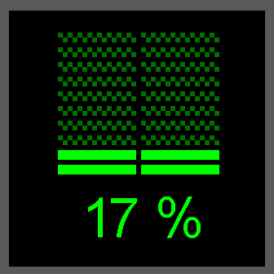
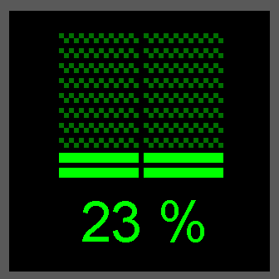
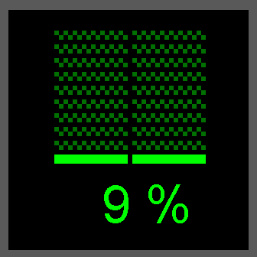
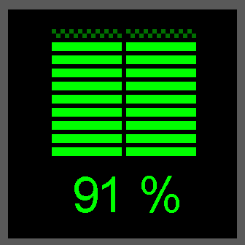
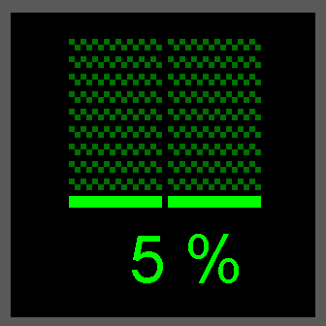
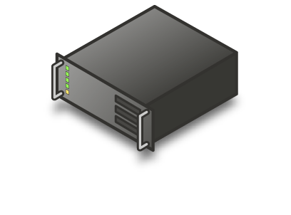

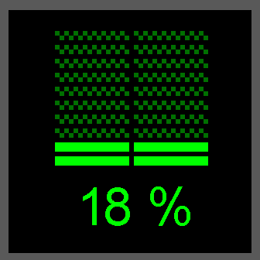
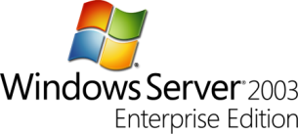

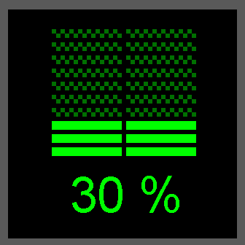
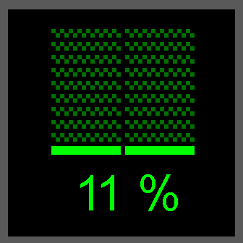
In the future: Dynamic Datacenter will help
Notes:
This is how the future might look like (nearly all components have been released today):
It starts with a typical server rack filled with Windows Server 2003 R2 machines. They all consume energy and run certain tasks. They are monitored with System Center products.
In near future, customers are able to upgrade to Windows Server 2008. This allows you to activate the hypervisor feature to virtualize the current server. Nothing else has changed so far, you just add an additional switch, that’s it. Clearly you can optimize your machines for virtualization, as well as you can run the same situation today with Virtual Server 2005 R2 SP1
(click 1)
The machines are still monitored with System Center and you can now create a report over time. You will find out which machine will be utilized at what time, maybe some are hardly used during night or at the weekend. Nevertheless you cannot switch them off as few people still need them at certain hours.
(click 2)
(The following click will start a longer animation, some people like to explain first and then click or vice versa)
By introducing the System Center Virtual Machine Manager, you address this situation in a smart way. Machines hardly at certain times used can be consolidated on the same hosts, based on their performance needs. VMM helps you to identify these candidates by exactly knowing the performance profiles of these machines and suggesting the best host / machine combinations for these machines. After moving the machines to the new hosts, the old hosts could be powered down to save energy. At the end of the weekend / nights, the machines can be moved back to the original situation. The “quick migration” might take around a minute or less and does not require any specific hardware, this can be done with any certified Windows Server hardware! There are no additional costs involved, too! (beside VMM). The quick migration can be fully automated with PowerShell scripts and be executed by System Center based on your trend reports without any manual interaction.
(click 3)
In case of an unexpected server need (people working against your trend), System Center will identify the correct server, is able to power on the appropriate host and move back the machine to the original host to address the increased performance needs. Again, such a quick migration might take around one minute (to boot the server and move the virtual machine). Nearly all know real world scenarios can be addressed by this timeframe.
(click 4)

Slide 23
Tips for
The Green Server

Slide 24
What energy is used by regular servers?
Mainstream server: 420 W*
Blade server (excl. frame): 275 W*
Highly efficient dep. server: 163 W*
*: Vendor information, average of comparable models
Stanford University: Estimating total power consumption of servers in the US and the world, 02/2007
How many server do you own?
2M server shipped in Q2 2007 (IDC)
4M server in commercial US datacenter
SMB customers: +30 in average
Remember: all data center server energy must be at least doubled (“cooling” etc.)
Notes:
Traditional server nowadays needs in average around 400-500W per server. This is depending of course on the server components (processing power, storage, cards, memory) of the server. High-end servers (multi-core Unix & mainframe machines) consume around 9,000W and more an hour. Blades seems to be more efficient with energy, but you need to add the frame to them. If you only run 1 single blade, the frame would be a large addition, in a normal case with many blades in a single frame, this can be ignored for this discussion.
(click)
Some facts from IDC as a background for you: 2M server shipped in Q2 2007. Now, the worldwide energy used for servers is noticeable! And even the midsize SMB customer have 30servers and more, each running at 400W in average.

Slide 25
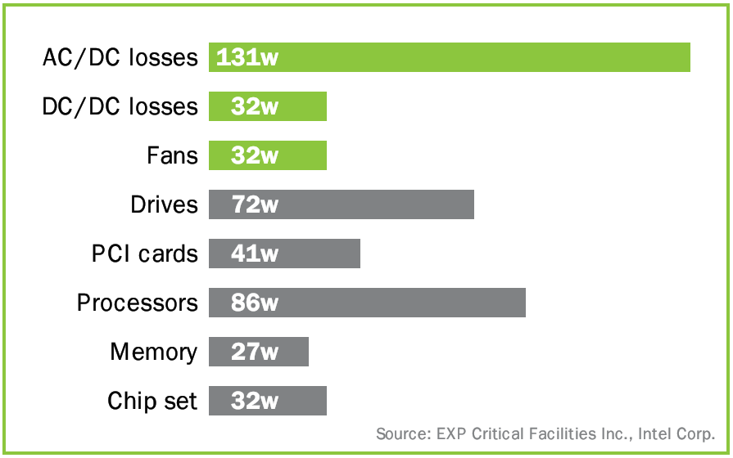
Where energy is “lost” in servers
The typical low-end server power supply has an efficiency rate of 75-85%: 400W ~ 60-100W losses
A high-end server power supply reaches
95% efficiency: 400W ~ 20W losses
Smaller power supplies needed, less heat produced
Average power supply; vendor information
Around 160W are lost per server, based on a typical dual proc. 450W 2U server, which is 35%!
The Green Grid Opportunity: Decreasing datacenter and other IT energy usage patterns www.thegreengrid.org
Notes:
Again, smart hardware purchases reduced the energy needs directly from the beginning. What is not needed at the beginning must not be reduced later on!
Especially at low costs servers, they are not very efficient (60-70% based on some estimations, though 75-85% are more realistic) due to cost pressure. Now, if customers would look at the lifetime costs, they might ask for other power supplies and spend 10$ more at the beginning to save >10$ over the next years. 85-90% efficiency for power supplies is affordable and the norm for highend servers! Modern blade racks or the latest high-end servers can even reach 95% with smart supply designs (shutting of unused supplies of redundant supply sets to reach higher utilization = efficiency).
Remember though, that the efficiency of power supplies unfortunately is not a static value but a function of the hardware parts and the load of the power supply. So it will vary over a broader range; and an efficient supply for high loads might be inefficient for lower loads. Best practice is to not oversize the power supply and at the same time run the server at little load: this will be the most inefficient situation for any power supply. Try to achieve a higher utilization from the beginning: are you really planning to change the server over time 8add cards or disks) so you need an oversized power supply?
(click)
The results are clear: with a better power supply you save energy & costs. Each hour, each day, each year. 100W savings an hour is 876KWh a year. This can be 175 CHF (0.2 CHF per KWh) and could be more than the prize for a better power supply. So ask you hardware vendor for different options when you purchase your new servers. Changing existing power supplies might not have a positive ROI due to server outage and maintenance work, but you would have to do your own math.

Slide 26

Replacing the power supplies is not always an option, but other components can be optimized, too
CPU
46%
Processor power management represents the best opportunity today
Source: Intel Server Products Power Budget Analysis Tool
http://www.intel.com/support/motherboards/server/sb/cs-016976.htm
Notes:
This slide is valid for servers only!
Beside the energy lost for conversion, the different components of the servers are using energy, too. Now, if you don’t need certain components, don’t put them in your servers but remove them during initial server assembling!
Most of the energy in servers is used by the CPU, followed by PCI cards and motherboards. With Windows 2003 onwards, we can address the CPU issue, and with Windows Server 2008, we will address the PCI-E cards. This makes a big chunk out of the server energy.
Power management can be controlled in several ways. The whitepapers at the end describes certain features in more details. Some hardware vendors implement the management in the firmware / bios of the systems. Microsoft’s point of view is that the OS should control the system settings defined in the ACPI specifications. Pro and cons are discussed in several technical resources, some of them are mentioned at the end and are worth to be read.
(Some background information:
There are some power savings features the OS simply can’t manage as quickly as hardware can, due to the nature of the hardware design. For example, AMD is shipping processors today where they manage the deeper ACPI c-states (processor idle sleep states) in hardware, due to the way in which they’ve chosen to integrate their memory controllers with the CPU, and the interaction with UMA graphics. They still need OS to enter the first level idle state, then they h/w can go deeper opportunistically. There are many other examples of this device-specific behavior.)
Now, with the new / upcoming “flash memory” hybrid hard disks introduced with Windows Vista or diskless servers booting from SAN (since Windows 2003), and new disks needing half the energy compares to traditional disks, this area is addressed, too. Unfortunately there are no test results available describing the achieved power savings (if any!) with this technology). In the moment, SAN drives requires more energy than local drives, especially when you add the needed network components, so this is not an option purely seen from an energy point of view!
So let’s focus on the area where we can offer a solution today: the CPU.

Slide 27
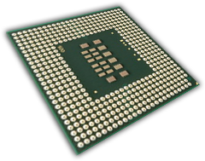
The processor consumes most, but is addressable with current technology
Used for years in laptops (Intel started in 2000)
  Capable server are prevalent in the market today
Offers considerable power savings with negligible impact to performance or responsiveness
  Scale performance state based on workload
  Managed by the operating system
Fully supported by Windows Server
  Windows Server 2003 SP1
  Windows Server 2008 improves capabilities
Notes:
The processor consumes most but was addressed first with the Mobile Chipsets and processors from Intel. The saving feature is proven within Windows XP since the year 2001, so there is no risk with is anymore. Microsoft is confident that this feature actually works that we have implemented it in Windows Server 2003, too [it has been supported natively since Windows XP in 2001] but not enabled by default due to lack of capable hardware at that time and enabled it by default in Windows Server 2008 (due to the new, capable servers sold today). This is our biggest saving offer right now to our customers and we will discuss it in more details on the next slides.

Slide 28

A smart processor choice helps most
If you need less from the beginning, you save more!
Xeon® 5X00 SKUs
All processor: 64-bit / Dual-core / 4M L2 cache / Intel® VT
Xeon® 5100 series SKUs
Intel® Xeon Processor 5160 - 3.00 GHz / 1333MHz FSB / 80W
Intel® Xeon Processor 5150 - 2.66 GHz / 1333MHz FSB / 65W
Intel® Xeon Processor 5148 - 2.33 GHz / 1333MHz FSB / 40W
Intel® Xeon Processor 5140 - 2.33 GHz / 1333MHz FSB / 65W
Intel® Xeon Processor 5130 - 2.00 GHz / 1333MHz FSB / 65W
Intel® Xeon Processor 5120 - 1.83 GHz / 1066MHz FSB / 65W
Intel® Xeon Processor 5110 - 1.60 GHz / 1066MHz FSB / 65W
Xeon® 5000 series SKUs
Intel® Xeon Processor 5080 - 3.73 GHz / 1066MHz FSB / 130W
Intel® Xeon Processor 5060 - 3.20 GHz / 1066MHz FSB / 130W
Intel® Xeon Processor 5050 - 3.00 GHz / 667MHz FSB / 95W
http://www.intel.com
Notes:
Some energy numbers from Intel processors. Just highlight that modern processors might need much less energy than older ones, and as higher the frequency, the higher the energy needs. Nevertheless, when you purchase new servers, make a smart processor decision either within a single processor vendor (here: Intel) or by comparing different vendors (like AMD with Intel).
Again, right sizing your server needs upfront will allow you to purchase you need, and not you think you need! This can save you money at acquisition time as well as at runtime!

Slide 29
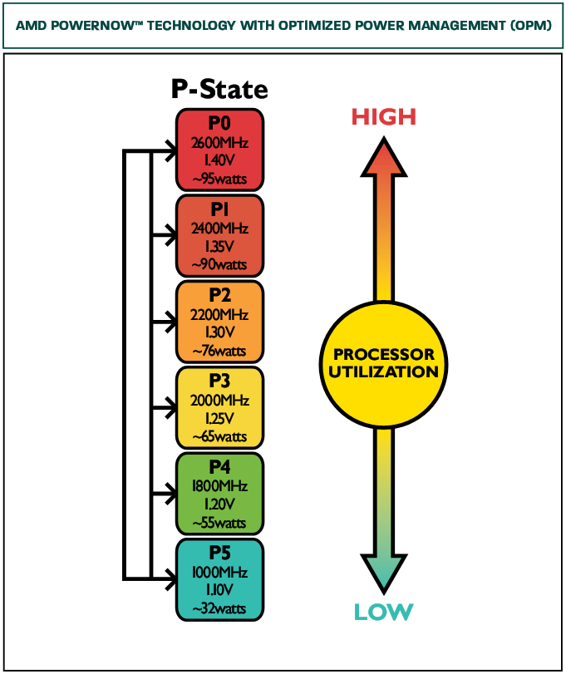
The OS can then save energy with modern Intel / AMD technology
Example: Processor state power policy
  Reduce frequency if performance allows
State | Freq | % | Type
0 | 2800 | 100 | Performance
1 | 2520 | 90 | Performance
2 | 2142 | 85 | Performance
3 | 1607 | 75 | Performance
4 | 964 | 60 | Performance
5 | 482 | 50 | Performance
Maximum Processor State
Minimum Processor State
http://www.amd.com
Notes:
Processors nowadays know different “states”. In the past there was the turbo switch on your 386 machine, remember? This switch changed the overall frequency of the whole system from 8 to 33 MHz (or something like this). Now, modern processors handle this differently due to the overall increased system complexity and the higher frequencies. You simply cannot run the whole system at 2+ GHz.
Each processor model has its own boundaries of the highest (default) and lowest frequencies and the specific steps in between. Older processors knows a single state, newer up to 5. A good rule of thumb: as lower the frequency as lower the consumed energy. To find out the different states, the OS must be able to read the processor settings from the bios, specified in the ACPI specifications. In Windows 2008, we support Intel and AMD processors out of the box, in Windows Server 2003, you must install AMD add-ons. By default, Windows Server 2003 runs at the highest frequency level all the time, but you can enable dynamic frequency switching on certain systems. Enabling must be done in the bios as well as on the OS level. Switching today is then highly dynamic, done automatically of the OS if wished and might take a 1/10 of a second, so nothing people should be afraid about.
(click)
If you run Windows Server 2008 or have enabled this feature for Windows Server 2003 (SP1), Windows figures out the different states and changes between them automatically. In Windows Server 2008, you can even define the max and min states at certain systems from all of the available states if you want to set your own boundaries. The feature set for both server OS are described in much more details in the mentioned whitepapers in the resource list as we can give here just a highly simplified model for the short overview.
(click)
As you can see here in the AMD product information, each state is not only running at a different frequency, but uses different energy, too. Frequency and energy are related to each other; you cannot simply change the voltage / energy and run at certain frequencies. The physical models and more theory behind is described in the whitepapers and at the intel and AMD web pages. You see here by the AMD example that different processor states could be used and therefore the energy need of the processor changes. Clearly different frequencies are related to different processor performance, too: as higher the frequency, as more performance can be achieved. So it depends how much performance do you need at which frequency you can / want to run.

Slide 30
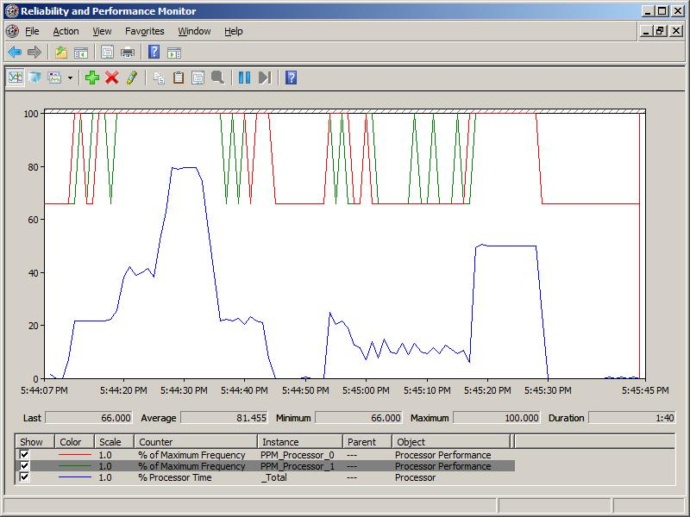
You can “see” the states in Perfmon
Max Processor State
Min Processor State
Performance needs
Notes:
You can see the frequency changes (related with the different p-states of the processor) in Perfmon by monitoring the processor frequency over time; best together with the processor utilization: if the utilization raises, the frequency will go up, and then drop again when the workload is over.
To show the perfmon example in real, simply open perfmon and ad the following counters:
Processor Performance: % of max frequency (all instances, though one might be enough). Keep the % Processor time and show both curves over time: if there is no or little load on the server, the frequency will drop to the lower limit you have configured or will stay on the upper limit and waste energy if you didn’t. This can be done on your presentation laptop, too. You might need to start the Perfmon application as an admin under Vista to see the processor performance counter object!

Slide 31
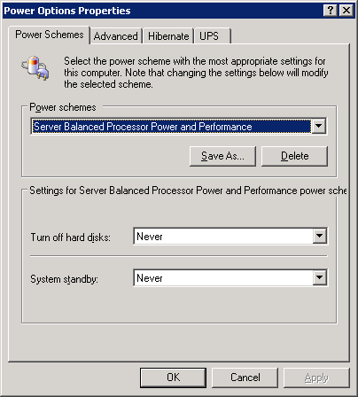
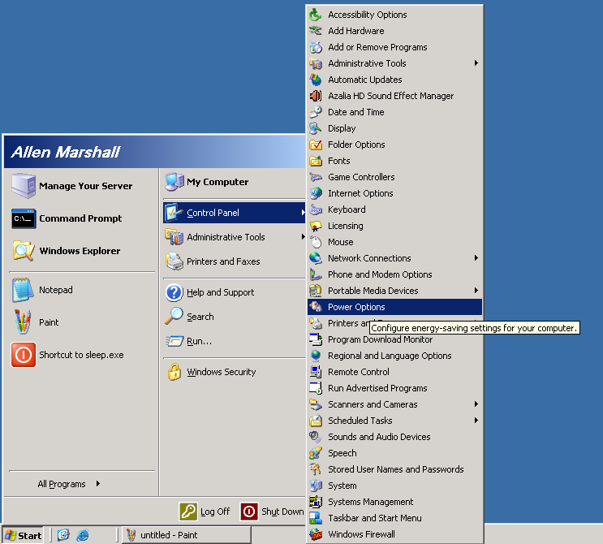
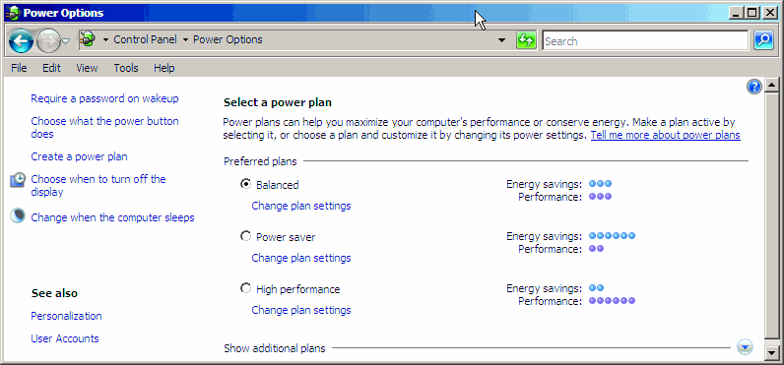
It is very easy to implement these savings on capable hardware (activate in bios first!)
Notes:
There is a great whitepaper which describes this slide in details (s. link below). In summary: You just activate the “state switch” feature in Windows Server 2003 like on would do on your laptop:
(Click)
In “control panel /energy settings” simply choose a different energy scheme than (max power / always on). There is a VBScript in the whitepaper which checks your processors for all available states and another script to set the energy states on your servers. The whitepaper can be found at http://www.microsoft.com/whdc/system/pnppwr/powermgmt/w2k3_ProcPower.mspx
(click)
This feature is enabled at Windows Server 2008 by default (screenshot) remember though that this feature must be activated in the bios AND your hardware must actually allow the dynamic p-state switching.

Slide 32
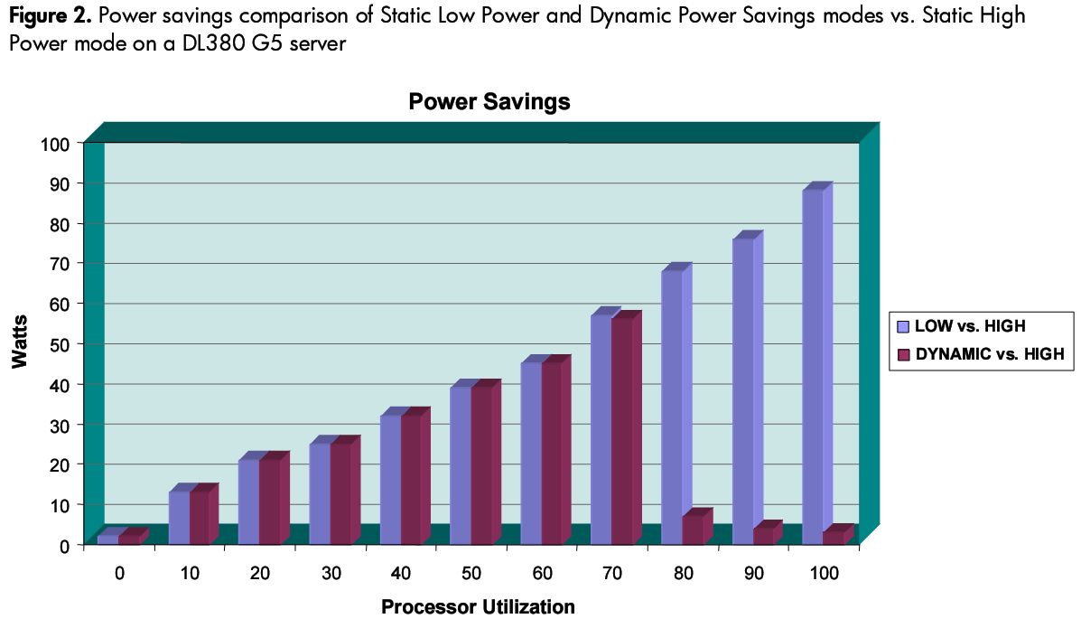
What can you expect from this technology?
Unique onboard power measurement (HP DL380 G5)
HP whitepaper: Power regulator for ProLiant servers, 3rd edition 02/2007 www.hp.com
Notes:
HP did some tests with the p-state technology with the common server model DL380 G5. The whitepaper is available at the HP website. The results are impressive:
If you set the processor fix to the lowest state, you loose performance. But is this performance lost noticeable for your end users? Remember they lived with a Pentium Pro server few years ago, while you now offering them a XEON multicore machine etc. So if you put the machine in the lowest state and fix the machine at that state, regardless how much load you put on the server, it is always running on the lowest voltage / frequency state and saves a lot of energy compares to the “always on” mode. So this is the easiest way to save energy. But you should allow the question why you have purchased this processor if you could have simply purchased another model at the beginning!
Interesting is the dynamic mode, the brown charts. You see up to 60% utilization that the dynamic mode saves nearly as much energy as the “always low” mode, because the processor finds enough time (>40%) to switch back to the low modes. At 70%, the processor cannot switch anymore often enough so the dynamic mode is less energy efficient as the “always low” mode and this gets even worse and higher utilization. Nevertheless, the server actually needs the power of the processor at these utilization numbers and in the “always low” mode you would see a noticeable performance problem. So let’s take a look at the performance charts.

Slide 33
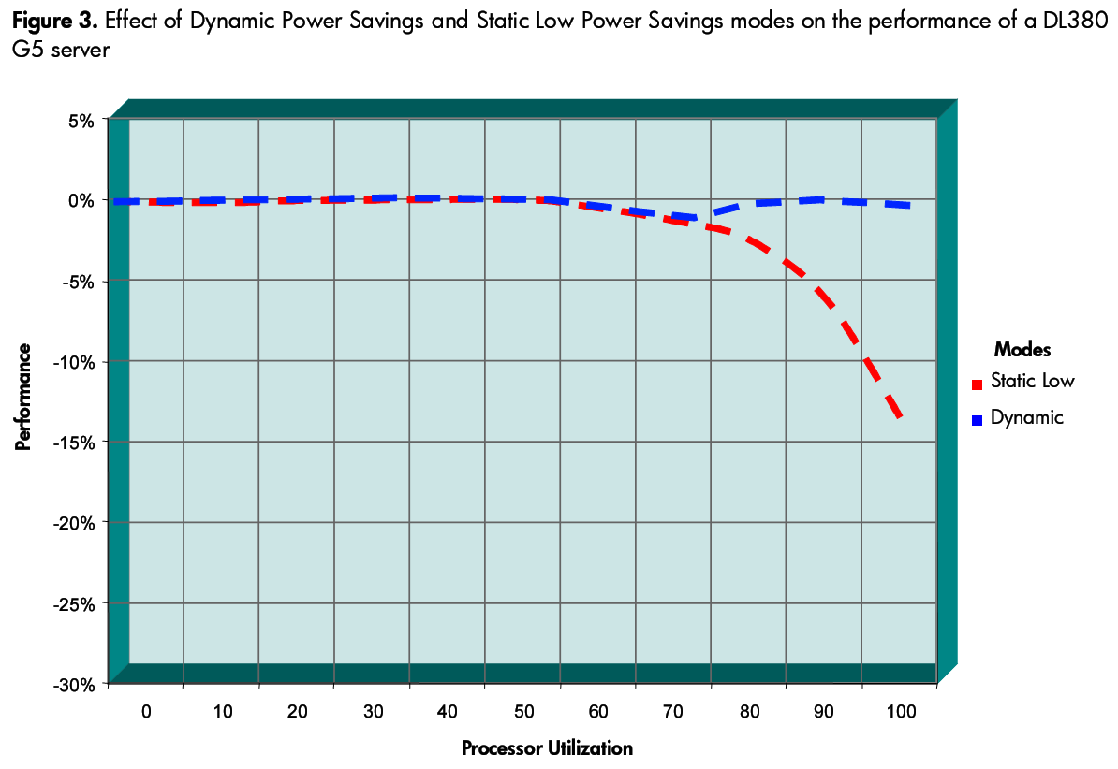
What can you expect from this technology?
Unique onboard power measurement (HP DL380 G5)
HP whitepaper: Power regulator for ProLiant servers, 3rd edition 02/2007 www.hp.com
Notes:
This chart shows the performance comparison of the different processor p-states. The default line (0% loss of performance) is the high state processor mode, which uses the most energy, too. When there is low utilization of the server, there is no measurable difference between the 3 modes: even the “always low” processor can handle these small work loads. While utilization increases, the dynamic mode switches nicely between the different processor modes. This allows to keep with the performance of the “always high” state (the zero % line) up to the overall 50-60% server utilization, but allows energy savings at the same time as we have seen in the previous slide.
Now, while the “always low” mode shows a noticeable performance problem from 60-70% utilization load on, the dynamic mode simply stops switching. At higher workloads, the dynamic mode simply does not switch anymore to the “low energy modes” and stays at the same level as the “always high” processor mode. There is more or less no performance difference between the dynamic mode and the “always high” mode, but also no measurable energy difference anymore (s. slide before).

Slide 34


What can you expect from this technology?
Unique onboard power measurement (HP DL380 G5/G4)
Example: ProLiant DL380 G4
running database application
12% power savings at 50% CPU load
CPU power
savings =
298 KWh
Cooling power
savings =
447 KWh
~745 KWh annual savings per server
HP whitepaper: Power regulator for ProLiant servers, 3rd edition 02/2007 www.hp.com
Notes:
Overall, the dynamic mode seems to be a great compromise for a server: at high workloads, it’s has the same performance as the traditional mode “always one”. At low workloads, it saves as much energy as the “always low” mode. In between, it tries to achieve the best of both worlds. And everything is done automatically without manual investigations.
Now, as most server systems run at low utilization loads, the dynamic processor modes of Windows Server 2003 and Windows Server 2008 allows to save energy while not affecting server performance. A short example from HP shows this in clear numbers:
The average saving was 12% on the server which will reduce the datacenter cooling costs accordingly. These 12% will not affect the server performance as there are always unused processor cycles where the frequency could drop. With 12% savings at the server level, the overall savings in direct costs are ~300KWh per server and year. If you add the indirect costs for cooling etc. At the end, this might sum up to 745 KWh per year per server. Both numbers are noticeable savings, achieved with little efforts and no initial upfront investments (beside changing software settings on your servers for Windows Server 2003 machines).
If you can achieve 12% on your hardware depends on many factors (from processor over server implementations to workload / load on the server). So don’t take the 12% for granted or even as a hard fact! It could be between 0 to ??%, but at least you just have to set some software switches and it will give you the best you can get!

Slide 35
Savings summary for servers
Efficient (dynamic) hardware is the key
Activate free Windows software features
Now do the math
  2 M Server shipped in Q2-07. Assume 50% runs on Windows. If each of them would save 12%:
  420 GWh savings per year!
  Even for smaller customers (30 servers)
  the savings might be noticeable!
  “Save 12% energy = same as 3-4 servers”
  This does NOT include additional savings for cooling etc!
Notes:
Summary of saving options for servers:
Efficient hardware means first: efficient power supplies. They are more expensive and requires changes at your systems. Nevertheless this should be on your list for all future server purchases! Think about DC servers like the rackable server systems, too which brings even higher efficiency!
Without larger upfront investments, try the software options from Windows Server 2003 and later. The calculation is based only on the 300KWh (12%) savings HP has seen in their tests:
Average Server: 400W, 12% savings
2M servers, 50% on Windows = 1M servers
1M servers x 400w x 24h x 365d x 12% savings: 420 gigawatt hours (GWh) savings worldwide per year
(the average power plant is about the same size).

Slide 36
Tips for
The Green Client
Notes:
On client side, we will speak about saving energy of course, too. This is a key area and Microsoft made a huge step forwards with Windows Vista to address this topic.
But beside, there are some more information about reducing carbon footprint overall.

Slide 37
Clients vary dramatcially in their needs
Device | Off (W) | Sleep (W) | Idle (w) | Use (w)
Busines PC | 2-3 (8) | 3-4 (8) | 50-60 | 100-120
Barebones | 2,5-5 | 3-4 (8) | 50-60 | -300
Laptops | <1 | <1 | 15-30 | 20-50
High end graphic cards |  |  | 50-80 | 200-240
Vendor information, average about several models
Do your PCs run 24 by 7? If so, why?
Notes:
The table shows the average energy needs for different PC types (business PC, barebones, laptops) WITHOUT displays for the PCs! 30” displays will take 150W (Apple Cinema HD), 24” is about 90W, but you find efficient ones with 40W, too.
If someone wants to save much energy, laptops are the best way. With display, they consume much less than a normal PC alone.
Business PCs are a smart choice regarding the high volume numbers in all offices worldwide.
Private gamers will use more energy in their graphic cards alone than the normal PC with all additional devices (printers, display etc) together. Do you really need this graphic power? Sometimes, yes, sometimes no. Unfortunately there is no software switch to switch between cards on the fly, so you would need 2 PCs.
Nevertheless, most PCs can be switched off most of the times, which you should do to save a lot of wasted energy. Interesting enough, PCs today will use more or less the same amount of “leak energy” (switched off) while in sleep mode (powering the RAM). So the sleep mode and the soft-off mode is as good as each other for most modern systems. Be aware that there are some negative exceptions, though!
(click)
Highlight laptops: uses so much less than desktops (and they come with their own display already in the calculation
Lowlight: high end graphic cards, sometimes needs the same amount as the rest of the systems!

Slide 38
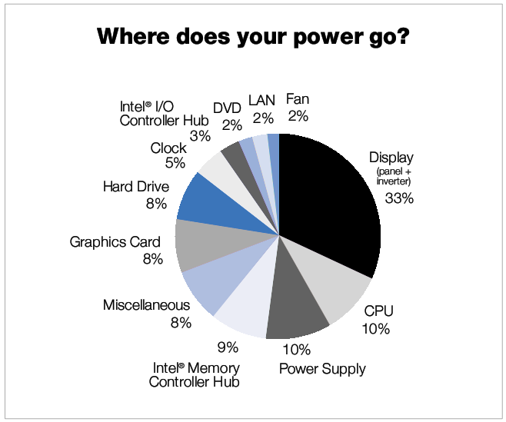
Clients consume differently than servers
The Battery Life Challenge - Balancing Performance and Power (Intel Corporation)
http://onlinetoolkit.intel.com/docs/busi/ExtendingBatteryLifeWP.pdf
Notes:
As you can see, the energy needs of a desktop are different compares with a server: servers have no display, and the graphic cards might be used in a different way. So a simple processor state switch will bring not much. Anyway, Windows allows you to use this feature since Windows 2000 on laptops, but nobody prevents you from doing the same on desktops, too.
Nevertheless, there are much more components and many of them can be now addressed with Windows Vista and a smart choice of hardware. Displays nowadays uses less energy than old CRT monitors, but with the increasing size of the displays and the demand for very bright displays, it went bad again.

Slide 39
Biggest saving potential: “switch off” the PCs when you don't need them: Vista sleep mode
“Switch off” means not always “shut down”
  Since Windows 2000: Standby and hibernate
  Windows Vista sleep mode is very efficient
    Single concept of Sleep to avoid user confusion
    On desktops hybrid sleep saves state to disk as well
      Prevents data loss in case of a power failure
Systems management is no longer an excuse to let your desktops run 24 x 7
  SC Configuration Manager 2007 comes with WakeOnLAN, maintenance windows
You don’t have to depend on your users!
Notes:
If you look at modern PCs, many of them do not offer a physical power switch anymore.
The soft switch therefore leads to the fact that the PC will still consume energy if it’s powered down. This is little energy but measurable. At home, you might want to add a physical switch but this would prevent a media center to power on at night to record your movies. In the office, this might prevent your systems management tasks at night, so you will have to live with the leak current of the soft off. Luckily, modern PCs has a very low “leak” current as you have seen in the previous slide. (remember the table 2 slides before)
In the past, we confused the users with many different saving states. In Vista we consolidated them to “Sleep Mode”. This will allow a very quick resume time as it uses the memory instead of the hard disk for the system state. The sleep mode is so quick, that it might even “replace” the screen saver.
To avoid data loss in case of a energy loss, Vista will create a hibernate file in addition. It won’t be used in normal circumstances but in case of a energy loss, it’s there. At a laptop, this is not needed as it has it’s own UPS: the build-in battery.
The sleep mode allows your users to sleep their PCs at night and allows your IT admins to manage the PCs as needed. In addition, we have seen 2 slides above that the sleep mode is most of the time as efficient as the soft-off mode, so there is no reason not to use it (when the hardware supports it and is not a bad exeption of the soft-off mode!)
(Click)
Nowadays, WakeOnLan is implemented in all hardware. And modern systems management suites like System Center Configuration Manager 2007comes with WOL technology to allow overnight software deployments and patching. So there is no technical excuse not to use this feature.
(click)
Trusting your users is nice, but not smart. You need control about the devices to actually guarantee that they are switched off. This can be done centrally via group policies for example.

Slide 40
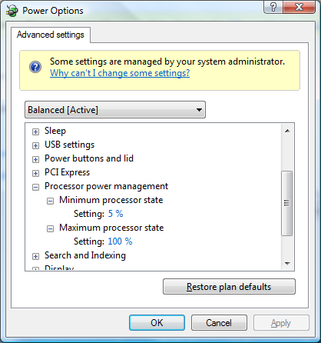
With Vista, there is central control
Like with servers, save processor energy
  Save energy at HD, USB, WLAN PCI-E and display, too!
Sleep mode has faster resume time than hibernate (avg. <2sec compares to 10sec)
  Much better user acceptance
  Use it like your screen saver!
Complete management via group policies
  Default settings save already energy for you
  Customize them for your needs to save more
http://www.microsoft.com/whdc/system/pnppwr/powermgmt/Optimize_Power.mspx
Notes:
Of course the server options are in your PCs, too. They are enabled by default for laptops or can be enabled for desktops.
Highlight the options to centrally manage the PCs, worldwide, around the clock, wherever they are. Highlight the new sleep mode: single mode, might replace your screen saver?
All settings for Vista and for Windows Server 2008 are configurable via group policies. There are whitepapers at microsoft.com describing these features in details. The links are provided at the end of the slides.
(click)
Example of the UI for the power settings in UI.

Slide 41
Let’s do a simple math for your PC`s:
 | Idle (W) | Sleep(W) | Savings (W)
Mean of PC Pentium IV | 67,3 | 3,3 | 64,0
Mean of 17” CRT monitors | 61,2 | 1,8 | 59,4
Mean of 17” LCD monitors | 35,3 | 2,3 | 33,0
With 0,2 CHF / KWh, the savings are
152 CHF or 119,5 CHF / PC / year
For 500 PCs: 76,000 CHF / 59,750 CHF
For 1,000 PCs: 152,000 CHF / 119,500 CHF
Savings with monitor / LCD
Total hours a year: 24h x 365 = 8,760 h
Operating hours a year: 10h x 5 x 52 weeks = 2,600 h
Nonuse hours per year: 8,760 h – 2,600 h = 6,160 h
Potential energy savings Idle vs. sleep:
Power draw in KWh | Power draw / year (idle) | Power draw / year (sleep) | Savings per year (sleep vs idle)
P4 with CRT | 791,56 | 31,42 | 760,14
P4 with LCD | 632,02 | 34,5 | 597,52
Notes:
Take a look at the first table:
If your machine is in idle mode, it consumes 60W. If it’s in sleep mode, it’s just 3W (like being switched off)
If your display is in idle mode, it consumes 35-60W. If it’s in sleep mode, it’s just 2W (a little bit more than being switched off).
This allows a big amount of savings, when you calculate 8h usage and 16h idle versus 16h sleep. Plus the sleep during the weekend as you can see in table 2.
(click)
Now, due to the high numbers of clients, we do the financial calculation here as well: a single PC saves 120 – 150 CHF a year, which is for 500 PCs already 60,000 CHF a year! This allows you to purchase SA on your clients including the MDOP, for example ☺

Slide 42
But IT is not only an energy consumer
Start with the “less-paper” office
Control your client printer settings with Active Directory Group Policies in
Windows Server 2003 R2
  Assign local printers for machines to avoid “printing in India (on a remote printer)”
  Assign printer preferences: double side, 2 pages per side to reduce paper needs
  Use electronic printouts: XPS or OneNote
    Annotate your printouts on your PCs
Notes:
While we focused so far on energy only, green IT is much broader. While everybody figured out today, that the paperless office is an unrealistic dream, the “less-paper” office could be achieved today. With Windows Server 2003 R2, you can assign printers to machines via group policies. With this, you could assign local printers to your roaming machines, so they do not print (or print at least less) at remote printers.
You could also set the default printer settings to double side printing, 2 pages per side, eco mode to reduce the paper and toner needs for each printout. As most printouts are drafts or test prints, this avoids unnecessary print costs and environmental pollution.
Another step is to train people to use “electronic printers” like XPS or OneNote. Here, no paper is used at all, people can search within their prints easily and even annotate them. No tablet is needed to use OneNote efficiently, this works on any Windows machine running Windows XP or higher.

Slide 43
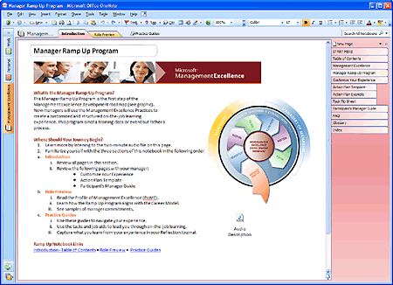
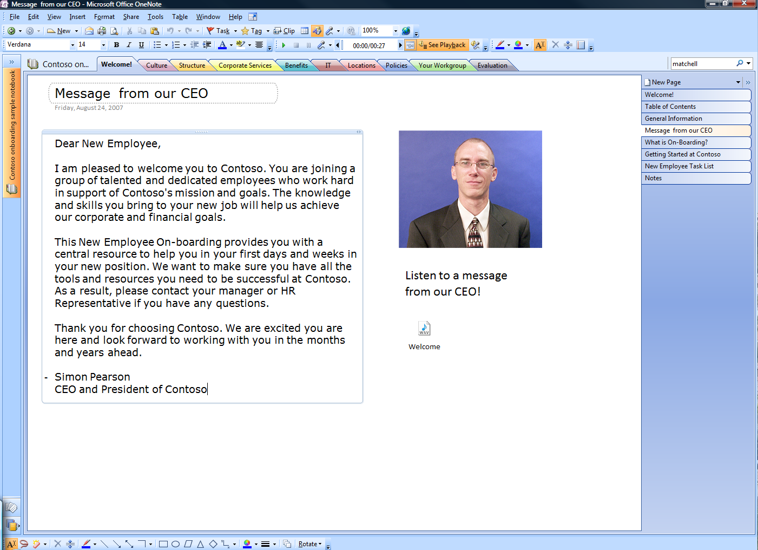
Reduce the environmental footprint with OneNote 2007
Move from paper notebooks to e-notebooks
http://office.microsoft.com/en-us/help/HA102377491033.aspx
Notes:
How OneNote 2007 can help to save the environment
OneNote 2007 can greatly reduce our environmental footprint over using paper notebooks. By using OneNote as a digital notetaking and distribution tool, we can replace not only paper-based notebooks, but even things like learning, training, and on-boarding materials. This can help minimize the number of trees we cut down, paper and package processing and associated byproducts, as well as the fuel associated with shipping such materials via air or ground.
How Microsoft is reducing its carbon footprint with OneNote 2007
Many teams at Microsoft have already changed many of their internal processes and materials to paperless versions. Existing training and on-boarding classes and their associated documentation have been converted into OneNote notebooks that are distributed electronically, and more and more are following this trend.
Here are a few examples of areas where Microsoft is reducing the use of paper and packaging:
Employee and Manager training classes
New Employee Orientation
Engineering Excellence classes
Sales and Marketing materials
Legal and Finance materials

Slide 44
Think about electronic workflows, too
Microsoft Office SharePoint Server 2007 comes with electronic workflow module
  Circulate information, run approval processes or requests vacations without printing forms
  Be up to date with automatic status reports
  Fully integrates in Office & Outlook
  Learn more about the
  Swiss Government Showcase OXBA
Store
Process
OXBA
eGov
Status control
http://www.oxba.admin.ch
Notes:
Most companies still uses paper workflows where people have to sign or fill out paper forms which will hardly be used later on like vacation requests or common approval / notification processes. MOSS 2007 based on SharePoint allows many of these workflows to be converted in electronic workflows. This avoids unnecessary printouts and allow much faster status reporting on these workflows. The Swiss Government has started to develop an e-government solution based on this technology which is offered to all interested organizations and which shows the capabilities of these workflows in a great way. The link (German only!) describes the solution:
It’s describing a case management solution for government purposes, which could be reused in any other vertical, too. It includes scanner solutions to integrate papers / letters from citizens in the workflow, and handles the rest fully electronically.

Slide 45



OXBA: solution for Public Sector
Notes:
Here are some screen shots from the OXBA example. The solution is based on MOSS, but highly customizable to allow CI and other ideas to be implemented. The UI from the MOSS server farm is visible in the webbrowser but can be implemented in the Office UI, too
(Click)
You see the customized Office UI. At the right corner, the multi language add-ons are visible, a feature missing out of the box in MOSS 2007.
(Click)
A short overview of the different workflows we ship in the OXBA solution out of the box.

Slide 46


Maybe you can avoid some travels
Office Live Meeting and Office Communication Server 2007 allow scheduled and ad-hoc audio video and web conferencing from 2 to thousands of people
See your counterparts in new ways
Notes:
Each travel today will have carbon footprint associated with it. Some travel more, some less. And it’s clear that not all travels can or even should be avoided! At the end we are humans and want to act and treated like humans which most often includes personal contacts including “touching” (smelling) the counterpart by shaking hands, kisses etc. depending on your culture. Nevertheless there are meetings which could be avoided at all and some which could be moved to audio / video or web conferencing. Without discussing the differences in details, it should be noticed that Microsoft is offering a full suite of solutions to address all the different needs of its customers: from small 1:1 conferences even with the free Windows Live messenger up to full company meetings with thousands of participants. The new roundtable device offering a 360 degrees panoramic view allows a new dimension of group conferencing compared to the classic video conferencing front to front.

Slide 47

If you still need to travel, do you always need a laptop with you?
Windows Mobile Devices are excellent for
  Emails, meetings, tasks and contacts
  Take notes on OneNote Mobile or Office Mobile (Word, Excel, PowerPoint)
  Run business applications like CRM or SQL
  Navigates you around with GPS and Pocket Streets
Fully managed with System Center
  Secured by device encryption and policies
Just a fraction of energy compared to laptops
Device | Email | Notes | Messaging | Idle
Laptop | 15,2 W | 14,2 W | 14,2 W | 14 W
PDA | 1,4 W | 1,3 W | 1,3 W | 1,2 W
Energy Consumption in Mobile Devices: Why Future Systems Need Requirements-Aware Energy Scale-Down; HP Labs, Palo Alto, CA, USA
Notes:
Often forgotten in the energy discussion are devices other than laptops and desktops: PDAs, smartphones or whatever name people would like to use. If you simply compare devices, the PDA needs a fraction of the typical laptop in normal usage scenarios.
Windows Mobile devices, available as phone or PDA devices offer nearly the same application support as full blown Windows devices: Office Mobile can be used to work on Word, Excel or OneNote documents and can sync / share them easily with PCs. Even Powerpoints can be reviewed on these devices (or edited with 3rd party software). In addition there are several business applications available for Windows Mobile including Microsoft CRM or SQL mobile versions. Working on these devices is getting better more and more with larger screens & high resolutions as well as integrated keyboards or voice control. Battery life is nowadays up to several days (phone versions) or at least a full working day (PDA) with Bluetooth, Wireless network or 3G / high speed connectivity.
Together with GPS support and mapping applications like Pocket Streets and others, they can replace in certain scenarios the need for laptops.
With the latest versions of Windows Mobile, Microsoft is offering full systems management support including device encryption and Group Policy management.

Slide 48
Savings summary for clients
Don’t depend on your users, depend on (group) policies
  Use sleep mode on efficient hardware
  Avoid unnecessary paper waste with smart printing
  Offer travel alternatives
Monitor your client hardware & settings with SC Configuration Manager 2007
  WoL allows maintenance at night
Notes:
Most important point here: You are in control with group Policies and Windows Vista. If you haven’t found so far a business case for Windows Vista, maybe the saving opportunities due to the guaranteed sleep mode might be one.
In addition, find out what you have and monitor the settings of your system to guarantee the most efficient environment for you. SC Configuration Manager with its DCM solution can help you with this challenge.

Slide 49
Summary or lessons learned

Slide 50
If we summarize the easy options:
By using software settings in Windows,
  Save ~12% per server (~420 KW per year)
    2 M server sold in Q2 2007
  Save 600 KWh per client (sleep vs. idle mode)
    40 M Windows Vista sold in H1 2007
And money is not everything you will save…
Notes:
Summary
While we have seen many options to save energy, most of them will come with some initial investments:
smarter hardware, mainly more efficient power supplies and modern processors
consolidation of machines whenever possible
Switching to new technologies like LCD instead of monitors and business PCs / laptops instead of full blown PCs.
Beside, there are easy to use software settings in Windows you can try in addition. Even if you “just” save 12% on your servers with the features in Windows Server 2003 SP1 or Windows Server 2008, or you power off your clients when you don’t need them, guaranteed and not trusted on humans, you can save a lot of energy and the associated costs. While this will help you to use your money more efficient instead for energy, you can also do soemthing positive for the environment, as you will see on the next slide.

Slide 51

There are environmental savings, too!
For a SMB (30 server, 500 PCs), this would be
Server and clients can save 321,000 KWh each year which is 62,500 CHF savings.
(0,2 CHF per KWh)
For 312,600 KWh wasted energy you need 350,000 m² of trees to reduce the amount of CO₂
(0,2-/ 0,4t CO₂ per 1,000KWh; ~3t CO₂ per 10,000m² wood per year
(gas / coal power plants), vendor and WWF information)
This CO₂ is the equivalent of 53 cars more on our streets
(12,000 KM per year with EU recommendation for cars: 130g CO₂; per km)
Notes:
The financial savings might not be interesting for your region due to cheap energy. Nevertheless, the energy costs will raise for sure in the future. And remember, the savings per clients per year are equivalent to the SA + MDOP amount so spend your money more wisely by investing in new functionality and not just “fuel”.
Some companies wants to be “green” so the other calculations are mainly for the “greenness” of these people. The example is for a midsize company. Many people can image these number much better than larger numbers. And they are impressive enough already so people will be willing to follow you afterwards:
Typical midsize company: 30 sever / 500 PCs:
Financial calculation (12% per server (s.a.) or 600 KW in average per client (s.a.))
Save 62,520 CHF per year (312,600 KWh / year)
30 server x 400W x 24h x 365d * 12% = 12,614 KW
500 PC x 600 KW savings = 300,000 KW
The other calculation:
1,000 KWh ~ 0,338 t CO₂ (coal) or 0,198t CO₂ (gas) (industry numbers)
The average coal power plant (listed at WWF) will generate 0,4t of CO₂ per 1,000 KWh
The worst coal power plants (listed at WWF) will even generate 1,3t of CO₂ per 1,000 KWh
The saved energy of 312,000 KWh is around 62,4t CO₂ for gas or 105 for CO₂ coal power plants (vendor information, not WWF).
Nuclear energy requires also a lot of CO₂ during production of the nuclear energy pellets. They are not better than the mentioned coal and gas power plants.
The EU recommendation for cars is 130g CO₂ per km. With 12,000 KM per year (average utilization for most insurance companies) this will give us 1,56t CO₂ per car per year. With the 62,4t or 105t CO₂ above this will bring us to 40 or 67 cars or the 53 cars in average of coal and gas.
Now for the trees:
They are converting 1,4 to 15t C per Hektar (10,000m²) of wood, depending on the kind of trees growing there. The average is 2-5t CO₂ per Hektar. So for 62,4t CO₂ we would need 170,000 m2 (with 3t in average) or 350,000 (3t in average) for 105t CO₂ of coal power plants.

Slide 52

The key, again, is “knowing”
  http://www.microsoft.com/dynamics/environment.mspx
Notes:
As mentioned often in the presentation, knowing is always the key to improve. You a all know a similar quote like:
If you cannot measure it, you cannot improve it. And that’s true.
System Center Configuration Manager is key for your infrastructure for all kind of areas: components, settings (and licenses etc, too).
For your company, you might be interested to hear that Microsoft Dynamics AX has started to work on a new dashboard to monitor your company carbon footprint. An ERP tool is probably the best way to do this, as it has all your company information in a single place.
A similar dashboard is currently created together with and for communities and cities and will be released end of 2007 .

Slide 53

Microsoft takes care about waste
Notes:
Microsoft itself has clear guidelines to be a “good citizen” in all areas; but in environmental aspects, too. Avoiding waste, recycling as much as possible and using renewable resources are clear guidelines for the company. In addition, we are helping others to take care about the e-waste:

Slide 54


Microsoft takes care about “e-waste”, too
http://www.digitalpipeline.org/
Notes:
How Digital Pipeline works
Digital Pipeline connects organisations who wish to donate used computers to organizations that need them. We have established a group of trusted Partners who operate under the highest ethical and quality standards, to facilitate the refurbishment and distribution of used computers to Beneficiaries.
Making a donation:
There are three ways to make a donation.
The first option enables organisations to donate their own used PCs to DP Deployment Agents who specialise in providing refurbished computers to technologically excluded schools and communities in Africa and other parts of the world.
Deployment Agents manage the whole process from start to finish, including collection and refurbishment of the donor’s PCs to Digital Pipeline standards so they are ready for use by Beneficiaries. These standards require every PC to be data wiped by DP Refurbishers using approved data eradication software products to protect the Donor’s privacy. All partners who handle donated PCs are expected to do so in a legally compliant and ethical way that protects the interests of Donors and Beneficiaries.
Donors are expected to cover their Deployment Agent’s costs for managing their PC donations to Digital Pipeline standards and are also expected to pay a Recycling Fee of £10 for each donated PC that’s registered with Digital Pipeline. This is set aside by Digital Pipeline in a Recycling Fund that pays Deployment Agents to remove and recycle PCs that are no longer useful, from areas where they deploy registered PCs. Remaining funds from these fees are used by Digital Pipeline to cover its costs for activities such as tracking PCs, providing Donor reports, auditing partners and managing its operations.
Another option enables organisations to refurbish and sell their decommissioned PCs or any other type of ICT equipment through a DP Refurbisher and donate the proceeds to Digital Pipeline, so it can use such donations to fund PC purchases for Beneficiaries, PC recycling and other activities.
If neither of these options is suitable, organisations or individuals can support Digital Pipeline’s activities by making a straightforward donation of funds.
Providing PCs and support to Beneficiaries:
PCs are delivered to Beneficiaries by DP Deployment Agents who assess the needs of Beneficiaries and provide services where needed such as installation, training, maintenance and support so that Beneficiaries can fully benefit from the PCs that they receive.
Beneficiaries pay a Digital Pipeline administration fee of £5 per PC and their Deployment Agent’s costs for arranging PC delivery. Beneficiaries are also expected to pay for any additional services that they request from their Deployment Agent.
Quality standards:
PC refurbishment is carried out by DP Refurbishers who work in accordance with Digital Pipeline quality standards that mitigate business risks and support legal requirements for Donors as well as ensuring that every PC provided to Beneficiaries is safe and fit for purpose.
Every PC must therefore be free of its previous owner’s data, safety tested and ready to use with a monitor, keyboard, mouse and operating system installed.
Tracking and reporting:
Digital Pipeline manages a PC Tracking System that enables Partners to register and keep track of any Digital Pipeline PCs that they handle.
PCs are first registered with Digital Pipeline by their original DP Refurbisher – this involves providing serial numbers and other information that helps to identify them. Deployment Agents who handle the PCs en route to their final Beneficiaries update this information so that Donors can be provided with status reports and Digital Pipeline can perform audits.
Digital Pipeline’s PC Tracking System, donor reports and independent partner audits give Donors added confidence that their donations are being managed in a professional and ethical way and that their preferences are being respected.
Recycling Fund:
Digital Pipeline is focused on reducing environmental pollution from electronic waste in areas that it serves, particularly in developing countries where this is a growing threat to the local environment and people’s health.
Digital Pipeline has established a Recycling Fund that provides incentives for our Partners to remove and responsibly recycle PCs that are no longer useful from these areas. Our policy is that for every Donor PC that is sent out, another PC that has reached the end of its useful life or an equivalent weight in PC components should be recycled in its place. Digital Pipeline keeps track of exactly what has been recycled by Partners and when to ensure that the appropriate quantities and weights of PCs or components have been recycled within a reasonable timescale.
The Recycling Fund is funded by fees that are levied by Digital Pipeline on donated PCs when these are registered with Digital Pipeline and is also funded by individuals and organisations that make cash donations to Digital Pipeline.

Slide 55
Lessons learned (or your next steps):
Find out your energy consumption in IT
  Server, desktops, laptops (per model maybe?)
  Cooling and data center costs (as part of total)
  Maybe a redesign saves cooling costs?
Make energy one of your purchase criteria
  Contact your hardware vendors
Take a look at the new software options
  Vista, Windows 2003 and dynamic IT
Think Green!
Notes:
Lessons learned
If customer is interesting, Microsoft Consulting Services and Microsoft partners can help with infrastructure optimization, a first step on the way to Green IT.

Slide 56
Resources
WinHEC 2007 Presentation
Windows Server Power Management
    http://download.microsoft.com/download/a/f/d/afdfd50d-6eb9-425e-84e1-b4085a80e34e/SVR-T327_WH07.pptx
White Papers
  Processor Power Management in Windows Vista and Windows Server 2008
    http://www.microsoft.com/whdc/system/pnppwr/powermgmt/ProcPowerMgmt.mspx
  How to Enable Processor Power Management in Windows Server 2003
    http://www.microsoft.com/whdc/system/pnppwr/powermgmt/w2k3_ProcPower.mspx
  Windows Vista Energy Conservation
    http://www.microsoft.com/whdc/system/pnppwr/powermgmt/VistaEnergyConserv.mspx
  What Microsoft is doing
  http://www.microsoft.com/presspass/download/features/2007/SustainabilityFactSheet.doc
The Green Grid organization
http://www.thegreengrid.org
Estimate your power savings
http://pmdb.cadmusdev.com/powermanagement/quickCalc.html
Notes:
Useful resources and links for your customers.

Slide 57

Learn more for your private life, too
  http://liveearth.msn.com/
Notes:
And for your private life, start think about changes, too. MSN LiveEarth has tons of information how to start.Every small step will help!

Slide 58

Microsoft

Slide 59
Customer questionnaire
Who owns the energy costs? (IT or facilities)
  Is energy part of your IT budget already?
    Could you split the costs down to consumers (server, desktop, storage…)
  Do you plan for energy cost rise?
Could you measure IT energy consumptions?
  By server type, desktops, datacenter aisle…
  Are you aware about trends (day / week / weekend / month)?
  Do you have a list of your top consumers?
Would you try the suggested power settings?
  Are server or client more important?
  Could you measure the impact? (baselines before / afterwards)
Do you care about additional steps?
  End user awareness (“Sleep is good”)
  Lighting & environmental improvements…
  “Paperless office”
Please see slide notes for more information!
Notes:
Microsoft Switzerland, namely Frank Koch (Bern) (mailto:frankoch@microsoft.com) is looking for customers from all segments to do a real world test of the suggested power settings on your servers and / or desktops. A typical engagement could look like this:
Servers:
Identify potential servers
If load is at 80%+, the chance to find free processor cycle are minimum at the estimated effect is minimal, maybe to small to be measured
A script is provided to be executed on all test servers to identify the possible p-states. By this list, good test candidates are chosen.
A power baseline should be created (1-2 weeks of average consumption)
The power settings (dynamic settings) are done (manual or by script)
A new power baseline is created
The results are compared
Estimated time efforts at customer: 2 day
half day intro & identify test servers
¼ day implementing of the power baseline measurement
¼ day implementing of the new power settings
¼ day implementing of the second power baseline measurement
¼ day sharing the results with Frank Koch to create the final report & presentation
half day summary presentation of the findings (done by Frank Koch)
Outcome summary report (1-2 pages) & PPT with the results, to be used within the customer
We would kindly ask to share the results anonymously for a Swiss wide study about these settings implemented at different customers of different size & segment.

