Slide 1
Windows Server 2008 and the Green Datacenter
Ward Ralston
Senior Technical Product Manager
Microsoft Corporation

Slide 2
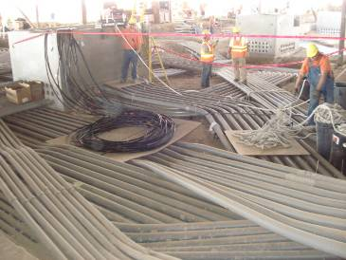
What's a Green Datacenter?
Electricity
Cooling
Facilities Design
Organization
Monitoring and Reporting
Power Saving Checklist
Power Efficient Hardware
Server Consolidation
Revamping Power and Cooling
Overhaul Wasteful Power
Investigate DC Power

Slide 3
What is going on in the industry
Green is In
Green is top VC funding
1.5% of US electricity in DC
Higher density computing
Blades are being deployed
Industry taking initiative
Or gov’t agencies will
Data Center Dynamics Conf

Slide 4
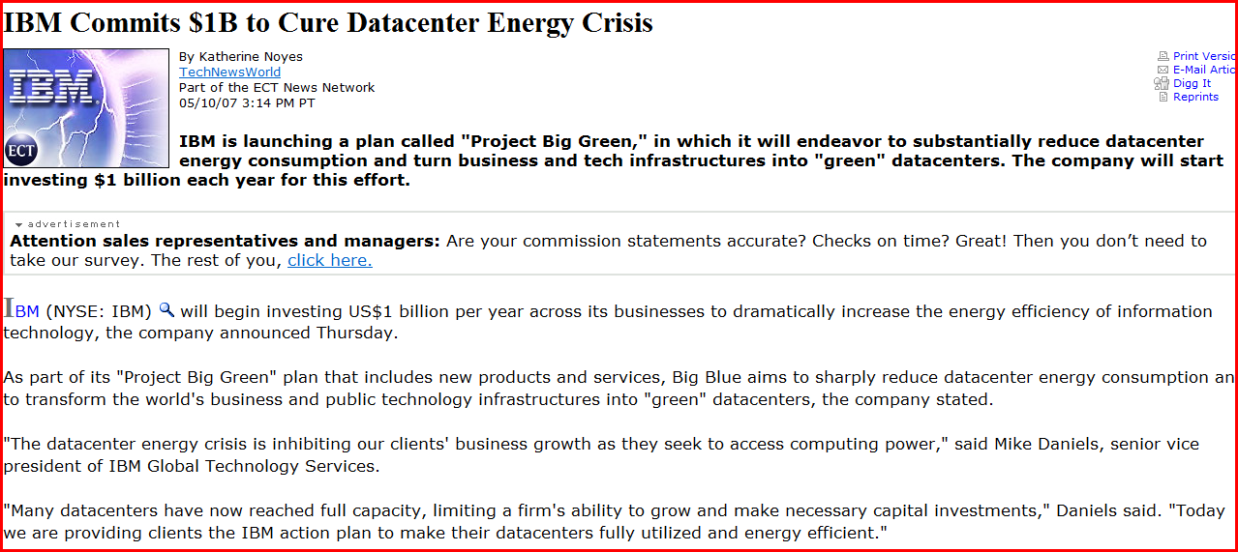
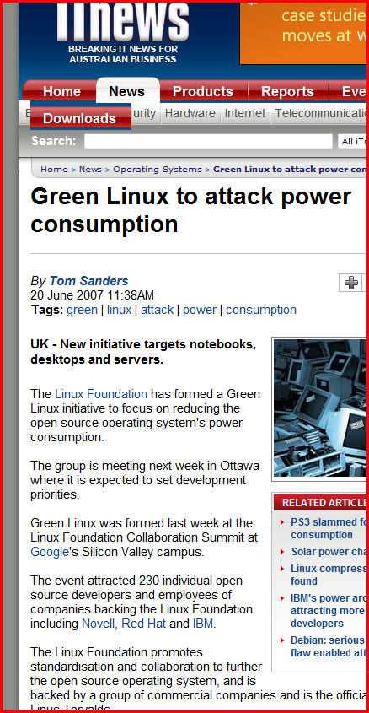
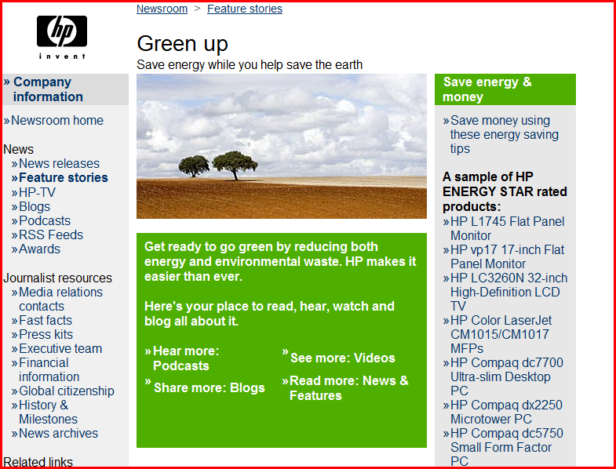
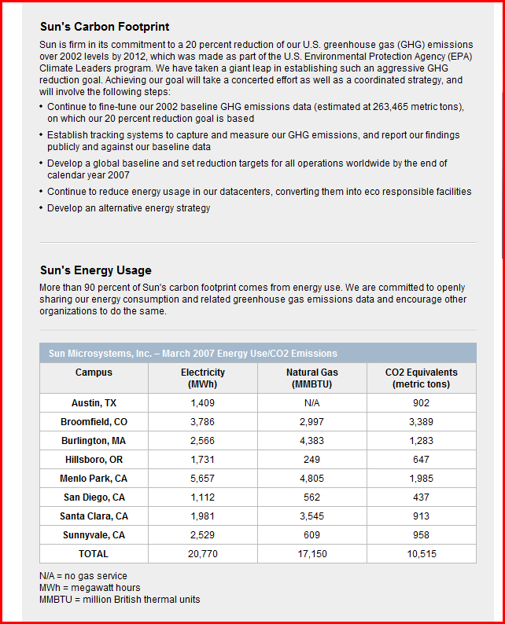
Industry interest

Slide 5
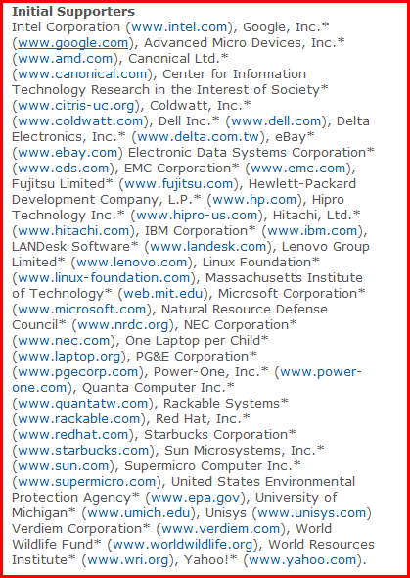

Slide 6
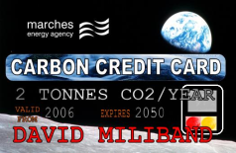
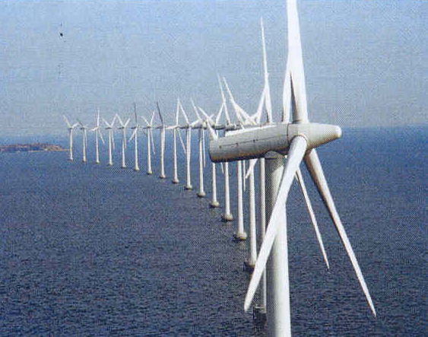
Public policy
Public Law 109–431 109th Congress
An Act To study and promote the use of energy efficient computer servers in the United States
EPA and Energystar working on DC and Servers Recommendations
Utilities experimenting
Incentives, rebates – HW & Virtualization
Carbon Credits
Renewable Energy Credits

Slide 7
Competition & Industry
Green Executives – Director and VPs
Win Svr 2008 partners
AMD, Intel, HP, Dell
Performance per watt
It’s not about the facts
It’s Marketing, PR
Linux power saving momentum
Catching up on Laptops

Slide 8
Example Server Power Budget
Processor power management represents the best opportunity today
Source: Intel Server Products Power Budget Analysis Tool
http://www.intel.com/support/motherboards/server/sb/cs-016976.htm

Slide 9
Windows Server 2008 Power Management
Windows Server 2008 fully support platform power management capabilities
Device, processor power management
AMD PowerNow
System sleep
Control through Group Policy
The most relevant power savings features for servers today are:
Processor power management
PCI Express Active State Power Management
Allen Marshall Principle Program Manager Windows Core Platform Architecture

Slide 10
Processor Power Management Benefits
Mature, reliable technology
Significant deployments in mobile, desktop systems
Capable server processors are prevalent in the market today
Offers considerable power savings with negligible impact to performance, responsiveness
Balances power savings with CPU utilization
Throttles frequency and voltage to CPU
Scale performance state based on workload
Enter processor sleep states when idle (no thread ready to run)
No user intervention required
Managed by the operating system
Manageable with Group Policy
Fully supported by Windows
Windows Server 2003 – not on by default
Windows Server 2008

Slide 11
Virtulization
Add a VS Slide Ward
Addresses Server Sprawl
Typical consolidation is 8:1
MS Seeing 5:1

Slide 12
Multi-Core Power Efficiency
System Power
Performance
(measured system Watts)
(business operations per second)
Intel® Core™ Microarchitecture
Exceptional Software Scaling
Same Power Envelope
Outstanding Performance per Watt
Lower is better
Higher is better
1.5X more
Data Source: Published or Intel measured results as of Oct 9, 2006 using SPECjbb2005*
Over 4X
Single-Core
Dual- Core 5160
Quad- Core E5345
Single-Core
Dual- Core 5160
Quad- Core E5345
3.60 GHz
3.00 GHz
2.33 GHz
3.60 GHz
3.00 GHz
2.33 GHz
More Performance in a Stable Power Infrastructure
Performance tests and ratings are measured using specific computer systems and/or components and reflect the approximate performance of Intel products as measured by those tests. Any difference in system hardware or software design or configuration may affect actual performance. Buyers should consult other sources of information to evaluate the performance of systems or components they are considering purchasing. For more information on performance tests and on the performance of Intel products, visit http://www.intel.com/performance/resources/limits.htm or call (U.S.) 1-800-628-8686 or 1-916-356-3104.
Notes:
Frequency Goes Down
CPU Power has Gone Down (110W with single core) … now 80W with both Dual-core and Quad-Core
But Performance has gone up over 4X
Resulting in 4.5X performance / watt
Same system power
Better Performance
Make that takeaway

Slide 13
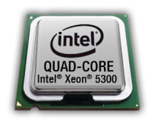
Quad-Core Intel® Xeon® Processor 5300 Series Integer and Java performance for Windows Server 2003*
SPECint*_rate_base2000*
SPECjbb2005*
Higher is better
Enhanced General- Purpose Computing
Higher is better
Faster Server-Side Java Enterprise Applications
Business operations per second
2.53x
2.61x
Data Source: Published or measured results as of Nov 13, 2006. See backup for details
Up to 150% (2.5x) Better Performance than AMD Opteron*-based DP Platforms
Dual-Core Xeon 5160 – Dual-Core Intel® Xeon® Processor 5160; (“Woodcrest 3.00 GHz”); Quad-Core Xeon X5355 – Quad-Core Intel® Xeon® Processor X5355; (“Clovertown 2.66 GHz”); Dual-Core Opteron 2220 – Dual-Core AMD Opteron* Model 2220SE (“2.80 GHz”); Xeon 3.60GHz – 64-bit Intel® Xeon® Processor 3.60; (“Irwindale 3.60 GHz”);
Performance tests and ratings are measured using specific computer systems and/or components and reflect the approximate performance of Intel products as measured by those tests. Any difference in system hardware or software design or configuration may affect actual performance. Buyers should consult other sources of information to evaluate the performance of systems or components they are considering purchasing. For more information on performance tests and on the performance of Intel products, visit http://www.intel.com/performance/resources/limits.htm or call (U.S.) 1-800-628-8686 or 1-916-356-3104.
13
Notes:
13
xeon single core 3.6 Ghz
intel dual core is woodcrest at 3 ghz
quad is clovertown 2.66 ghz
dual core opteron 2.8 Ghz

Slide 14
Server Power Management Future Directions
Windows Server will extend APIs to better enable centralized management
Efforts underway to standardize measuring power consumption at the chassis level
Facilitates server power budgeting
Platform technology improvements continue
Advanced CPU power features drive into server SKUs
Server memory power is now under scrutiny
NIC link rate scaling offers power savings

Slide 15
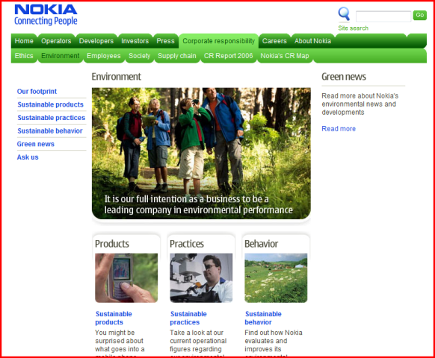
Customers are interested examples
Nokia
BOSCH
Vodafone
Nestle
Credit Suisse
HSBC
Unilever
Philips
EDS
“No, we are very interested in green computing. You just aren’t talking to us about it yet.”
“Big deal for Credit Suisse, considering new generation sparc and desktop workload centralisation for greeness ( =cost reduction ).”
“HSBC are the worlds only carbon neutral bank and proud of it.
They are keen to understand what we are doing in these areas,...”
“One of my themes for the year actually”
Joseph Williams Global Technology Director, EPG

Slide 16
Consensus growing on Environmental Impact
Public
Opinion increasing
The Cost of Energy
rising
Datacenter Energy Consumption rising
Government Laws / Regulations
increasing
Consumer Demand
Increasing
Shareholder Demand
Increasing
Corporate
Customer Demand
Increasing
Competition
Ripe Technology
Analyst, Industry forums, press
The Green Datacenter
Inflection point

Slide 17
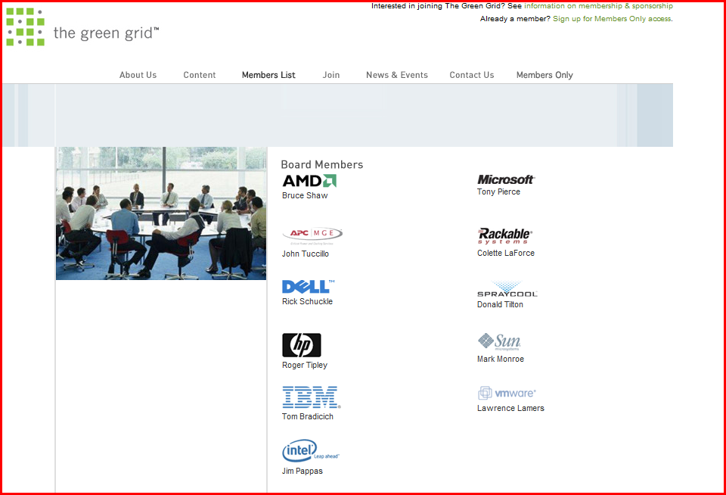
Green Datacenter Leadership Activity:
Many passionate internal teams and individuals
DPE
Environmental Compliance
EPG
Global ISV
Live/MSN
MCS
Mgmt & Infrastructure solution accelerator team
OS Kernel Product team
Public Sector
Research & Strategy
SLG
Strategic Relations
Virtualization Product team
Windows Server team
listed alphabetically

Slide 18
Green Efforts from Microsoft the new GDI
Green Datacenter Initiative
3.
Four areas”
Evangelize and Communicate
Partner
Learn
Adapt
Field Purposed
Credibility and Collateral
Communication and Collaboration (example: greendc)
Competitive and Industry understanding
Everyone can contribute
Green Efforts from Microsoft
Good Citizenship / Eco Projects (cool)
Consumer green computing
Green Datacenter Initiative

Slide 19
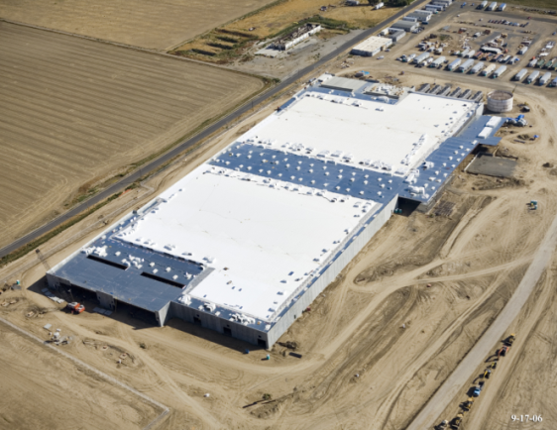
How important is the Green Data Center?
Michael Manos Sr. Director MSN/Windows Live
Over the last 3 months
Over 14 requests for customer visits
10 requests for EBCs
Weekly emails requesting more information
MS Executives at all levels asking
What are the costs of the data centers?
What is being done to improve the efficiency?

Slide 20
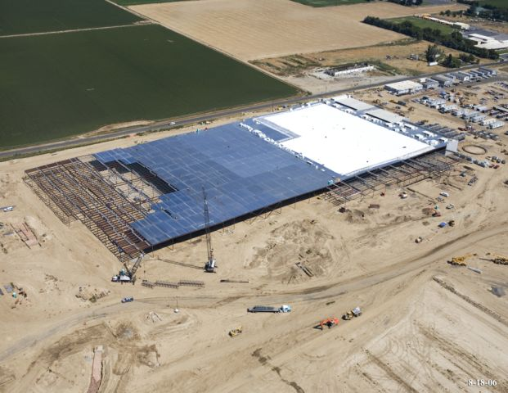
Real World
The Quincy Video can be used with customers
What goes on in building a data center
Power monitoring
Branch circuit monitoring
What products
Application Monitoring
Reporting

Slide 21
Making the Right Design Decisions
Electricity
Cooling
Facilities Design
Organization
Monitoring and Reporting
Companies who can help customers build energy efficient data centers
Lee Technologies, OSIsoft, Ascent Technologies, EYP

Slide 22
Resources Windows Power Management
WinHEC 2007 Presentation
Windows Server Power Management
http://download.microsoft.com/download/a/f/d/afdfd50d-6eb9-425e-84e1-b4085a80e34e/SVR-T327_WH07.pptx
White Papers
Processor Power Management in Windows Vista and Windows Server 2008
http://www.microsoft.com/whdc/system/pnppwr/powermgmt/ProcPowerMgmt.mspx
How to Enable Processor Power Management in Windows Server 2003
http://www.microsoft.com/whdc/system/pnppwr/powermgmt/w2k3_ProcPower.mspx
Power Policy Configuration and Deployment in Windows Vista
http://www.microsoft.com/whdc/system/pnppwr/powermgmt/PMpolicy_Vista.mspx
Optimizing Windows Vista Platforms for Energy Efficiency
http://www.microsoft.com/whdc/system/pnppwr/powermgmt/Optimize_Power.mspx
Windows Vista Energy Conservation
http://www.microsoft.com/whdc/system/pnppwr/powermgmt/VistaEnergyConserv.mspx
Notes:
3/5/2008 3:45 PM
© 2005 Microsoft Corporation. All rights reserved.
This presentation is for informational purposes only. Microsoft makes no warranties, express or implied, in this summary.
22

Slide 23
Calls to Action
Join the Internal Green Datacenter Alias
greendc
Contribute and use the Green Datacenter Team site
http://sharepoint/sites/greendatacenter/default.aspx
Add GDI in your FY08 commitments
Contact us for help: Lewis Curtis (lcurtis) and Dave Ohara (v-daveo)
Work with your customers on Green Datacenter initiatives
Notes:
3/5/2008 3:45 PM
© 2005 Microsoft Corporation. All rights reserved.
This presentation is for informational purposes only. Microsoft makes no warranties, express or implied, in this summary.
23

Slide 24
© 2007 Microsoft Corporation. All rights reserved. Microsoft, Windows, Windows Vista and other product names are or may be registered trademarks and/or trademarks in the U.S. and/or other countries.
The information herein is for informational purposes only and represents the current view of Microsoft Corporation as of the date of this presentation. Because Microsoft must respond to changing market conditions, it should not be interpreted to be a commitment on the part of Microsoft, and Microsoft cannot guarantee the accuracy of any information provided after the date of this presentation. MICROSOFT MAKES NO WARRANTIES, EXPRESS, IMPLIED OR STATUTORY, AS TO THE INFORMATION IN THIS PRESENTATION.

Slide 25
PowerPoint Template Subtitle color
Example of a slide with a subhead
Set the slide title in “title case”
Set subheads in “sentence case”
Generally set subhead to 40pt or smaller so it will fit on a single line
The subhead color is defined for this template but must be selected; In PowerPoint 2007, it is either the second or the fifth font color from the right

Slide 26
PowerPoint Guidelines
Font, size, and color for text have been formatted for you in the Slide Master
Use the color palette shown below
See next slide for additional guidelines
Hyperlink color: www.microsoft.com
Sample Fill
Sample Fill
Sample Fill
Sample Fill
Sample Fill
Sample Fill

Slide 27
Bar Chart Example

Slide 28
Pie Chart Example

Slide 29
Line Chart Example

Slide 30
Area Chart Example

Slide 31
Demo Title
demo
Name
Title
Group

Slide 32
Video Title
video

Slide 33
Partner Title
partner
Name
Title
Group

Slide 34
Customer Title
customer
Name
Title
Group

Slide 35
Announcement Title
announcing

Slide 36
© 2007 Microsoft Corporation. All rights reserved. Microsoft, Windows, Windows Vista and other product names are or may be registered trademarks and/or trademarks in the U.S. and/or other countries.
The information herein is for informational purposes only and represents the current view of Microsoft Corporation as of the date of this presentation. Because Microsoft must respond to changing market conditions, it should not be interpreted to be a commitment on the part of Microsoft, and Microsoft cannot guarantee the accuracy of any information provided after the date of this presentation. MICROSOFT MAKES NO WARRANTIES, EXPRESS, IMPLIED OR STATUTORY, AS TO THE INFORMATION IN THIS PRESENTATION.

