Slide 1
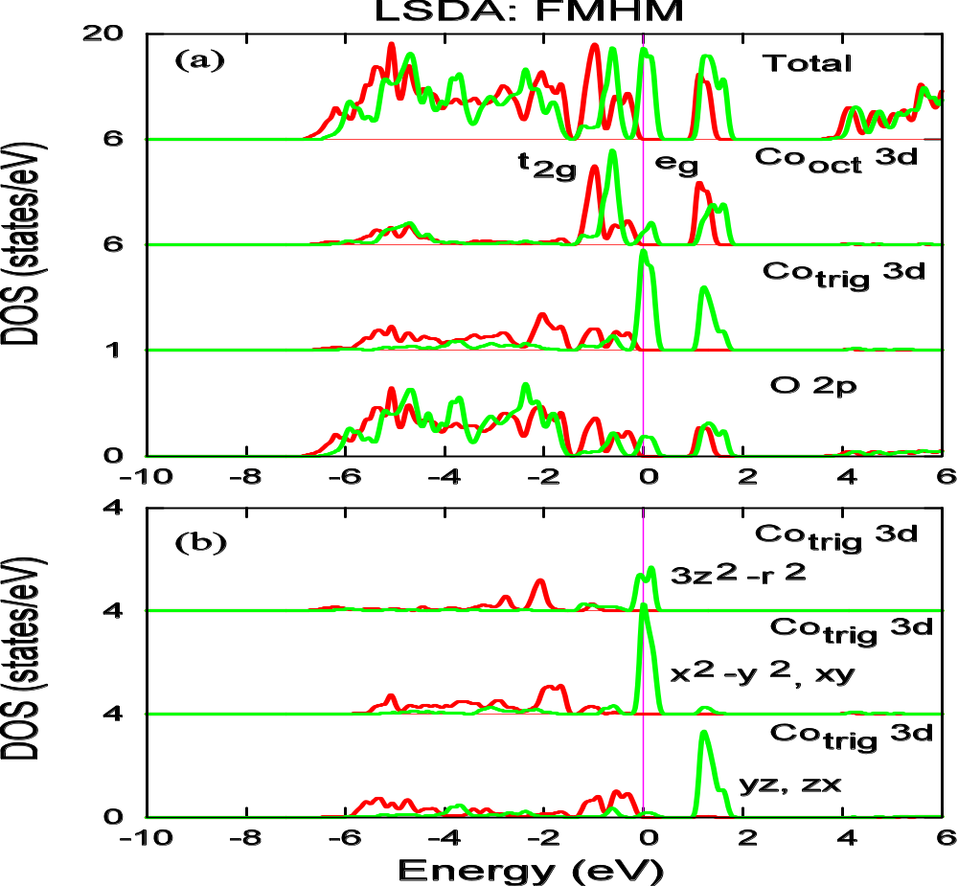
The near degeneracy leads to
the so-called half-metallicity

