Slide 1
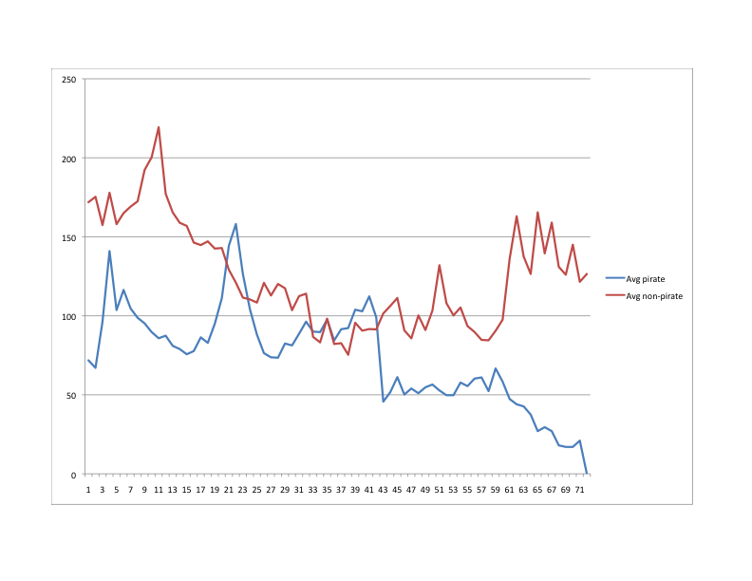
Average sales (weeks after pub date)
Average week at which seeded content first seen

Slide 2
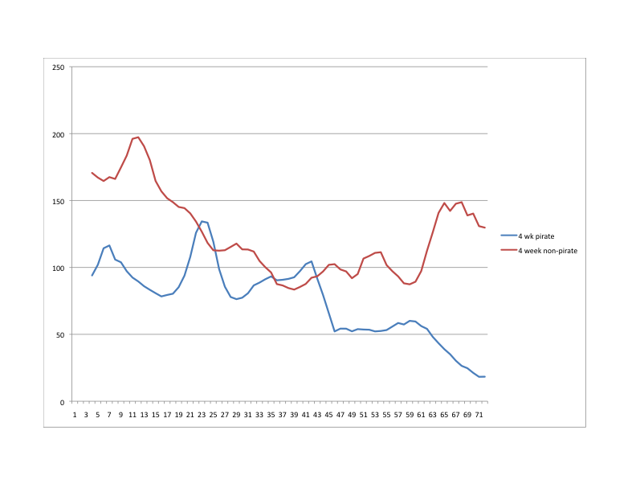
Four-week rolling averages
Average week at which seeded content first seen

