Slide 1
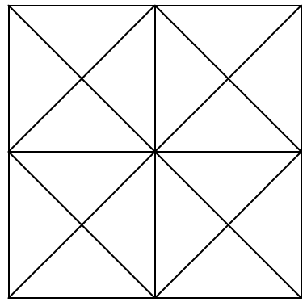
Don had p coins. Then he found 86 more coins in a drawer. Choose the expression that shows how many coins Don has now.
Maths Starter
Question 1
Don had y coins. Then he found 86 more coins in a drawer but lost 45 of the coins going down stairs. Choose the expression that shows how many coins Don has now. Is it:
86
86+y-45
y
y-86+45
Question 2
Pat has r red peppers, 79 green peppers and 23 orange peppers. Choose the expression that shows how many peppers Pat has. Is it:
r+79+23
r-79-23
79
79-r+23
Question 3
How many triangles can you see?
Question 3
How many triangles can you see?

