Slide 1
Software Testing
A New Approach for ABC inc.

Slide 2
Agenda
Overview of current process
Review of strengths and weaknesses
Overview of proposed new process
What is Session-based Testing?
Why should we include it in our testing process?
Prototype dashboard demonstration
Review of strengths and weaknesses
Q & A

Slide 3
Overview of Current Process

Slide 4
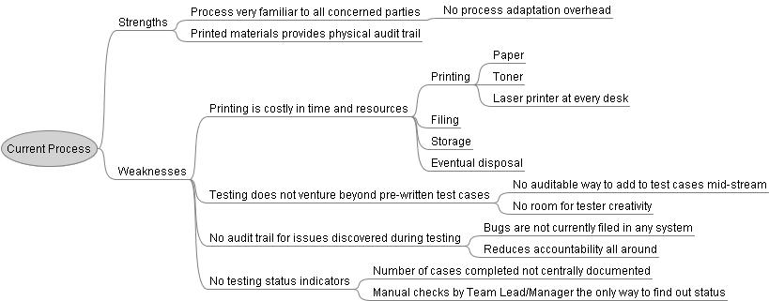
Current Process – Strengths and Weaknesses

Slide 5
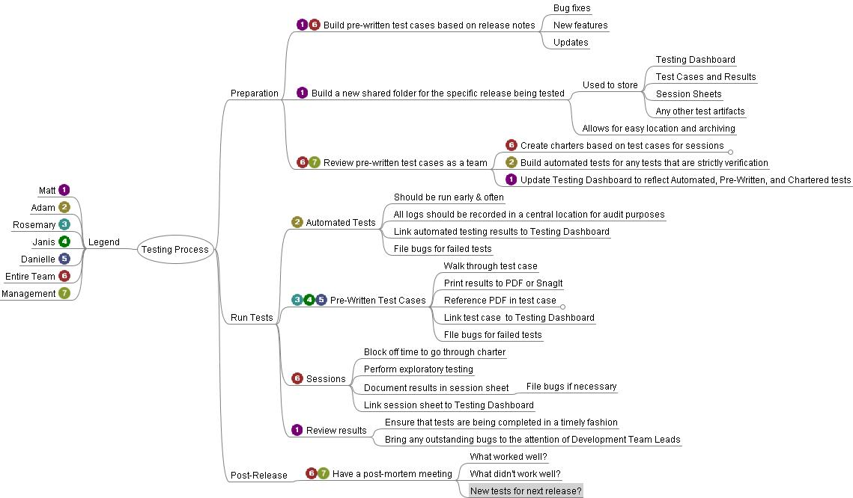
Overview of proposed new process

Slide 6
What is Session-Based Testing?
A testing tool which applies a process to Exploratory Testing for the purpose of gathering metrics and other useful data
“... structured exploratory testing, which may seem like a contradiction-in-terms, but "structure" does not mean the testing is pre-scripted. It means we have a set of expectations for what kind of work will be done and how it will be reported.”
James Bach, Satisfice Inc., http://www.satisfice.com/sbtm/

Slide 7
Why should we include it in our testing process?
Allows for rapid testing, especially where specifications are unavailable or incomplete
“Exploratory testing is unscripted, unrehearsed testing. Its effectiveness depends on several intangibles: the skill of the tester, their intuition, their experience, and their ability to follow hunches. But it's these intangibles that often confound test managers when it comes to being accountable for the results.”
“We invented Session-Based Test Management as a way to make those intangibles more tangible. ”
James Bach, Satisfice Inc., http://www.satisfice.com/sbtm/

Slide 8
Prototype Dashboard Demonstration
A source of information on the current state of testing
Allows audit trail of testing work

Slide 9
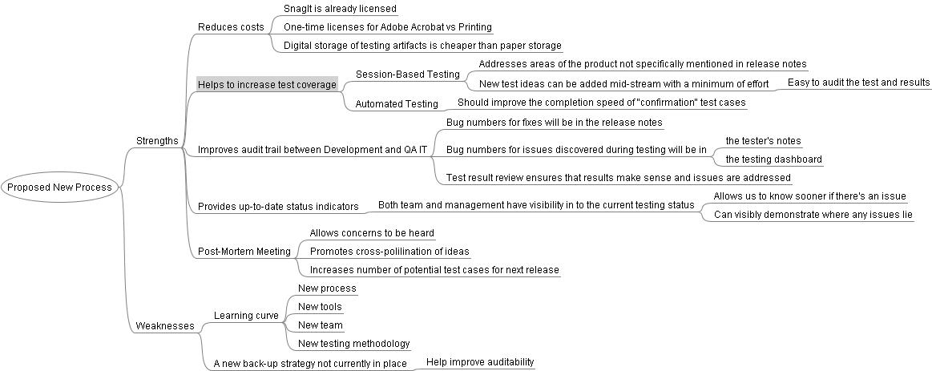
Suggested New Process - Review of Strengths and Weaknesses

Slide 10
Thank You
Next Up:
Question & Answer Session

