Slide 1
Here I Am To
// Light Of The World

Slide 2
Light of the world
You stepped down
Into darkness
Opened my eyes
Let me see

Slide 3
Beauty that made this heart adore You
Hope of a life spent with You

Slide 4
Here I am to worship
Here I am to bow down
Here I am to say that You’re my God

Slide 5
You’re all together lovely
All together worthy
All together wonderful to me

Slide 6
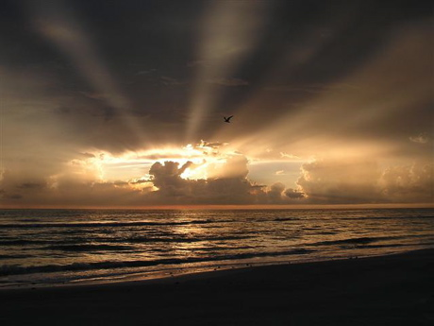
King of all days
Oh so highly exalted
Glorious in heaven above

Slide 7
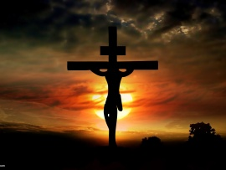
Humbly You came to the Earth You created
All for love’s sake became poor

Slide 8
Here I am to worship
Here I am to bow down
Here I am to say that You’re my God

Slide 9
You’re all together lovely
All together worthy
All together wonderful to me

Slide 10
I’ll never know
How much it cost
To see my sin
Upon that cross

Slide 11
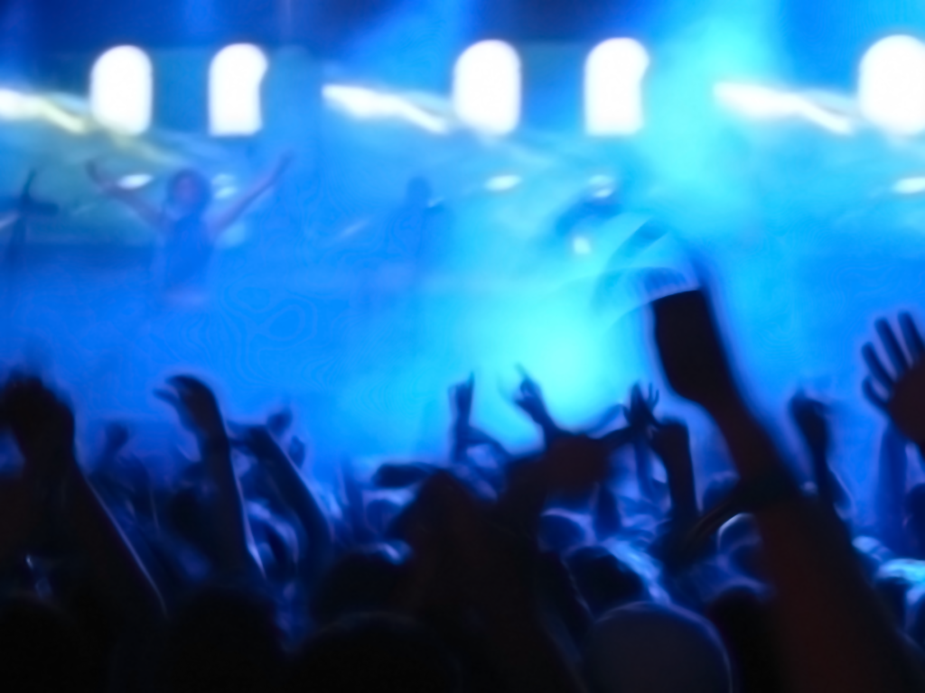
I worship You Hallelujah, Hallelujah I worship You for who You are

Slide 12
Better is One Day

Slide 13
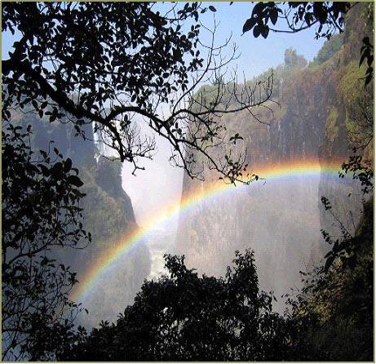
How lovely is Your dwelling place
Oh Lord Almighty
For my soul longs and even faints
For You

Slide 14
Oh, here my heart is satisfied
Within Your presence
I sing beneath the shadow of Your wings

Slide 15
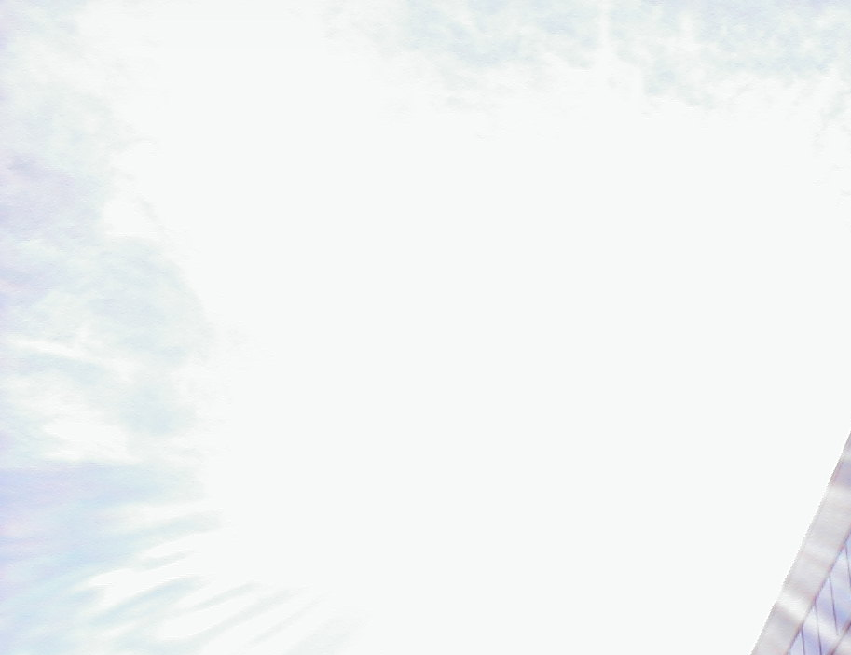
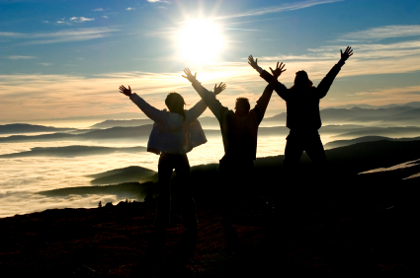
Better is one day in Your courts
Better is one day in Your house
Better is one day in Your courts
Than
thousands
else
where

Slide 16
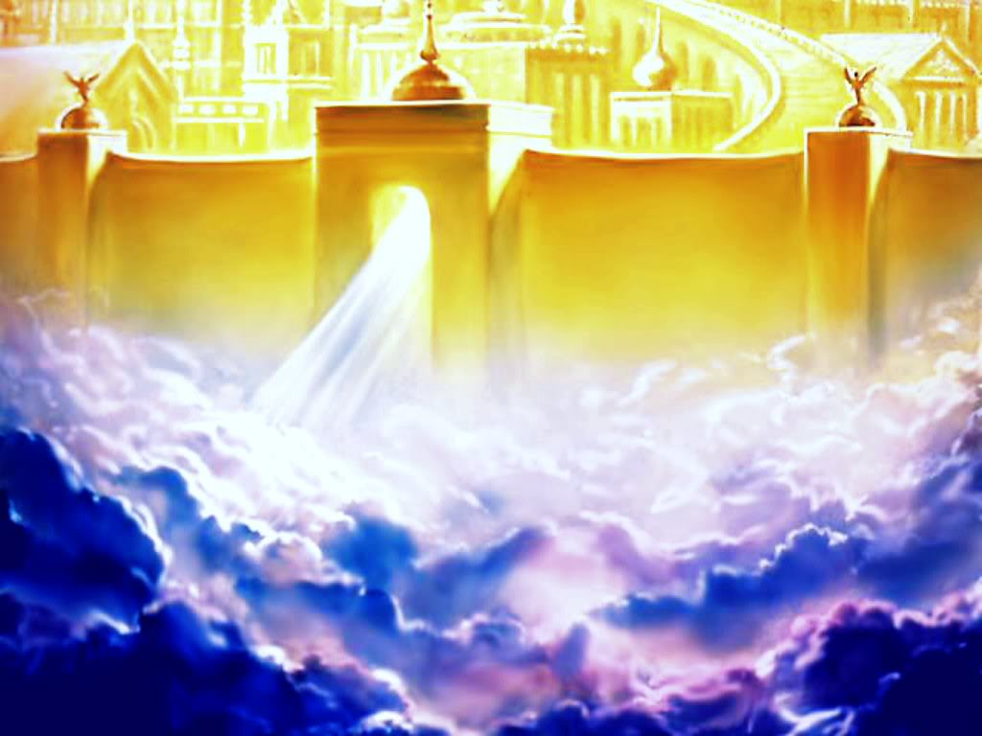
Better is one day in Your courts
Better is one day in Your house
Better is one day in Your courts
Than thousands elsewhere
Thousands elsewhere

Slide 17
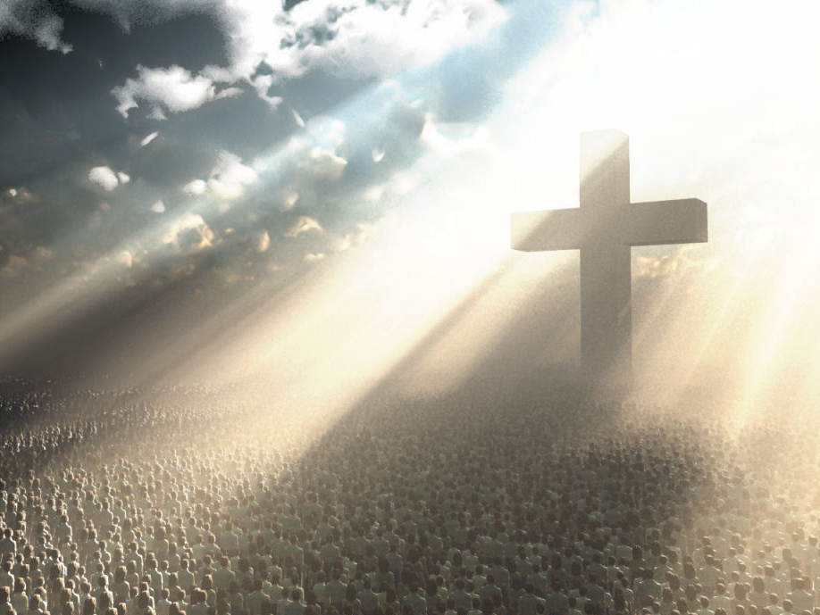
One thing I ask and I would seek
To see Your beauty

Slide 18
To find You in the place
Your glory dwells

Slide 19
Better is one day in Your courts
Better is one day in Your house
Better is one day in Your courts
Than thousands elsewhere

Slide 20
Better is one day in Your courts
Better is one day in Your house
Better is one day in Your courts
Than thousands elsewhere
Than thousands elsewhere

Slide 21
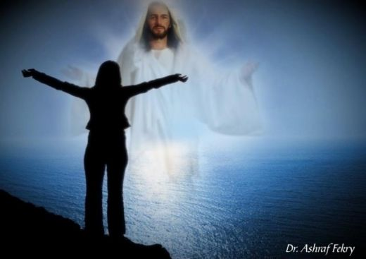
My heart and flesh cry out
For You the living God
Your Spirit’s water to my soul

Slide 22
I’ve tasted and I’ve seen
Come once again to me
I will draw near to You
I will draw near to You

Slide 23
Better is one day in Your courts
Better is one day in Your house
Better is one day in Your courts
Than thousands elsewhere

Slide 24
Better is one day in Your courts
Better is one day in Your house
Better is one day in Your courts
Than thousands elsewhere
Than thousands elsewhere

