Slide 1
History of Timepieces
Jerri L. Landis
American Intercontinental University
PRES111-1101B-08

Slide 2
INTRODUCTION
Clocks and watches have been around in one form or another for centuries. The history and steps that has evolved to produce the watches of today is a long and fascinating road.
Giving the styles and countries the inventors have come from has helped to make clocks and watches what they are today.

Slide 3
THE BEGINNINGS
The Stars and the Sun were the first natural tools used to tell time.
The Egyptians were the first to create the sundial in 1500 BC.
The sundial uses the shadows of the sun to tell time.
Around 4000 BC, the Egyptians discovered that by using the stars and the moon, they could not only tell time but created a calendar.
Notes:
The sundial's dial or upright stick is used to produce a shadow that will tell the time. The height or tilt of this dial can be used to determine the season. The dial produces a longer shadow during the summer than in winter. Man determined when to do their hunting, when to move to different locations all bu the sun. The gnomon or dial stick pointed toward the north star gives the most accurate time.

Slide 4
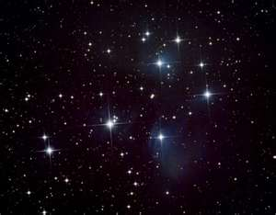
THE SUN AND STARS
The stars have been used since the time of the caveman to tell time and to guide them along their way.
Stars cannot only tell you where you are but can also indicate the seasons and the changing of the tides.
Notes:
The North Star has been used by everyone to determine where they are. Sailors used the North Star as their compass. The Egyptians discovered that by using the moon and the stars, cycles could be developed, thus creating the first calendar.

Slide 5
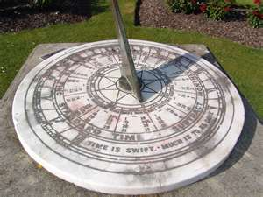
THE SUN AND STARS
The Sun and the Stars are still used today to determine location and direction.
The Sun and Stars can be called the first GPS.
Sundials were large and cumbersome and viewed as a status symbol among the Romans.
Notes:
Those who donated towards the town sundial had their names inscribed on the face of the instrument. The sundials were made for specific latitudes due to the Sun’s altitude in the sky decreased at higher latitudes. This produced longer shadows as apposed to shorter ones. (Britannica, 2000). In 263 BC a sundial from Sicily Italy was brought to Rome, for over 100 years, the Romans were going by the wrong time.

Slide 6
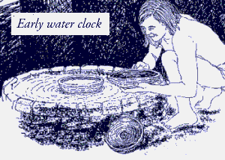
THE WATER CLOCK
The Water Clock or Clepsydra was first used by the Greeks. This clock did not rely on the moon or the stars and could be used inside the home. They were usually large and made of stone. Markings on the inside of the bowl used to collect water told the hour of the night.
Notes:
The water clock was the first night time clock. During the daytime, knowing what time it was could be easily determined. However, at night people had no clue. Thus the water clock would enable people to know how late it was. It was probably used to mark the first child’s curfew. Water Clocks are still used in North Africa to this day.

Slide 7
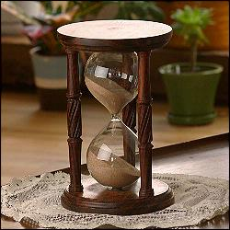
THE HOURGLASS
By far the most portable of timepieces were first developed by the Third Century BCE.
It allows sand to fall at a uniform speed from one side of the specially formed glass to the other side.
Being cheaper to make and accurate made this timepiece popular.
Still used today.
Notes:
The hourglass is unique in design and easy to make. These timepieces are primarily used to measure minutes of time. The Three Minute Egg is born.

Slide 8
WEIGHTED CLOCKS
These clocks use weights that are tied to a barrel or gear shaft. As gravity pulls the weights down, the barrel turns, thus time moves.
It is unknown who invented it or when the first weighted clock was made, however in 1309 the construction of the clock for the Church of St. Eustorgio in Milan is the earliest record of a weighted clock.
Notes:
The weighted clocks were mainly used for churches and towers. These clocks were huge due to the mechanisms needing to be large because of the weights needed to manipulate and register time. These clocks were not accurate due to the mechanisms involved. The verge-and –foliot mechanism depends on the weights attached.

Slide 9
MECHANICAL CLOCKS
Developed in 1656, by Dutch scientist Christiaan Huygens. (NIST, 2009)
The Pendulum clock uses natural oscillation to keep time.
Galileo is credited with the first pendulum clock designed, yet he never actually built one.
Huygens original spring mechanism design improved the accuracy of any previously constructed clocks.
His first design causes clocks to loose one minute a day. His redesign, which is still used today, has watches only loosing 10 seconds a day. (NIST, 2009)
Notes:
As with all the timepieces developed so far the mechanical clocks were the only clocks to maintain accurate time. Huygens design did not keep accurate time, it was off by one minute every day. After redesigning the spring mechanism, clocks were off by 10 seconds a day. His redesign spring mechanism is still used today by some watch makers.

Slide 10
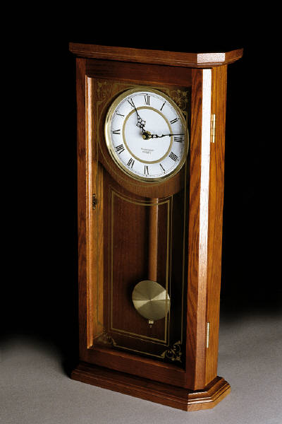
MECHANICAL CLOCKS CONT.
Further redesigns by other craftsmen had clock accuracy to 100th of a second. These redesigns also allowed clocks to become smaller, where watches came about.

Slide 11
QUARTZ CLOCKS
By the 1920’s clocks were a mainstay in businesses and homes. Clocks developed into pocket watches, these too were found everywhere.
Women first work their watches as broaches. They were used as adornments to their outfits, so women had several so that they could wear them with anything.
Men used pocket watches, mostly these were worn by business men.
Notes:
Pocket watches and broaches were the common and most practically way to wear these timepieces. By the mid 1920’s designers developed a way to make the timepieces smaller and thinner. This design helped to create the wristwatch.

Slide 12
THE WRISTWATCH
Pocket watches were used until the end of World War II.
Between the 1930’s and 1940’s, the wrist watch became smaller, cheaper to produce than pocket watches and were beginning to be worn as everyday jewelry.
The 1950’s was the beginning of the battery powered watch.
The 1970’s found the mechanical watch, one you have to wind, obsolete.

Slide 13
CONCLUSION
From the beginning of time to today, humankind has been fascinated by time. The creation of the clock to the wristwatch has been a step toward the artistry and technology used today.
Clocks and watches are used as a statement of style, individuality, and social status.
Watches are collected by many people, I am one of those. I have many watches, some old, some new, sports watches, and one even made out of a coconut.

Slide 14
REFERENCES
Cutmore,, M, London,, David, & London,, Charles. (1976). Watch collectors handbook.
http://watches,lovetoknow.com/History_of_watches
Renais, M. (n.d.). Watches! how did people tell time in the era of the roman empire 2000 years ago?. Retrieved from http.www.ShoppeWatch.com
U.S. Commerce Department, National Institute of Standards and Technology. (2009). A walk through time. Washington DC: Government Printing Office.

