Slide 1
Russia Sales and retail distribution landscape
David Lord
November 2010

Slide 2
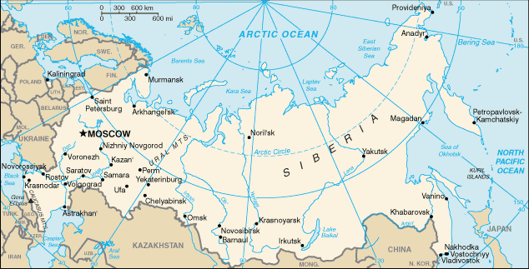
Sub -distributors
City | No.
Moscow | 14
St Petersburg | 3
Novosibirsk | 1
Nizhniy Novgorod | 2
Yekaterinburg | 2
Samara | 1
Kazan | 1
Chelyabinsk | 2
Rostov o Don | 1
Ufa | 2
Volgograd | 2
Perm | 1
Kraznoyarsk | 1
Voronezh | 1
Krasnodar | 2
Vladivostok | 1
Irkutsk | 1
Khabarovsk | 1
Novokyzneck | 1
Orenburg | 1
Penza | 1
Lipeck | 1
Kemerovo | 1
Tyla | 1
Kirov | 1
Tiver | 1
Stavropol | 1
Arkhangelsk | 1
Tambov | 1
Vologda | 1
Updated 07.11.10

Slide 3
Russia – 2010 sales by region

Slide 4
Russia – 2010 sales by region in %

Slide 5
Russia – 2010 ytd sales out by type
Sales out July to Oct
£360,859

Slide 6
Russia – 2010 ytd sales out by type in %

Slide 7
Russia – 2009 sales out by type

Slide 8
Russia – 2009 sales out by type in %

Slide 9
Russia – 2008 sales out by type

Slide 10
Russia – 2008 sales out by type in %

Slide 11
Russia – retail targets
Retail distribution in all main hypermarkets, supermarkets, automotive chains, petrol forecourts.
Hypermarket
Metro C & C
Lenta
Karousel
Maxidom
7th Continent
Auchan
Real
Diy Multiples
Castorama
Leroy Merlin
Praktiker
OBI
Petrol sites
Luk Oil
BP
Rosneft
TNK
EK
MTK
Automotive
Kemp
Tekhkom
Rus Auto
MVO
AGA

Slide 12
Russia – regional split
Regional percentage change in sales

Slide 13
Russia - development

Slide 14
2008 – comparison sales in/ out

Slide 15
2009 – comparison sales in/ out

Slide 16
Russia – hypermarkets

Slide 17
Russia – petrol stations

Slide 18
Russia – automotive chains

Slide 19
Impacto data
15th November 2010

Slide 20
Shelf share by brand

Slide 21
POS placement by % outlets

Slide 22
Distribution by brand (outlets % with at least 1 sku)

Slide 23
TW distribution by region

Slide 24
Product availability by outlet -average number of sku’s per outlet

Slide 25
Planogram maintenance - % outlets with planogram

