Slide 2
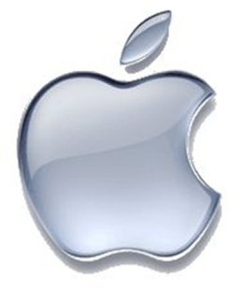
Mac vs. PC
The Battle Of The Brands

Slide 3
Contents
Apple information
Microsoft information
Comparing the two companies
Products
Customer input
Overall satisfaction rate

Slide 4
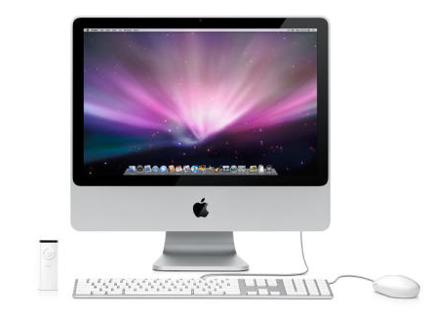
Mac

Slide 5
ADVANTAGES OF MAC
Efficient
Environmentally friendly
Secure
Compatible
Notes:
7 hour battery life
Energy efficient
100% recyclable
Safe from viruses
Born ready
Can run Windows softwares

Slide 6
Mac Advertisement

Slide 7
Disadvantages of Mac
Cost
Not video game friendly
Heat
Limited
USB Ports
Notes:
Limited software

Slide 8
Customer Satisfaction
Rated #1 from PC magazine and American Customer Satisfaction Index for customer service
80% customer satisfaction rate from Forrester Research survey
#1 in customer service*
80% customer satisfaction*
Notes:
Rated #1 from PC magazine and American Customer Satisfaction Index for customer service
80% customer satisfaction rate from Forrester Research survey
Rated #1 from PC magazine and American Customer Satisfaction Index for customer service

Slide 9
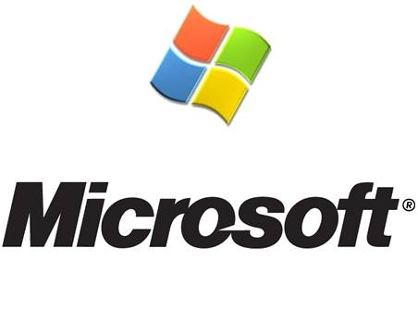
Notes:
A lot of "business standard" software is available for it - such as Microsoft Word, Excel, Access, Outlook, etc.
- A PC and the consoles will most likely always be the gamer's choice.
- Great for large companies
- Open and powerful hardware platform, which can provide effective and reliable control, with no requirement for additional processors or complex hardware additions.
- Centralized structure, reduced hardware costs, fewer interfaces, easy upgrade paths, full integration and high reliability.

Slide 10
ADVANTAGES OF PC
Most compatible type of computer
Inexpensive
Easy to upgrade
Customize your needs
Compatibility
Notes:
Upgrades allow personal
Easy to find, more of it
Games are mostly for pcs

Slide 11
DISADVANTAGES OF PC
Inconsistent parts
Reliability Issues
Many viruses
Low battery life
Lack of before purchase installments
Notes:
-security programs are around 50 dollars per year while mac has no program because computer hackers don’t bother to make iruses for only 10% of the population of people who have computers use mac
-2.5 hours average a PC’s battery which isn’t reasonable to people on the go who aren’t always close to power hookups, need to make business presentations etc
-for example there's iLife, the suite of multimedia tools that comes standard on the Mac. With iLife you can organize photos and home movies and turn them into watchable DVDs. Garageband helps you create your own music and another iLife element aids in Web site creation.
Pc’s will have to buy a video-editing program that usually costs $80, and CyberLink DVD Suite, which runs $104. But if she wants Adobe's (ADBE) Photoshop Elements, including a membership in Photoshop.com Plus, she'll need to shell out about $140. Sonic Solutions' (SNIC) Roxio Creator 2009, which combines video-editing and DVD-creating tools, will cost another $100. And the closest equivalent to Garageband on Windows is Cubase Sequel and it goes for another $100.
- pcs maybe cheaper but more software needs to be purchased to get it up to speed with a mac

Slide 12
Making the Choice
Preference | Mac | PC
Gaming
Accessibility
Low Cost
Longevity
Security
Environmental Impact

Slide 13
Customer Satisfaction PC
Around 70% ratings for PC Companies
Reliability and service are repeated issues
Notes:
Dell also dropped 5 percent after raising its ranking last year. Dell's problem is customers' perception of product reliability as well as service, Compaq, acquired by HP in 2002, is ranked 73

Slide 14
Mac Vs. PC

