Slide 1
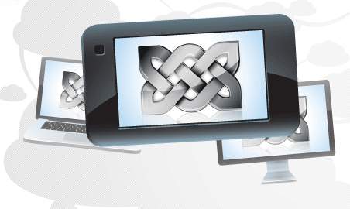
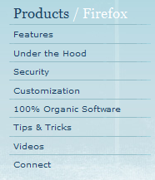
Stay in Sync With Your Firefox
Access your history, bookmarks and even open tabs on your phone or any computer.
Get the Free Firefox Sync Add-on Now
Why Sync Up?
Get Up and Go
Doing online research from the office, only to see it's time to head home? Now you can go back to your opened tabs and search history in an instant from your phone or any PC. Your Firefox is as you left it, no matter where you log in.
Backup Your Info
All your settings, passwords, bookmarks, and other customizations are saved in a more universal way, not tethered to a single machine. If you replace a device, you don't lose your Firefox.
Security
Your information is encrypted so only you can access it when you enter a Secret Phrase. Firefox puts security as a top priority and syncing is no exception.
Get Started
Install the free Firefox Sync Add-on.
Restart Firefox and follow prompts to create an account with both a password and a Secret Phrase.
Install Firefox Sync on all the other devices you use.
Sign-in and choose how to sync, then start browsing where you left off.

