Slide 1
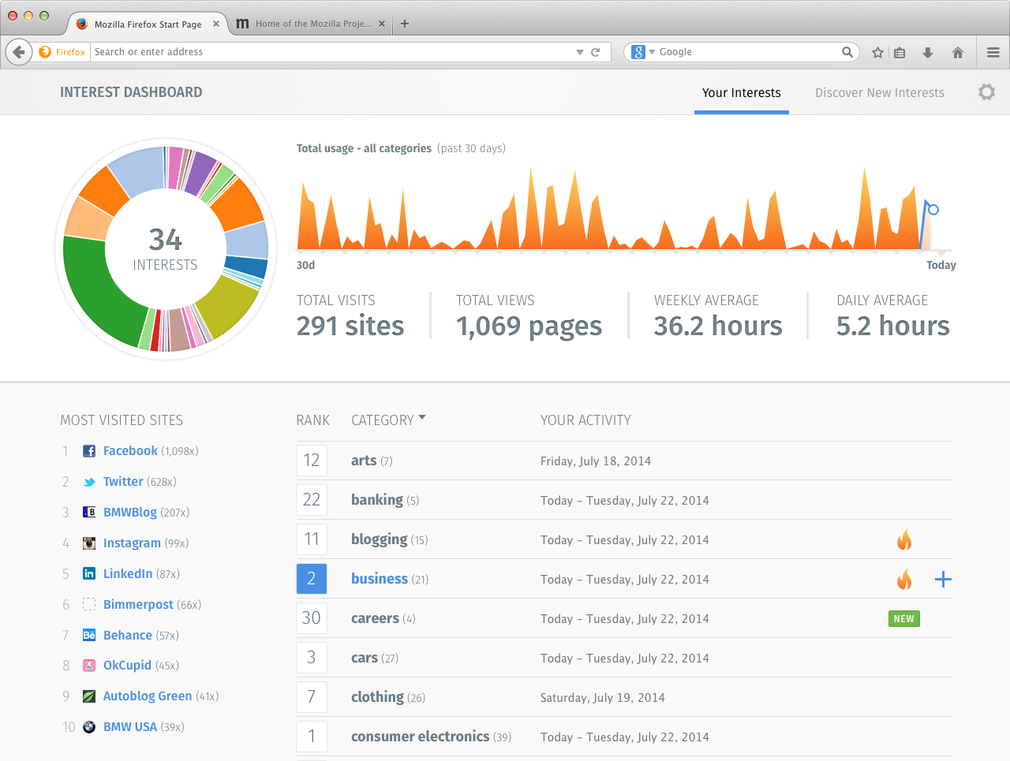
The area graph will display the intensity of an interest topic in the last 30 days
This is your interest wheel. Click on the different categories to start exploring your history!
Summarized stats reflecting the total or selected category
Icons will appear indicating movement of particular category
Your favorite sites
Click to expand to see details on how the interest was categorized
Your interest ranking

