Slide 1
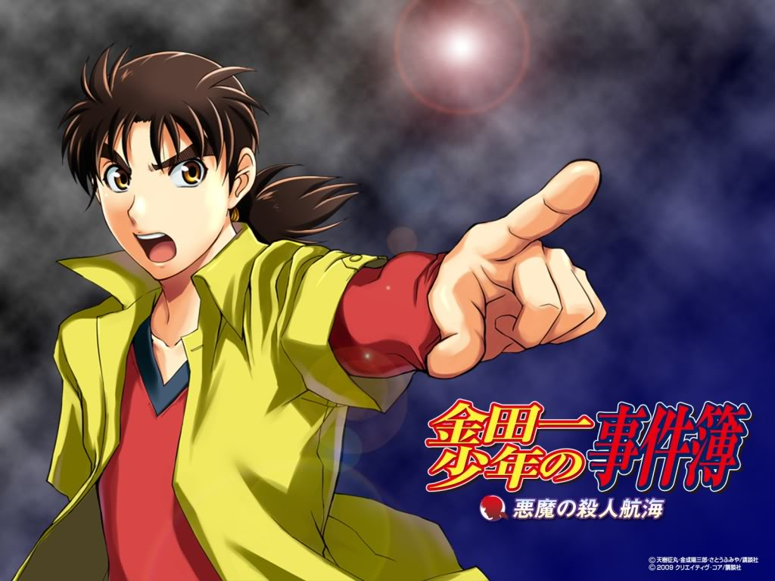
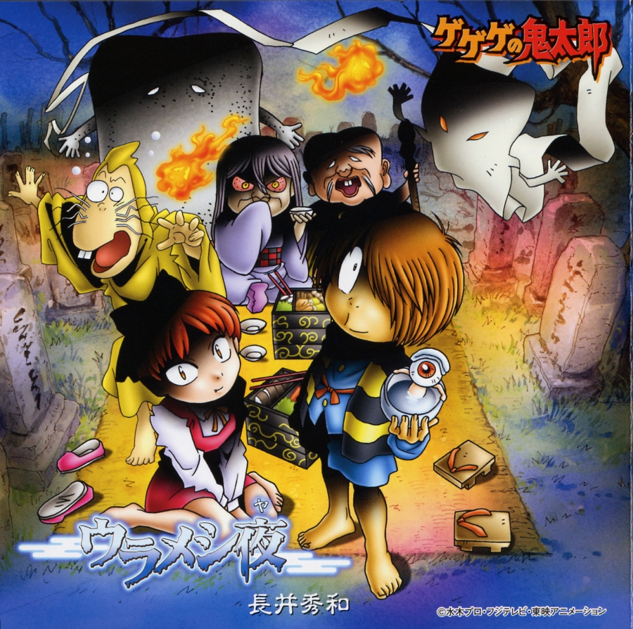
Alley has worked on numerous many television series; the two that he is known for are Saint Seiya and Lupin III. His team has done plenty of character designs for other anime shows as well, including “Abhdhbd no mineden” and “Kinenenejichi Case Files”, which are among the most well known anime in Japan.
Saint Saiya (1986) Lupin III (1984)
Character Design
Animation Director
Design Supervisor
Animation Director

