Slide 1
Jawien-03
By
Jeff Martin
http://img.photobucket.com/albums/v518/breakdancingrobot/Title.gif

Slide 2
History part 1
82 years old
exertional chest pain associated with shortness of breath
apical ischemia from sestamibi nuclear scan, technetium (99mTc)
left ventricular dysfunction from left ventricular angiogram
end-stage renal disease needing hemodialysis
non-insulin dependent diabetes mellitus
Hypertension poorly controlled
chronic obstructive pulmonary disease
Cardiac catheterization: 80% stenosis of the mid-left anterior descending, 40% stenosis of the intermediate ramus and distal circumflex, and a dominant right coronary artery without significant stenosis.
Percutaneous transluminal coronary angioplasty (PTCA) with stent placement to the mid-left anterior descending was performed with no residual stenosis with Thrombolysis In Myocardial Infarction (TIMI)-3 flow seen in the left anterior descending after the procedure.
Dialysis was performed on the day of cardiac intervention and the patient was discharged in stable condition.

Slide 3
History part 2
Six days following discharge from the hospital, the patient experienced severe sharp pain in the right groin without any skin discoloration of the right lower extremity. The patient denied numbness, tingling, or loss of voluntary movement.
On physical examination, a pulsatile mass was noted in the right groin.

Slide 4
History part 3
On physical examination, a pulsatile mass was noted in the right groin.

Slide 5
Steps
What is the most likely diagnosis?
List the differential diagnosis
List required laboratory and imaging tests.
Treatment (possibile treatment/medical solutions depending on imaging findings)
Prognosis.

Slide 6
Diagnosis
What is the most likely diagnosis?

Slide 7
Diagnosis
Possible diagnoses:
large hematomas
pseudoaneurysms (PSAs)
arteriovenous fistulas (AVFs)
retroperitoneal hemorrhage
abdominal aortic aneurysm extended into the femoral artery
deep vein thrombosis

Slide 8
Diagnosis
deep vein thrombosis
50% have no symptoms so it’s possible.
Not usually associated with cath.
Differentiate with Doppler ultrasound.

Slide 9
Diagnosis
abdominal aortic aneurysm extended into the femoral artery
Not associated with cath. Consider if other diagnoses are not confirmed by ultrasound.
Abdominal ultrasound.
CT.

Slide 10
Diagnosis
retroperitoneal hemorrhage
Common if the site is to high.
Usually back pain.

Slide 11
Diagnosis
large hematomas
pseudoaneurysms (PSAs)
arteriovenous fistulas (AVFs)
Hematomas may break down the fibrin plug leading to a pseudoaneurysm.
Arteriovenous fistulas will have unidirectional flow on Doppler ultrasound and often a bruit. Usually close within a year.

Slide 12
Diagnosis
Ultrasound with doppler is usually the only imaging, but CT may also be used.
Pseudoaneurysms may be confused with plain hematomas.
In doppler ultrasound: “A localized hematoma and a thrombosed PSA are indistinguishable in appearance.” The thrombosed pseudoaneurysm may have a visible tract.
http://radiologykey.com/pulsatile-groin-mass-in-the-postcatheterization-patient/

Slide 13
Diagnosis
Hemotomas may infiltrate soft tissue or retroperitoneum without forming an obvious mass visible with ultrasound.
Hemotomas and pseudoaneurysms may distort or compress structures.
Back pain may be a sign of retroperitoneal hemotoma. CT may be necessary.
http://radiologykey.com/pulsatile-groin-mass-in-the-postcatheterization-patient/

Slide 14
Diagnosis
Pseudoaneurysms without a fibrous wall should probably be called pulsile hemotomas. http://radiologykey.com/pulsatile-groin-mass-in-the-postcatheterization-patient/
Pseudoaneurysms may be considered a type of hemotoma; an aneurysm-like hematoma. https://doi.org/10.1016/j.jvs.2005.11.009

Slide 15
Diagnosis
A pseudoaneurysm, i.e., pulsatile hematoma, will show inward flow during systole and outward flow during diastole with a yin yang pattern.
https://doi.org/10.1016/j.jvs.2005.11.009

Slide 16
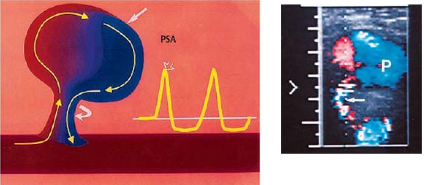
Diagnosis
http://radiologykey.com/pulsatile-groin-mass-in-the-postcatheterization-patient/

Slide 17
Diagnosis
A pseudoaneurysm, i.e., pulsatile hematoma is the most likely diagnosis.
http://radiologykey.com/pulsatile-groin-mass-in-the-postcatheterization-patient/

Slide 18
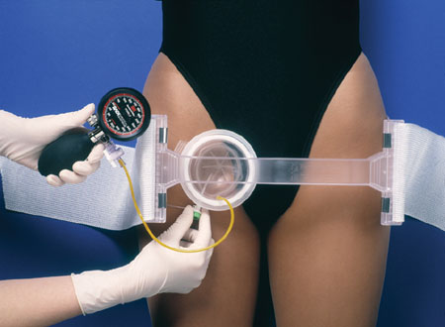
Prevention and Intervention
The most causative factor is not enough time with manual compression.
http://radiologykey.com/pulsatile-groin-mass-in-the-postcatheterization-patient/

Slide 19
Prevention and Intervention
Groin Bleeds and Other Hemorrhagic Complications of Cardiac Catheterization: A list of relevant issues
Jackson Thatcher, MD, FACC, Director of Inpatient Cardiology The Park Nicollet Heart Center at Methodist Hospital
St. Louis Park, Minnesota
Volume 16 - Issue 3 - March, 2008
http://www.cathlabdigest.com/articles/Groin-Bleeds-and-Other-Hemorrhagic-Complications-Cardiac-Catheterization-A-list-relevant-is

Slide 20
Prevention and Intervention
Recognize and early intervention.
RAO projection helps prevent low sticks.
LAO projection is not blocked by hip prosthesis.
Manage coagulopathy treatment.
Fluid bolus for unexpected BP drop.
http://www.cathlabdigest.com/articles/Groin-Bleeds-and-Other-Hemorrhagic-Complications-Cardiac-Catheterization-A-list-relevant-is

Slide 21
Prevention and Intervention
Doppler ultrasound on the table in the cath lab.
“Don’t let them succumb in the CT scanner looking for what you already know must be there.”
http://www.cathlabdigest.com/articles/Groin-Bleeds-and-Other-Hemorrhagic-Complications-Cardiac-Catheterization-A-list-relevant-is

Slide 22
Prevention and Intervention
Early intervention is important because the hematoma can dissolve the fibrin plug to form a pseudoaneurysm.
http://www.cathlabdigest.com/articles/Groin-Bleeds-and-Other-Hemorrhagic-Complications-Cardiac-Catheterization-A-list-relevant-is

Slide 23
Compression
Femo-stop
C-clamps (no longer used due to slippage.)

Slide 24
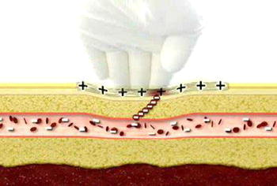
Homeostasis pads
Chito-Seal
Clo-Sur PAD
SyvekPatch
Neptune Pad
D-Stat Dry
https://www.researchgate.net/figure/7094748_fig1_Figure-4-Formation-of-a-clot-after-sheath-removal-through-interaction-of-the-positive

Slide 25
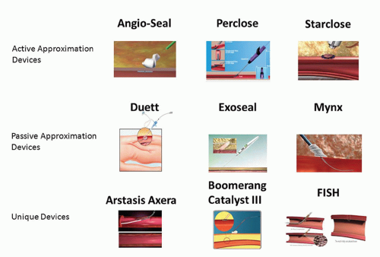
Closure Systems

Slide 26
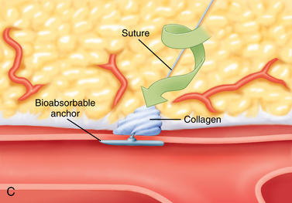
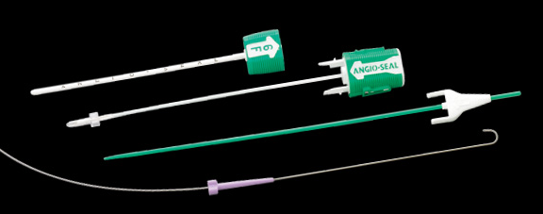
Angioseal

Slide 27
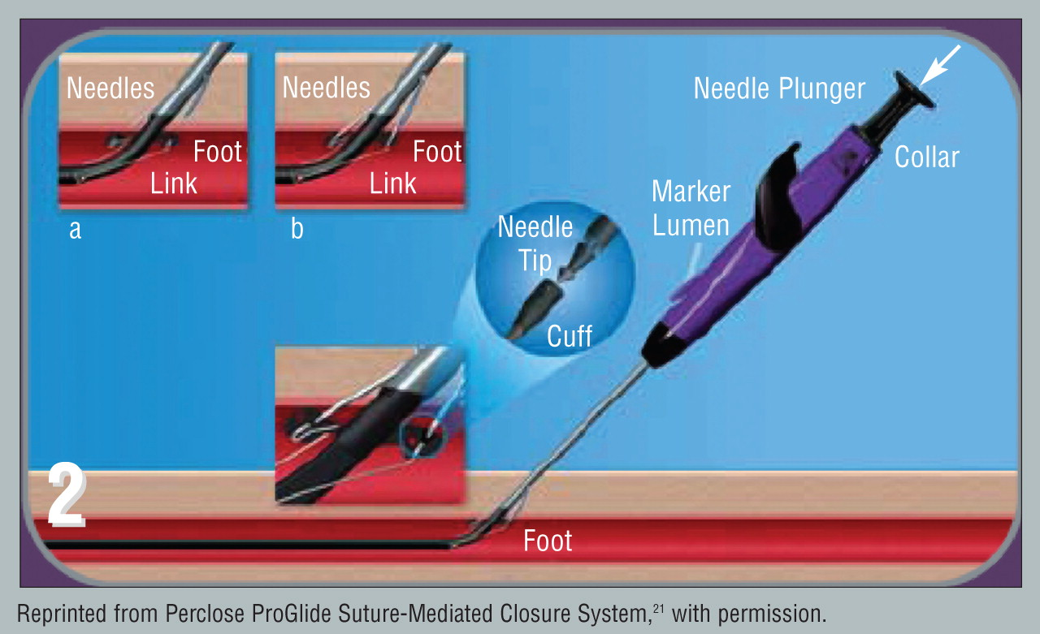
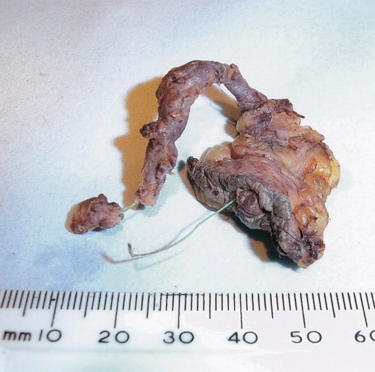
Proglide Perclose

Slide 28
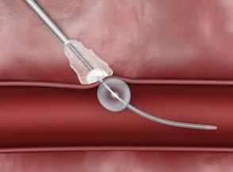
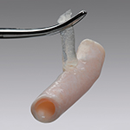
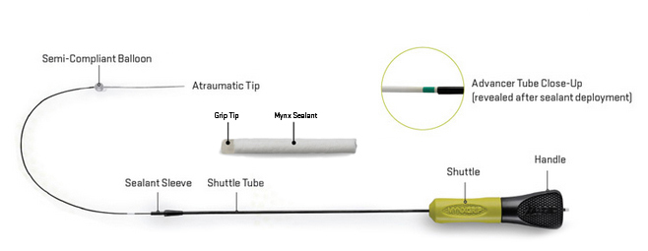
Mynxgrip

Slide 29
X-site suture

Slide 30
Closure Systems

Slide 31
Pseudoaneurysm Treatment
Ultrasound guided compression of the neck of the PA for 30 to 60 minutes.
Injection of procoagulant solutions and/or embolization coils, and/or balloon occlusion of the PA neck.
Surgical repair.
Grossman's Cardiac Catheterization, Angiography, and Intervention edited by Donald S. Baim

Slide 32
Pseudoaneurysm Treatment
Do nothing.
80% of cases resolve spontaneously.
Consider travel distance for the patient for follow up.
Frank J. Criado, MD 09/05/08 Vascular Disease Management

Slide 33
Suture Device Case
62 year old male with abdominal aortic aneurysm. Cath repair. Suture with a Prostar XL device.
Developed a pseudoaneurysm two days later.
Brachial artery cath into the PA.
Balloon occlusion of the opening and 10,000 IU of thrombin into the PA over 20 minutes.
Endovascular Pseudoaneurysm Repair Using Transarterial Thrombin Injection and Covered Stent
Jon C. George, MD, Division of Interventional Cardiology and Endovascular Medicine, Deborah Heart and Lung Center, Browns Mills, New Jersey Cath Lab Digest Volume 21 - Issue 7 - July 2013

Slide 34
Prognosis
Prevention = best prognosis. Keep in mind that compression can cause nerve damage that may take one month to resolve.
Do nothing = 80% of cases resolve with no complications
Non-surgical interventions. More invasive have a greater risk of complications. If neck is thin, then external compression is non-invasive.

Slide 35
Conclusion
Prevention with compression and closure devices. Consider the patient. E.g. coagulation status.
Consider do nothing and monitoring. 80% of pseudoaneurysm cases resolve with no complications.
Retroperitoneal bleeding is dangerous. Give fluids before blood pressure drops.
Non-surgical interventions. More invasive have a greater risk of complications. If neck is thin, then external compression is non-invasive.

Slide 36
Check out the video game

