Slide 1
MarCom SER Aug. 2016
.
.
Elodie Segaud, Marketing Communications Manager

Slide 2
Channel Marketing
Grow sales
Target group: installers
Purpose:
Boost sales in selected product categories
Reduce customer churn
Tactics:
MarCom vehicles to be defined
Next step: mid-September
Status: ongoing

Slide 3
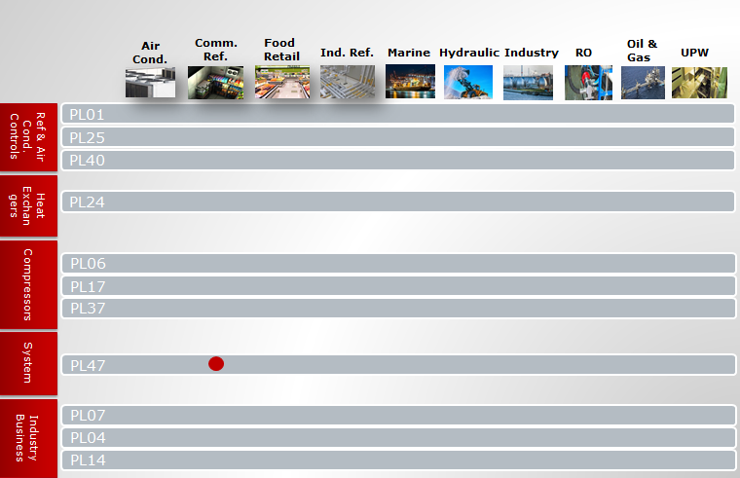
Packaged condensing units: Optyma Plus INVERTER
1st step: Raise awareness
Target group: installers, end-users
Purpose: Promote launch of OP+ INVERTER
Tactics:
Press coverage: press release, advertisement, online banner
POS material for Channel Partners
Local exhibition
Deadline: end of Sept.
Status: ongoing

Slide 4
Packaged condensing units: Optyma Plus INVERTER
2nd step: Build interest and create action
Target group: installers
Purpose: Create pull by providing more detailed information about CU
Tactics: highlight key benefits for installers, inform about Eco-design (Lot 1 ENTR) and low-GWP refrigerants
Snail mail with discount to be used at Channel Partners
Follow-up to be done by sales
Deadline: end of Dec.
Status: not started

Slide 5
Packaged condensing units: Optyma Plus INVERTER
3rd step: Build interest
Target group: end-users and retailers
Purpose: Create pull by providing more detailed information about CU
Tactics: focus on energy savings and environmental aspects
Case studies in relevant media
Landing page
Google AdWords
Deadline: TBD
Status: not started

Slide 6
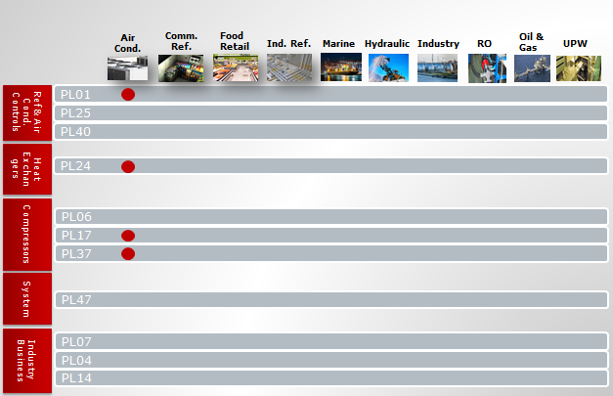
Chiller hotspot
Raise awareness
Target group: OEMs
Purpose: Raise awareness on application knowledge and wide portfolio
Tactics: repurpose existing assets
Webpages on local websites
Repurpose Mostra press release
Adapt video in ES + FR
Email banner for KAM sales + customer service
Newsletter to dedicated OEMs
Online banners on dedicated trade portals
Translate relevant case studies
Deadline: mid-Sept.
Status: ongoing

Slide 7
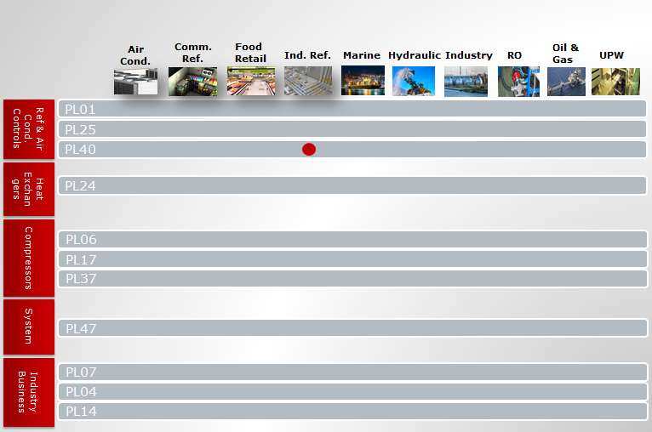
AKS 4100 short (280 mm) for ammonia
Build interest and create action
Target group: OEMs lead engineers + purchasers (JCI, Clauger, etc.)
Purpose: Engage customers and generate concrete leads
Tactics: Snail mail in 2 waves
1st: traditional sales letter + puzzle with a missing piece
2nd: Missing piece of puzzle (AKS short) + 4 pages leaflet highlighting USPs in OEM setting (single-supplier + product benefits) + Case story Heat Pac’s at Danfoss Nordborg
Goals: Gain market share from HB and secure business with Clauger
Deadline: beg. of Sept.
Status: ongoing

Slide 8
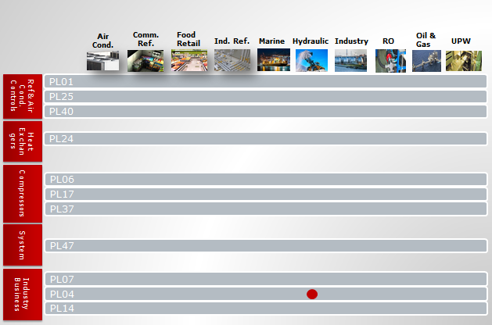
MBS 1600
Raise awareness
Target group: OEMs
Purpose: Establish leading positioning
Tactics:
Flyer
Website
Deadline: wk 36
Status: ongoing

Slide 9
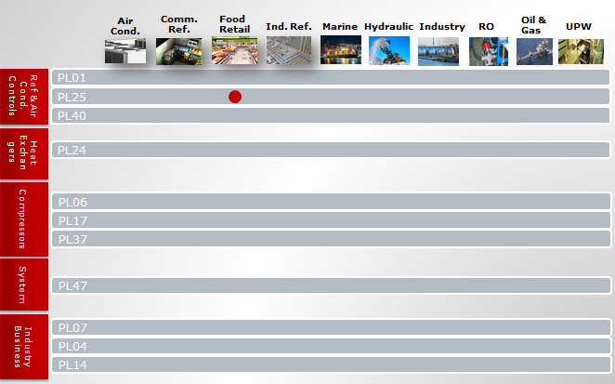
Ejector technology for CO2
Build awareness
Target group: OEMs, consultants, retailers (energy managers)
Purpose: Ensure visibility and retain attention
Tactics: Describe and demonstrate high level benefits.
ATMOsphere Barcelona
Press coverage through press release, article, case study
Deadline: ongoing
Status: Done

