Slide 1
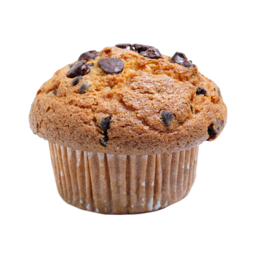
It is My Birthday
^{Join me for a cooking test}
On Sunday, January 15th, 3PM
At 26 canterbury street, Ramsgate
RSVP: 07 89 78 80 35

