Slide 1
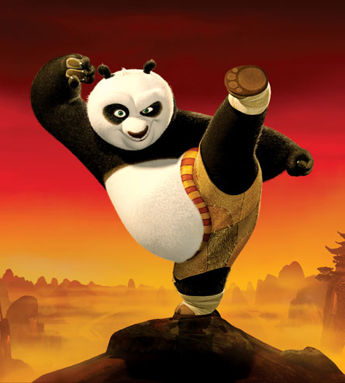
Kung Fu Punctuation
Click on the belt you wish to complete
RED BELT
BLACK BELT
WHITE BELT

Slide 2
KUNG FU PUNCTUATION – WHITE BELT
Lesson Objectives
To learn the Kung Fu moves for four punctuation marks.
To use these moves in a game of Kung Fu punctuation.

Slide 3
Capital Letter
Throw both hands over head. Make the noise, Wa!

Slide 4

Full Stop
Throw a short, right-handed punch at the air in front of you. Make the noise, Ha!

Slide 5

Comma
With your right arm bent so that your hand is in front of your face, make a short twisting motion at the wrist to signify the comma shape. Make the noise, Shi!

Slide 6

Semi-Colon
Do the full-stop punch, then the comma shape directly underneath it. Make the noises, Ha! Shi!

Slide 7
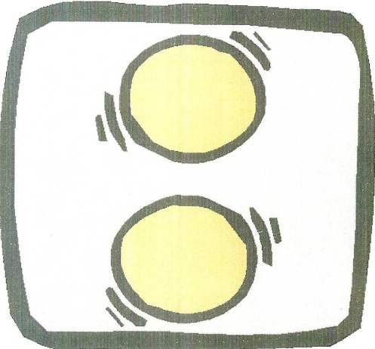
Colon
Follow the full-stop punch immediately with one directly beneath it. Make the noises, Ha! Ha!

Slide 8
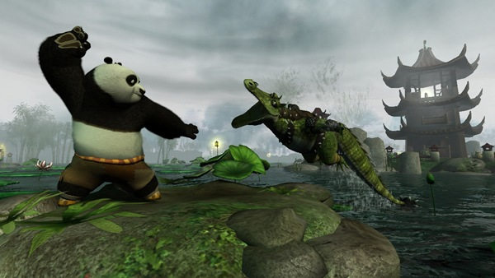
Advanced Kung Fu Punctuation
Perform the correct move and sound to match the punctuation mark

Slide 9
She walked to the shop.

Slide 10
She bought apples, pears and tea.

Slide 11
It was hot; we went to the beach.

Slide 12
Tennis, which is a popular sport, can be played in pairs.

Slide 13
I speak the following languages: English, Spanish and French.

Slide 14
He was late; he missed the bus.

Slide 15
Unfortunately, we lost the game.

Slide 16
I caught three fish: a tuna, a cod and a salmon.

Slide 17
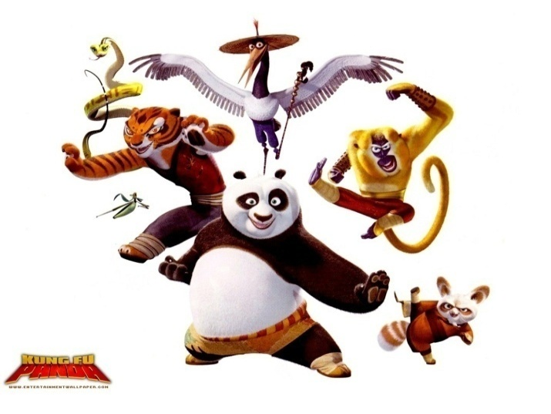
Tournament
A proper bout of Punctuation Kung Fu requires three players: two combatants and a referee. The combatants face each other. The referee says the words ''capital letter'', and the opponents bow to each other while repeating the same phrase.
The referee then calls out three punctuation marks and the players have to put the moves and sounds for these together, in sequence, as quickly as they can. The winner is the one who puts together all three moves and their accompanying sounds correctly in the quickest time.

Slide 18
WHITE BELT TOURNAMENT

Slide 19
KUNG FU PUNCTUATION – RED BELT
Lesson Objectives
To learn the Kung Fu moves for seven punctuation marks.
To use these moves in a game of Kung Fu punctuation.

Slide 20
Capital Letter
Throw both hands over head. Make the noise, Wa!

Slide 21
Full Stop
Throw a short, right-handed punch at the air in front of you. Make the noise, Ha!

Slide 22
Comma
With your right arm bent so that your hand is in front of your face, make a short twisting motion at the wrist to signify the comma shape. Make the noise, Shi!

Slide 23
Semi-Colon
Do the full-stop punch, then the comma shape directly underneath it. Make the noises, Ha! Shi!

Slide 24
Colon
Follow the full-stop punch immediately with one directly beneath it. Make the noises, Ha! Ha!

Slide 25
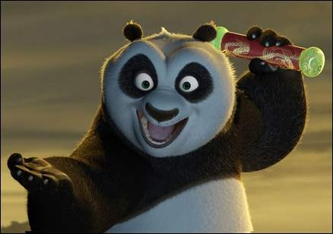

Question Mark
Separate the curly bit into three cutting movements with the hand: one horizontal left to right, one curved around, and one vertical coming from the bottom of the curved one. Then at the bottom of the shape you have just drawn in the air, bung in a full-stop punch. Make the noises, Shi! Shi! Shi! Ha!

Slide 26
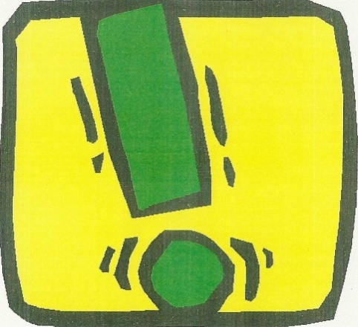
Exclamation Mark
A long vertical slash, from top to bottom, followed by a full stop. Make the noises, Shiiiiii! Ha!

Slide 27
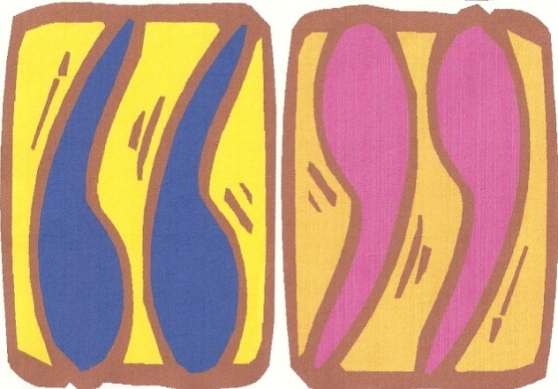
Speech Marks
Stand on one leg, extend your arms diagonally to the skies and wiggle your index and middle fingers in an approximation of speech marks. Make the noise, Haeeeee!

Slide 28
Advanced Kung Fu Punctuation
Perform the correct move and sound to match the punctuation mark

Slide 29
Walking to the shop, I whistled.

Slide 30
What is the capital of France?

Slide 31
I thought he was dead!

Slide 32
I want to live in Jamaica; it’s warmer there.

Slide 33
She said, “I want lipstick, eye-shadow and mascara.”

Slide 34
He went to the park; it was crowded.

Slide 35
“Who are you?” he asked.

Slide 36
Don’t you dare!

Slide 37
Is this the way to Amarillo?

Slide 38
She shouted, “go away!”

Slide 39
“Oh my God!” she shrieked, “is that Zac Efron?”

Slide 40

Tournament
A proper bout of Punctuation Kung Fu requires three players: two combatants and a referee. The combatants face each other. The referee says the words ''capital letter'', and the opponents bow to each other while repeating the same phrase.
The referee then calls out three punctuation marks and the players have to put the moves and sounds for these together, in sequence, as quickly as they can. The winner is the one who puts together all three moves and their accompanying sounds correctly in the quickest time.

Slide 41
RED BELT TOURNAMENT

Slide 42
KUNG FU PUNCTUATION – BLACK BELT
Lesson Objectives
To learn the Kung Fu moves for nine punctuation marks.
To use these moves in a game of Kung Fu punctuation.

Slide 43
Full Stop
Throw a short, right-handed punch at the air in front of you. Make the noise, Ha!

Slide 44
Comma
With your right arm bent so that your hand is in front of your face, make a short twisting motion at the wrist to signify the comma shape. Make the noise, Shi!

Slide 45
Semi-Colon
Do the full-stop punch, then the comma shape directly underneath it. Make the noises, Ha! Shi!

Slide 46
Colon
Follow the full-stop punch immediately with one directly beneath it. Make the noises, Ha! Ha!

Slide 47
Question Mark
Separate the curly bit into three cutting movements with the hand: one horizontal left to right, one curved around, and one vertical coming from the bottom of the curved one. Then at the bottom of the shape you have just drawn in the air, bung in a full-stop punch. Make the noises, Shi! Shi! Shi! Ha!

Slide 48
Exclamation Mark
A long vertical slash, from top to bottom, followed by a full stop. Make the noises, Shiiiiii! Ha!

Slide 49
Speech Marks
Stand on one leg, extend your arms diagonally to the skies and wiggle your index and middle fingers in an approximation of speech marks. Make the noise, Haeeeee!

Slide 50

Apostrophe
With your right arm fully extended to the air, wiggle your index finger. Make the noise, Blubalubaluba! (This is the best I can do to approximate the sound you can make with your tongue when you flap it up and down against the inside of your lips.)

Slide 51
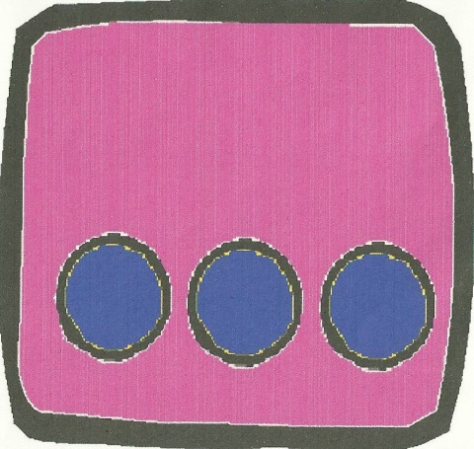
Ellipsis
Three punches along a horizontal line. Make the noises, Ha! Ha! Ha!

Slide 52
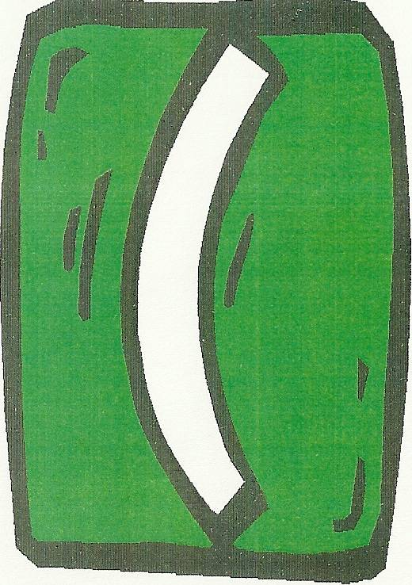
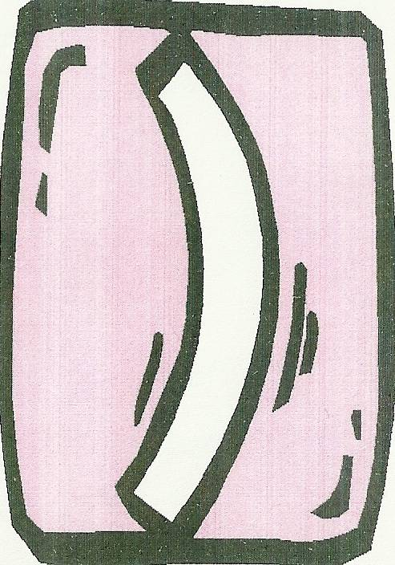
Brackets
Using your left hand first, draw a curved convex line in the air; use your right hand to do the opposite motion for the closing bracket. Make the noises, Shi! Shi!

Slide 53
Advanced Kung Fu Punctuation
Perform the correct move and sound to match the punctuation mark

Slide 54
The boys bike was broken

Slide 55
Spaghetti is the favorite food of many people however I dont like it

Slide 56
For the sleepover you have to bring pillow blanket toothbrush and toothpaste

Slide 57
Lets go to the beach asked Jane
Sure I will call Marina too replied John

Slide 58
Today SSR Silent Sustained Reading will start at 8 am

