Slide 1
Beer record
Started November 2011

Slide 2
Beer type: Beer name :
Basis of recipe: Brew date: Brew volume:
Extract/partial mash/full mash?: Yeast:
Partial mash grains | Type | Amount | % of Grain | Details
Hops | Type | Amount | When added | Details (% Alpha Acid)
Procedure
Fermentation
Results

Slide 3
Beer type: Mild Beer name: 1551 MILD
Basis of recipe: Arkells Mash-tun Mild, BYOBRA Brew date: 4/11/11 Brew volume: 19 litres
Extract/partial mash/full mash?: Partial mash Yeast: Muntons Gervin English Ale
Partial mash grains | Type | Amount (g) | % of Grain | Details
 | Crystal Malt – dark(-ish) | 800 | 33% | Wine Emporium. Looks medium-to-dark
 | Chocolate malt | 120 | 5% | Wine Emporium
 | Light spray malt | 1000 | 41% | Wine Emporium
 | Dark Spray malt | 500 | 21% | Muntons (EBC 44.7, Protein 8% max, pH 5.6)
Hops | Type | Amount (g) | When added | Details (% Alpha Acid)
 | Fuggles | 20 | First Wort | 3.8%
 | Fuggles | 22 | After hot break (T-80) | 3.8% (Calculated to give 24 EBU)
 | Fuggles | 8 | Post-boil (50⁰C) | 3.8%
Procedure:
Steeped grains in bag in 5l in brew bucket (with kettle element and tap). Initial temp 73⁰C, 65⁰C after dunk, 60⁰C after 15 mins, raised to 70 ⁰C . After 30 mins, at 65 ⁰C , grain bag removed and lightly sparged with 1 l. water at 55 ⁰C.
Added FWH, all malts and water to 19l. OG checked: 1034. Added 60g light brown sugar: rechecked at 1036 (at 15 ⁰C ).
Brought to boil. Foam subsided after 10 mins, added hops. Boiled on a strong boil for 90 mins .
Cooled in sink: 30 mins 48 ⁰C, 60 mins 37⁰C. Brought back to 18 l (OG 1035 at 30 ⁰C, = 1038 at 15⁰C). Strained into 2nd bucket then back to (sterilised) brewbucket. Aerated with paddle and whisk.
Yeast reconstituted as per packet, in water at 35 ⁰C then in 250ml wort at 35 ⁰C for an hour (done in parallel) before pitching at 30 ⁰.
Fermentation:
Foamy crust within 4 hours. After 12 hours (overnight), good ‘head’. Bubble rate c 15 per minute. Air temp 20 ⁰C , rising to 22 ⁰C and bubble rate of 30+ pm. Slowed to 4 pm after 36 hours, 1 pm after 48 hours. At 7 days, still bubbling every few mins, racked off into carboy. Measured at 1014 at 20 ⁰C. (= 1015), 3.3% ABV. After 2 weeks in carboy, at 1012. Bottled with 3.9g sugar added as a primer on 29 Nov.
Results: Flat in the bottle. Rich taste with long chocolate notes. Little hopiness evident. Nice and dark. Shaken to re-activate yeast with mixed results. Lovely and smooth.

Slide 4
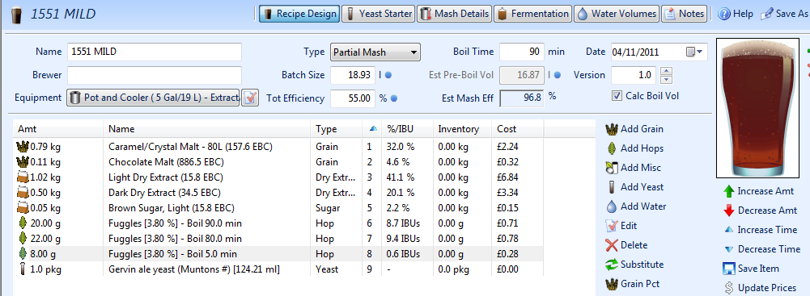
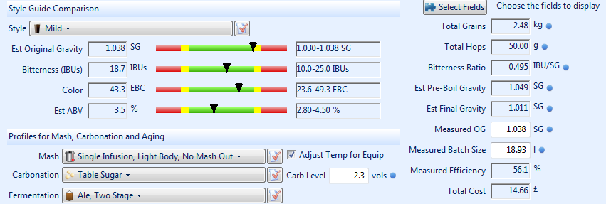

Slide 5
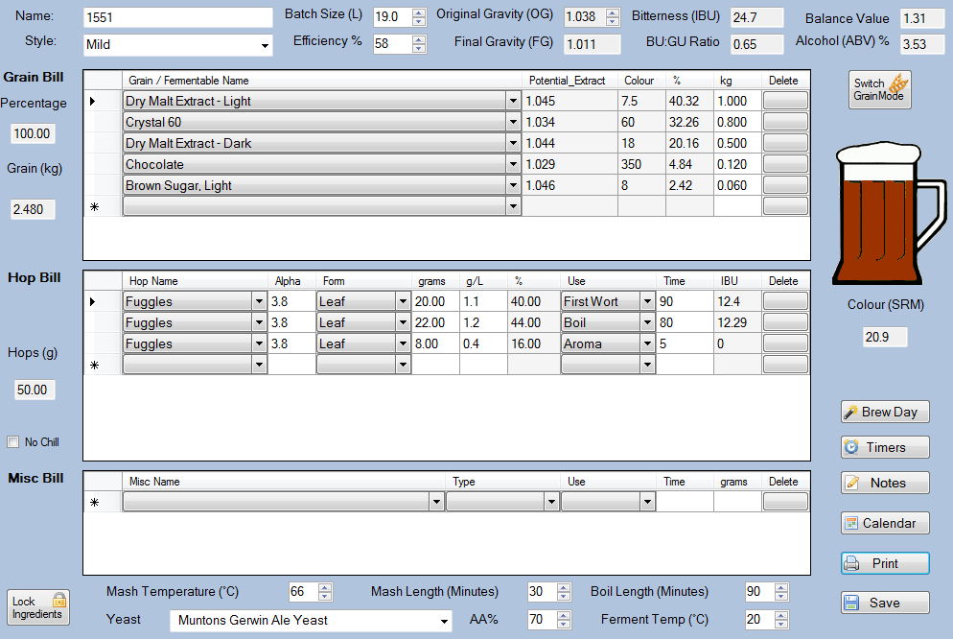

Slide 6
Beer type: Bitter Beer name: BOG standard bitter (Bitter late than never)
Basis of recipe: Various from BYOBRA Brew date: 18/11/11 Brew volume: 19 litres
Extract/partial mash/full mash?: Partial Yeast: Danstar Nottingham
Partial mash grains | Type | Amount (g) | % of Grain | Details
 | Crystal Malt | 228 | 10% | Wine Emporium. Looks medium-dark.
 | Chocolate malt | 26g | 1% | Wine Emporium
 | Medium Spraymalt | 2000g | 89% | Wine Emporium
Hops | Type | Amount | When added | Details (% Alpha Acid)
 | Fuggles | 25g | First Wort Hops | 3.8%
 | Goldings | 25g | FWH | 5.7%
 | Goldings | 10g | Last 10 mins of boil | 5.7%
Procedure
Steeped grains in bag at 65 -75 ⁰C for 30 mins, rinsed with warm water. Hops and 1kg spraymalt added, water to 12.5 litres. Brought to boil (took 30 mins). Boiled for 90 mins. Second 1kg malt and finishing hops added for last 10 mins. Strained into 2nd vessel, added cooled boiled water to make 20 litres. OG 1.041. Cooled – 1 hour. Back into 1st vessel . Lost some through open tap.....Aerated by pouring and agitating. In parallel, yeast started as per packet, pitched at 30 ⁰C. Looks browner than I’d like.
Fermentation
At 7 hours – good foamy head. Fast ferment, then slowed – still going slowly after 10 days at 20 ⁰C. 6/12/11: at 1012 = 3.6% ABV (i.e. After 18 days). Into barrel and bottle with 56g sugar. Cloudy, tastes caramel, smooth, nice bitter finish.
Results: Mid amber colour. Little hop aroma. Nice head straight from the barrel. Caramel evident. Good hoppy finish. Drinkable. Still drinkable from the bottle after 3 months.

Slide 7
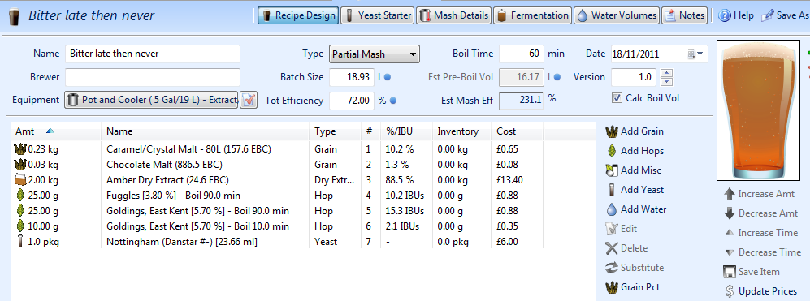
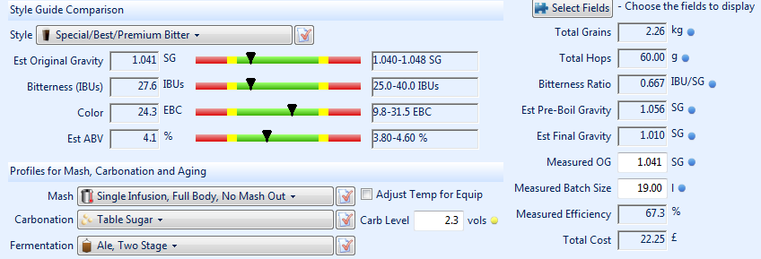

Slide 8
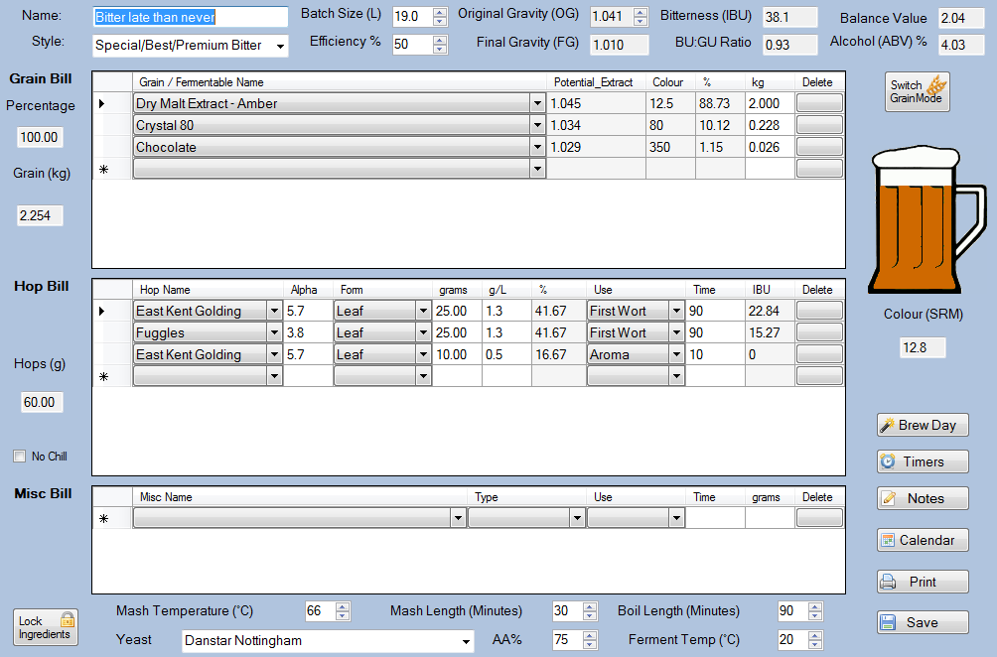

Slide 9
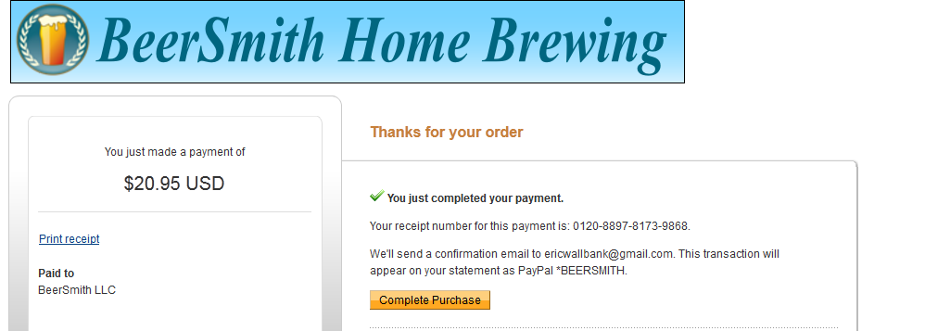
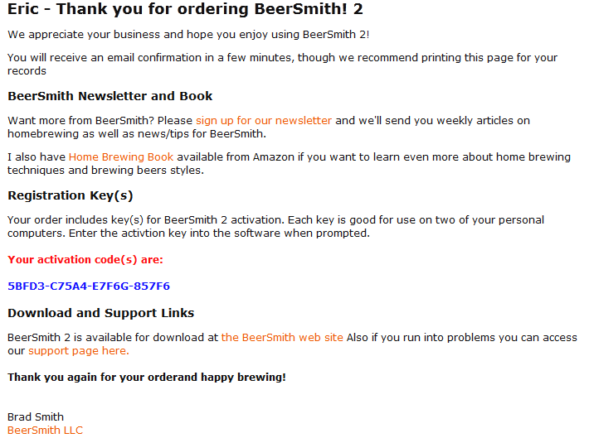

Slide 10
Beer type: Oatmeal stout – or Imperial stout or London Porter. Beer name: Neck Tar or Newgate’s Knocker
Basis of recipe: Brew date: 27 12 11 Brew volume:
Extract/partial mash/full mash?: Full Mash Yeast: Wyeast 1084 Irish Ale
Full mash grains | Type | Amount | % of Grain | Details
 | See next page........
Hops | Type | Amount | When added | Details (% Alpha Acid)
Procedure: Mash in Tom’s cooler box. Sparge with rotating sprinkler. Bin problems so took a while to get to the boil. FWH hops just thrown in, others in a hopbag. Boil for 90 mins. Transferred to carboy – too near the top so into large bin. Yeast started as per packet – early, since the boil was late starting.
Fermentation: Nice head after overnight. At 9 days (4/1/12) tap leaking so transferred to carboy. SG 1022, equals 5.5% ABV. On7/1/12, stopped bubbling completely, SG measured at 1019 = 6% ABV. Bottled on 2/2/12. Added 4oz cane sugar as bottle primer. Final volume produced 19 litres.
Results: Black – opaque. After 3 months in bottle it’s getting smooth (previously a choco coffee bitterness to the end on the palate). Very, very fizzy on pouring. Rich, full in the mouth.

Slide 11
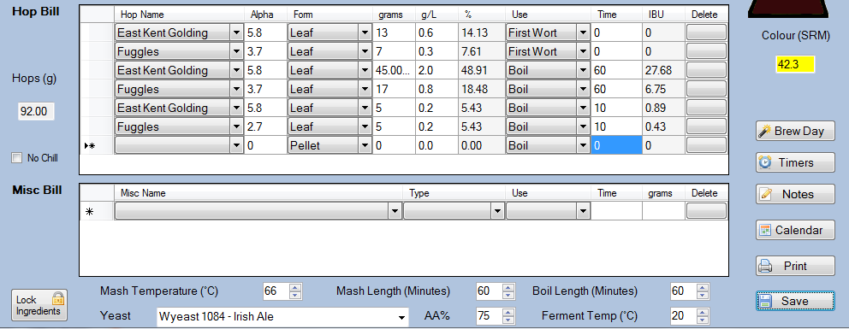

Slide 12
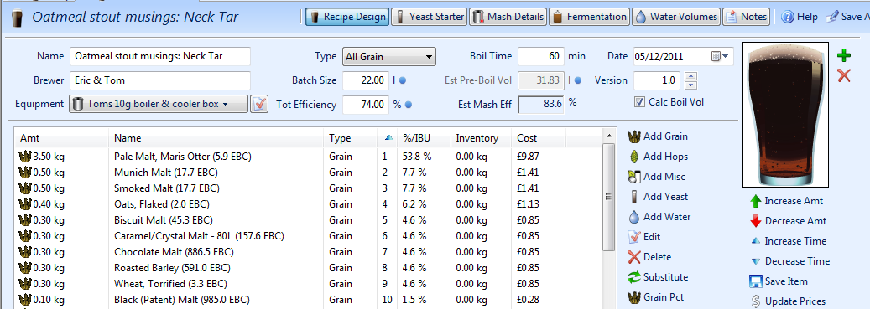
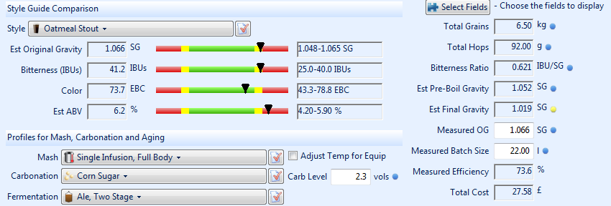

Slide 13
Beer type: Blonde Beer name : BFG (Bitter, Fruity & Golden) / Rye smile / or Hoppy Daze
Basis of recipe: Brew Wharf ‘King of the Junga’, etc. Brew date: 7th April 2012 Brew volume: c 20 litres
Process: Full mash Yeast: Nottingham Target: 4.0% ABV, 33 IBUs, very pale
Full mash grains | Type | Amount | % of Grain | Details
 | Pale malt (Maris Otter) | 2.56kg
 | Munich malt | 0.5
 | Rye malt | 0.5
 | Torrified Wheat | 0.13
Hops | Type | Amount | When added | Details (% Alpha Acid)
 | Citra | 7g | FWH | 15%
 | Nelson Sauvin | 7g | FWH | 12.6%
 | Citra | 10g | 5 mins from end of boil | 15%
 | Nelson Sauvin | 10g | 5 mins from end fo boil | 12.6%
 | Citra | 10g | Post-boil, wort at 90 ⁰C | 15%
 | Nelson Sauvin | 10g | Post-boil, wort at 90 ⁰C | 12.6%
Procedure: Mash: 15 litres at 71 ⁰C strike temp, mash at 68 ⁰C for 1 hour (down to 64 ⁰C). Sparge at 80 ⁰C into big bucket and FWH. Sparge temp 80 – 72 – 80. Pre-boil: 23 litres at 1040 at 20 ⁰C. Takes 40 mins to get to boil, then 60 mins. Flavour hops at end minus 5 mins, aroma hops at 90 ⁰C post-boil. Plate chiller clogs up so initially into fermenter at 45 ⁰C , then chilled in the sink. Yeast starter well going when pitched at 30 ⁰C .
Fermentation: Starts at 22 ⁰C, moved to 19/20 ⁰C. Good head after 18 hours. Subsided by day 3. Lovely fruity hoppy aroma from the airlock. 22nd April (day 15) – still bubbling slowly through airlock. SG at 1014. Bottled on 2nd May. Primed with 1.5 oz of sugar . Produced 35 bottles.
Results: Amber rather than gold.

Slide 14
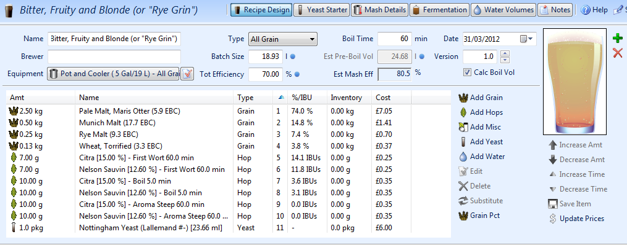
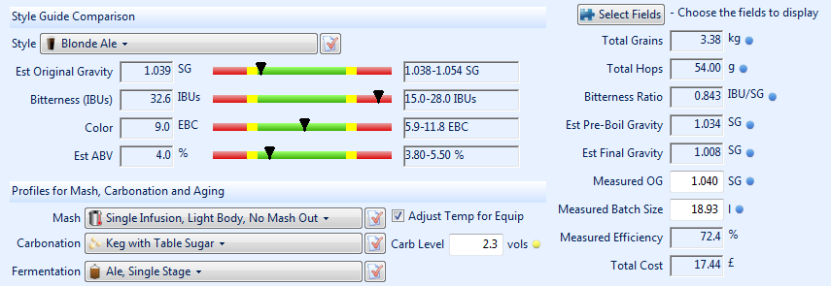

Slide 15
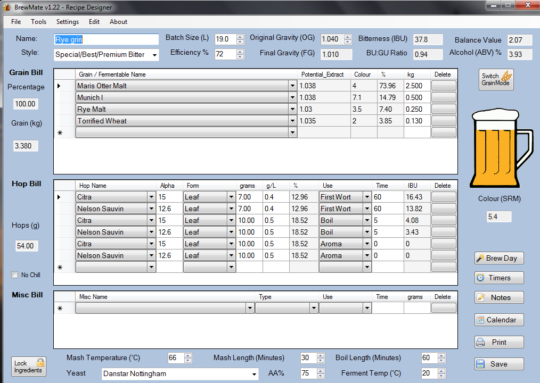

Slide 16
Beer type: Blonde – Brew 2 Beer name: Haystackfest ‘...and Summer that.’
Basis of recipe: Brew Wharf ‘King of the Junga’, etc. Brew date: 28th April 2012 Brew volume: c 22 litres
Process: Full mash Yeast: Nottingham Target: 4.0% ABV, 28 IBUs, very pale
Full mash grains | Type | Amount | % of Grain | Details
 | Pale malt (Maris Otter) | 2.56kg
 | Munich malt | 0.5
 | Rye malt | 0.5
 | Torrified Wheat | 0.13
Hops | Type | Amount | When added | Details (% Alpha Acid)
 | Citra | 7g | FWH | 15%
 | Nelson Sauvin | 7g | FWH | 12.6%
 | Citra | 10g | 5 mins from end of boil | 15%
 | Nelson Sauvin | 10g | 5 mins from end fo boil | 12.6%
 | Citra | 10g | Post-boil, wort at 80 ⁰C | 15%
 | Nelson Sauvin | 10g | Post-boil, wort at 80 ⁰C | 12.6%
Procedure: Mash: 15 litres at 72 ⁰C strike temp, mash at 66 ⁰C for 1 hour (down to 64 ⁰C after 30 ins, hot water added to 67). Sparge at 75 ⁰C into big bucket and FWH. Pre-boil: 25 litres. 20 mins to boil, then 60 mins. Flavour hops at end - 5 mins, aroma hops at 90 ⁰C post-boil. Used chiller coil. Hop strainer clogged so strained into fermenting bucket. Yeast starter well going when pitched at 28 ⁰C .
Fermentation: Starts at 20 ⁰C. Good head after 18 hours. Subsided by day 2, stopped by day 3. Checked SG - 1014 Added 5g each NS and Citra on Friday May 4th as dry hops. Into carboy on May 20th and into garage at 12 ⁰C. Into Corny Keg on May 23rd. SG 1012., with a bottle left over.
Results: Still cloudy when drunk over Haystackfest, June3rd/4th. Pale, lovely citrusy hops. Highly drinkable. All went, and quickly. Voted ahead (just) of Tom’s ‘A Bitter this...’, went ahead of the Oxford Gold.

Slide 17
Beer type: Blonde – Brew 3 Beer name: AGM brew “All Grain Mash”.
Basis of recipe: Brew Wharf ‘King of the Junga’, etc. Brew date: 7th June2012 Brew volume: c 22 litres
Process: Full mash Yeast: Safale us -05 Target: 4.0% ABV, 30 IBUs, very pale
Full mash grains | Type | Amount | % of Grain | Details
 | Pale malt (Maris Otter) | 2.5kg | 70.6
 | Munich malt | 0.4 | 11.3
 | Rye malt | 0.5 | 14.1
 | Torrified Wheat | 0.15 | 4
Hops | Type | Amount | When added | Details (% Alpha Acid)
 | Citra | 10g | FWH | 15%
 | Cascade | 12g | FWH | 7%
 | Citra | 10 g | 10 mins from end of boil | 15%
 | Cascade | 10g | 10 mins from end fo boil | 7%
 | Citra | 10g | Post-boil, wort at 85 ⁰C | 15%
 | Cascade | 10g | Post-boil, wort at 85 ⁰C | 7%
Procedure: Mash: 15 litres at 72 ⁰C strike temp, mash at 66 ⁰C for 1 hr 10m (down to 64 ⁰C after 30 ins, hot water added to 67). Sparge at 80 ⁰C into big bucket and FWH. 3 litres recirculated. Sparge stuck so re-stirred and re-circulated till ‘clean’. Pre-boil: 25 litres. Boil 60 mins. Protofloc at end minus 15 mins. Flavour hops at end - 10 mins, aroma hops at 85 ⁰C post-boil. Used chiller coil. Used new braid strainer – OK. 1045 OG. Yeast starter, pitched at 30 ⁰C.
Fermentation: Went strongly for 3 days then stopped. Kegged on (c) 6th July. Final OG 1012, giving an ABV of 4.3%. Fresh with a bitter finish. Just a keg full, no bottles.
Results: Nice easy drinking pale ale with nice citrussy hoppiness.

Slide 18
Beer type: Blonde – Brew 4 Beer name: Tony’s birthday beer – Full S’Ale (or Fools Ale)
Basis of recipe: all the other blondes.... Brew date: 28th June2012 morning. Brew volume: c 22 litres
Process: Full mash Yeast: Safale us -05 Target: 4.0% ABV, 28 IBUs, very pale
Full mash grains | Type | Amount | % of Grain | Details
 | Pale malt (Maris Otter) | 2.5kg | 70.6
 | Munich malt | 0.5 | 11.3
 | Rye malt | 0.5 | 14.1
 | Torrified Wheat | 0.12 | 4
Hops | Type | Amount | When added | Details (% Alpha Acid)
 | Nelson Sauvin | 16g | FWH | 12.3%
 | Cascade | 10g | FWH | 7%
 | Citra | 10 g | 10 mins from end of boil | 15%
 | Nelson Sauvin | 10g | 10 mins from end fo boil | 12.3%
 | Citra | 10g | Post-boil, wort at 85 ⁰C | 15%
 | Cascade | 10g | Post-boil, wort at 85 ⁰C | 7%
Procedure: Mash: 15 litres at 72 ⁰C strike temp, mash at 65 ⁰C for 1 hr (down to 62 ⁰C after 30 ins, hot water added to 67). Sparge at 80 ⁰C into big bucket and FWH. 3 litres recirculated. Stirred at 30 mins and re-circulated till ‘clean’. Pre-boil: 25 litres. Boil 75 mins. Protofloc at end minus 10 mins. Flavour hops at end - 5 mins, aroma hops at 85 ⁰C post-boil. Used chiller coil. Used braid strainer – OK. 1046 OG. Yeast starter, pitched at 28 ⁰C.
Fermentation: Bubbling well later the same day, and good head by following morning. 19/7 – SG 1012, into keg. (= 4.7% ABV). Dry-hopped on 23/7 with 5g each of N.S., Cascade and Citra.
Results. All went in 2 hours. A little cloudy, but tasty and hoppy.

Slide 19
Beer type: Russian Imperial Stout Beer name: Rasputin’s revenge.
Basis of recipe: Brew date: 27th July 2012. Brew volume: c 10-12 litres
Process: Full mash Yeast: Safbrew T 58, 2 packs Target: 8% ABV, 60 IBUs, very dark
Full mash grains | Type | Amount | % of Grain | Details
 | Pale malt (Maris Otter) | 3.1 | 63
 | Special B | 0.5 | 10
 | Crystal (dark) | 0.3 | 6
 | Chocolate | 0.25 | 5
 | Roasted Barley | 0.25 | 5
 | Biscuit Malt | 0.2 | 4
 | Black Malt | 0.1 | 2
 | Torrified Wheat | 0.2 | 4
 | Light brown sugar | 0.4 |  | Added on Day 3 of fermentation
 | Molasses | 0.2 |  | ditto
Hops | Type | Amount | When added | Details (% Alpha Acid)
 | First Gold | 40g | FWH | 8.1%
 | First Gold | 10g | 5 mins from end of boil | 8.1%
 | Fuggles | 20g | 5 mins from end of boil | 3.8%
Procedure: Mash in at 77 degrees, 18 litres. Mashed 1 hour – 67 – 69 – 66 – 65. Sparged to 15 litres at 1062. Boiled to c 12 litres (1 hour). At 1068. Third of a Protofloc tab
Fermentation: Started bubbling within 4 hrs. Good head next day. Day 3: Krausen subsided, added .4kg light brown sugar and .3kg molasses: should move OG to 1088, and if FG is 1.025 then 8.5% ABV. 13th Sept – moved off trubb. 1032, so c 7.8% . Rich, slightly sweet, complex. Little or no aroma.
Results: Bottled on 23rd Oct – 31 bottles of .25 or .33l. Syrupy, complex, very dark. 14/11 – ditto, but smoother. The Special B comes through – would prob miss that out another time.

Slide 20
Beer type: Brown Ale Beer name: Black Knight
Basis of recipe: Second running from RIS . Brew date: 27th July. Brew volume: c 10-12 litres
Process: Full mash Yeast: Safale US 05 Target: 3% ABV, under 20 IBUs, very dark
Full mash grains | Type | Amount | % of Grain | Details
 | Pale malt (Maris Otter) | 3.1 | 63
 | Special B | 0.5 | 10
 | Crystal (dark) | 0.3 | 6
 | Chocolate | 0.25 | 5
 | Roasted Barley | 0.25 | 5
 | Biscuit Malt | 0.2 | 4
 | Black Malt | 0.1 | 2
 | Torrified Wheat | 0.2 | 4
Hops | Type | Amount | When added | Details (% Alpha Acid)
 | First Gold | 4g | FWH | 8.1%
 | Fuggles | 8g | FWH | 3.8%
 | Worcester Goldings | 3g | End of boil | 5.8%
 | First Gold | 7g | End of boil | 8.1%
 | Fuggles | 10g | End of boil | 3.8%
Procedure: Mash in at 77 degrees, 18 litres. Mashed 1 hour – 67 – 69 – 66 – 65. RIS Sparged to 15 litres at 1062. Brown Ale sparged to 15 litres at 1023 pre-boil. 90 min boil to reduce OG. Third of a Protofloc tab. Post-boil at 1034, c. 11 litres
Fermentation: Slow ferment for 2 days then slowed down. 13/9 – moved off trubb. At 1010, so c 3.0%. Dry hop with Tom’s fresh Ist Gold. Generated white mould – bottled anyway on 21/9.
Results: 4/11/12 – Dark, clear, easy drinking, long choc finish, a little lacking in body. Overall, OK. Turned into a nice, tasty, complex mild. Don’t get the Special B flavour. Would brew again just for this, never mind the RSS.

Slide 21
Beer type: Imperial IPA Beer name: Bengal Tiger Reserve
Basis of recipe: Brew date: 28th Sept 2012 Brew volume: c 22 litres
Process: Full mash Yeast: Safale US 05 Target: 7.5% ABV, lots of citrus hop – a ‘grown up’ Rye PA
Full mash grains | Type | Amount | % of Grain | Details
 | Pale malt (Maris Otter) | 2.5kg | 37
 | Munich | 1.5kg | 22
 | VIenna | 1kg | 15
 | Rye | 1kg | 15
 | Crystal (Pale) | 0.5 | 8
 | Torrified wheat | 0.2 | 3
Hops | Type | Amount | When added | Details (% Alpha Acid)
 | Fuggles | 70g | FWH | 3.8%
 | Ist Gold | 7 | FWH | 5.5%
 | Citra | 25 | FWH | 15%
 | Citra | 20 | 15 mins to end of boil
 | Cascade | 20 | 15 mins to end of boil | 5.5%
 | Nelson Sauvin | 13 | Steep (80 degrees, 30 mins)
 | Citra | 20 | Ditto
 | Cascade | 17 | ditto
Procedure: Mash in at 75 degrees, 18 litres. Mashed 1 hour – 68 – 67 - 65. Sparged to 26 litres at 1065. 60 min boil. Half a Protofloc tab. Post-boil at 1072, c. 22 litres.
Fermentation: Started quickly – going well overnight – at 18 C. 23/10 – moved off trub into 2nd carboy. At 1016 = ABV 7.4%. Dry hop 24/10: 10g Cascade, 25g Citra. Bottled 30/11. Primed with 80g sugar. Moved into garage 18/12
Results: Slightly cloudy, amber-ish, nice lacy head, lots of hoppy aroma and taste, long bitter finish. V Nice. Cleared by April. Still lovely: smooth, full-bodied, tasty. April 2015 – very smooth.

Slide 22
Beer type: IPA Beer name: Andya pale ale
Basis of recipe: Brew date: 3 Nov 2012 2012 Brew volume: c 22 litres (plan) – 30 l (actual)
Process: BAIB Yeast: Safale US 05 Target: 6.0%, classic English IPA
Full mash grains | Type | Amount | % of Grain | Details
 | Pale malt - Maris Otter | 5.25
 | Munich Malt | 0.5
 | Biscuit | 0.25
 | Cara-pils | 0.25
 | Black Malt | 0.03
 | Sugar | 0.75 |  | Added post-mash – see below
Hops | Type | Amount | When added | Details (% Alpha Acid)
 | Fuggles | 50g | FWH | 4.5%
 | Goldings | 50g | FWH | 5.7%
 | Fuggles | 20 | 10 mins to end of boil | 4.5%
 | Goldings | 20 | 10 mins to end of boil | 5.7%
 | Cascade | 20 | Aroma steep – added at 80 deg. | 7.0%
 | Fuggles, Goldings | 35 of each | Dry Hop | Across 5 gallon and 2 gallon Corny kegs
Procedure: BIAB. – 2 bags in large boil bucket. 40l on mash-in. After 60 mins, only 1040 (target 1060). Mashed to 90 mins and sugar added. Volume too high: 36l pre-boil. Boiled 90 mins. Filled carboy + 2 demijons. 2nd yeast sachet to start these. At 1052 – should give c. 5.2%. Next time: smaller boiler, 1 bag, top up wort to 20l if req’d.
Fermentation: Very strong for 3 days at 18-19 C. 15/11 – clearing, at 1010! So 5.5%, round up to 6.0... 3/12 - moved off trub into clean carboys/demijons. Amber, clear (ing), hoppy taste – needs dry-hops for aroma. 3/1/13 – dry hopped into Corny kegs.
Results: Andy: ‘This is Effing good beer’. Lovely – pale, hoppy, tasty. Doesn’t taste like 5.5%. All 7 gals went.

Slide 23
Beer type: Belgian Dubbel Beer name: Doubbloon...or Blackbeerd
Basis of recipe: Brew date: 8 Nov 2012 2012 Brew volume: c 22 litres
Process: Full Mash Yeast: Safale US 05 Target: 6.0%, 18 IBU, dark – 50 EBC
Full mash grains | Type | Amount | % of Grain | Details
 | Pale malt - Belgian | 3.0 | 60
 | Munich Malt | 0.5 | 10
 | Special B | 0.5 | 10
 | Crystal (dark) | 0.25 | 5
 | Biscuit malt | 0.25 | 5
 | Candi Sugar - dark | 0.5 | 10 | Added 10 mins before end of boil
Hops | Type | Amount | When added | Details (% Alpha Acid)
 | Styrian Goldings | 50 | FWH | 3.0%
 | Tettnang | 10 | 10 mins before end of boil | 3.8%
 | Tettnang | 20 | Steep - at 85 degrees
 | Tettnah | 30 | Dry hop, 24/12
Procedure: Mash in water 15 litres at 74, after mash 65. Mash for 90 mins +. Sparge water at 80. Sparge to give 25 litres: OG at end of sparge 1016, wort pre-boil 1041 excl. Candi sugar. Problem with boiler element so wort cooled to 85 mid-boil. Dissolved sugar added 10 mins before end of boil, along with half a Whirfloc and the aroma hops. Chilled to 25, into small boiler, yeast pitched at 24 degrees (4 hrs after smacking the pack). 22l at 1059.
Fermentation: Nothing after 24 hrs. Bubbling after 48, at 20 c. Kept at 17-19 degrees for next 48 hours – still bubbling well. Airlock slowed down – nearly stopped - 3 days after starting. 14/11 – at 1020. 27/11 – still bubbling slowly. Moved to our ensuite to warm up a degree or two. 5/12 – stopped. Moved into Carboy 8/12 – at 1018 = 5.4%. Brief activity then stopped. Moved into barrel and dry hopped 24/12.
Results: Served from barrel at Swanage New Year. Dark brown, slightly sweet, a hint of ‘Belgian’, little/no hops. Prefer a dark bitter. It all got drunk though. The ‘Special B’ came through strongly.

Slide 24
Beer type: Oatmeal Stout Beer name: Fat Ewe - Cotswold Stout
Basis of recipe: Brew date: 31 Jan 2013 Brew volume: c 22 litres
Process: Full Mash Yeast: Safale US 05 (and WLP 004) Target: 5.0%, 30 IBU, dark – 70 EBC
Full mash grains | Type | Amount | % of Grain | Details
 | Pale malt - Maris Otter | 3.0 | 58
 | Brown Malt | 0.5 | 10
 | Munich | 0.3 | 6
 | Crystal (dark) | 0.25 | 5
 | Biscuit malt | 0.3 | 6
 | Oats | 0.3 | 6
 | Torrified wheat | 0.25 | 5
 | Black Malt | 0.15 | 3
 | Roasted barley | 0.1 | 2
Hops | Type | Amount | When added | Details (% Alpha Acid)
 | Fuggles | 25g | FWH | 3.5%
 | East Kent Goldings | 25g | FWH | 6.45%
 | Fuggles | 7g | 10 mins from end of boil
 | EKG | 7g | ditto
 | Fuggles | 5g | Aroma steep at 80 C
 | EKG | 5g | ditto
Procedure: Mash in at 72 c, mash at 68 to 66 c over an hour. Sparge at 80: 24 litres at 1053. Boil 1 hour to 22 l at 1056. WLP tube exploded on opening so wasted - used US 04. Forgot the Protofloc.
Fermentation: 7/02 – fermented in utility, a little cold (16-18 c). Stopped – at 1022 (=4.5%). Moved to bathroom. Moved into clean carboy March 19th – strong roast flavours, long dry choc finish. Bottled 4th April: 37.5 litres. More rounded. Fizzy in the carboy.
Results: 25/04 – frothy when poured but OK when settled. Strong Roasted taste but smooth. Opaque. Became dangerous – exploding bottles. Rounded out by late August .

Slide 25
Beer type: Pale bitter Beer name: The Light Side of the Moon
Basis of recipe: Brew date: 28 Mar 2013 Brew volume: c 22 litres
Process: BIAB Yeast: Safale US 05 Target: 3.6%, 35 - 40 IBU, pale, citrus hoppy
Full mash grains | Type | Amount | % of Grain | Details
 | Pale malt - Maris Otter | 2.75
 | Munich | 0.25
 | Crystal (Light -100 EBC) | 0.25
 | Torrified wheat | 0.15
 | Black Malt | 0.03
Hops | Type | Amount | When added | Details (% Alpha Acid)
 | Cascade | 20g | FWH | 7%
 | Citra | 8g | FWH | 15%
 | Cascade | 10g | At end of boil | 7%
 | Citra | 10g | ditto | 15%
 | Citra | 10g | Dry-hop
 | Cascade | 10g | Dry-hop
Procedure: 20 l at 72 C in small boiler. Mash-in (in bag), down to 68 C. At 1 hr at 63 – warmed up. Strained grain bag. FWH hops added – loose! – and brought to boil. Topped up to 20l. Transferred to large boiler with hop strainer. Boil 1 hr – topped up to 22 l. Cooled to 30C in 30 mins and into carboy. At 1036. Yeast pitched dry.
Fermentation: Bubbling after 16 hrs. Almost stopped after a week. Transferred to clean carboy 11/04. At 1013 so 3.0% - a bit low. Still bubbling v. slowly. Dry-hopped. Bottled 23/04/13
Results: End April/early May - A lovely colour of...brown – not pale at all! A little thin but nice aroma and fruity hop taste, not-too-bitter finish. Tastes and looks like an ordinary bitter with a citrusy twist.

Slide 26
Beer type: Belgian Blonde Beer name: A little gem
Basis of recipe: Brew date: 12 April 2013 Brew volume: c 22 litres
Process: Full mash Yeast: White Labs 530 Belgian Abbey Target: 6 - 6.5 %, 20 IBU, pale, not hoppy, like an Affligem or Leffe
Full mash grains | Type | Amount | % of Grain | Details
 | Pale malt – Belgian 2-row | 3.0 | 60
 | Munich | 0.5 | 10
 | Pilsner 2-row | 0.5 | 10
 | Aromatic malt | 0.25 | 5
 | Cara-pils | 0.25 | 5
 | Candi Sugar - pale | 0.5 | 10
Hops | Type | Amount | When added | Details (% Alpha Acid)
 | Styrian Goldings | 30g | Straight after the mash ends | 5.4%
 | Tettnang | 15g | End of boil minus 10 mins | 4.5%
 | Tettnang | 15g | At end of boil, 80 degreees | 4.5%
 | Tettnang | `4g | Dry hop – A week before bottling
Procedure: Mash-in at 72 C, dropped to 65 C. Aft er 30 mins mash temp raised gradually to 70. 90 mins mash. Sparge at 80 C. Sparge stuck twice – mashed too hot? Boil for 75 mins. Sugar added 10 mins from end. Pre-boil OG 1048 (without sugar). Post-boil OG 1061. Yeast pitched at 25 C.
Fermentation: Good krausen after a day. Energetic – came up thro’ the airlock on morning of the 14th. Settled down a day later. Kept ‘warm’ - wrapped in an old anorak. 20 C outside the carboy so 22 in the middle? Warmed up to 22 around day 3, kept their till day 7, then to 17-18. On 28/04 -day 26 – clearing, stopped, at 1010 (= 6.7 %). 08/05/13 – moved off trub, dry hopped. Smooth with a dry, slightly sharp finish. Bottled 24/05/13.
Results: Somewhere between Leffe Blond and Affligem. Nice, obviously ‘Belgian’.

Slide 28
Beer type: Blonde Beer name : Les have another beer (for Les’s 60th)
Basis of recipe: Haystackfest Brew date: 18th June 2013 Brew volume: c 20 litres
Process: Full mash Yeast: Safale US 05 Target: Under 4.0% ABV, 28 IBUs, very pale
Full mash grains | Type | Amount | % of Grain | Details
 | Pale malt (Maris Otter) | 2.5kg
 | Munich malt | 0.5
 | Caragold | 0.25
 | Rye malt | 0.13
 | Torrified Wheat | 0.13
Hops | Type | Amount | When added | Details (% Alpha Acid)
 | Citra | 12 | FWH | 15%
 | Citra | 10 | 10 mins from end of boil | 15%
 | NZ Cascade | 10 | 10 mins from end fo boil | 6.9%
 | Citra | 10 | Post-boil, wort at 90 ⁰C | 15%
 | NZ Cascade | 10 | Post-boil, wort at 90 ⁰C | 6.9%
 | Citra | 10 | Dry Hop
 | NZ Cascade | 10 | Dry hop
Procedure: Mash at 66 C for one hour. Sparge at around 78 C. Boil 1 hour. Cooled to 30 C, yeast added. 24 litres at 1036 – more beer, but weaker than expected.
Fermentation: 09/07/13 – at 1012, so 3.1% - a bit lower than planned. Moved into clean carboy. Gold with red/orange. 26/7: into keg with dry hopping, plus 4 bottles. 1011 so 3.4%.
Results:

Slide 29
Beer type: Blonde Beer name : Drinking Beer No 5 (“DB5”)
Basis of recipe: Haystackfest , etc Brew date: 9th July 2013 Brew volume: c 20 litres
Process: Full mash Yeast: Safale US 05 Target: Under 4.0% ABV, 28 IBUs, very pale, strong citrus hop aroma and flavour.
Full mash grains | Type | Amount | % of Grain | Details
 | Pale malt (Maris Otter) | 2.5kg
 | Munich malt | 0.5
 | Caragold | 0.125
 | Crystal – pale | 0.125
 | Rye malt | 0.25
 | Torrified Wheat | 0.13
Hops | Type | Amount | When added | Details (% Alpha Acid)
 | Fuggles | 40 | FWH | 4.5%
 | Citra | 10 | 10 mins from end of boil | 15%
 | NZ Cascade | 10 | 10 mins from end fo boil | 6.9%
 | Citra | 15 | Post-boil, wort at 90 ⁰C | 15%
 | NZ Cascade | 15 | Post-boil, wort at 90 ⁰C | 6.9%
 | NZ Cascade | 20 | Dry hop
Procedure: Mash at 66 C for one hour. Sparge at around 78 C. Boil 1 hour. Cooled to 30 C, yeast added. 3 4 litres at 1044 – on track for around 4.2%
Fermentation: 09/07/13 – at 1012, so 3.1% - a bit lower than planned. Moved into clean carboy. Gold with red/orange. 26/07 – transferred to clean carboy. At 1016 – a bit high – which makes it 3.7%. Clear. 31/7 dry hopped 20g NZ Cascade. Still at 1016. Bottled on 09/08. At 1014 = 3.9%. In range for a Special bitter.
Results:

Slide 30
Beer type: Stout Beer name: Fat Ewe Two - Cotswold Stout
Basis of recipe: Brew date: 3 Sept 2013 Brew volume: c 22 litres
Process: Full Mash Yeast: Safale US 05 Target: 5.5%, 30 IBU, dark
Full mash grains | Type | Amount | % of Grain | Details
 | Pale malt - Maris Otter | 2.5 | 48
 | Brown Malt | 0.5 | 10
 | Munich | 0.55 | 10
 | Crystal (medium) | 0.12 | 2 | 100 EBC
 | Wheat malt - smoked | 0.5 | 10
 | Chocolate Malt | 0.2 | 4
 | Torrified wheat | 0.2 | 2
 | Black Malt | 0.15 | 2
 | Roasted barley | 0.5 | 10
Hops | Type | Amount | When added | Details (% Alpha Acid)
 | Styrian Goldings | 22g | FWH | 3%
 | East Kent Goldings | 28g | FWH | 6.45%
Procedure: Mash in at 72 c, mash at 66 c for over an hour. Liquor treated with half a camden tab to remove Chloramines. Sparge at 82: 25 litres at 1053. Boil 1 hour to 22 l at 1056. No aroma or flavour hops.
Fermentation: Fermented in utility, a little warm(22c). Moved on 25 Sept – at 1020 so at 4.7%. Still glugging but very slowly. Added 100g brown sugar on 27 Sept to ‘mimic’ secondary bottle conditioning. Glugged some more then stopped. Shaking releases lots of gas from the beer. 29/11/13 – no longer ‘gasses’ when rattled. At 1020. Bottled 05/12/13 with 50g muscovado.
Results: By Feb 2014 rounding out nicely. Nice head when poured – not explosive!

Slide 31
Beer type: Blonde Beer name : Cheltenham Gold Cup
Basis of recipe: Haystackfest , etc Brew date: 28th July 2013 Brew volume: c 20 litres
Process: Full mash Yeast: Safale US 05 Target: Under 4.0% ABV, 20 IBUs, very pale, English hop aroma and flavour.
Full mash grains | Type | Amount | % of Grain | Details
 | Pale malt (Maris Otter) | 2.5kg
 | Munich malt | 0.5
 | Caragold | 0.25
 | Biscuit malt | 0.2
 | Torrified Wheat | 0.15
Hops | Type | Amount | When added | Details (% Alpha Acid)
 | Fuggles | 30 | FWH | 4.5%
 | Fuggles | 10 | 10 mins from end of boil
 | East Kent Goldings | 10 | 10 mins from end fo boil | 6.5%
 | Fuggles | 10 | Post-boil, wort at 90 ⁰C
 | EKG | 10 | Post-boil, wort at 90 ⁰C
 | Fuggles | 12 | Dry Hop
 | East Kent Goldings | 18 | Dry hop
Procedure: Mash at 66 C for one hour. Sparge at around 80 C. Boil 1 hour. Cooled to 30 C, yeast added. 24 litres at 1040 – on track for around 3.8%.
Fermentation: Not particularly vigorous and stopped by 2/8 – checked, at 1.014, so 3.4%. 15/8 – moved into keg. Dry hops added. Still at 1014, and cloudy.
Results:

Slide 32
Beer type: Blonde Beer name : Wight-wash ( for New Year 2013, Isle of Wight)
Basis of recipe: Haystackfest , etc Brew date: 29th November 2013 Brew volume: c 20 litres
Process: Full mash Yeast: Danstar Windsor Target: Under 4.0% ABV, 20 IBUs, very pale, citrussy hop aroma and flavour.
Full mash grains | Type | Amount | % of Grain | Details
 | Pale malt (Maris Otter) | 2.5kg
 | Munich malt | 0.25
 | Caragold | 0.25
 | Raw malt | 0.25
 | Torrified Wheat | 0.15
Hops | Type | Amount | When added | Details (% Alpha Acid)
 | Citra | 8 | FWH | 15%
 | Nelson Sauvin | 8 | FWH | 12.6%
 | Fuggles | 10 | 5 mins from end fo boil
 | Nelson Sauvin | 10 | 5 mins from end of boil
 | Citra | 10 | Dry Hop
 | Nelson Sauvin | 10 | Dry Hop
Procedure: Mash at 66 C for an hour and a half. Sparge at around 80 C. Boil 1 hour. Cooled to 30 C, yeast added. 24 litres at 1040 – on track for around 3.8%.
Fermentation: Very lively for 24 hours, then a long, very slow fermentation in the Utility at 16 degrees – moved to the ensuite (18 degrees?) still going and still cloudy at Xmas, so not taken to New Year. On 8/1/14 at 1012 (=3.4%). Moved on 9/1 and dry-hopped. Bottled on 20/01/14 – at 1009 (different hydrometer). Primed with 30g sugar – Beersmith said 25g, How To Brew said 35g for 1.5 x carbonation.
Results:

Slide 33
Beer type: Belgian Blonde Beer name: A little gem 2
Basis of recipe: Brew date: 9 Jan 2014 Brew volume: c 22 litres
Process: Full mash Yeast: White Labs 530 Belgian Abbey Target: 6 - 6.5 %, 20 IBU, pale, not hoppy, like an Affligem or Leffe
Mash grains | Type | Amount | % of Grain | Details
 | Pale malt – Belgian 2-row | 3.0 | 65
 | Munich | 0.5 | 11
 | Caravienne | 0.25 | 5
 | Aromatic malt | 0.25 | 5
 | Cara-pils | 0.1 | 5
 | Candi Sugar - pale | 0.5 | 11
Hops | Type | Amount | When added | Details (% Alpha Acid)
 | Hallertau Mittelfrau | 25g | Straight after the mash ends | 4.9%
 | Ditto | 10g | End of boil minus 10 mins
 | Ditto | 10g | At end of boil, 80 degreees
 | Ditto | 14g | Dry hop – A week before bottling
Procedure: Mash-in at 74 C, dropped to 67 C. Aft er 30 mins mash temp at 66, at 1 hr 65. 70 mins mash. Sparge at 80 C. Sparge smooth. Boil for 75 mins. Sugar added 10 mins from end. Pre-boil 25 litres OG 1044 (without sugar). Post-boil OG 1058, 22litres. Yeast pitched at 25 C. – 5 weeks past it’s best by date, little fizz on undoing the lid.
Fermentation: Nothing after 24 hours at 20c. Moved into airing cupboard to warm up a few degrees – signs of life after 30 hrs, going well on day 2 at 20 c so moved to 18 c. 3” head after 48hrs. Went very energetically, then sporadically – needed shaking to get going again. Still glugging on 19/10. On 4/2 still v. slow fermentation - at 1009 (so 6.4%). Moved off trub into clean carboy. Dry hopped 27/2/14. Bottled 9/3/14 – 80g of sugar.
Results:.

Slide 34
Beer type: Gluten-Free Blonde Beer name:
Basis of recipe: Wight-Wash – GF version Brew date: 16th Feb 2014 Brew volume: c 15 litres
Process: Partial mash. Yeast: Safale US05 Target: Around 4.0% ABV, 25 IBUs, very pale, citrussy hop aroma and flavour.
Full mash grains | Type | Amount | % of Grain | Details
 | Sorghum syrup) | 1.5kg | 68
 | Brewers’ Maize | 0.25kg | 11
 | Sweet potato | 200g |  | Cooked & mashed
 | Candi sugar (Dark) | 0.25kg | 11
 | Muscovado | 0.15 | 7
 | Light Brown sugar | 0.05 | 2
Hops | Type | Amount | When added | Details (% Alpha Acid)
 | Citra | 10 | FWH | 15%
 | Citra | 10 | Boil 5 mins from end
 | Nelson Sauvin | 10 | ditto | 12.6%
 | Nelson Sauvin | 5 | After flame-out, at 85 degrees
 | Citra | 5 | dtto
 | Nelson Sauvin | 6 | Dry Hop
 | Citra | 6 | ditto
Procedure: Mash maize & potato at 66 C for an hour, drained. Sorghum added, boil 1 hour. Hops added in hopbags. Cooled to 28 C, yeast added. 15 litres at 1046 – around 4.5%.
Fermentation: Slow to start, not very vigorous, then stopped – added yeast nutrient on 18th, again on 20th (at 1018). 22nd – at 1007, so 5% abv. Done. Dry hopped on 27/2/14. Bottled 10/3/14 – 30g of sugar.
Results:

Slide 36
Beer type: Blonde Beer name : Dave’s 60th Birthday Bash Brew
Basis of recipe: Wight Wash copy Brew date: 5th May 2014Brew volume: c 20 litres
Process: Full mash Yeast: Danstar Nottingham Target: Under 4.0% ABV, 20 IBUs, very pale, citrussy hop aroma and flavour.
Full mash grains | Type | Amount | % of Grain | Details
 | Pale malt (Maris Otter) | 2.25kg | 69
 | Munich malt | 0.25 | 8
 | Caragold | 0.25 | 8
 | Rye malt | 0.37 | 11
 | Torrified Wheat | 0.15 | 4
Hops | Type | Amount | When added | Details (% Alpha Acid)
 | Citra | 8 | FWH | 15%
 | Nelson Sauvin | 8 | FWH | 12.6%
 | Citra | 10 | 5 mins from end fo boil
 | Nelson Sauvin | 10 | 5 mins from end of boil
 | Citra | 10 | Dry Hop
 | Nelson Sauvin | 10 | Dry Hop
Procedure: Water treated with half a Camden tab. Mash in at 67 C, 1 hr mash. Sparge a mess – strainer came apart and valve clogged so tipped mash into bucket, cleaned out and returned. The mash stuck. 25l pre-boil at 1.033. 70 mins boil. Result: 23 litres at 1.036 so should come out around 3.6%.
Fermentation: Went well. On 14/5/14 at 1011 so smack on 3.6%. Needs dry-hopping – not much aroma. Now just need to keep it for 8 weeks. Kegged on 31/05/14. At 1009 so 3.5%. Dry hopped on June 30th.
Results:

Slide 37
Beer type: Belgian Tripel Beer name: La Trappe d’Or Tripel (First runnings)
Basis of recipe: Brew date: 5 May 2014 Brew volume: c 9 litres
Process: Full mash Yeast: White Labs 530 Belgian Abbey Target: 8.5 - 9 %, 25 IBU, pale, not hoppy.
Full mash grains | Type | Amount | % of Grain | Details
 | Pale malt – Belgian 2-row | 3.0 | 58
 | Munich | 0.8 | 15
 | Carabelge | 0.5 | 10 | In Beersmith as Caraamber
 | Aromatic malt | 0.25 | 5
 | Cara-pils | 0.25 | 5
 | Caravienne | 0.27 | 5
 | Candi Sugar - pale | 0.128 | 2
Hops | Type | Amount | When added | Details (% Alpha Acid)
 | Hallertau Mittelfrueh | 20g | Straight after the mash ends | 4.0%
 | Tettnang | 10g | End of boil minus 10 mins | 2.2%
 | Tettnang | 5g | At end of boil, 80 degreees | 2.2%
 | Tettnang | 10g | Dry hop – A week before bottling
Procedure: Mash in at 76 c, mash at 67 c. Raised to 70 c after 60 mins. 90 mins mash. First runninngs of 10 litres from a full mash tub: at 1.064 preboil and w/out sugar. 70 mins boil (interrupted by element cut-out). Sugar added 10 mins from end. 9 l at 1.088 – could be 9.5%. Yeast started day efore, half pitched here.
Fermentation: Started within 2 hours and went strongly then petered out. On 14/5/14 at 1020, so 9%. Maybe that’s it? OG 088 * attenuation 75 to 80 % (from WLP) = 66 to 70; 88 minus 66 to 70 = 18 to 22, i.e. 1018 to 1022. 1020 is smack in the middle.....Moved on 20/5 into a demijon and a half. Bottled on 17/7/14 – at 1.015, =9.6%. 28g sugar to prime .
Results: Flat. Bottled re-primed on 17/8/14 – 4 bottles from half-demijon didn’t need this, fizzy when opened.

Slide 38
Beer type: Belgian pale ale Beer name: Trappe D’Or blonde (Second runnings).
Basis of recipe: Brew date: 5 May 2014 Brew volume: c 15 litres
Process: Full mash Yeast: White Labs 530 Belgian Abbey Target: 4%, 20 IBU, pale, not hoppy.
Mash grains | Type | Amount | % of Grain | Details
 | Pale malt – Belgian 2-row | 3.0 | 58
 | Munich | 0.8 | 15
 | Carabelge | 0.5 | 10 | In Beersmith as Caramber
 | Aromatic malt | 0.25 | 5
 | Cara-pils | 0.25 | 5
 | Caravienne | 0.27 | 5
 | Candi Sugar - pale | 0.128 | 2
Hops | Type | Amount | When added | Details (% Alpha Acid)
 | Hallertau Mittelfrueh | 22g | Straight after the mash ends | 4.0%
 | Tettnang | 10g | End of boil minus 10 mins | 2.2%
 | Tettnang | 5g | At end of boil, 80 degreees | 2.2%
 | Tettnang | 10g | Dry hop – A week before bottling
Procedure: Mash in at 76 c, mash at 67 c. Raised to 70 c after 60 mins. 90 mins mash. Second runninngs of 16 litres from a full mash tub: at 1.028 preboil and w/out sugar. 70 mins boil (interrupted by element cut-out). Sugar added 10 mins from end. 15 l at 1.043 – should be around 4.1%. Yeast started day before, half pitched here.
Fermentation: Started quickly, within 12 hours, and strongly. Stopped after 4 days. On 14/5/14 at 1008, so c. 4.6%. Moved on 20/5 into clean carboy. Bottled on 18/7/14 – at 1.005, = 5%. About 12 litres.
Results: OK but flat. Re-primed with 1 g sugar per 330ml on 17/8/14.

Slide 39
Beer type: Blonde Beer name : 60th Birthday brew/Vailima housewarmer
Basis of recipe: Wight wash, but darker and more malty Brew date: 2nd July 2014. Brew volume: c 20 litres
Process: Full mash. Yeast: Danstar Nottingham Target: 4.0% ABV, Usual Blonde – but darker, more malty, citrussy hoppy.
Full mash grains | Type | Amount | % of Grain | Details
 | Pale malt (Maris Otter) | 2.5kg | 71
 | Munich malt | 0.28 | 8
 | Caragold | 0.20 | 6
 | Aromatic malt | 0.30 | 9
 | Carapils/Dextrine | 0.2 | 6
 | Black malt | 0.05 | 1
Hops | Type | Amount | When added | Details (% Alpha Acid)
 | Cascade | 30 | FWH | 7%
 | Citra | 10 | 5 mins from end fo boil | 15%
 | Nelson Sauvin | 10 | 5 mins from end of boil | 12.6%
 | Citra | 10 | Dry Hop
 | Nelson Sauvin | 10 | Dry Hop
Procedure: Water: 2/3 sraight tap, 1/3 softened; treated with half a Camden tab. Mash in at 67 C, 1 hr mash. Clean sparge.
Fermentation: Solid without getting over-excited. Moved to cornykeg on 5/8/14 – at 1.015, so 3.1%.
Results:

Slide 40
Beer type: Bitter Beer name : AGM 2014 – Cheltenham Spa Pale Ale
Basis of recipe: Wight wash, but darker and more malty Brew date: 27th July 2014. Brew volume: c 20 litres
Process: Full mash. Yeast: Nottingham. Target: 4.0% ABV, some colour and faint dark malt and citrusy hops.
Full mash grains | Type | Amount | % of Grain | Details
 | Pale malt (Maris Otter) | 2.5 | 73
 | Amber malt | 0.25 | 7
 | Crystal 40EBC | 0.25 | 7
 | Rye malt | 0.25 | 7
 | Torrified Wheat | 0.13 | 4
 | Chocolate malt | 0.05 | 2
Hops | Type | Amount | When added | Details (% Alpha Acid)
 | Pride of ringwood | 25g | FWH | 9%
 | Morueka | 10 | Boil 5 mins | 6.6%
 | Cascade | 10 | Ditto | 6.9%
 | Motueka | 12 | Dry hop 6 dys
 | Cascade | 12 | ditto
Procedure: Water: 2/3 sraight tap, 1/3 softened; treated with half a Camden tab. Mash in at 67 C, 1 hr mash. Clean sparge. 26l at 1.034 pre-boil. Messy boil – 2 tripped elements do wort moved twice mid-boil. 23l at 1.039 post-boil.
Fermentation: Solid without getting over-excited. Moved on 17/8 – clear, at 1.013 so 3.4%.
Results: Coppery-orange colour. Slight citrus aromas. Slight bitterness (hops and malts) – at first taste not a session beer but after the first pint it calls for another.... A bitter rather than a Pale Ale in colour and taste.

Slide 41
Beer type: Bitter/mild Beer name: Pembrokeshire Pint
Basis of recipe: Quick to be drinkable Bitter/Mild Brew date: 18th August 2014. Brew volume: c 20 litres
Process: Full mash. Yeast: Safale US 05 Target: 3.5% ABV, 25 IBU, dark colour and malts, citrusy hops (Spa Pale Ale but darker.)
Full mash grains | Type | Amount | % of Grain | Details
 | Pale malt (Maris Otter) | 2.2 | 73
 | Amber malt | 0.25 | 8
 | Crystal 40EBC | 0.25 | 8
 | Roasted barley | 0.05 | 2
 | Torrified Wheat | 0.15 | 5
 | Chocolate malt | 0.10 | 3
Hops | Type | Amount | When added | Details (% Alpha Acid)
 | Pride of ringwood | 25g | FWH | 9%
 | Morueka | 10 | Boil 5 mins | 6.6%
 | Cascade | 10 | Ditto | 6.9%
 | Motueka | 10 | Dry hop 6 dys
 | Tettnang | 10 | ditto
Procedure: Water: 2/3 sraight tap, 1/3 softened; treated with half a Camden tab. Mash in at 68 C, 1 hr mash. Clean sparge. 25l at 1.027 pre-boil. 22l at 1.034 post-boil.
Fermentation: Took a day to get going. Steady. On 27/8, at 1.009 so 3.1%, and clearing so moved to garage from utility. Moved into barrel on 3/9/14 (16 days from brew) – clear. Dry-hopped.
Results: Session bitter – low in bitterness. Nice copper colour. Little roast flavours coming through. Went in Pembs over a fortnight.

Slide 42
Beer type: Autumn warmer Beer name: ‘ Head porter’
Basis of recipe: Brew date: 22nd Oct 2014. Brew volume: c 20 litres
Process: Full mash. Yeast: Safale US 05 Target: 3.5to 4 % ABV, 25 IBU, dark colour and malts, traditional hops
Full mash grains | Type | Amount | % of Grain | Details
 | Pale malt (Maris Otter) | 2.2 | 61
 | Amber malt | 0.25 | 7
 | Crystal 120 EBC | 0.25 | 7
 | Roasted barley | 0.20 | 5.5
 | Chocolate malt | 0.20 | 5.5
 | Smoked malt | 0.5 | 14
Hops | Type | Amount | When added | Details (% Alpha Acid)
 | Pride of ringwood | 15g | FWH | 9%
 | Northern Brewer | 10 | FWH | 8.5%
 | Ditto | 10 | 5mins from end of boil
Procedure: Water: 2/3 sraight tap, 1/3 softened; treated with half a Camden tab. Mash in at 68 C, 1 hr mash. Sparge filter blocked so wort moved into bucket to clear, then back into mash tun –so temp dropped. Then sparge stuck. 25l at 1.038 pre-boil. 22l at 1.042 post-boil.
Fermentation: Took a day to get going. Steady. On 30/10, at 1.013 so 3.8%. Still going occasionally. 09/11 – moved off trub, still at 1013. No dry hopping. Bottled on 5/12/14. Still at 1013, so 3.9%
Results: Sampled on 12/12/14. Very dark – just about see a light through it. Enough head. Smoothing out – roasty with slight bitterness towards the end. Kept well – drinking nicely in March. Would do again – tasty and full-bodied but not too strong. The ‘House porter’? Maybe add a bit more smoked malt and a touch more bittering hops? Some bitterness from dark crystal, Choc and Roast Barley – turn these down a bit?

Slide 43
Beer type: Belgian pale ale Beer name: Trappe D’Or blonde – Gem 3
Basis of recipe: Brew date: 22 Oct 2014 Brew volume: c 20 litres
Process: Full mash Yeast: White Labs 500 Belgian Abbey Target: 4%, 20 IBU, pale, not hoppy.
Full mash grains | Type | Amount | % of Grain | Details
 | Pale malt – Belgian 2-row | 2.5 | 60
 | Munich | 0.25 | 6
 | Aromatic malt | 0.5 | 12
 | Cara-pils | 0.25 | 6
 | Caravienne | 0.4 | 10
 | Candi Sugar - pale | 0.5 | 12
Hops | Type | Amount | When added | Details (% Alpha Acid)
 | Styrian glodings | 30g | FWH | 2.2
 | Northern brewer | 10g | FWH | 9
 | Tettnang | 5g | At end of boil minus 5 mins | 2.2%
 | Tettnang | 10g | Whirlpool – at 90 C
Procedure: Mash in at 77 c, mash at 67 c. Dropped to 64 c after 60 mins. Sparge at 82C. Preboil 1038, 25 litres. Sugar added during boil. Boiled hard (2 elements for a while). 1044 post-boil
Fermentation: Started within 24 hours, and strongly. Stopped after 5 days. On 30/10/14 at 1010, so c. 4.4%. 09/11 –moved off trub. Still at 1010. Bottled on 13/12 – still at 1010. Carb’d with 85g white sugar. C 20 litres bottled .
Results:

Slide 44
Beer type: Bitter Beer name : New Year 2014 – Off Your Face
Basis of recipe: Pale, slightly stronger, zesty Brew date: 10th Nov 2014. Brew volume: c 22 litres
Process: Full mash. Yeast: Nottingham. Target: 4.5% ABV, some colour and faint dark malt and citrusy hops.
Full mash grains | Type | Amount | % of Grain | Details
 | Pale malt (Maris Otter) | 2.9 | 73
 | Munich malt | 0.75 | 7
 | Crystal 12EBC | 0.20 | 7
 | Rye malt | 0.5 | 7
 | CaraPils | 0.1 | 4
Hops | Type | Amount | When added | Details (% Alpha Acid)
 | Citra | 17g | FWH | 14.6%
 | Morueka | 10 | Boil 5 mins | 6.6%
 | Citra | 10 | Ditto | 6.6%
 | Motueka | 12 | Dry hop 6 dys
 | Cascade | 12 | ditto
Procedure: Brew in a Bag. 20l liquor at 77 C – mash in – to 70 C so cold added - to 66 C. 30 mins, at 65 c – bag lifted, element on – to 69 C. At 1 hr at 66 C. Bag rinsde with hot in bucket – added to wort. Topped up to 25l. 1.043. Strong boil 1 hour. 23l at 1.046 so efficiency around 78 % - good. Could be 4.8%?
Fermentation: Started overnight. Went well for 3 days. On 5/12 at 1.016 – high. Tastes good. Dry hopped 23/12; barrelled on 28/12.
Results:

Slide 45
Beer type: Bitter Beer name : Drinking beer No 6
Basis of recipe: Pale, weak, quick, zesty Brew date: 5th Dec 2014. Brew volume: c 22 litres
Process: Full mash. Yeast: Nottingham. Target: 4.5% ABV, some colour and faint dark malt and citrusy hops.
Full mash grains | Type | Amount | % of Grain | Details
 | Pale malt (Maris Otter) | 23.0 | 93
 | Crystal 30EBC | 0.20 | 7
Hops | Type | Amount | When added | Details (% Alpha Acid)
 | Northdown | 17g | FWH | 9.2%
 | Citra | 10 | 10 mins from end of boil | 14.8%
 | Citra | 10 | Post-boil
Procedure: Brew in a Bag. 30l liquor at 72 C – mash in – to 67 C 30 mins, at 64 c – element on – to 67 C. At 1 hr at 66 C. Strong boil 1 hour. 26 l pre-boil. 23l post-boil at 1.031 so efficiency around 70 % .
Fermentation: Started overnight. All done in a week. Went to 1010 so 2.9%. Dry hopped after 10 days, drinking straight away.
Results: Light, a little thin. Better after a few days dry-hopping – nice and citrusy. Drank some over Xmas, bottled c 10 litres on Dec 28th – white mould on surface around hop bag, so drew off from underneath and added sugar syrup to bottles.

Slide 46
Beer type: Belgian tripel Beer name: Tripel trouble
Basis of recipe: Simple tripel Brew date: 17 Jan 2015. Brew volume: c 12 litres
Process: Full mash. WLP530 . Target: 8-9% ABV, low hops, lots of malt and yeast flavours, pale.
Full mash grains | Type | Amount | % of Grain | Details
 | Pale malt (Belgian) | 3.5 | 76
 | Munich | 0.25 | 6
 | Aromatic malt | 0.12 | 3
 | Candi sugar | 0.5 | 13
Hops | Type | Amount | When added | Details (% Alpha Acid)
 | Hallertau Mittelfreu | 30 | FWH | 4.6%
 | Tettnang | 10 | 10 mins from end of boil | 2.2%
Procedure: Full mash. Mash into 15 litres at 78 C – to 67 C . 30 mins, at 64 c – hot water added - to 67 C. At 1 hr 25 mins at 64 C. Mash tun strainer clogged so mash tipped into bucket, cleared, mash back into chiller bin. First runnings (no sparge) 15l at 1053. Gives a 1st runnings efficiency of 66%. Strong boil 1 hour. 26 l pre-boil. 23l post-boil at 1.031 so efficiency around 70 % . To a hard boil for 1hr 15 mins. Sugar, protofloc, coil and hops added at end -10mins. Quick chill to 30 C. 10-12 litres into carboy. At 1071 so should be around 8%.
Fermentation: Took a day to get going then very vigorous – huge foamy head. Moved from 18 c to 20-22 C after 3 days. After 7 days at 1012, so 7.8%. Should go a bit more but stopped bubbling?
Results:

Slide 47
Beer type: Belgian blond Beer name:
Basis of recipe: 2nd runnings from Tripel Brew date: 17 Jan 2015. Brew volume: c 5 litres
Process: Full mash. WLP530 . Target: 3 % ABV, low hops, lots of malt and yeast flavours, pale.
Full mash grains | Type | Amount | % of Grain | Details
 | Pale malt (Belgian) | 3.5
 | Munich | 0.25
 | Aromatic malt | 0.12
 | Candi sugar | 0.5
 | Caragold 12 EBC | 0.2 |  | Steeped in wort post-mash – 30 mins at 66 C
Hops | Type | Amount | When added | Details (% Alpha Acid)
 | Hallertau Mittelfreu | 10 | FWH | 4.6%
 | Tettnang | 5 | Whirlpool | 2.2%
Procedure: Full mash. Mash into 15 litres at 78 C – to 67 C . 30 mins, at 64 c – hot water added - to 67 C. At 1 hr 25 mins at 64 C. Mash tun strainer clogged so mash tipped into bucket, cleared, mash back into chiller bin.
2nd runnings (from batch-sparge) gave c 8 litres at c 1025. Caragold steeped in wort – gave 1028. Hard boil for 1 hour. Effective mash efficiency 18% (pre-Caragold). 5 litres into demijon at 1030 – c 3%? Used 20% of a WLP530 bottle.
Fermentation: Took a day or so to get going then very lively. Cool – 18 C – for 3 days then into the kithchen at 20-22 C. On 24/01 (after 7 days) at 1012 – only 2.3 %. Stopped bubbling so maybe that’s it?
Results: Lots of body – tastes more than 2. something....

Slide 48
Beer type: Pacific Pale Ale Beer name: Hoppily ever Arfter (or, A Dab of the Hoppo)
Basis of recipe: Based on previous pale ales : 3rd April 2015. Brew volume: c 40 litres (Double batch)
Process: Full mash. Yeast: Safale US 05 Target: 3.5% ABV, 25 IBU, dark colour and malts, citrusy hops (Spa Pale Ale but darker.)
Full mash grains | Type | Amount | % of Grain | Details
 | Pale malt (Maris Otter) | 5.0 | 72
 | Munich malt | 0.8 | 11
 | Crystal 60EBC | 0.8 | 11 | And 100g Carapils
 | Roasted barley | 0.05 | 1
 | Torrified Wheat | 0.25 | 4
Hops | Type | Amount | When added | Details (% Alpha Acid)
 | Citra | 30g | FWH | 13%
 | Citra | 10 | Boil 5 mins
 | Wai Iti | 20 | Ditto
 | Citra | 10 | Steep at 90 C
 | Wai Iti | 20 | ditto
 | Citra | 20 | Dry hop
 | Wai Iti | 20 | Ditto
 | Motueka | 20 | ditto
Procedure: Water: 2/3 sraight tap, 1/3 softened; treated with half a Camden tab. Mash in at 76 C, 1 hr mash. Long sparge. 40l at 1.040 at end of sparge: water added to 46l pre-boil. 42l at 1.040 post-boil. Messy boil – elements both failed. Into 2 fermenters.
Fermentation: Straighforward. Went to 1012, 3,7%. Dry hopped for 7 days to party date of 3rd May.
Results: Orange-brown rather than pale or red. Big hop aroma and taste upfront. Enough body, slight sweetness, bitterness OK. Very drinkable – both kegs went. People seemed to like it. Would perhaps go for pale or red with same other ingredients; perhaps less Citra, more of the other hops.

Slide 49
Beer type: Special Bitter Beer name: Vanessa Barnes Landlady
Basis of recipe: Timothy Taylor Landlord Clone Brew date: 30 Jan 2015. Brew volume: c 19 litres
Process: Full mash. Wyeast 1469 W Yorkshire Ale Target: 4.3 % ABV, pale, hoppy.
Full mash grains | Type | Amount | % of Grain | Details
 | Pale malt Golden Promise | 4.0 | 93
 | Crystal 60 EBC | 0.25 | 6
 | Chocolate malt | 0.04 | 1
Hops | Type | Amount | When added | Details (% Alpha Acid)
 | East Kent Goldings | 45 | FWH | 4.4%
 | Styrian Gokdings | 30 | Fwh | 2.2%
 | ditto | 20 | Boil 10 mins
Procedure: BIAB in smaller brewbin. 20 litres at 72 C. Mash in - to 65 C. Dropped to 62, raised to 64. Mash 90 mins. Drained bag over rice strainer, rinsed with boiling water. Quickly to boil – now two elements. 1044 pre-boil. No top-up. Boil 1 hour. Quick chill – full coil immersion. C19 litres at 1048 - a bit over on OG, under on volume. Mash efficiency 71%.
Fermentation: Started after less than 24 hours. Went smoothly. Kept at between 16 and 22. After 8 days, at 1011 (=5.0%) and still going slowly. Moved into clean carboy on 9/3 – at 1009, so 5.0%. Bottled on 11/3. Aroma OK but not strong, slight malt taste, long tasty bitter finish. Carbed with 80g sugar. 34 bottles of 500ml.
Results: Needed a bit of help to fizz. Nice colour, clear, long complex finish. Good.

Slide 50
Beer type: Dubbel Beer name: Dubbel or quits
Basis of recipe: Brew date: 24 April 2015. Brew volume: c 19 litres
Process: Full mash. WLP 530 Belgian Ale yeast
Full mash grains | Type | Amount | % of Grain | Details
 | Belgian 2-row | 3kg | 65
 | Munich | .5kg | 11
 | Aromatic | 0.35 | 7.5
 | Crystal 150 EBC | 0.25 | 5.5
 | Special B | 0.25 | 5.5
 | Candi Sugar – Dark | 0.25 | 5.5
Hops | Type | Amount | When added | Details (% Alpha Acid)
 | Hallertau Mittelfreu | 30g | FWH | 4.6%
 | Tettnang | 10g | Boil 10 mins | 2,2
 | Tettnang | 10g | Steep/whirlpool | 2.2
Procedure: Full mash - 60 mins at 66 C. (Later found out thermometer ‘out’ so probably 68c). 22 litres at 1056 so targetting 6%. Sugar added boil 10 mins
Fermentation: Slow to start – yeast dated Feb. On 19/5/15, at 1018 – 5% ish. Moved. Warmed up to 21 c. Bottled on 19/6/15: at 1015 after adding priming sugar so probably 1013 before, = 5.6%. Primed with 80g of dark brown sugar.
Results: Smooth, malty with a hint of sharpness. Very fizzy in the pouring – continued fermenting in the bottle? Are the unfermentables (from high mash temp) becoming fermentable over time?

Slide 51
Beer type: Red Ale Beer name:
Basis of recipe: Yakima red, Red IPA.... Brew date: 24 April 2015. Brew volume: c 19 litres
Process: Full mash. Danstar BRY 97 American West Coast ale yeast
Full mash grains | Type | Amount | % of Grain | Details
 | Maris Otter | 2.6kg | 67
 | CaraRed | 0.5 | 13
 | Munich | 0.5 | 13
 | Crystal 150 EBC | 0.20 | 5
 | Roasted Barley | 0.05 | 1
 | Roasted Barley | 0.03 | 1 | Added in grain bag at Boil end -10 mins to add colour
Hops | Type | Amount | When added | Details (% Alpha Acid)
 | Citra | 20g | FWH | 12.0%C
 | Citra | 10g | Boil 10 mins
 | Cascade | 10g | Boil 10 mins
 | Citra | 10g | Steep/Whirlpool
 | Cascade | 10g | ditto
 | Cascade | 15g | Dry hop
 | Wai Iti | 15g | ditto
Procedure: Full mash. After mash in at 70c – cooled to 68, dropped to 65 over 60 mins. Forgot to recycle first few litres of runnings. Later, stuck sparge. 23 litres at 1040 into carboy
Fermentation: . Slow fermentation. On 19/05/15, at 1020, so v. Low – 2.6% - and tastes unpleasant. Moved, and Dry hopped anyway. Kept at 19/20 C. On 26/5 at 1014 so stillgoing. Not as unpleasant - chlorine? Antiseptic? Plastic? 31/5 – at 1013 so 3.5%. Kept at 20 C. On 6/6 at 1010 (3.9%) and almost tasting better?
Result: On 17/6 at 1006. Acid. Nasty aroma (chlorine, disinfectant) and acid finish. Binned it.

Slide 52
Beer type: Pacific Pale Ale Beer name: Jo & Chris ‘The Hoppy Cup-ale’
Basis of recipe: Similar to Hoppliy ever Arfter: 20 May 2015. Brew volume: c 40 litres (Double batch)
Process: Full mash. Yeast: Safale US 05 Target: 3.8% ABV, 30 IBU, amber colour, citrusy hops (Spa Pale Ale but darker and hoppier.)
Full mash grains | Type | Amount | % of Grain | Details
 | Pale malt (Maris Otter) | 5.0 | 76
 | Aromatic malt | 0.5 | 8
 | Crystal 60EBC | 0.65 | 14 | And 200g Carapils; and 100g Crystal 150 EBC
 | Roasted barley | 0.07 | 1 | Into boiler late in boil
 | Torrified Wheat | 0.1 | 1
Hops | Type | Amount | When added | Details (% Alpha Acid)
 | Citra pellets | 35g | FWH | 12.6%
 | Citra | 10 | Boil 5 mins
 | Wai Iti | 20 | Ditto
 | Citra | 10 | Steep at 90 C
 | Wai Iti | 20 | ditto
 | Citra | 20 | Dry hop
 | Wai Iti | 20 | Ditto
 | Motueka | 20 | ditto
Procedure: Water: 2/3 sraight tap, 1/3 softened; treated with a Camden tab. Mash in at 75 C, 1 hr mash at 69 down to 67. Long sparge. 40l at 1.040 at end of sparge: water added to 46l pre-boil. 42l at 1.040 post-boil Clean boil . Into 2 fermenters.
Fermentation: In brew fridge set tom19 C. Not particularly violent. On 26/5 at 1014. Moved into kegs on 12/6 – one at 1012, one at 1013/4. Dry hopped for a week before chilling and serving.
Results: Zesty, hoppy nose, lovely coppery orange colour. Clear. Easy drinking: both kegs went at Jo & Chris’s wedding

Slide 53
Beer type: SMaSH Pacific Pale Ale Beer name: Bird Island Blonde
Basis of recipe: Brew date: 2 July 2015 Brew volume: c 19 litres
Process: Full mash. Yeast: Safale US 04
Full mash grains | Type | Amount | % of Grain | Details
 | Maris Otter | 3.6kg | 100
Hops | Type | Amount | When added | Details (% Alpha Acid)
 | Motueka | 15g | FWH | 10.5%
 | Motueka | 15g | Boil end – 10 mins
 | Motueka | 15g | Steep
 | Motueka | 15g | Dry Hop
Procedure: Water 50/50 tap/softened. All liquor de-chlorinated with ½ a Camden tab. Mash in at 77c – to 70 – cold added to 67. Mash 60 mins – at 64 C. Clean sparge and boil. 19 litres at 1044
Fermentation: In fermenting fridge at19C. Started quickly. On 10/7 clear and at 1012 = 4.2%; all done? Dry-hopped into carboy on 21/7 – still at 1.012. Kegged for Chilli festival weekend.
Results: Clean and simple. Pale. Some fruitiness on the nose – could be more – and a bitter finish. Very drinkable. Keg went.

Slide 54
Beer type: Rye ale Beer name:
Basis of recipe: Brew date: 2 July 2015 Brew volume: c 19 litres
Process: Full mash. Yeast: Safale US 05
Full mash grains | Type | Amount | % of Grain | Details
 | Maris Otter | 2.4kg | 59
 | Rye | 1kg | 25
 | Munich | 0.25 | 6
 | Carared | 0.25 | 6
 | Meanoidin malt | 0.15 | 4
 | Rice hulls | 0.5
Hops | Type | Amount | When added | Details (% Alpha Acid)
 | Northdown | 12g | FWH | 9.2
 | Ditto | 20 | Boil 5 mins
 | Cascade | 10g | Steep
 | Hallertau Mittelfreu | 10g | Steep
 | Cascade | 15g | Dry Hop
 | Hallertau Mittelfreu | 15g
Procedure: Water 50/50 tap/ softened. All liquor treated with camden tab. Mash at 68 C (154 F) – a little high? Sparge at 75C. Slow sparge, then stuck. 25 litres to boil – very frothy. 21 l at 1046 into fermenter.
Fermentation: Started OK. No big head. On 10/7, clear but only at 1020 – should go to 1010-ish. 29/7 still at 1020 after rattling and warming up. Attenuation 55%? – should be 70%+ . On 30/7, at 1020/22. Split into 4: carboy as is: 3 demijons with 1/3 vial of WLP 665 Flemish Ale blend and 0, 5 and 10g oak chips (steamed). After a couple of days at 21 c, small bubbles around edge.
Results:

Slide 55
Beer type: Not so pale ale, not for AGM 2015 Beer name:
Basis of recipe: Red, 4%, hoppy Brew date: 23 July 2015 Brew volume: c 20 litres
Process: Full mash. Yeast: Danstar Nottingham
Full mash grains | Type | Amount | % of Grain | Details
 | Maris Otter | 3.0kg | 81 | Brupaks Pale Malt – no details
 | Carared | 0.25kg | 7
 | Crystal 60 EBC | 0.25 | 7
 | Crystal 150 EBC | 0.085 | 2
 | Crystal 240 EBC | 0.045 | 1
 | Roasted Barley | 0.07 | 2
Hops | Type | Amount | When added | Details (% Alpha Acid)
 | Centennial | 20g | FWH | 11.2
 | Ditto | 10 | Boil 5 mins
 | Cascade | 10g | Ditto
 | Centennial | 10g | Steep
 | Cascade | 15g | Steep
 | Cascade | 20g | Dry hop
Procedure: Water 70/30 tap/ softened. All liquor treated with camden tab. Mash at 68 C, sparge at 75C. Clean sparge. 25 litres to boil. 21 l at 1041 into fermenter. (n.b. Mash thermometer later found t be reading 2 degrees high so mashed at 70-ish)
Fermentation: 25/7 – appears o have stopped fermenting – at 1014. Attenuation 65%. Mash a bit high, lots of unfermentables? Moved into clean carboy. Bottled on 10/8 – still at 1.013 so 3.7%. Brown rather than red.....
Results: Clear, dark reddish-brown. Perfect head. Floral hops aroma and taste, followed by hint of dark malts. Would try again with less of the dark crystal and Roast Barley, and review the hop schedule to get closer to Yakima Red.

Slide 56
Beer type: Flanders Red Ale Beer name: Eau Rouge
Basis of recipe: Jamil’s Flanders Red (w/mods) Brew date: 30/7/15 Brew volume: c 19 litres
Process: Full mash. Yeast: WLP Flanders Red Ale WLP665 blend
Full mash grains | Type | Amount | % of Grain | Details
 | Vienna | 2.5 | 39
 | Pilsner | 2.5 | 39
 | Munich | 0.5 | 8
 | Special B | 0.23 | 4
 | Wheat Malt | 0.25 | 4
 | Melanoidin Malt | 0.25 | 4
 | Carared | 0.25 | 4 | EBC 45
 | Oak chips | 25 |  | To be added to secondary
Hops | Type | Amount | When added | Details (% Alpha Acid)
 | East Kent Goldings | 18 | FWH | 4.4
 | Styrian Goldings | 22 | FWH | 2.4
Procedure: Liquor 60/40 tap/softened, treated with ½ Camden tab and boiled. Mash in at 77 C, mash at 68C for 60 mins. Sparge at 78-80 C. Boiled 70 mins. 25 litres at 1056 pre-boil. 22litres at 1068 into carboy.
Fermentation: Nothing at first. Took a couple of days at 21 C to get going, then a brief krausen and rapid airlock bubbling. Went well for a week then slowed/stopped. Left at 19 C for 3 months, then at ambient (cooling into Oct and Nov). Tested first on 15/11/15 (at 15 weeks) : at 1006 so a whopping 8.2%. Apparent attenuation 90%? Tart but not sour – still got a way to go. Hasn’t formed a skin (pellicle) as suggested. Warming. Needs to be kept at 22-23 C for the bacteria to work?
Results:

Slide 57
Beer type: Almost SMaSH Pacific Pale Ale (DMaDH) Beer name:
Basis of recipe: Brew date: 4 August 2015 Brew volume: c 20 litres
Process: Full mash. Yeast: Safale US 04
Full mash grains | Type | Amount | % of Grain | Details
 | Maris Otter | 3.0kg | 85
 | Carapils | 0.3 | 9
 | Crystal Gold | 0.1 | 3 | EBC 12
 | Crystal Pale | 0.15 | 4 | EBC 60
Hops | Type | Amount | When added | Details (% Alpha Acid)
 | Centennial | 15g | FWH | 11.2%
 | Ditto | 10g | Boil end – 10 mins
 | Ditto | 15g | Steep
 | ditto | 15g | Dry Hop
 | Wai Iti | 10 | Dry hop
Procedure: Water 50/50 tap/softened. All liquor de-chlorinated with ½ a Camden tab and boiled. Mash in at 74c – to 68 – cold added to 66. Mash 60 mins – at 60 C. 2 litres boiling added – to 64 C Left fo 15 mins. Clean sparge and boil. 22 litres at 1040.
Fermentation: In fermenting fridge at19C. Started quickly. On 10/8, at 1.009 . On Weds 26/8 moved into keg: at 1007 so 4.3% - stronger than planned (due to low final gravity – due to lower temp mash creating fewer non-fermentables) . Dry-hopped.
Results:

Slide 58
Beer type: Bavarian Weisse Beer name: Hand Held De Weisse
Basis of recipe: Brew date: 2 Oct 2015 Brew volume: c 12 litres
Process: Full mash. Yeast: WLP 351 Bavarian Weizen
Full mash grains | Type | Amount | % of Grain | Details
 | Wheat malt | 0.75
 | Flaked wheat | 0.75
 | Pilsner malt | 0.5
 | Munich0.75 | 0.5
Hops | Type | Amount | When added | Details (% Alpha Acid)
 | Hallertau Mittel;freu | 12g | FWH
 | Ditto | 5g | Boil 5 mins
Procedure: Mash at 64-68 C for 1 hour. Sparge stuck – very sticky mash.
Fermentation: Fermented quickly, at 17 C (19 in the carboy) for 3 days then at 19C. Very sulphorous. On 15/10 at 1.010 sso 4.3%: moved prior to bottling. Cloudy – good. Tasting wheaty and slightly tart – OK. Bottled on 19/10: still at 1010, smoother than a few days ago. Primed with 60g cane sugar.
Results: Cleared in the bottle so can be drunk clear or cloudy. Golden when clear. Nice big head. Smooth. Tastes like a wheat beer – a good first attempt.

Slide 59
Beer type: Smoky Autumn warmer Beer name: ‘Night Porter’
Basis of recipe: Head Porter, stronger &with more smoked malt. Brew date: 15nd Oct 2015. Brew volume: c 20l.
Process: Full mash. Yeast: WLP 004 Irish Ale Target: 5% ABV, 25 IBU, dark colour and malts, smoky malt evident, traditional hops
Full mash grains | Type | Amount | % of Grain | Details
 | Pale malt (Maris Otter) | 3.0 | 59
 | Amber malt | 0.25 | 5
 | Crystal 240 EBC | 0.15 | 3
 | Roasted barley | 0.20 | 4
 | Chocolate malt | 0.20 | 4
 | Smoked malt | 1.0 | 20
 | Brown malt | 0.5 | 5
Hops | Type | Amount | When added | Details (% Alpha Acid)
 | Northdown | 26g | FWH | 9.2%
 | Fuggles | 10 | Boil 5 mins | 3.9%
Procedure: Water: 2/3 sraight tap, 1/3 softened; treated with half a Camden tab. Mash in at 68 C, 1hr 20 mins mash. Clean sparge, boil and chill. 23litres at 1052. Very roasty.....and can’t taste the smoked malt in the wort.
Fermentation: Slow to get going, then OK – then controlled - not violent. On 27/10 at 1.013 = 5.1%. On 8/11 moved off trub: at 1.012. Attenuation 76% - spec says 69-74% - much higher than HP1 despite a lower attenuating yeast. (But HP1 mashed at higher temp so more unfermentables). Smoother than expected. Bottled on 13/12: at 1008 so 5.8%.
Results: Smooth, drinkable, undertones of smokiness, a little residual ‘bite’ from the dark malts. Lovely. A very deep red colour.

Slide 60
Beer type: Another attempt at a Red Beer name:
Basis of recipe: Brew of 23/7 that was too dark. Brew date: 8th November 2015 Brew volume: c 20 litres
Process: Full mash. Yeast: Safale US 05
Full mash grains | Type | Amount | % of Grain | Details
 | Maris Otter | 3.0kg | 86
 | Carared | 0.15kg | 7
 | Crystal 60 EBC | 0.25 | 4
 | Crystal 150 EBC | 0.05 | 1
 | Crystal 240 EBC | 0.03 | 1
 | Roasted Barley | 0.03 | 1
Hops | Type | Amount | When added | Details (% Alpha Acid)
 | Apollo | 9g | FWH | 19.7%
 | Ditto | 10 | Boil 5 mins
 | Cascade | 10g | Ditto | 6.8%
 | Cascade | 10g | Steep
 | Cascade | 20g | Dry hop
Procedure: Water 50/50 tap/ softened. All liquor treated with camden tab. Mash at 65/66 C, sparge at 80C. Clean sparge. 25 litres to boil. A weak boil. 23 l at 1034 into fermenter. Lower OG than predicted – sparge too long? Under-crushed M.O.?
Fermentation: Started in a day, went cleanly – kept at 19C. On 26/11 at 1010 so 3.3%. Pale – not red.....Moved into clean carboy. Kegged into corny on 13/12, at 1010 still, dry-hopped. Drinking by 18/12. Orange rather than red. Tasty.
Results: Orange rather than red. Tasty. Half drunk over Xmas, remainder moved into another keg as hop bag blocked the outlet pipe, and later bottled on 13/1 – carbonated with 30g table sugar. Drinkable – a little harsh – the Apollo bittering hops
.

Slide 61
Beer type: Pacific Pale Ale Beer name:
Basis of recipe.: Previous pale ales Brew date: 26th November 2015 Brew volume: c 20 litres
Process: Full mash. Yeast: Safale US 05
Full mash grains | Type | Amount | % of Grain | Details
 | Maris Otter | 4 | 84
 | Carapils | 0.25kg | 5
 | Crystal 60 EBC | 0.5 | 11
Hops | Type | Amount | When added | Details (% Alpha Acid)
 | Sorachi Ace | 20g | FWH | 14.9%
 | Cascade | 10 | Boil 15 mins | 6.8%
 | Wai Iti | 20g | Boil 5 mins | 3%
 | Wai Iti | 20g | Steep 95C to chill
 | Wai Iti | 15g | Dry hop
 | Motueka | 5g | Dry Hop
Procedure: Water 50/50 tap/ softened. All liquor treated with camden tab. Mash at 65/66 C, sparge at 80C. Clean sparge. 25 litres to boil. 22l at 1047 into carboy.
Fermentation: Smooth. On 13/12 at 1010 = 4.8%. Sharp. On 27/12 moved into barrel under a soda syphon canister and dry-hopped. Smoother.
Results: Unpleasantly acrid and harsh aroma and flavour. Improved with time but still not right. Over-carbonated, causing carbonic acid? Insufficiently clean barrel – though no secondary fermentation from infection? Later, continued to pressurise in the barrel, so looks like an infection. Binned it.

Slide 62
Beer type: American IPA, 6%-ish Beer name:Bengal Tiger Cub
Basis of recipe.: Previous pale ales Brew date: 15th Jan 2016 Brew volume: c 20 litres
Process: Full mash. Yeast: Safale US 05
Full mash grains | Type | Amount | % of Grain | Details
 | Maris Otter | 3 | 55
 | Rye | 0.8 | 15
 | Munich | 0.8 | 15
 | Vienna | 0.4 | 9
 | Crystal 60 EBC | 0.4 | 7
Hops | Type | Amount | When added | Details (% Alpha Acid)
 | Sorachi Ace | 30g | FWH | 14.1%
 | Cascade | 20g | Boil 5 mins | 6.8%
 | Nelson Sauvin | 20g | Ditto | 12%
 | Cascade | 20g | Steep 20mins | 6.8%
 | Motueka | 15g | Dry Hop
 | Cascade | 20g | Ditto
Procedure: Water 50/50 tap/ softened. All liquor treated with camden tab. Mash at 65/66 C, sparge at 80C. Clean sparge. 25 litres to boil. 22l at 1055 into carboy so c 5.6%.
Fermentation: Clean. Moved on 2/2/16 to clean carboy: at 1012 so 5.6%. Lemony (the Sorachi Ace coming through?). Dry hopped on 7/4/16. Bottled on 13/4 – at 1014 (up?). Carbonated with 55g table sugar.
Results:

Slide 63
Beer type: American IPA, 4%-ish Beer name: Drinking beer 10
Basis of recipe.: Previous pale ales Brew date: 16th April2016 Brew volume: c 20 litres
Process: Full mash. Yeast: Safale US 05
Full mash grains | Type | Amount | % of Grain | Details
 | Maris Otter | 3 | 80
 | Munich | 0.5 | 13
 | Crystal Carapils | 0.25 | 7
Hops | Type | Amount | When added | Details (% Alpha Acid)
 | Sorachi Ace | 5g | FWH | 14.1%
 | Apollo | 5g | FWH | 19.5
 | Apollo | 15g | Steep 20 mins | 19.5
 | Citra | 15g | Steep 20mins | 13.4%
 | Amarillo | 15g | Steep 20 mins | 10.5%
 | Apollo | 10 | Dry Hop
 | Citra | Ditto
 | Amarillo | ditto
Procedure: Water 50/50 tap/ softened. All liquor treated with camden tab. Mash at 65/66 C, sparge at 75C. Sparge stuck once. 25 litres to boil. 22l at 1043 into carboy so c4.5%.
Fermentation: Clean. On 12/5/16 moved to clean carboy: at 1010 so 4.3%. Nice. Dry hopped. Bottled on 19/5/16 – c5litres kegged.
Results:

Slide 64
Beer type: Pale, easy-going, 3.8% Beer name: Haystack Pale Ale
Basis of recipe.: Previous pale ales Brew date: 12th May Brew volume: c 20 litres
Process: Full mash. Yeast: Safale US 05
Full mash grains | Type | Amount | % of Grain | Details
 | Maris Otter | 2.5 | 77
 | Rye | 0.5 | 16
 | Crystal 150EBC | 0.25 | 8
Hops | Type | Amount | When added | Details (% Alpha Acid)
 | Sorachi Ace | 10 | FWH | 14.1%
 | Apollo | 5g | FWH | 19.5
 | Apollo | 15g | Steep 20 mins | 19.5
 | Citra | 15g | Steep 20mins | 13.4%
 | Amarillo | 15g | Steep 20 mins | 10.5%
 | Sorachi Ace | 15 | Dry Hop
 | Citra | 10
 | Amarillo | 10
Procedure: Water 50/50 tap/ softened. All liquor treated with camden tab. Mash at 65/66 C, sparge at 75C. Clean Sparge. 25 litres to boil. 21l at 1035 into carboy so c.3.8%.
Fermentation: On 26/5 at 1008 so 3.5%. Clear. Dry hopped into fermenter.
Results:

Slide 65
Beer type: English Pale Ale with a hoppy twist Beer name:
Basis of recipe.: Brew date: 2nd Aug 2016 Brew volume: c 20 litres
Process: Full mash. Yeast: Safale US 04
Full mash grains | Type | Amount | % of Grain | Details
 | Maris Otter | 3.5 | 95
 | Crystal Caramalt 30EBC | 0.2 | 5
Hops | Type | Amount | When added | Details (% Alpha Acid)
 | East Kent Goldings | 25 | FWH | 6%
 | “” | 15g | Boil 15 mins
 | “ | 20g | Steep 20 mins
 | “ | 20g | Steep 20mins
 | “ | 40 | Dry hop
Procedure: Water 100% tap. All liquor treated with camden tab. Mash at 65/66 C, sparge at 75C. Mash pH measured for first time: 5.8 – high. Clean Sparge. 25 litres to boil. 20l at 1044 into carboy so c.4.4%.
Fermentation:
Results:

Slide 66
Beer type: Hoppy Pale Ale Beer name:
Basis of recipe.: Previous pale ales + Bredog Dead Pony Club. Brew date: 2nd August 2016. Brew volume: c 20 l.
Process: Full mash. Yeast: Safale US 05
Full mash grains | Type | Amount | % of Grain | Details
 | Maris Otter | 2.5 | 80
 | Biscuit | 0.25 | 7
 | Crystal 30 EBC | 0.3 | 8
 | Crystal 150EBC | 0.2 | 5
Hops | Type | Amount | When added | Details (% Alpha Acid)
 | Chinook | 12 | FWH | 14.6%
 | Chinook | 5 | Bol 15 mins | “
 | Citra | 5g | ditto | 13.4
 | Citra | 10g | Steep 20mins | 13.4%
 | Amarillo | 10g | Steep 20 mins | 10.5%
 | Chinook | ? | Dry Hop
 | Citra | 25
 | Amarillo | 25
Procedure: Water 50/50 tap/ softened. All liquor treated with camden tab. Mash at 62/65C, sparge at 75C. Mash pH at 6 – added 4g baking soda to reduce. Clean Sparge. 25 litres to boil. 21l at 10 into carboy so c.%.
Fermentation:
Results:

