Slide 1
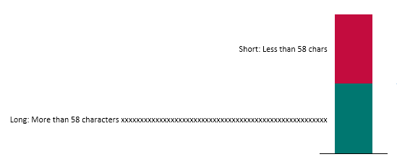
Resulting XML in pptx file (LibreOffice #97083 - think-cell example (2).pptx\ppt\slides\slide1.xml):
Chart created by think-cell:
<a:fld id="{EE1E08C8-6881-443F-AF61-A7AAC98BE165}" type="datetime'Sho''''''rt'''''': Less'''' t''''h''a''n 58'' c''''ha''rs'''''"> <a:rPr lang="en-US" altLang="en-US" sz="1400"/> <a:pPr/> <a:t>Short: Less than 58 chars</a:t>
</a:fld>
Short: Less than 58 chars
<a:fld id="{C7210672-8A34-4B8D-9FAC-208B77A1035B}" type="thinkcell&lt;?xml version=&quot;1.0&quot; encoding=&quot;UTF-16&quot; standalone=&quot;yes&quot;?&gt;&lt;root reqver=&quot;23045&quot;&gt;&lt;version val=&quot;24178&quot;/&gt;&lt;PersistentType&gt;&lt;m_guid val=&quot;3bad6a25-6993-4e86-938e-596c650e2156&quot;/&gt;&lt;m_prec&gt;&lt;m_yearfmt&gt;&lt;begin val=&quot;0&quot;/&gt;&lt;end val=&quot;4&quot;/&gt;&lt;/m_yearfmt&gt;&lt;/m_prec&gt;&lt;/PersistentType&gt;&lt;/root&gt;"> <a:rPr lang="en-US" altLang="en-US" sz="1000"/> <a:pPr/>
<a:t>Long: More than 58 characters xxxxxxxxxxxxxxxxxxxxxxxxxxxxxxxxxxxxxxxxxxxxxxxxxxxxxx</a:t>
</a:fld>
Long: More than 58 characters xxxxxxxxxxxxxxxxxxxxxxxxxxxxxxxxxxxxxxxxxxxxxxxxxxxxxx
Screenshot of chart in PowerPoint:

