Slide 1
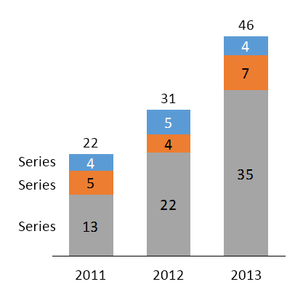
Chart from think-cell
Screenshot of chart in PowerPoint
46
31
22
Series
Series
Series
2011
2012
2013
PowerPoint’s date footer created with PowerPoint > Insert > Text > Header and Footer
Screenshot of PowerPoint’s Header and Footer settings
Screenshot of date footer in PowerPoint

