Slide 1
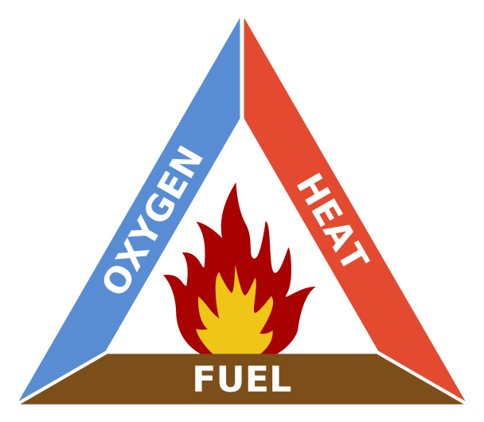
Fire Fire!

Slide 2
Fire Fire!
Levels of difficulty: 3
Quiz
Procedures manuals
Call outs prompting action
Digital certification of health and safety training after finishing game levels and quiz.
Go out in an orderly fashion!
See you at assembly point!

Slide 3
Fire Fire!
Story boards for scenarios
Scoring points but no negative marking
Three levels to simplify learning of procedures

Slide 4
Video at https://www.youtube.com/watch?v=fkQdmsgyHLo
WARNING: Content may be explicit, and, is intended for gamification and health and safety training purposes. Parental guidance and consent is asked for prior to exposing minors to the training, however, health and safety procedures remain a priority in case of a real emergency.

Slide 5
Video at https://www.youtube.com/watch?v=GYoUWKhKQdI.

Slide 6
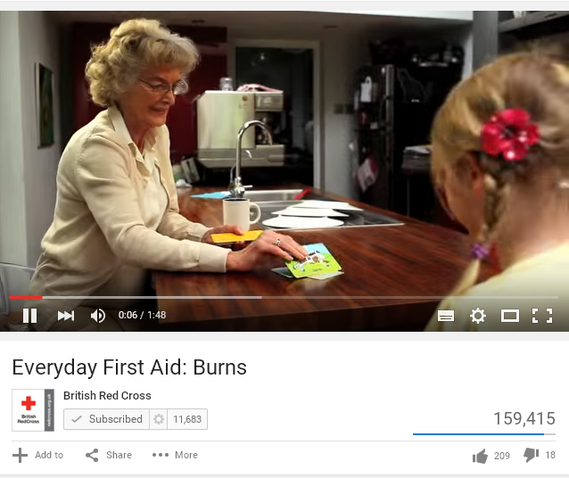
Video at https://www.youtube.com/watch?v=WJ14hgHzES8

Slide 7
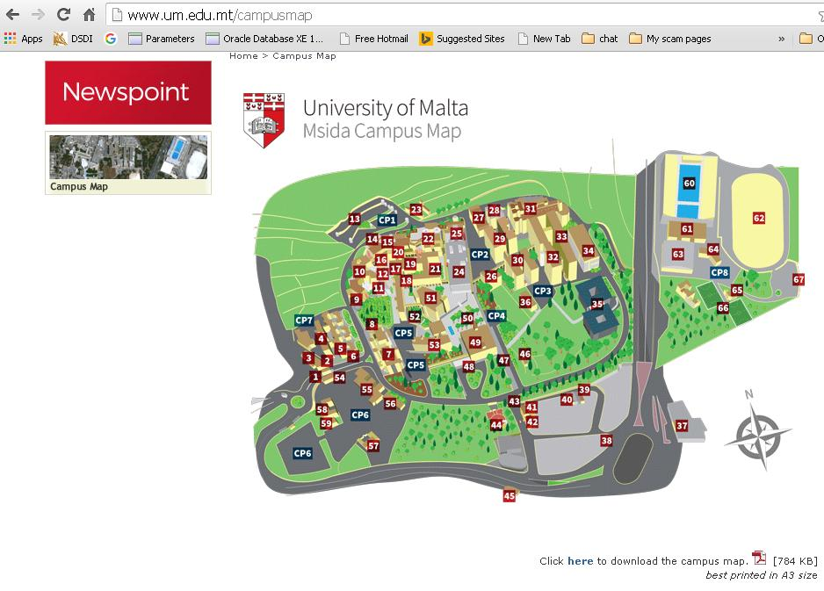
In case of fire, remain calm and go out in an orderly fashion to a safe location, preferably an assembly point.
Call 112 and ask fire brigade to put out the fire.
http://www.um.edu.mt/campusmap

Slide 8
Service providers
Training in first aid
St. John Ambulance - http://www.stjohnambulancemalta.com/
National Fire Protection Association, UK –
http://www.nfpa.org/safety-information/for-consumers/fire-and-safety-equipment.
Hands-on training for general maintenance
http://etc.gov.mt/Category/3/6/Training-Trainees.aspx.
City and Guilds – http://www.cityandguilds.com/.
Emergency number in Malta 112.

Slide 9
References
Fire Fire!
References
YouTube.com, social network.
OHSA, Malta, available online at http://ohsa.org.mt/.
Steve Krug, Don’t Make Me Think (2nd Edition)
ISBN-13: 978-0-321-34475-5, available on Creative Edge.
Jenny Preece et. al, Human Computer Interaction, published by Addison-Wesley.
ISBN 0-201-62769-8.
Matthew MacDonald, HTML5 – The Missing Manual, published by O’Reilly
ISBN 978-1-449-30239-9.

