Slide 1
Unit No:03 Projections of Points & Lines
Yash B. Parikh
M.Tech. (CIM)
Assistant Professor
Department of Mechanical Engineering
Symbiosis Institute of Technology

Slide 2
Special Case..!!! (θ+Ø = 90˚)
When a line is inclined to both H.P. and V.P. by 45˚.

Slide 3
LINE IN A PROFILE PLANE ( MEANS IN A PLANE PERPENDICULAR TO BOTH HP & VP)
For T.V.
ORTHOGRAPHIC PATTERN OF LINE IN PROFILE PLANE
VP
VT
PP
a’
a’
a”
A
Φ
FV
LSV
b’
b’
b”
θ
X
Y
HT
a
B
For F.V.
TV
a
b
b
HP
Results:-
1. TV & FV both are vertical, hence arrive on one single projector.
2. It’s Side View shows True Length ( TL)
3. Sum of it’s inclinations with HP & VP equals to 90⁰ (
4. It’s HT & VT arrive on same projector and can be easily located
From Side View.
θ
+
Φ
= 90⁰ )
OBSERVE CAREFULLY ABOVE GIVEN ILLUSTRATION

Slide 4
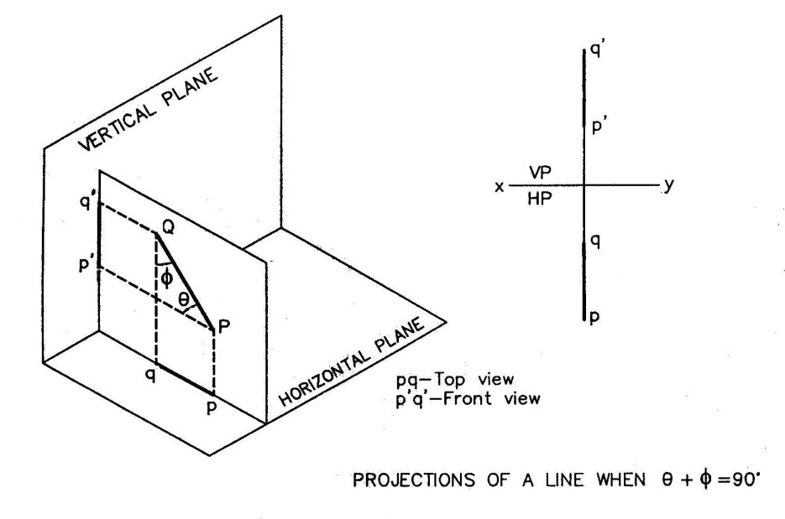
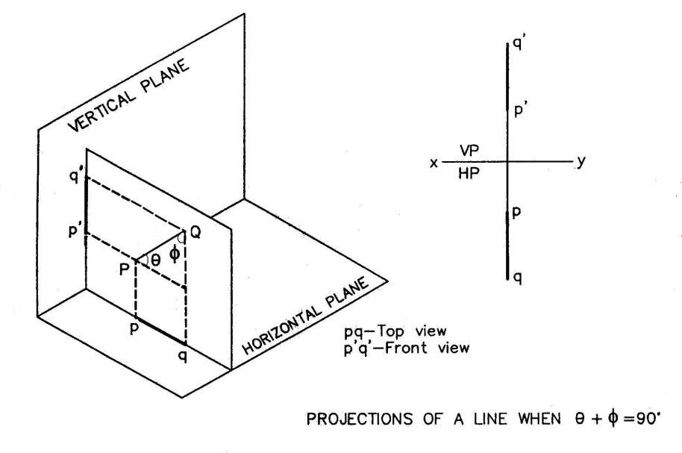
♥ If θ + Φ = 90⁰, then the required projections ( front view and top view ) will lie on a same straight line.
♥ But, if the end P of the line PQ is nearer to VP then the position of the line PQ and the required projections (front view and top
view) will be as following:

Slide 5
Special Case..!!! (θ+Ø = 90˚)
The H,T. & V.T. in this case are obtained by Trapezoidal Method.
Draw final projections of line AB.
Draw lines parallel to the XY reference line through a, b & a’, b’.
Locate point a1’ as aa1’ = a’o and locate point b1’ as bb1’ = b’o.
Join a1’ & b1’ to produce it to intersect with the plan produced line, which is H.T. denoted by h.

Slide 6
Special Case..!!! (θ+Ø = 90˚)
Similarly locate point a1 as a’a1 = oa and locate b1 as b’b1 = ob. Join a1b1 to get V.T. shown by v’.
a1’b1’ shows T.L. in elevation and which is inclined to θ to H.P.
a1b1 shows T.L in plan which is inclined at Ø to the V.P.

Slide 7
Example..!!!
A line AB, 50 mm long, is inclined at 30˚ to the HP and 60˚ to the VP. Its end A is 25 mm above the HP and 20 mm in front of the VP. Draw its projections and locate its traces.

Slide 8
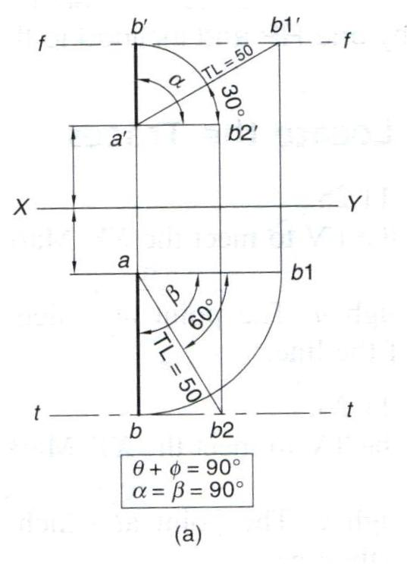
Answer..!!!
Method - 01

Slide 9
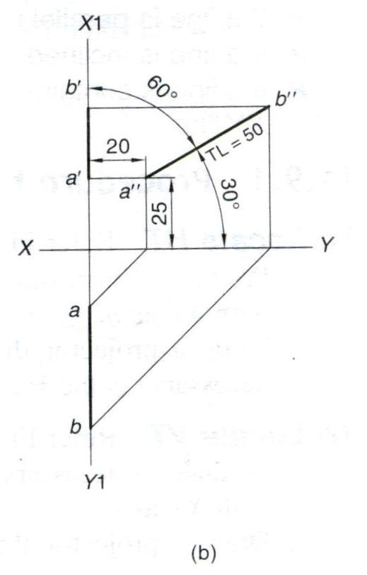
Answer..!!!
Method - 02

Slide 10
Thank You

