Slide 1
Test 1
Tag line here

Slide 2
Agenda
Agenda1
Agenda2
Agenda3
Agenda4
Why Agenda?
Agenda5
Agenda6

Slide 3
Who are we..
Overview
Overview 1
overview2
overview3
overview4
The Team
Info 1
Info2 -
Industry Certified

Slide 4
Our Domain
Industry
Industry1
Industry 2
Industry 3
Industry4
Industry 5
C.O.E
Consulting
Open source Technologies
Server Administration

Slide 5
Mission & Vision
Mission
THE MISSION GOES HERE
Vision
VISION SHOULD BE DIFFERENT FROM THE MISSION

Slide 6
Our Services
Services1
Services 2
Services 3
services4
Services 5

Slide 7
Why Us?
We care for start-ups
Reason 2
Reason 3
Reason 4
Reason 5
Reason 6

Slide 8
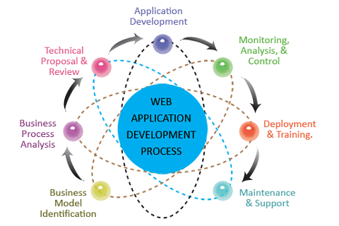
Development

Slide 9
Software Development
Web Development
Detailed development models
Custom E-Commerce Development details
Development 4
Development 5

Slide 10
What we offer..
Offer 1
Offer 2
Offer 3
Offer 4
Offer 5
Offer 6

Slide 11
Us & OpenSource
We are a big believer in the open source movement. The management encourages all its employees to use open source software
The employees are active members of the open source community and contribute on a daily basis
This presentation, logos have been designed using open source - LibreOffice and Gimp

