Slide 1
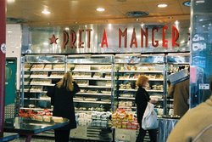
The three basic functions at Prêt a Manger
Nutritional ‘mechanical’ and aesthetic design of the sandwiches and snacks
Product / Service Development
Design, location
and management of stores and in-store processes and the network that supplies them
Marketing
Operations
Promotional activities, market research, etc.

Slide 2
The relationship between the operations function and other core and support functions of the organization
Engineering/ technical function
Product/service development function
Understanding of the capabilities and constraints of the operations process
Analysis of new technology options
Understanding of process technology needs
Accounting and finance function
New product and service ideas
Provision of relevant data
Understanding of the capabilities and constraints of the operations process
Operations function
Financial analysis for performance and decisions
Market requirements
Marketing function
Understanding of human resource needs
Understanding of infrastructural and system needs
Provision of systems for design, planning and control, and improvement
Recruitment development and training
Human resources function
Information technology (IT) function

Slide 3
All operations are transformation processes …
Inputs
Transformation process
Outputs
that transform inputs …
into outputs

