Slide 1


Slide 2


Slide 3


Slide 4


Slide 5

Slide #12

Slide 6

That’s A LOT of GROWTH!
But why is Consumer Electronics circuit protection important?
All consumer electronics – from smartphones and wearables to TVs and the latest connected home technologies – all need circuit protection.
Why?
    Reliability
    Safety
    Protect Technology
    Protect Life

Slide 7

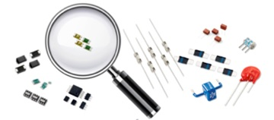
What IS Circuit Protection?
Vital elements in applications from consumer electronics and telecom circuits to automobiles and industrial equipment.
Protects sensitive electronics against harm caused by:
  over-currents,
  over-voltages,
  electrostatic discharge (ESD),
  lighting surges, and
  other electrically harmful occurrences.
Notes:
What exactly is electronic circuit protection? Circuit protection components are vital elements in applications from consumer electronics and telecom circuits, to automobiles and industrial equipment. They protect sensitive electronic devices and business assets against harm caused over-currents, over-voltages, electrostatic discharge (ESD), lighting surges, and other electrically harmful occurrences.

Slide 8
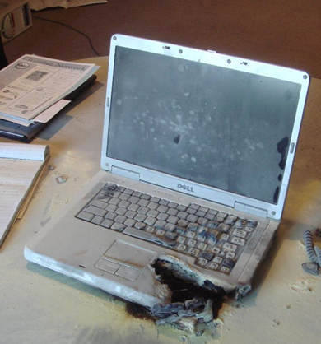
Why Circuit Protection is Crucial
For protecting
people
For protecting technology
For protecting businesses and
their brand’s reputation
Notes:
Circuit protection components are vital in a broad range of electrical and electronic design applications because they protect people, electronic devices, and business assets (equipment, buildings) from harm.

Slide 9


Where Circuit Protection Is Used
In virtually every electrical and electronic device made today, including:
  Consumer Electronics
  Automotive Components
  LED Lighting
  Telecom
  Industrial
Notes:
Designing the appropriate circuit protection is critical to preventing dangerous products from reaching the public.
Example: Lithium ion cells, like the ones in laptops, are subject to thermal runaway. Raising the temperature of a Li-ion battery above the 140 degree F mark leads to a compromised cell which causes an explosion and a resulting fire. Battery packs for laptops and other portable devices contain many levels of protection to assure safety under (almost) all circumstances when in the hands of the public. The safety begins with the battery cell, which includes: [1] a built-in temperature switch called PTC that protects against high current surges, [2] a circuit interrupt device (CID) that opens the electrical path if an over-charge raises the internal cell pressure to 1000 kPa (145psi), and [3]a safety vent that releases gas in the event of a rapid increase in cell pressure.
In addition to these internal safeguards, an external electronic protection circuit prevents the charge voltage of any cell from exceeding 4.30V. Furthermore, a fuse cuts the current if the skin temperature of any cell approaches 90°C (194°F). To prevent the battery from over-discharging, a control circuit cuts off the current path at about 2.20V/cell. (Content on battery protection from: http://batteryuniversity.com/learn/article/safety_circuits_for_modern_batteries).

Slide 10
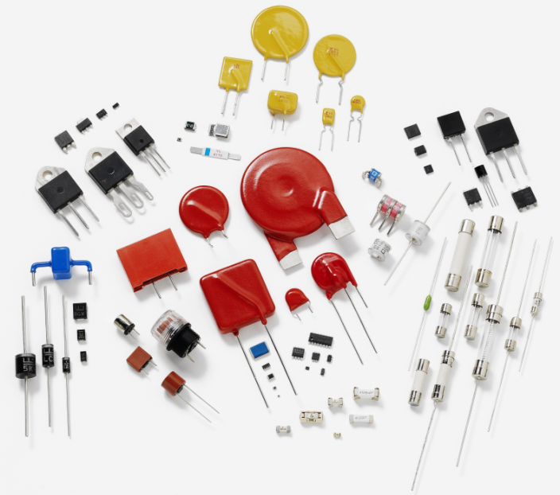
Circuit Protection Device Types
Cartridge Fuses Positive Temperature Coefficient (PTC) Fuses Gas Discharge Tubes (GDT) Varistors (MOV, TMOV) Polymer ESD Suppressors Transient Voltage Suppression (TVS) Diodes Protection Thyristors TVS Diode Arrays SIDACtor Devices LED Protectors (PLED)
Notes:
What kinds of circuit protection devices are available to device designers? Common types of circuit protection devices for electronic products include: fuses, GDTs (Gas Discharge Tubes), resettable PTCs, varistors, ESD Suppressors (Pulseguard), TVS diodes, TVS diode arrays, SIDACtor devices, and PLEDs (LED protectors). Many of these are used in Consumer Electronics applications.

