Slide 1
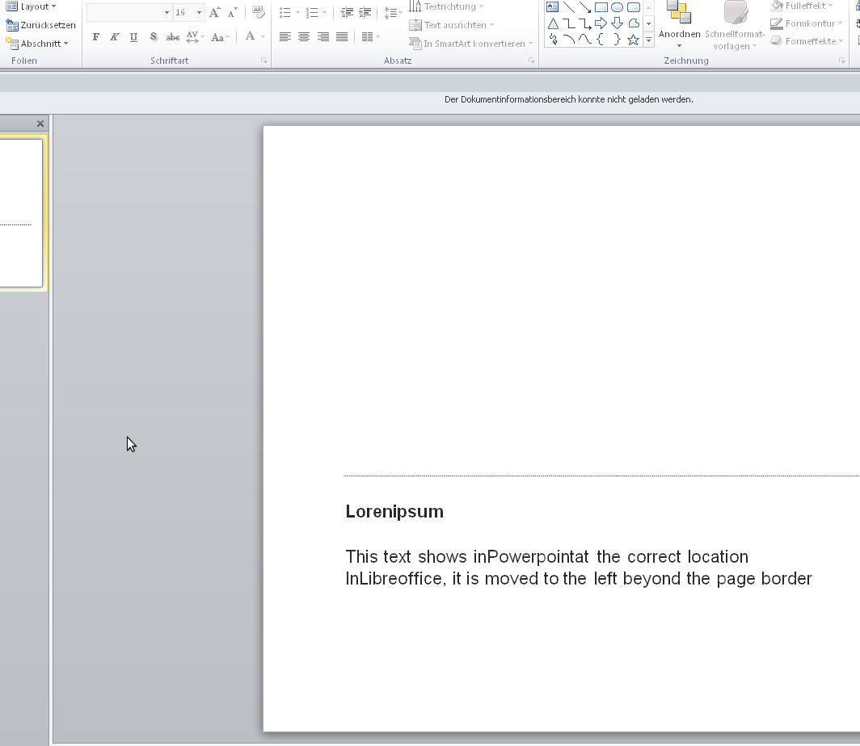
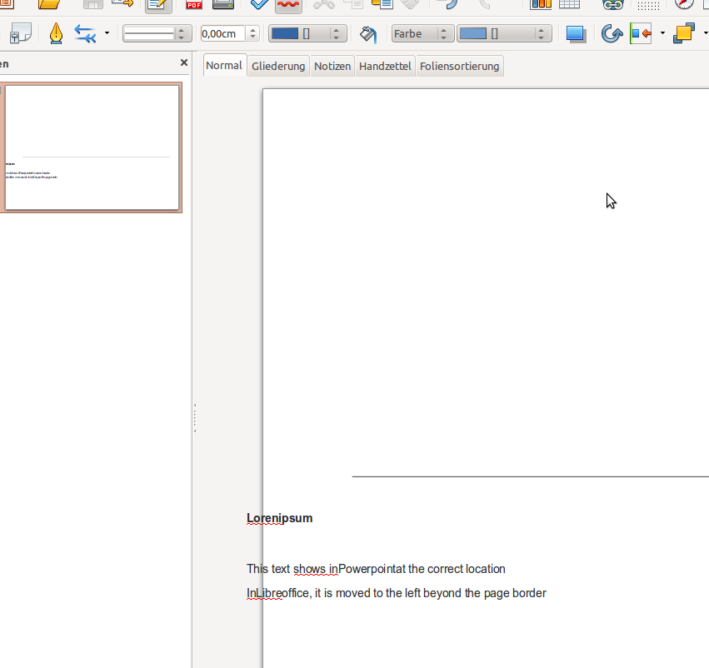
Lorenipsum
This text shows inPowerpointat the correct location
InLibreoffice, it is moved to the left beyond the page border

