Slide 1
Cloud Data Serving:
From Key-Value Stores to DBMSs
Raghu Ramakrishnan
Chief Scientist, Audience and Cloud Computing
Brian Cooper
Adam Silberstein
Utkarsh Srivastava
Yahoo! Research
Joint work with the Sherpa team in Cloud Computing
Notes:
1
Data-backed web applications have stringent availability, performance and partition tolerance requirements that are difficult, sometimes even impossible, to meet using conventional database management systems. On the other hand, they typically are able to trade off consistency to achieve their goals. This has led to the development of specialized key-value stores, which are now used widely in virtually every large-scale web service. On the other hand, most web services also require capabilities such as indexing provided by a DBMS. We are witnessing an evolution of data serving as systems builders seek to balance these trade-offs. In this talk, I will survey some of the solutions that have been developed, including Amazon's S3 and SimpleDB and Yahoo!'s PNUTS, and discuss the challenges in building such systems as "cloud services", providing elastic data serving capacity to developers, along with appropriately balanced consistency, availability, performance and partition tolerance.

Slide 2
Outline
Introduction
Clouds
Scalable serving—the new landscape
  Very Large Scale Distributed systems (VLSD)
Yahoo!’s PNUTS/Sherpa
Comparison of several systems

Slide 3
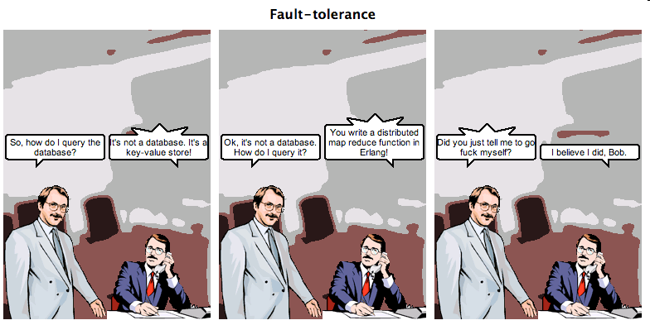
Databases and Key-Value Stores
http://browsertoolkit.com/fault-tolerance.png

Slide 4
Typical Applications
User logins and profiles
  Including changes that must not be lost!
    But single-record “transactions” suffice
Events
  Alerts (e.g., news, price changes)
  Social network activity (e.g., user goes offline)
  Ad clicks, article clicks
Application-specific data
  Postings in message board
  Uploaded photos, tags
  Shopping carts

Slide 5
Data Serving in the Y! Cloud
FredsList.com application
DECLARE DATASET Listings AS
( ID String PRIMARY KEY,
Category String,
Description Text )
1234323, transportation, For sale: one bicycle, barely used
5523442, childcare,
Nanny available in San Jose
32138,
camera,
Nikon D40,
USD 300
ALTER Listings
MAKE CACHEABLE
Simple Web Service API’s
Compute
Database
Storage
Search
Caching
Grid
PNUTS /
SHERPA
Foreign key
photo → listing
MObStor
Vespa
memcached
Messaging
Tribble
Batch export

Slide 6
CLOUDS
Motherhood-and-Apple-Pie
Notes:
Need some slides up front to layout what our definition of a cloud entails (since it’s a rapidly emerging buzzword that has no intrinsic definition. )
6

Slide 7
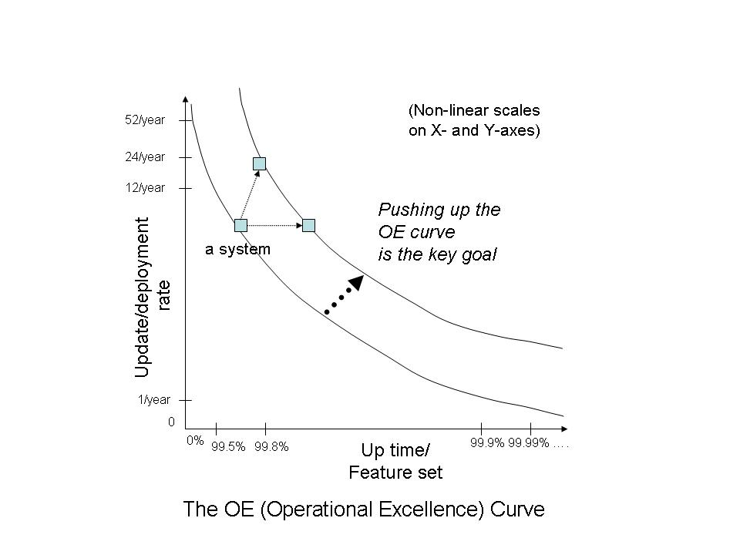
Why Clouds?
Abstraction & Innovation
  Developers focus on
  apps, not infrastructure
Scale & Availability
  Cloud services should
  do the heavy lifting
Agility & Innovation
Quality & Stability
Demands of cloud storage have led to simplified KV stores
Notes:
Up arrow – more updates with the same quality, can only be done by moving the curve
Right arrow – more quality without losing features
Quicker in the same quality
Y Axis = “Agility” , measured by how many releases we can have in a year
X Axis = “Quality”, measured by up time

Slide 8
Types of Cloud Services
Two kinds of cloud services:
  Horizontal (“Platform”) Cloud Services
    Functionality enabling tenants to build applications or new services on top of the cloud
  Functional Cloud Services
    Functionality that is useful in and of itself to tenants. E.g., various SaaS instances, such as Saleforce.com; Google Analytics and Yahoo!’s IndexTools; Yahoo! properties aimed at end-users and small businesses, e.g., flickr, Groups, Mail, News, Shopping
    Could be built on top of horizontal cloud services or from scratch
    Yahoo! has been offering these for a long while (e.g., Mail for SMB, Groups, Flickr, BOSS, Ad exchanges, YQL)

Slide 9
Yahoo! Query Language (YQL)
Single endpoint service to query, filter and combine data across Yahoo! and beyond
  The “Internet API”
SQL-like SELECT syntax for getting the right data.
SHOW and DESC commands to discover the available data sources and structure
  No need to open another web browser.
Try the YQL Console
  http://developer.yahoo.com/yql/console/
Notes:
YQL Consol – DEMO?
http://developer.yahoo.com/yql/console/
9

Slide 10
Requirements for Cloud Services
Multitenant. A cloud service must support multiple, organizationally distant customers.
Elasticity. Tenants should be able to negotiate and receive resources/QoS on-demand up to a large scale.
Resource Sharing. Ideally, spare cloud resources should be transparently applied when a tenant’s negotiated QoS is insufficient, e.g., due to spikes.
Horizontal scaling. The cloud provider should be able to add cloud capacity in increments without affecting tenants of the service.
Metering. A cloud service must support accounting that reasonably ascribes operational and capital expenditures to each of the tenants of the service.
Security. A cloud service should be secure in that tenants are not made vulnerable because of loopholes in the cloud.
Availability. A cloud service should be highly available.
Operability. A cloud service should be easy to operate, with few operators. Operating costs should scale linearly or better with the capacity of the service.

Slide 11
Yahoo! Cloud Stack
EDGE
Horizontal Cloud Services
YCS
YCPI
Brooklyn
…
WEB
Horizontal Cloud Services
VM/OS
yApache
PHP
App Engine
Provisioning (Self-serve)
APP
Monitoring/Metering/Security
Horizontal Cloud Services
VM/OS
Serving Grid
…
Data Highway
OPERATIONAL STORAGE
Horizontal Cloud Services
PNUTS/Sherpa
MOBStor
…
BATCH STORAGE
Horizontal Cloud Services
Hadoop
…

Slide 12
Yahoo!’s Cloud:
Massive Scale, Geo-Footprint
Massive user base and engagement
  500M+ unique users per month
  Hundreds of petabyte of storage
  Hundreds of billions of objects
  Hundred of thousands of requests/sec
Global
  Tens of globally distributed data centers
  Serving each region at low latencies
Challenging Users
  Downtime is not an option (outages cost $millions)
  Very variable usage patterns

Slide 13
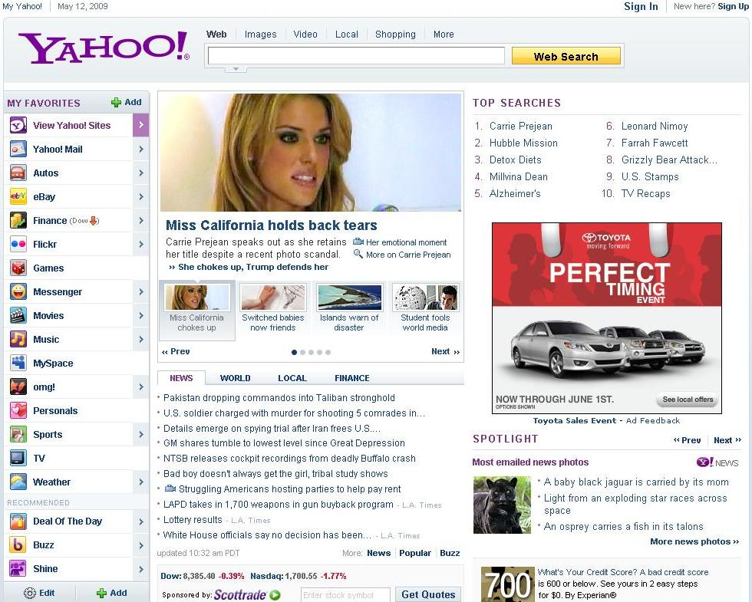

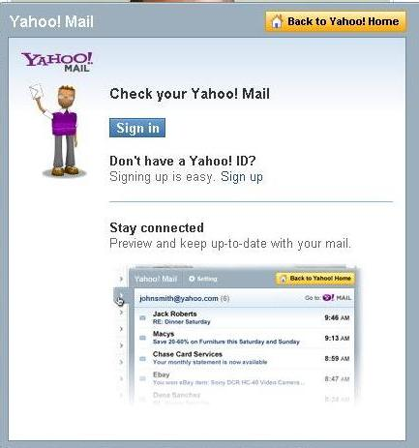
Horizontal Cloud Services: Use Cases
Content Optimization
Search Index
Machine Learning
(e.g. Spam filters)
Ads Optimization
Attachment
Storage
Image/Video Storage &
Delivery
Notes:
13

Slide 14
New in 2010!
SIGMOD and SIGOPS are starting a new annual conference, to be co-located alternately with SIGMOD and SOSP:
ACM Symposium on Cloud Computing (SoCC)
PC Chairs: Surajit Chaudhuri & Mendel Rosenblum
Steering committee: Phil Bernstein, Ken Birman, Joe Hellerstein, John Ousterhout, Raghu Ramakrishnan, Doug Terry, John Wilkes

Slide 15
DATA MANAGEMENT IN THE CLOUD
Renting vs. buying, and being DBA to the world …
Notes:
Need some slides up front to layout what our definition of a cloud entails (since it’s a rapidly emerging buzzword that has no intrinsic definition. )
15

Slide 16













Help!
I have a huge amount of data. What should I do with it?
UDB
Sherpa
DB2

Slide 17
What Are You Trying to Do?
Data Workloads
OLTP
(Random access to a few records)
OLAP
(Scan access to a large number of records)
Read-heavy
Write-heavy
By rows
By columns
Unstructured
Combined
(Some OLTP and OLAP tasks)

Slide 18
Data Serving vs.
Analysis/Warehousing
Very different workloads, requirements
Warehoused data for analysis includes
  Data from serving system
  Click log streams
  Syndicated feeds
Trend towards scalable stores with
  Semi-structured data
  Map-reduce
The result of analysis often goes right back into serving system

Slide 19
Web Data Management
Warehousing
Scan oriented workloads
Focus on sequential disk I/O
$ per cpu cycle
CRUD
Point lookups and short scans
Index organized table and random I/Os
$ per latency
Large data analysis
(Hadoop)
Structured record storage
(PNUTS/Sherpa)
Object retrieval and streaming
Scalable file storage
$ per GB storage & bandwidth
Blob storage
(MObStor)

Slide 20
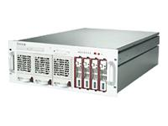
One Slide Hadoop Primer
Data file
HDFS
HDFS
Good for analyzing (scanning) huge files
Not great for serving (reading or writing individual objects)
Reduce tasks
Map tasks

Slide 21



Ways of Using Hadoop
Data workloads
OLAP
(Scan access to a large number of records)
By rows
By columns
Unstructured
Zebra
HadoopDB
SQL on Grid

Slide 22
Hadoop Applications @ Yahoo!
 | 2008 | 2009
Webmap | ~70 hours runtime ~300 TB shuffling ~200 TB output | ~73 hours runtime ~490 TB shuffling ~280 TB output +55% hardware
Terasort | 209 seconds 1 Terabyte sorted 900 nodes | 62 seconds 1 Terabyte, 1500 nodes 16.25 hours 1 Petabyte, 3700 nodes
Largest cluster | 2000 nodes 6PB raw disk 16TB of RAM 16K CPUs | 4000 nodes 16PB raw disk 64TB of RAM 32K CPUs (40% faster CPUs too)

Slide 23
SCALABLE DATA
SERVING
ACID or BASE? Litmus tests are colorful, but the picture is cloudy
Notes:
Need some slides up front to layout what our definition of a cloud entails (since it’s a rapidly emerging buzzword that has no intrinsic definition. )
23

Slide 24
“I want a big, virtual database”
“What I want is a robust, high performance virtual relational database that runs transparently over a cluster, nodes dropping in and out of service at will, read-write replication and data migration all done automatically.
I want to be able to install a database on a server cloud and use it like it was all running on one machine.”
-- Greg Linden’s blog

Slide 25
The World Has Changed
Web serving applications need:
  Scalability!
    Preferably elastic, commodity boxes
  Flexible schemas
  Geographic distribution
  High availability
  Low latency
Web serving applications willing to do without:
  Complex queries
  ACID transactions

Slide 26
VLSD Data Serving Stores
Must partition data across machines
  How are partitions determined?
  Can partitions be changed easily? (Affects elasticity)
  How are read/update requests routed?
  Range selections? Can requests span machines?
Availability: What failures are handled?
  With what semantic guarantees on data access?
(How) Is data replicated?
  Sync or async? Consistency model? Local or geo?
How are updates made durable?
How is data stored on a single machine?

Slide 27
The CAP Theorem
You have to give up one of the following in a distributed system (Brewer, PODC 2000; Gilbert/Lynch, SIGACT News 2002):
  Consistency of data
    Think serializability
  Availability
    Pinging a live node should produce results
  Partition tolerance
    Live nodes should not be blocked by partitions

Slide 28
Approaches to CAP
“BASE”
  No ACID, use a single version of DB, reconcile later
Defer transaction commit
  Until partitions fixed and distr xact can run
Eventual consistency (e.g., Amazon Dynamo)
  Eventually, all copies of an object converge
Restrict transactions (e.g., Sharded MySQL)
  1-M/c Xacts: Objects in xact are on the same machine
  1-Object Xacts: Xact can only read/write 1 object
Object timelines (PNUTS)
http://www.julianbrowne.com/article/viewer/brewers-cap-theorem

Slide 29


Y! CCDI
PNUTS /
SHERPA
To Help You Scale Your Mountains of Data
Notes:
A project in Y!R focused on a long-range problem, origins in earlier work at Wisconsin. Basis for the Goldrush hack, which won the recent Local hack competition, and could contribute to creation/refinement of Y! Local content and Next Gen Search.

Slide 30
Yahoo! Serving Storage Problem
  Small records – 100KB or less
  Structured records – Lots of fields, evolving
  Extreme data scale - Tens of TB
  Extreme request scale - Tens of thousands of requests/sec
  Low latency globally - 20+ datacenters worldwide
  High Availability - Outages cost $millions
  Variable usage patterns - Applications and users change
30

Slide 31

What is PNUTS/Sherpa?
CREATE TABLE Parts (
ID VARCHAR,
StockNumber INT,
Status VARCHAR
…
)
A 42342 E
A 42342 E
B 42521 W
B 42521 W
C 66354 W
C 66354 W
D 12352 E
D 12352 E
E 75656 C
E 75656 C
Structured, flexible schema
F 15677 E
F 15677 E
Parallel database
A 42342 E
Geographic replication
B 42521 W
C 66354 W
D 12352 E
E 75656 C
F 15677 E
Hosted, managed infrastructure
31

Slide 32
What Will It Become?
A 42342 E
A 42342 E
B 42521 W
B 42521 W
C 66354 W
C 66354 W
D 12352 E
D 12352 E
E 75656 C
E 75656 C
F 15677 E
F 15677 E
Indexes and views
A 42342 E
B 42521 W
C 66354 W
D 12352 E
E 75656 C
F 15677 E

Slide 33
Technology Elements
Applications
PNUTS API
Tabular API
PNUTS
Query planning and execution
Index maintenance
Distributed infrastructure for tabular data
Data partitioning
Update consistency
Replication
YCA: Authorization
YDOT FS
Ordered tables
YDHT FS
Hash tables
Tribble
Pub/sub messaging
Zookeeper
Consistency service
33
Notes:
33

Slide 34
PNUTS: Key Components
  Caches the maps from the TC
  Routes client requests to correct SU
Maintains map from database.table.key-to-tablet-to-SU
Provides load balancing
  Stores records
  Services get/set/delete requests
34

Slide 35
Detailed Architecture
Local region
Remote regions
Clients
REST API
Routers
Tribble
Tablet Controller
Storage
units
35

Slide 36
DATA MODEL
36

Slide 37
Data Manipulation
37
Per-record operations
  Get
  Set
  Delete
Multi-record operations
  Multiget
  Scan
  Getrange
Web service (RESTful) API

Slide 38
Tablets—Hash Table
Name
Description
Price
0x0000
Grape
Grapes are good to eat
$12
Lime
Limes are green
$9
Apple
Apple is wisdom
$1
Strawberry
Strawberry shortcake
$900
0x2AF3
Orange
Arrgh! Don’t get scurvy!
$2
Avocado
But at what price?
$3
Lemon
How much did you pay for this lemon?
$1
Tomato
Is this a vegetable?
$14
0x911F
Banana
The perfect fruit
$2
Kiwi
New Zealand
$8
0xFFFF
38

Slide 39
Tablets—Ordered Table
Name
Description
Price
A
Apple
Apple is wisdom
$1
Avocado
But at what price?
$3
Banana
The perfect fruit
$2
Grape
Grapes are good to eat
$12
H
Kiwi
New Zealand
$8
Lemon
How much did you pay for this lemon?
$1
Lime
Limes are green
$9
Orange
Arrgh! Don’t get scurvy!
$2
Q
Strawberry
Strawberry shortcake
$900
Tomato
Is this a vegetable?
$14
Z
39

Slide 40
Flexible Schema
Posted date | Listing id | Item | Price
6/1/07 | 424252 | Couch | $570
6/1/07 | 763245 | Bike | $86
6/3/07 | 211242 | Car | $1123
6/5/07 | 421133 | Lamp | $15
Color
Red
Condition
Good
Fair

Slide 41
Primary vs. Secondary Access
Primary table
Posted date | Listing id | Item | Price
6/1/07 | 424252 | Couch | $570
6/1/07 | 763245 | Bike | $86
6/3/07 | 211242 | Car | $1123
6/5/07 | 421133 | Lamp | $15
Secondary index
Price | Posted date | Listing id
15 | 6/5/07 | 421133
86 | 6/1/07 | 763245
570 | 6/1/07 | 424252
1123 | 6/3/07 | 211242
Planned functionality

Slide 42
Index Maintenance
How to have lots of interesting indexes and views, without killing performance?
Solution: Asynchrony!
  Indexes/views updated asynchronously when base table updated

Slide 43
PROCESSING
READS & UPDATES
43

Slide 44
Updates
8
1
Sequence # for key k
Write key k
Routers
Message brokers
3
Write key k
7
2
4
Sequence # for key k
Write key k
5
SU
SU
SU
SUCCESS
6
Write key k
44

Slide 45
Accessing Data
4
1
Record for key k
Get key k
2
3
Record for key k
Get key k
SU
SU
SU
45

Slide 46
Range Queries in YDOT
Clustered, ordered retrieval of records
Apple
Avocado
Banana
Blueberry
Storage unit 1
Canteloupe
Storage unit 3
Lime
Storage unit 2
Strawberry
Storage unit 1
Storage unit 1
Canteloupe
Storage unit 3
Lime
Storage unit 2
Strawberry
Storage unit 1
Grapefruit…Pear?
Grapefruit…Lime?
Canteloupe
Grape
Kiwi
Lemon
Lime…Pear?
Lime
Mango
Orange
Router
Strawberry
Tomato
Watermelon
Apple
Avocado
Banana
Blueberry
Strawberry
Tomato
Watermelon
Lime
Mango
Orange
Canteloupe
Grape
Kiwi
Lemon
Storage unit 1
Storage unit 2
Storage unit 3

Slide 47
Bulk Load in YDOT
YDOT bulk inserts can cause performance hotspots
Solution: preallocate tablets

Slide 48
ASYNCHRONOUS REPLICATION AND CONSISTENCY
48

Slide 49
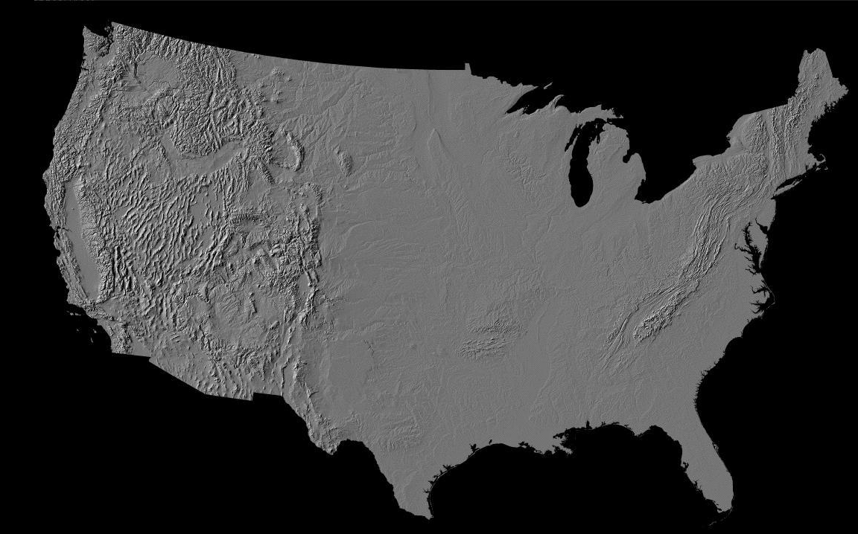
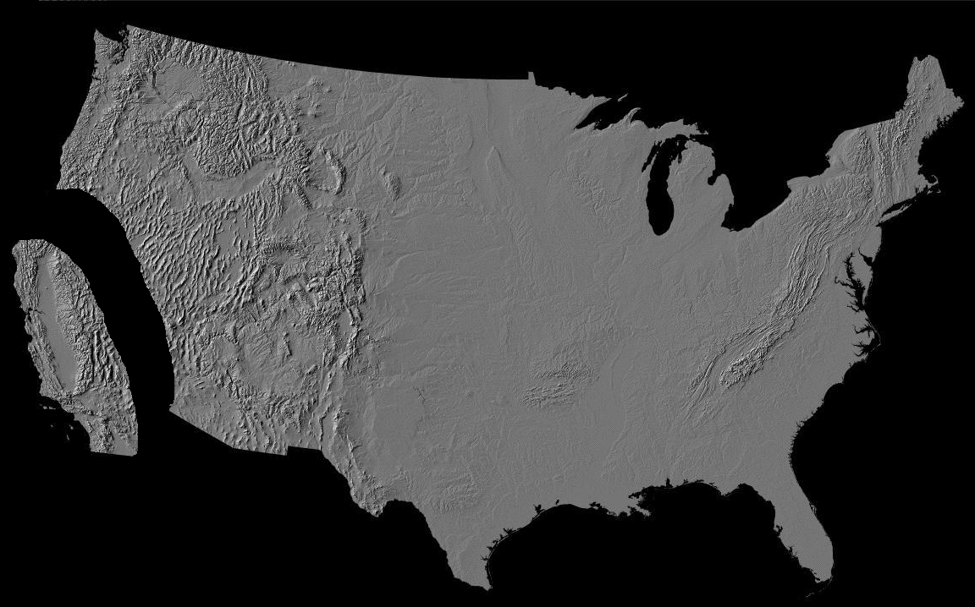


Asynchronous Replication
49

Slide 50
Consistency Model
If copies are asynchronously updated, what can we say about stale copies?
  ACID guarantees require synchronous updts
  Eventual consistency: Copies can drift apart, but will eventually converge if the system is allowed to quiesce
    To what value will copies converge?
    Do systems ever “quiesce”?
  Is there any middle ground?

Slide 51
Example: Social Alice
West
East
Record Timeline
User | Status
Alice | ___
___
User | Status
Alice | Busy
Busy
User | Status
Alice | Busy
User | Status
Alice | Free
Free
User | Status
Alice | ???
User | Status
Alice | ???
Free
Notes:
“Free” update goes to east coast first because of network disruption, and as it happens, this happens before original busy notification is received. Now the west coast receives the corresponding free notification while the east coast receives the original busy notification. No priority between these two outcomes …

Slide 52
PNUTS Consistency Model
Goal: Make it easier for applications to reason about updates and cope with asynchrony
What happens to a record with primary key “Alice”?
Record inserted
Update
Update
Update
Update
Update
Update
Update
Delete
v. 1
v. 2
v. 3
v. 4
v. 5
v. 6
v. 7
v. 8
Time
Generation 1
Time
As the record is updated, copies may get out of sync.
52

Slide 53
PNUTS Consistency Model
Read
Stale version
Stale version
Current version
v. 1
v. 2
v. 3
v. 4
v. 5
v. 6
v. 7
v. 8
Time
Generation 1
In general, reads are served using a local copy
53

Slide 54
PNUTS Consistency Model
Read up-to-date
Stale version
Stale version
Current version
v. 1
v. 2
v. 3
v. 4
v. 5
v. 6
v. 7
v. 8
Time
Generation 1
But application can request and get current version
54

Slide 55
PNUTS Consistency Model
Read ≥ v.6
Stale version
Stale version
Current version
v. 1
v. 2
v. 3
v. 4
v. 5
v. 6
v. 7
v. 8
Time
Generation 1
Or variations such as “read forward”—while copies may lag the
master record, every copy goes through the same sequence of changes
55

Slide 56
PNUTS Consistency Model
Write
Stale version
Stale version
Current version
v. 1
v. 2
v. 3
v. 4
v. 5
v. 6
v. 7
v. 8
Time
Generation 1
Achieved via per-record primary copy protocol
(To maximize availability, record masterships automaticlly
transferred if site fails)
Can be selectively weakened to eventual consistency
(local writes that are reconciled using version vectors)
56

Slide 57
PNUTS Consistency Model
Write if = v.7
ERROR
Stale version
Stale version
Current version
v. 1
v. 2
v. 3
v. 4
v. 5
v. 6
v. 7
v. 8
Time
Generation 1
Test-and-set writes facilitate per-record transactions
57

Slide 58
OPERABILITY
58

Slide 59
Distribution
6/1/07
424252
Couch
$570
Data shuffling for load balancing
Distribution for parallelism
6/1/07
256623
Car
$1123
6/2/07
636353
Bike
$86
6/5/07
662113
Chair
$10
6/7/07
121113
Lamp
$19
6/9/07
887734
Bike
$56
6/11/07
252111
Scooter
$18
6/11/07
116458
Hammer
$8000
Server 1
Server 2
Server 3
Server 4

Slide 60
Tablet Splitting and Balancing
Each storage unit has many tablets (horizontal partitions of the table)
Storage unit may become a hotspot
Storage unit
Tablet
Overfull tablets split
Tablets may grow over time
Shed load by moving tablets to other servers
60

Slide 61
Consistency Techniques
Per-record mastering
  Each record is assigned a “master region”
    May differ between records
  Updates to the record forwarded to the master region
  Ensures consistent ordering of updates
Tablet-level mastering
  Each tablet is assigned a “master region”
  Inserts and deletes of records forwarded to the master region
  Master region decides tablet splits
These details are hidden from the application
  Except for the latency impact!

Slide 62

Mastering
A 42342 E
A 42342 E
B 42521 E
B 42521 W
C 66354 W
C 66354 W
D 12352 E
D 12352 E
E 75656 C
E 75656 C
F 15677 E
F 15677 E
A 42342 E
A 42342 E
B 42521 W
B 42521 E
C 66354 W
C 66354 W
D 12352 E
D 12352 E
E 75656 C
E 75656 C
F 15677 E
F 15677 E
A 42342 E
B 42521 W
C 66354 W
D 12352 E
E 75656 C
F 15677 E
62

Slide 63
Record versus tablet master
Record master serializes updates
A 42342 E
A 42342 E
B 42521 E
B 42521 W
C 66354 W
C 66354 W
D 12352 E
D 12352 E
E 75656 C
E 75656 C
F 15677 E
F 15677 E
Tablet master serializes inserts
A 42342 E
A 42342 E
B 42521 W
B 42521 E
C 66354 W
C 66354 W
D 12352 E
D 12352 E
E 75656 C
E 75656 C
F 15677 E
F 15677 E
A 42342 E
B 42521 W
C 66354 W
D 12352 E
E 75656 C
F 15677 E
63

Slide 64
Coping With Failures
X
X
A 42342 E
B 42521 W
C 66354 W
D 12352 E
E 75656 C
OVERRIDE W → E
F 15677 E
A 42342 E
B 42521 W
C 66354 W
D 12352 E
E 75656 C
F 15677 E
A 42342 E
B 42521 W
C 66354 W
D 12352 E
E 75656 C
F 15677 E
64

Slide 65
Further PNutty Reading
Efficient Bulk Insertion into a Distributed Ordered Table (SIGMOD 2008)
Adam Silberstein, Brian Cooper, Utkarsh Srivastava, Erik Vee,
Ramana Yerneni, Raghu Ramakrishnan
PNUTS: Yahoo!'s Hosted Data Serving Platform (VLDB 2008)
Brian Cooper, Raghu Ramakrishnan, Utkarsh Srivastava,
Adam Silberstein, Phil Bohannon, Hans-Arno Jacobsen,
Nick Puz, Daniel Weaver, Ramana Yerneni
Asynchronous View Maintenance for VLSD Databases (SIGMOD 2009)
Parag Agrawal, Adam Silberstein, Brian F. Cooper, Utkarsh Srivastava and
Raghu Ramakrishnan
Cloud Storage Design in a PNUTShell
Brian F. Cooper, Raghu Ramakrishnan, and Utkarsh Srivastava
Beautiful Data, O’Reilly Media, 2009
Adaptively Parallelizing Distributed Range Queries (VLDB 2009)
Ymir Vigfusson, Adam Silberstein, Brian Cooper, Rodrigo Fonseca

Slide 66
COMPARING SOME
CLOUD SERVING STORES
Green Apples and Red Apples
Notes:
Stress preliminary status
66

Slide 67
Motivation
Many “cloud DB” and “nosql” systems out there
  PNUTS
  BigTable
    HBase, Hypertable, HTable
  Azure
  Cassandra
  Megastore
  Amazon Web Services
    S3, SimpleDB, EBS
  And more: CouchDB, Voldemort, etc.
How do they compare?
  Feature tradeoffs
  Performance tradeoffs
  Not clear!

Slide 68
The Contestants
Baseline: Sharded MySQL
  Horizontally partition data among MySQL servers
PNUTS/Sherpa
  Yahoo!’s cloud database
Cassandra
  BigTable + Dynamo
HBase
  BigTable + Hadoop

Slide 69
SHARDED MYSQL
69

Slide 70
Architecture
Our own implementation of sharding
Client
Client
Client
Client
Client
Shard Server
Shard Server
Shard Server
Shard Server
MySQL
MySQL
MySQL
MySQL

Slide 71
Shard Server
Server is Apache + plugin + MySQL
  MySQL schema: key varchar(255), value mediumtext
  Flexible schema: value is blob of key/value pairs
Why not direct to MySQL?
  Flexible schema means an update is:
    Read record from MySQL
    Apply changes
    Write record to MySQL
  Shard server means the read is local
    No need to pass whole record over network to change one field
…
Apache
Apache
Apache
Apache
Apache
(100 processes)
MySQL

Slide 72
Client
Application plus shard client
Shard client
  Loads config file of servers
  Hashes record key
  Chooses server responsible for hash range
  Forwards query to server
Client
Q?
Application
Shard client
Hash()
Server map
CURL

Slide 73
Pros and Cons
Pros
  Simple
  “Infinitely” scalable
  Low latency
  Geo-replication
Cons
  Not elastic (Resharding is hard)
  Poor support for load balancing
  Failover? (Adds complexity)
  Replication unreliable (Async log shipping)

Slide 74
Azure SDS
Cloud of SQL Server instances
App partitions data into instance-sized pieces
  Transactions and queries within an instance
Data
SDS Instance
Storage
Per-field indexing

Slide 75
Google MegaStore
Transactions across entity groups
  Entity-group: hierarchically linked records
    Ramakris
    Ramakris.preferences
    Ramakris.posts
    Ramakris.posts.aug-24-09
  Can transactionally update multiple records within an entity group
    Records may be on different servers
    Use Paxos to ensure ACID, deal with server failures
  Can join records within an entity group
Other details
  Built on top of BigTable
  Supports schemas, column partitioning, some indexing
Phil Bernstein, http://perspectives.mvdirona.com/2008/07/10/GoogleMegastore.aspx

Slide 76
PNUTS
76

Slide 77
Architecture
Clients
REST API
Routers
Tablet controller
Log servers
Storage
units

Slide 78
Routers
Direct requests to storage unit
  Decouple client from storage layer
    Easier to move data, add/remove servers, etc.
  Tradeoff: Some latency to get increased flexibility
Router
Y! Traffic Server
PNUTS Router plugin

Slide 79
Log Server
Topic-based, reliable publish/subscribe
  Provides reliable logging
  Provides intra- and inter-datacenter replication
Log server
Log server
Pub/sub hub
Pub/sub hub
Disk
Disk

Slide 80
Pros and Cons
Pros
  Reliable geo-replication
  Scalable consistency model
  Elastic scaling
  Easy load balancing
Cons
  System complexity relative to sharded MySQL to support geo-replication, consistency, etc.
  Latency added by router

Slide 81
HBASE
81

Slide 82
Architecture
Client
Client
Client
Client
Client
REST API
Java Client
HBaseMaster
HRegionServer
HRegionServer
HRegionServer
HRegionServer
Disk
Disk
Disk
Disk

Slide 83
HRegion Server
Records partitioned by column family into HStores
  Each HStore contains many MapFiles
All writes to HStore applied to single memcache
Reads consult MapFiles and memcache
Memcaches flushed as MapFiles (HDFS files) when full
Compactions limit number of MapFiles
HRegionServer
writes
Memcache
HStore
Flush to disk
reads
MapFiles
Notes:
Column family managed by HStore. Each HStore has one or more MapFiles. Write ahead log called HLog. In-memory structure called memcache. One memcache per HStore
Major caveat: I’ve left out the HLog component. This is an on-disk write ahead log; all writes to memcache are first written to the write ahead log. The major problem here is that the HLog is an HDFS file. Therefore, while the file is open, it will not survive a server failure and is not replicated. Until HDFS append exists, there does not seem to be any use for the HLog.

Slide 84
Pros and Cons
Pros
  Log-based storage for high write throughput
  Elastic scaling
  Easy load balancing
  Column storage for OLAP workloads
Cons
  Writes not immediately persisted to disk
  Reads cross multiple disk, memory locations
  No geo-replication
  Latency/bottleneck of HBaseMaster when using REST
Notes:
1) Column families are stored as HStores

Slide 85
CASSANDRA
85

Slide 86
Architecture
Facebook’s storage system
  BigTable data model
  Dynamo partitioning and consistency model
  Peer-to-peer architecture
Client
Client
Client
Client
Client
Cassandra node
Cassandra node
Cassandra node
Cassandra node
Disk
Disk
Disk
Disk

Slide 87
Routing
Consistent hashing, like Dynamo or Chord
  Server position = hash(serverid)
  Content position = hash(contentid)
  Server responsible for all content in a hash interval
Responsible hash interval
Server

Slide 88
Cassandra Server
Writes go to log and memory table
Periodically memory table merged with disk table
Update
Cassandra node
RAM
Memtable
(later)
Log
Disk
SSTable file

Slide 89
Pros and Cons
Pros
  Elastic scalability
  Easy management
    Peer-to-peer configuration
  BigTable model is nice
    Flexible schema, column groups for partitioning, versioning, etc.
  Eventual consistency is scalable
Cons
  Eventual consistency is hard to program against
  No built-in support for geo-replication
    Gossip can work, but is not really optimized for, cross-datacenter
  Load balancing?
    Consistent hashing limits options
  System complexity
    P2P systems are complex; have complex corner cases

Slide 90
Cassandra Findings
Tunable memtable size
  Can have large memtable flushed less frequently, or small memtable flushed frequently
  Tradeoff is throughput versus recovery time
    Larger memtable will require fewer flushes, but will take a long time to recover after a failure
    With 1GB memtable: 45 mins to 1 hour to restart
Can turn off log flushing
  Risk loss of durability
Replication is still synchronous with the write
  Durable if updates propagated to other servers that don’t fail

Slide 91
NUMBERS
91

Slide 92
Overview
Setup
  Six server-class machines
    8 cores (2 x quadcore) 2.5 GHz CPUs, RHEL 4, Gigabit ethernet
    8 GB RAM
    6 x 146GB 15K RPM SAS drives in RAID 1+0
  Plus extra machines for clients, routers, controllers, etc.
Workloads
  120 million 1 KB records = 20 GB per server
  Write heavy workload: 50/50 read/update
  Read heavy workload: 95/5 read/update
Metrics
  Latency versus throughput curves
Caveats
  Write performance would be improved for PNUTS, Sharded ,and Cassandra with a dedicated log disk
  We tuned each system as well as we knew how
Notes:
Updates write the whole record

Slide 93
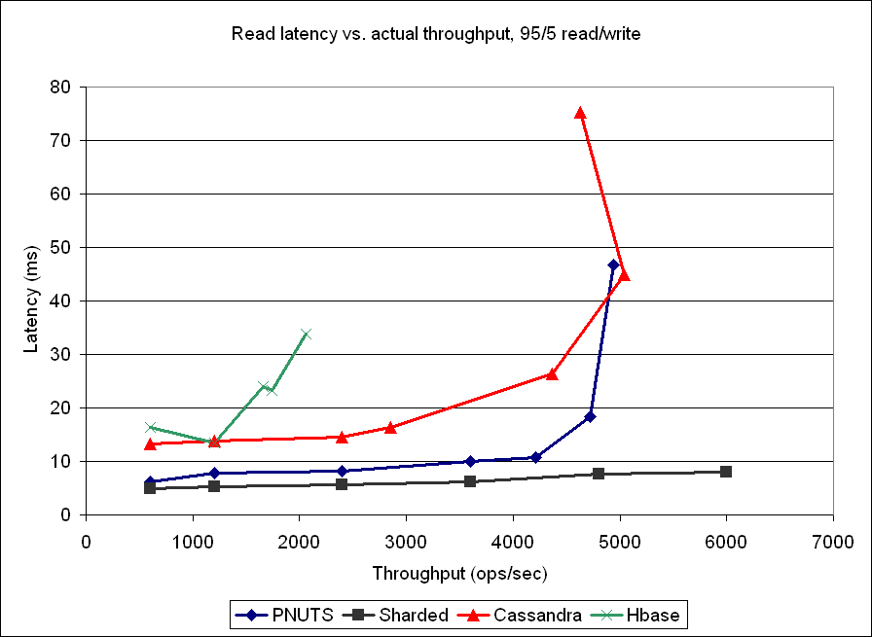
Results

Slide 94
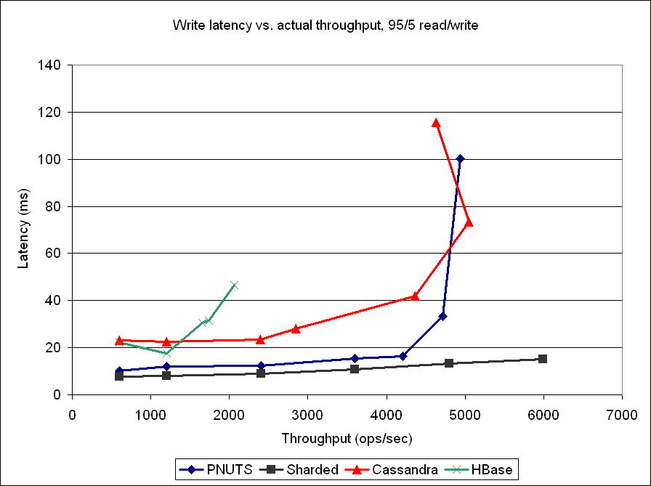
Results

Slide 95
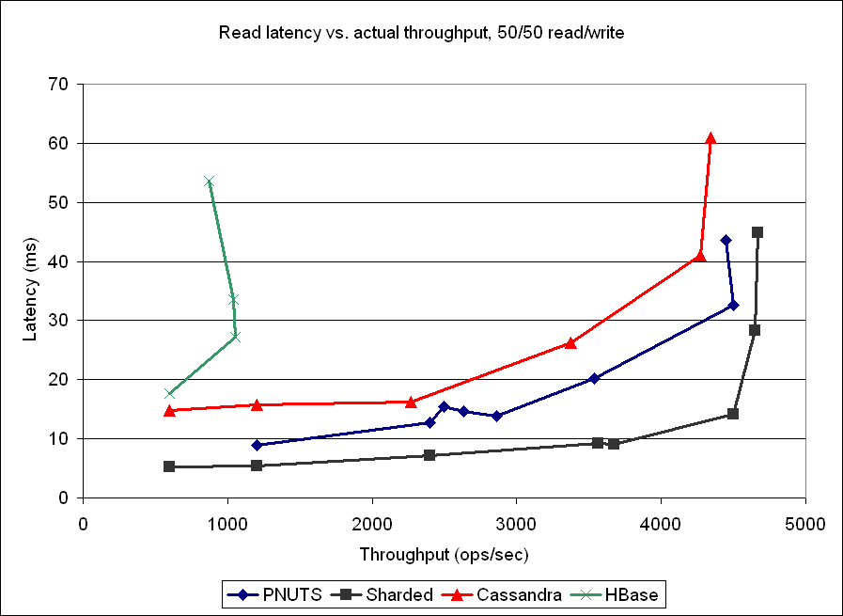
Results

Slide 96
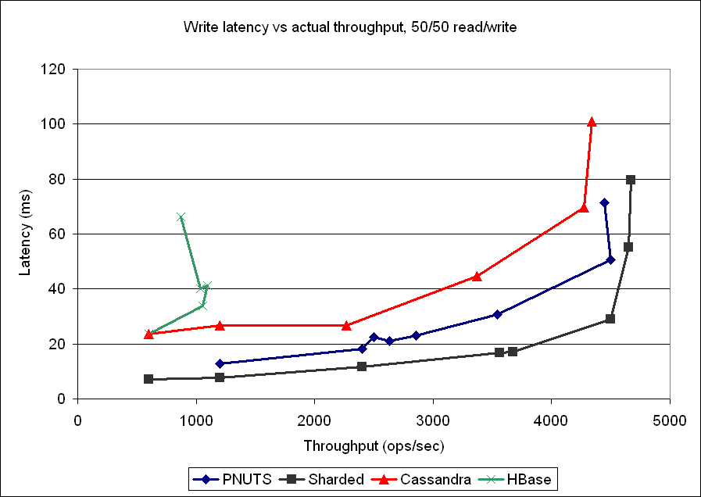
Results

Slide 97
Qualitative Comparison
Storage Layer
  File Based: HBase, Cassandra
  MySQL: PNUTS, Sharded MySQL
Write Persistence
  Writes committed synchronously to disk: PNUTS, Cassandra, Sharded MySQL
  Writes flushed asynchronously to disk: HBase (current version)
Read Pattern
  Find record in MySQL (disk or buffer pool): PNUTS, Sharded MySQL
  Find record and deltas in memory and on disk: HBase, Cassandra

Slide 98
Qualitative Comparison
Replication (not yet utilized in benchmarks)
  Intra-region: HBase, Cassandra
  Inter- and intra-region: PNUTS
  Inter- and intra-region: MySQL (but not guaranteed)
Mapping record to server
  Router: PNUTS, HBase (with REST API)
  Client holds mapping: HBase (java library), Sharded MySQL
  P2P: Cassandra

Slide 99
SYSTEMS
IN CONTEXT
99

Slide 100
Types of Record Stores
Query expressiveness
S3
PNUTS
Oracle
Simple
Feature rich
Object retrieval
Retrieval from single table of objects/records
SQL

Slide 101
Types of Record Stores
Consistency model
S3
PNUTS
Oracle
Best effort
Strong guarantees
Eventual consistency
Timeline consistency
ACID
Program centric consistency
Object-centric consistency

Slide 102
Types of Record Stores
Data model
PNUTS
CouchDB
Oracle
Flexibility,
Schema evolution
Optimized for
Fixed schemas
Object-centric consistency
Consistency spans objects

Slide 103
Types of Record Stores
Elasticity (ability to add resources on demand)
PNUTS
S3
Oracle
Inelastic
Elastic
Limited
(via data distribution)
VLSD
(Very Large Scale Distribution /Replication)

Slide 104
Data Stores Comparison
User-partitioned SQL stores
  Microsoft Azure SDS
  Amazon SimpleDB
Multi-tenant application databases
  Salesforce.com
  Oracle on Demand
Mutable object stores
  Amazon S3
Versus PNUTS
More expressive queries
Users must control partitioning
Limited elasticity
Highly optimized for complex workloads
Limited flexibility to evolving applications
Inherit limitations of underlying data management system
Object storage versus record management

Slide 105
Application Design Space
Get a few things
Sherpa
MObStor
YMDB
MySQL
Oracle
Filer
BigTable
Scan everything
Everest
Hadoop
Records
Files
105

Slide 106
Comparison Matrix
Partitioning
Availability
Replication
Storage
Reads/
writes
Failures handled
During failure
Local/geo
Consistency
Durability
Hash/sort
Dynamic
Sync/async
Routing
PNUTS
H+S
Rtr
Colo+
server
Read+
write
Async
Local+
geo
Timeline +
Eventual
Double
WAL
Buffer
pages
Y
MySQL
H+S
N
Cli
Colo+
server
Read
Async
Local+
nearby
ACID
WAL
Buffer
pages
Y
Colo+
server
Read+
write
Sync
Local+
nearby
N/A (no
updates)
Triple
replication
Files
HDFS
Other
Rtr
BigTable
S
Y
Colo+
server
Read+
write
Sync
Local+
nearby
Multi-
version
Triple
replication
LSM/
SSTable
Rtr
Dynamo
H
Y
Colo+
server
Read+
write
Async
Local+
nearby
WAL
Buffer
pages
P2P
Eventual
Cassandra
H+S
Y
P2P
Colo+
server
Read+
write
Sync+
Async
Local+
nearby
Eventual
Triple
WAL
LSM/
SSTable
Megastore
S
Y
Rtr
Colo+
server
Read+
write
Sync
Local+
nearby
ACID
Triple
replication
LSM/
SSTable
Azure
S
N
Cli
Server
Read+
write
Sync
Buffer
pages
Local
ACID
WAL
106
Notes:
106

Slide 107
Comparison Matrix
Global low
latency
Structured
access
Consistency model
Operability
Availability
SQL/ACID
Elastic
Updates
Sherpa
Y! UDB
MySQL
Oracle
HDFS
BigTable
Dynamo
Cassandra
107

Slide 108
QUESTIONS?
108

