Slide 1
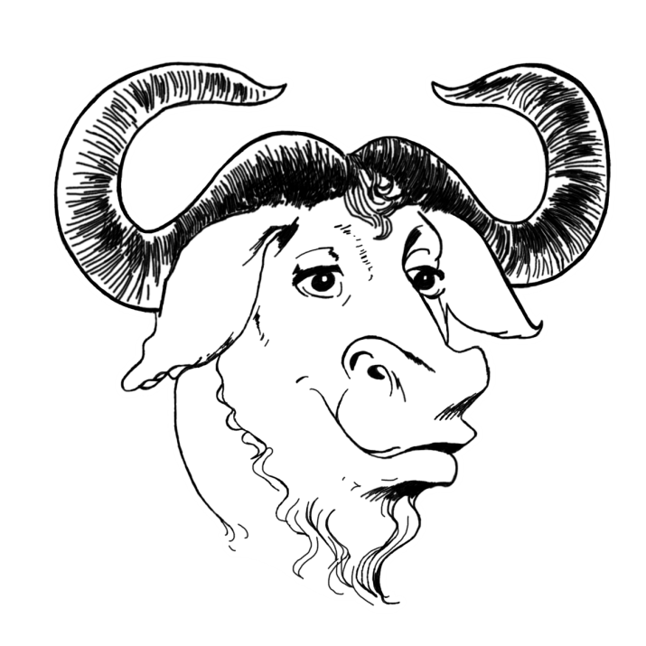

The GNU/Linux
Operating System
WOAH!
A history, the beauties, and why you should switch!
Notes:
Motion path

Slide 2
STOP!
Before we continue, you must know the real definition of a Hacker!
Hackers are people who hack away at a computer keyboard until a program works the way they want it to.
Now then, let’s continue ☺
Notes:
Slide transition

Slide 3

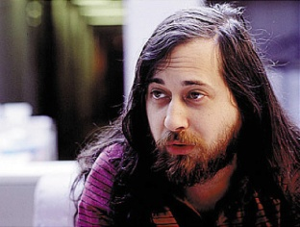

A (very) brief history
Richard Stallman
  A former Artificial Intelligence researcher at MIT, named Richard Stallman, went to New York City to get source code for a printer driver and was denied permission to have a copy of it because of an End User License Agreement after fighting with a flaky printer back at MIT.
  Was really pissed about it which fueled the fire to start the GNU (GNU’s Not Unix) project in the mid 1980s with the goal to create a fully free (As in liberty) operating system with the help of fellow hackers from around the world.
  They finished most of the operating system but it was missing a stable kernel.
  People discovered “Linux”, a monolithic kernel by a Finnish hacker named Linus Torvalds, and started gluing parts of the GNU system to it and eventually got a stable, free software operating system working
  After some years, problems arose when trying to convince the public and, especially, businesses to switch to Free Software because of misinterpretations due to the ambiguity of the name.
  A new side movement was started that advocated the idea of having the source code of a program be open to all to work on it. This became known as “Open Source”.
L
I
N
U
S
Notes:
Slide transition and advances after 3 minutes.

Slide 4



Who uses GNU/Linux?
Many well known businesses, celebrities, schools, services, and even governments use GNU/Linux. Here’s a few:
Google (For their services, Chromebooks, and Android)
Amazon
Facebook
Twitter
Diaspora*
Burlington Coat Factory
Ernie Ball
IBM
DreamWorks Animation
Wikipedia
New York Stock Exchange
London Stock Exchange
NASA
Russian schools
Stephen Fry (V for Vendetta)
Jamie Hyneman (MythBusters)
Valve (Steam)
The White House
The People’s Republic of China
Yahoo!
YouTube
Notes:
GIFs, obviously as well as text animation

Slide 5

What are the benefits of GNU/Linux?
Security
Reliability
Customization
Freedom
Price
Notes:
SmartArt animations

Slide 6

Wait… Freedom? What?
Yes! You get freedom with GNU/Linux!
Richard Stallman authored a copyleft legal document called the GNU General Public License that allows users of some of the software in GNU/Linux to have the following four freedoms to allow users to control the programs that they use instead of the inverse:
Freedom 0: The freedom to run the program as you wish.
Freedom 1: The freedom to study the source code and change it.
Freedom 2: The freedom to make copies and distribute them.
Freedom 3:
The freedom to make copies of modified versions of programs and distribute them as you wish.
Notes:
Advances after 45 seconds, hyperlinks

Slide 7


Alright so the freedom part is cool.
Now, what’s this about price?
Most distributions (“Distros” for short) are gratis. Gratis means “Free as in price”. You can typically download and install multiple copies to a computer without paying for more than one license like with Microsoft Windows. Often though, the teams behind the systems will ask for donations of not only money but actual computer hardware in order to keep the project going.
Many of the people behind GNU/Linux and other Free Software projects donate their spare time towards helping with bugs, documentation, translations, and new features without payment.

Slide 8


Security
GNU/Linux has a reputation of having high security.
This is due to the way that the software is analyzed and worked on.
Hundreds of thousands of individuals and companies from around the world contribute fixes to the software that makes up GNU/Linux and those fixes get released far more rapidly than in non-free or closed sourced systems like Windows or OS X.
Here’s a handful of the security features in GNU/Linux:
A person’s user account is typically not ran at a high level nor can programs be ran at a higher level WITHOUT the permission of the user.
GNU/Linux was built with the thought of multiple users sharing one computer
The file system can easily encrypt all the files in the user’s Home (Like My Documents) directory and disallows modification of the system files as a normal user.
Viruses and trojans don’t exist (Or at least for very long) in GNU/Linux because patches get released rapidly.
The built-in firewall is tough as nails and can easily be customized to fit a person’s needs
Notes:
Has paragraph transitions

Slide 9
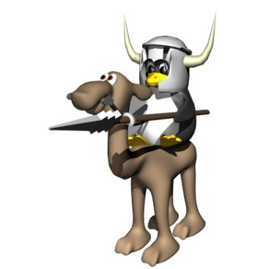

Reliability
The cool thing about GNU/Linux is how reliable it is. Many contributors have made this possible with thousands of fixes. A lot of the programs are worked on elaborately and in depth.
Ever have one of those programs on Windows that will NOT close? It’s much easier to end the program in GNU/Linux with the “kill -9” command!
9 out of 10 of the world’s super computers run GNU/Linux because of it’s reliability and as well as …

Slide 10


CUSTOMIZATION!
From the code to the look and feel, GNU/Linux can be customized to fit whatever your needs are.
You can easily create your own flavor of GNU/Linux to include whatever programs you need and use daily!
Disabled? Running a meth lab? Customize GNU/Linux to fit you! (Please don’t do drugs… mkay?)

Slide 11
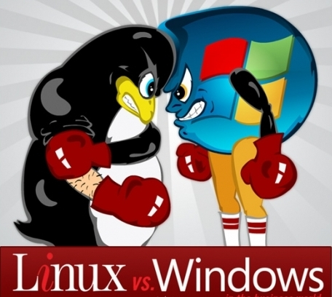
GNU/Linux vs. Microsoft Windows
[Insert Eye of the Tiger here]

Slide 12
We will now compare and contrast GNU/Linux to Microsoft Windows.
Number of users
Program compatibility
Usability
Sexiness

Slide 13
Desktop Operating System Market Share
Statistics from “Netmarketshare.com” as of April, 2014

Slide 14
Statistics from “Netmarketshare.com” as of April, 2014

Slide 15
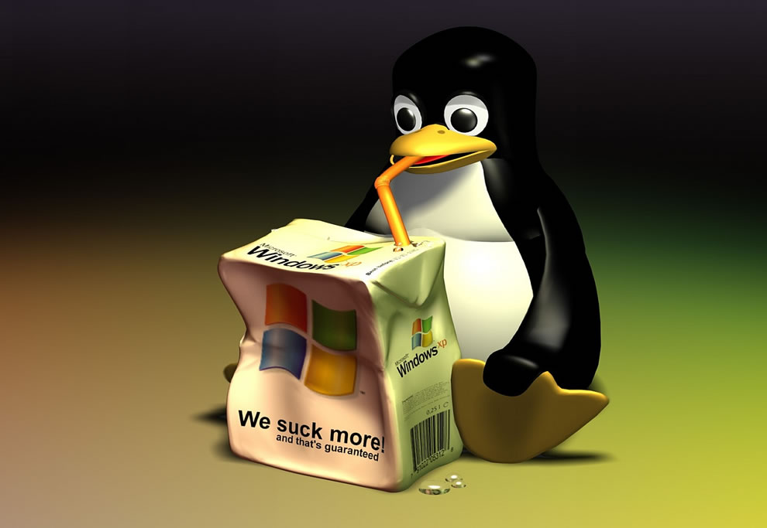
So what Windows programs are on GNU/Linux?
Quite a few! Some have Free Software alternatives too!
Skype
Mozilla Firefox
Google Chrome
Adobe Reader
VLC
Audacity

Slide 16
Alright, so what are some alternatives then smart guy?
Kinda pushy aren’t you? Jerk.
Microsoft Office > LibreOffice
Adobe Photoshop > GIMP
Windows Messenger, Yahoo Instant Messenger, AIM, etc. > Pidgin, Empathy
Microsoft Outlook > Mozilla Thunderbird, Evolution
iTunes > Rhythmbox, Banshee

