Slide 1
A new approach to the US Fusion program: Common Sense
Jeff Freidberg
KEPCO Prof. Emeritus NSE-MIT

Slide 2
The Purpose
Urge Fusion leaders and DoE leaders to acknowledge the obvious:
  The US domestic Fusion program is in bad shape
  And it’s getting worse
  Urge Fusion leaders to get their act together and develop a realistic 10 year program
  Urge DoE leaders to break out of their isolation and instead listen to the Fusion Community

Slide 3
The Strategy
Explain:
Why does the US need a fusion program?
Why is the program in bad shape?
How did we get in this mess?
What can we do to fix the problem?

Slide 4
Why does the US need a Fusion Program?
There is no shortage of fuel – 100’s of years of coal, gas, uranium.
There is a more limited supply of CO2 free fuel – 50 to 100 years of uranium.
Fusion is the ultimate long term solution to CO2 free fuel
But we do not need it in 30 years.
That’s good because we probably cannot deliver in 30 years. Need 50 -75 years.
Conclusion: Fusion is very important, but should not be viewed as an urgent, spare-no-expense project.

Slide 5
Why is the US Fusion program in such bad shape?
We are no longer world leaders in fusion research
Fusion is basically an experimental science program but many of our experiments have been shut down or curtailed
  1. MCX (U Md) 4. NCSX (PPPL)
  2. LDX (MIT) 5. Heavy Ion Beam (LBL)
  3. NCTX (U Wash) 6. Alcator C-Mod (MIT)
  Only new experiment is the upgraded spherical tokamak NSTX-U (PPPL)
  US Fusion technology program has been virtually eliminated

Slide 6
NSTX-U
A good experiment
A sensational team
Expect to learn a lot of new plasma physics
However, budget will limit compared to other new experiments such as EAST, KSTAR, W7-X, JT60SU
  Even so, is large – a big bang for the buck
  Conclusion: Very interesting physics but not designed to be a world leader in pushing fusion performance

Slide 7
The Major Problem:
Domestic budget being sacrificed for ITER
US ITER at $0.5B:
a good idea
US ITER at $4B:
a mistake
Total
USA
ITER

Slide 8
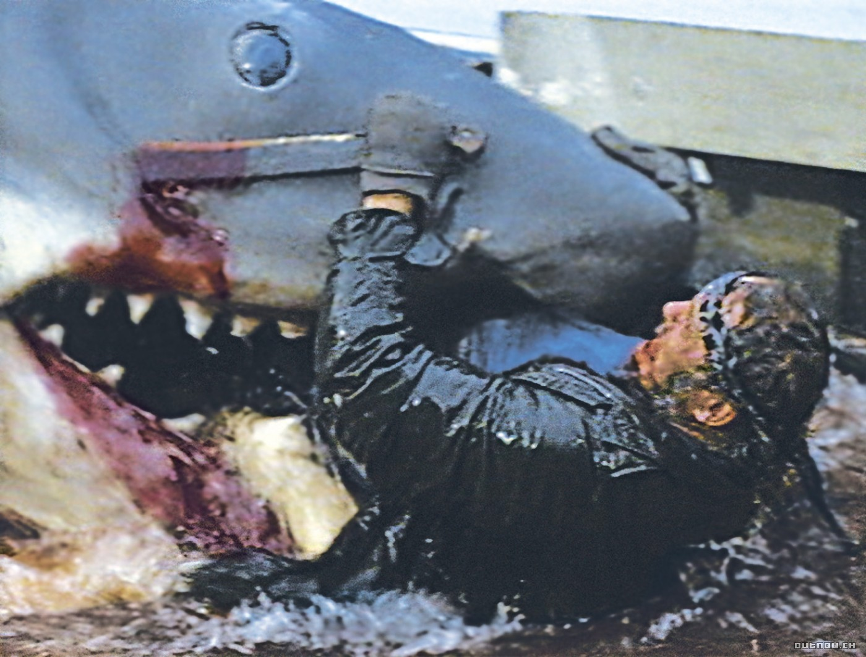
ITER is devouring the domestic fusion budget

Slide 9
How did we get into this mess?
Who did it?
State Department
Congress
OMB
DoE
US Fusion Community
What should they have done?
Learn how to negotiate
Do your job – pass a budget
Manage the budget, not the science
Keep your word; stop mismanaging
the program
Don’t be gullible; carry out due diligence

Slide 10
State Department
Learn how to negotiate
What should be in the agreement?
Initial projected US cost of ITER = $0.5B
If future projected US cost of ITER > $1.0B
  US can withdraw
  No penalty
  What is not in the agreement?
  An exit clause

Slide 11

DoE Leaders
Keep your word
“We will not fund ITER at the expense of the base program”
That is exactly what they are doing
DoE
Base Program

Slide 12

A specific example
Remarks By Energy Secretary Spencer Abraham
All Hands Meeting, PPPL, New Jersey January 30, 2003
… But let me be clear, our decision to join ITER in no way means a lesser role for the fusion programs we undertake here at home. It is imperative that we maintain and enhance our strong domestic research program - at Princeton, at the universities, and at our other labs. Critical science needs to be done in the U.S., in parallel with ITER, to strengthen our competitive position in fusion technology. …

Slide 13
DoE
Program Mismanagement
Strong words, but true
Without discussion, DoE has taken over the scientific leadership of the program
The fusion community is minimally consulted for advice on scientific issues
Scientific decisions are made purely internally within DoE
FESAC has become a shadow of its former self
Transparency of ITER spending and budgeting – top secret
Scientifically, DoE decision makers are not up to the job
Result: poor decisions, loss of community support

Slide 14
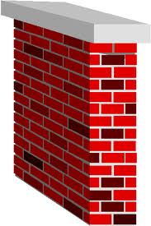

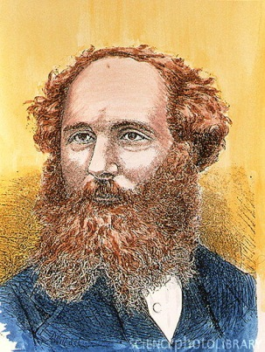

Current decision making process
SC
OMB
OFES
SENATE
STATE
HOUSE
DECISION
US
FUSION
PROGRAM

Slide 15
US Fusion Community
Inexcusable gullibility
“
“We will not fund ITER at the expense of the base program”
We trusted DoE

Slide 16
US Fusion Community
Lack of due diligence
From Snowmass 2002

Slide 17
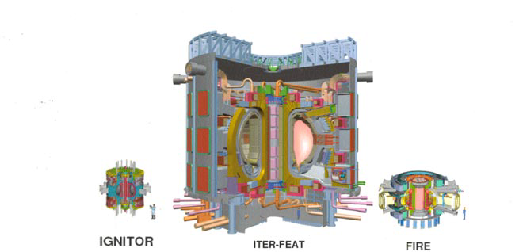
Cont.
ITER cost unrealistically low
We did not carry out due diligence

Slide 18
A Common Sense Approach
How can the community improve the situation?
Regain control of the scientific leadership
Reduce the US costs of ITER to about $1B - $1.5B
  Lower the US contribution
  Improve the ITER management structure
  Subcontract to other partners

Slide 19
What if we can’t reduce the cost?
Pull out of ITER
Return to older strategy – a series of smaller, low cost experiments
Remember, there is no crisis urgency
Key unpleasant observation – world has not yet produced a high performance steady state D-D plasma

Slide 20
Common Sense Program Goals
Domestic program
Stable base budget = $300M/yr
Restart fusion technology research on high leverage projects
Strong PhD educational program
New Projects
Optimistic: PPPL + GA + MIT combine resources + new money to build a next generation experiment (via Snowmass III?)
Pessimistic: Upgrade existing facilities and focus on current drive, plasma-wall interactions, and improving transport
Be very wary
DoE request for $460M/yr for 10 yrs unlikely to happen

Slide 21
What should we build?
A logical sequence
We build one of these
How do we prioritize?
Cheap is good
Tokamak
Copper Ignition
Engineering
Steady State
Stellarator
FNS
ITER

Slide 22
Why is this unlikely to happen?
Community may not be able to reach agreement
Budget fragile, don’t upset the apple cart
Wish I was more optimistic

Slide 23

Summary
Sad, Mad, Bad, Glad
Sad it happened
Mad it happened
Bad for saying it
Glad I said it
..……., the Grinch who stole fusion

