Slide 1
Batch : 2014
Course Code : 50121617
Course Name : Global Business Environment
Roll # 720
Assignment # A 610

Slide 2
Islamic Republic of Iran
Beyond the Ayatollah – Economy, Trade and Trading Blocs

Slide 3
About Iran
Known as Persia until 1935, Iran became an Islamic republic in 1979 after the ruling monarchy was overthrown and Shah Mohammad Reza PAHLAVI was forced into exile.
Conservative clerical forces led by Ayatollah Ruhollah KHOMEINI established a theocratic system of government with ultimate political authority vested in a learned religious scholar referred to commonly as the Supreme Leader (Presently Ayatollah Syed Ali Khameini)
Location - Middle East, bordering the Gulf of Oman, the Persian Gulf, and the Caspian Sea, between Iraq and Pakistan

Slide 4
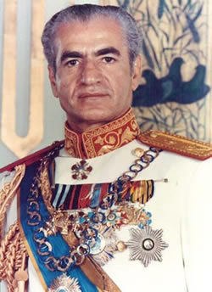
Shah Reza Pahlavi – Ousted during the Iranian Revolution of 1979

Slide 5
History That Affects Today’s Iran
US-Iranian relations became strained when a group of Iranian students seized the US Embassy in Tehran in November 1979 and held embassy personnel hostages until mid-January 1981.
During the period 1980-88, Iran fought a bloody, indecisive war with Iraq that eventually expanded into the Persian Gulf and led to clashes between US Navy and Iranian military forces.
The controversial re-election of President Ahmedinejad stoked allegations of rigging and sparked the infamous Velvet Revolution against the elections. Protesters were persecuted by the new Government.

Slide 6
The Ayatollah’s Government
Government Type – Theocratic Republic
Legal System – Religious legal system based on Sharia Law
Chief of State - Supreme Leader Ali Hoseini-KHAMENEI (Since 1989)
Head of Government - President Hasan Fereidun ROUHANI
Velayat-e-faqih – Rule of Jurisprudence. Theory by which a leading Islamic jurist (faqih) must provide political guardianship (velayat) to the people.

Slide 7
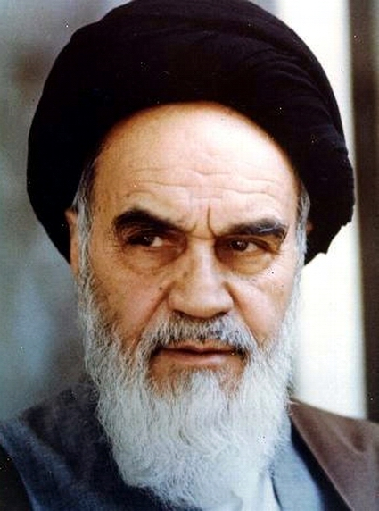
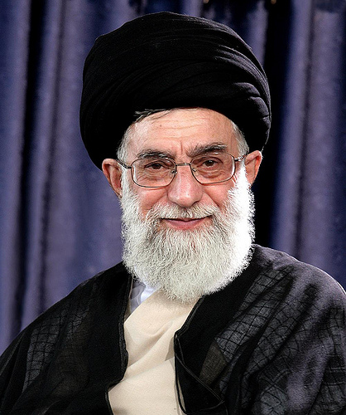
Ayatollah Ruhollah Khomeini
Ayatollah Syed Ali Khamenei

Slide 8
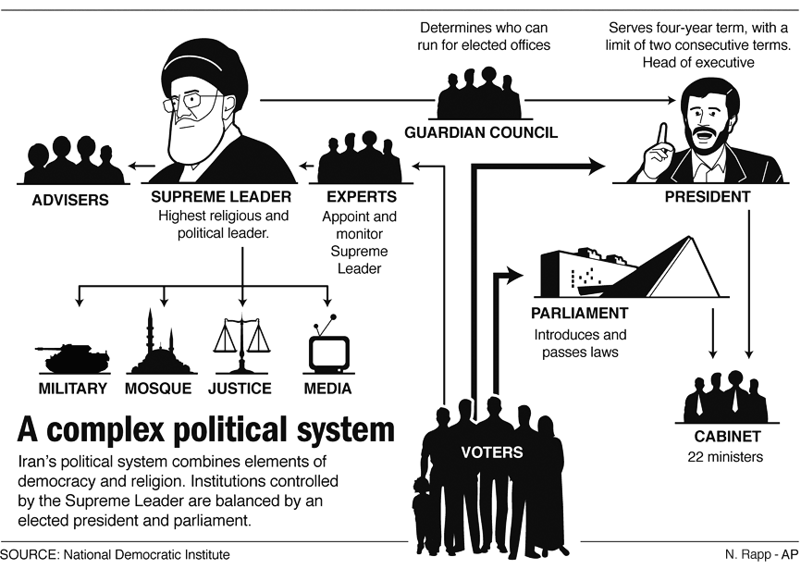
Iran’s Political System

Slide 9
The Economy
Gross Domestic Product - $988.4 billion
Per Capita Income - $13,000
Budget - Revenues: $79.69 billion
Expenditures: $92.63 billion
Budget Surplus or Deficit - -2.4% of GDP (Deficit)

Slide 10
International Trade
Agricultural Products Produced - wheat, rice, other grains, sugar beets, sugarcane, fruits, nuts, cotton; dairy products, wool; caviar
Industries within - petroleum, petrochemicals, fertilizers, caustic soda, textiles, cement and other construction materials, food processing (particularly sugar refining and vegetable oil production), ferrous and non-ferrous metal fabrication, armaments

Slide 11
International Exports
Export Figures - $67.04 billion (2012 est.)
Export Commodities – Petroleum 80%, Chemical and petrochemical products, Fruits and nuts, Carpets
Export Partners
China 22.1%,
India 11.9%,
Turkey 10.6%,
South Korea 7.6%,
Japan 7.1%

Slide 12
International Imports
Import Figures - $70.03 billion (2012 est.)
Import Commodities - industrial supplies, capital goods, foodstuffs and other consumer goods, technical services
Import Partners –
UAE 33.2%,
China 13.8%
Turkey 11.8%
South Korea 7.4%

Slide 13
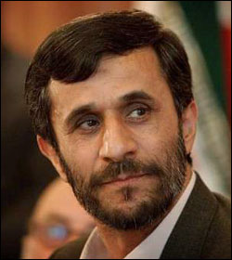
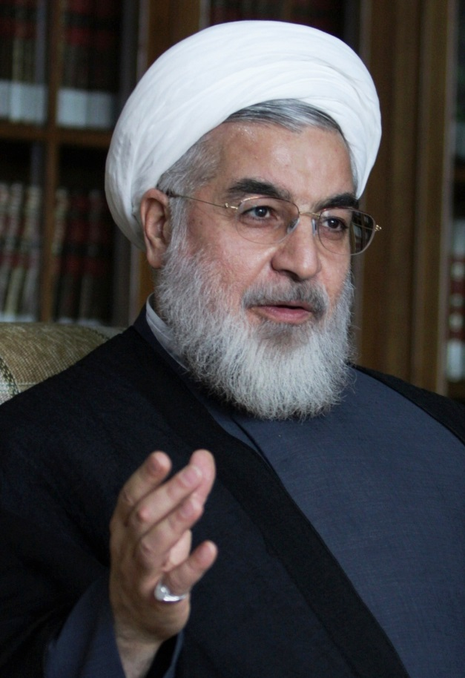
Former President Ahmedinijad
President Hasan Rouhani

Slide 14
International Investment
Reserves of Foreign Exchange and Gold - $74.06 billion (2012 est.)
External Debt - $14.84 billion (2012 est.)
Stock of FDI at Home - $37.31 billion
Stock of FDI Abroad - $3.345 billion

Slide 15
Trade in Energy
Electricity Exports - 6.707 billion kWh (2010 est.)
Electricity Imports - 3.015 billion kWh
Crude Oil Exports - 2.377 million bbl/day (2010 est.)
Crude Oil Imports - 15,600 bbl/day
Refined Petroleum Products Exports - 330,800 bbl/day (2010 est.)
Refined Petroleum Products Imports - 180,400 bbl/day

Slide 16
Trade in Energy
Natural Gas Exports - 9.05 billion cu m (2011 est.)
Natural Gas Imports - 10.59 billion cu m

Slide 17
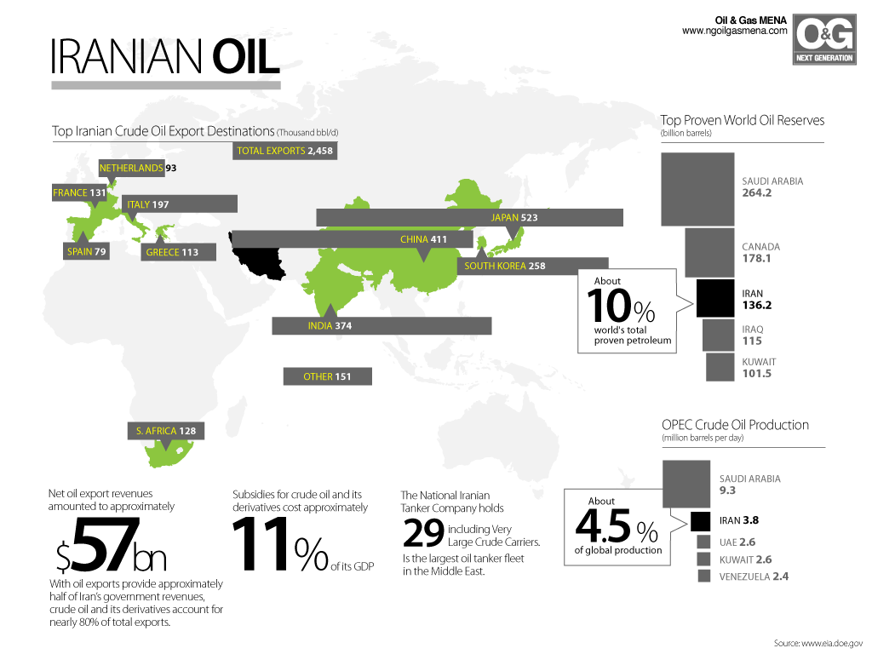

Slide 18
International Agreements – Environment
Party to - Biodiversity, Climate Change, Climate Change-Kyoto Protocol, Desertification, Endangered Species, Hazardous Wastes, Marine Dumping, Ozone Layer Protection, Ship Pollution, Wetlands
Signed, but not Tatified: Environmental Modification, Law of the Sea, Marine Life Conservation

Slide 19
International Agreements – Strategic and Trade
Conference on Interaction and Confidence Building Measures in Asia (CICA)
Developing 8 (D-8)
Economic Cooperation Organisation (ECO)
Food and Agriculture Organisation of UN (FAO)
Group of 15 (G-15)

Slide 20
International Agreements/Membership – Strategic and Trade
Group of 24 (G-24)
Group of 77 (G-77)
International Atomic Energy Agency (IAEA)
International Bank of Reconstruction and Development (IBRD)
International Civil Aviation Organization (ICAO)
International Criminal Court (National Committees)

Slide 21
International Agreements/Membership – Strategic and Trade
International Red Cross and Red Crescent Movement (ICRM)
International Development Association (IDA)
Islamic Development Bank (IDB)
International Fund for Agriculture Development (IFAD)
International Finance Corporation (IFC)
International Federation of Red Cross and Red Crescent Societies (IFRCS)

Slide 22
International Agreements/Membership – Strategic and Trade
International Hydrographic Organisation (IHO)
International Labour Organisation (ILO)
International Monetary Fund (IMF)
International Maritime Organisation (IMO)
International Mobile Satellite Organisation (IMSO)
Interpol

Slide 23
International Agreements/Membership – Strategic and Trade
International Olympic Committee (IOC)
International Organisation for Migration (IOM)
Inter-Parliamentary Union (IPU)
International Standards Organisation (ISO)
International Telecommunications Satellite Organization (ITSO)
International Telecommunication Union (ITU)

Slide 24
International Agreements/Membership – Strategic and Trade
Multilateral Investment Guarantee Agency (MIGA)
Non-Aligned Movement (NAM)
Organisation of Islamic Cooperation (OIC)
Organisation for the Prohibition of Chemical Weapons (OPCW)
Organisation of Petroleum Exporting Countries (OPEC)
Permanent Court of Arbitration (PCA)

Slide 25
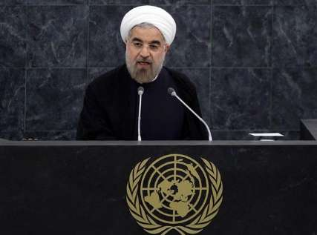
President Rouhani addressing the UN General Assembly as Head of the Non-Aligned Movement (NAM) (Sept 26, 2013)

Slide 26
International Agreements/Membership – Strategic and Trade
South Asian Association of Regional Cooperation – Observer (SAARC)
Shanghai Cooperation Organisation – Observer (SCO)
United Nations (UN)
United Nations Mission in Darfur (UNMID)
United Nations Conference on Trade and Development (UNCTAD)

Slide 27
International Agreements/Membership – Strategic and Trade
United Nations Educational, Scientific and Cultural Organization (UNESCO)
United Nations High Commissioner for Refugees (UNHCR)
United Nations Industrial Development Organisation (UNIDO)
United Nations Institute for Training and Research (UNITAR)
United Nations World Tourism Organisation (UNWTO)

Slide 28
International Agreements/Membership – Strategic and Trade
Universal Postal Union (UPU)
World Customs Organisation (WCO)
World Federation of Trade Unions (WFTU)
World Health Organisation (WHO)
World Intellectual Property Organisation (WIPO)
World Meteorological Organisation (WMO)

Slide 29
International Agreements/Membership – Strategic and Trade
Universal Postal Union (UPU)
World Customs Organisation (WCO)
World Federation of Trade Unions (WFTU)
World Health Organisation (WHO)
World Intellectual Property Organisation (WIPO)
World Meteorological Organisation (WMO)

Slide 30
International Agreements/Membership – Strategic and Trade
World Trade Organisation – Observer (WTO)

Slide 31
Iran & WTO
History
Iran officially submitted an application to join the World Trade Organization (WTO) on 19 July 1996. From July 1996 to May 2001, Iran’s application had not been considered, mainly as a result of US objections and the US veto power in the WTO Council.
From May 2001 Iran’s application for WTO membership has been brought up 22 times. At the 22nd time, on 26 May 2005, Iran’s application for WTO membership was approved unanimously by the organization’s members (and thus by the United States and Israel as a goodwill gesture so as to ease the nuclear negotiations between Iran and the international community).Thus the process of Iran’s membership in the WTO started.

Slide 32
Iran & WTO
Current Scenario
Iran has an observer status at the World Trade Organization (WTO) since 2005.
Iran has allocated $20 billion in loans to launch 20 trade centers in other countries. Iran had trade ties with 150 countries in 2011 with 80 countries transiting their products through Iran.
Iran's government has not agreed to be bound by WTO copyright laws, endorsing the free distribution of unlicensed software in massive quantities. Iran may change this status if and when it becomes a full member of WTO, as WTO members are encouraged to abide by WTO copyright regulations

Slide 33
Iran & WTO
Performance under WTO association
The WTO in its report "World Trade 2011" has praised Iran’s export growth in 2011, noting that while world trade expanded in 2011 by only 5 percent, Iran’s exports raised more than 30 percent/
According to the report, Iran exported more than 131 billion dollars of merchandise in 2011, ranking as the 23rd biggest exporter in the world. The country’s exports in 2010 stood at 101 billion dollars, the report further said. In 2011, Iran’s non-oil exports stood at USD 48.5 billion and are expected to reach USD 70 billion by 2013.

Slide 34
Iran & WTO
Performance under WTO association
Iran's non-oil exports increased over 500% in between 2005 and 2011. Iran's main non-oil exports are petroleum gases, liquefied gas hydrocarbons, liquefied propane, methanol, mineral fuels, chemical products, plastics, fruits, nuts, fertilizers, and carpets.
Iran is hoping to attract billions of dollars' worth of foreign investment while creating a more favorable investment climate, such as reduced restrictions and duties on imports and the creation of free trade zones like in Qeshm, Chabahar and Kish Island.

Slide 35
Iran and World Bank
Before the 1979 Iranian revolution, Iran was an active borrower from the World Bank. After the revolution, lending stopped anddid not resume until 1991. Between 1991 and 1993, seven World Bank projects were approved despite the United States voting against these projects.
The current portfolio of approved loans for Iran, which total approximately $847.4 million, are for projects such as primary health, earthquake recovery assistance, drainage and irrigation projects, and power sector improvements.

Slide 36
Iran and World Bank
Iran borrows solely from the World Bank’s market-rate lending facility – International Bank for Reconstruction and Development (IBRD). Iran’s Per Capita GDP ($2,300 in 2006) makes it ineligible to borrow from the World Bank’s concessional lending and grant-making facility, the International Development Agency (IDA)
There are currently nine active World Bank projects in Iran, worth a total of $1.36 billion

Slide 37
Tariff in Markets of Iran
Iran’s average tariff rate is a relatively high 21.8 percent.
Foreign investment is screened by the government, and there are restrictions on investment in several sectors of the economy.
State-owned commercial banks account for a majority of total banking-sector assets, and credit allocation is directed by the government. Capital markets are not fully developed.

Slide 38
Trade Barriers Against Iran
Iran has witnessed strained relations with the economies of the world after the US initiated a trade embargo that led to economic sanctions on the country. Being one of the prime exporters of crude oil to many countries, the country experienced one of the worst economic contractions in its history.
The sanctions followed as a result of Iran’s refusal to halt its ambition of building a nuclear stockpile. While the country insisted that its nuclear enrichment was for energy generation and for peaceful purposes, other countries (like US, Israel, Saudi Arabia) alleged that their motive was to build nuclear weapons.

Slide 39
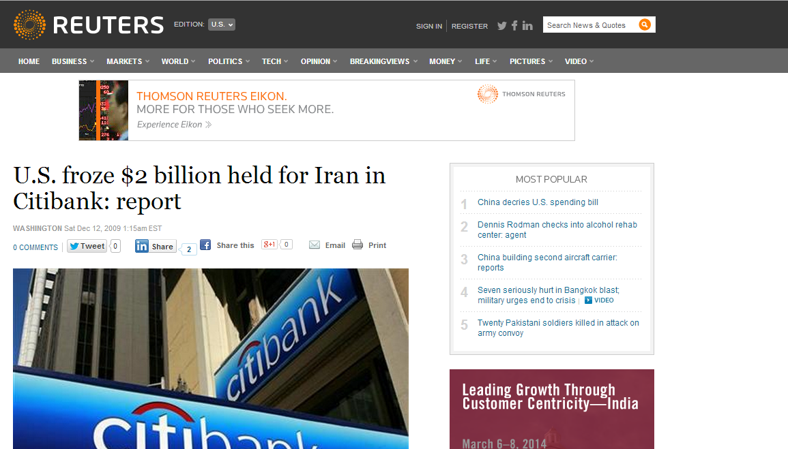

Slide 40
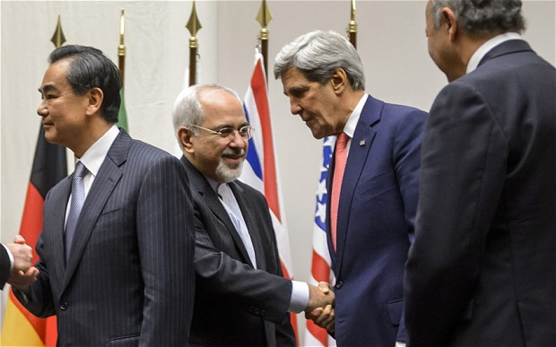
Iran and other powers reach landmark deal – Iran allows nuclear supervisors in their facilities

Slide 41
Trade Barriers Against Iran
But the latest developments cushioned by the newly elected Iranian President Hasan Rouhani and a reconciliatory West witnessed some improvements in the relationship. Iran agreed to allow UN inspectors into its enrichment facility to monitor the extent of nuclear build up in a path-breaking deal.
As a result, decisions were taken to loosen up the economic sanctions slowly. However, concerns have been voiced that the present rate of lifting the sanctions would not be adequate to revive the economy of Iran.

Slide 42
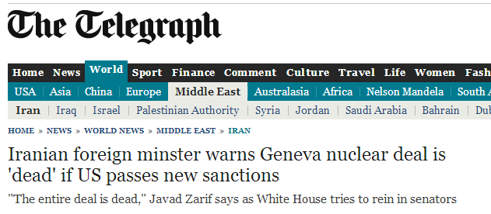

Slide 43
Competitive and Comparative Advantages for Iran
Iran has a Comparative Advantage in the production of Crude Oil and Natural Gas
Crude Oil
Production - 3.589 million bbl/day (2012 est.)
Rank in the world (country comparison) – 6th
Exports - 2.377 million bbl/day (2010 est.)
Rank in the world (country comparison) – 4th

Slide 44
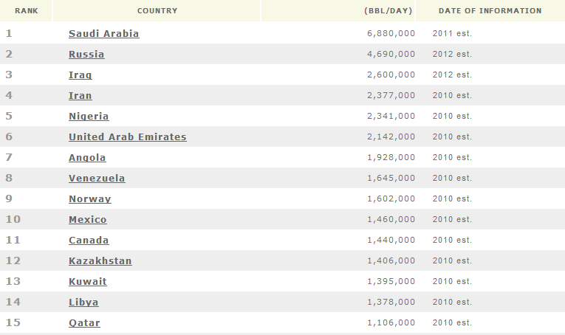
Crude Oil Exports – Comparative Advantage for Iran

Slide 45
Competitive and Comparative Advantages for Iran
Iran has a Comparative Advantage in the production of Crude Oil and Natural Gas
Natural Gas
Production - 151.8 billion cu m (2011 est.)
Rank in the world (country comparison) – 4th
Exports - 2.377 million bbl/day (2010 est.)
Rank in the world (country comparison) – 28th

Slide 46
Bilateral Trade between Iran and India
India and Iran hold regular bilateral discussions on economic and trade issues within the framework of India-Iran Joint Commission Meeting (JCM). The 16th JCM was held in New Delhi on July 8-9, 2010.
It was co-chaired by India’s External Affairs Minister Shri S.M. Krishna and Iran’s Minister of Economic Affairs and Finance H.E. Dr. Seyed Shamseddin Hosseini. During the 16thJCM, 6 MoUs/agreements were signed

Slide 47
Bilateral Trade between Iran and India
Agreements Discussed
(i) Air Services Agreement;
(ii) Agreement on Transfer of Sentenced Persons;
(iii) MoU on Cooperation in New & Renewable Energy;
(iv) MoU on Cooperation in Small Scale Industry between National Small Industries Corporation (NSIC) and Iranian Small Industries and Industrial Parks Organisation (ISIPO);

Slide 48
Bilateral Trade between Iran and India
Agreements Discussed
(v) Programme of Cooperation on Science & Technology and
(vi) MoU on Cooperation between Central Pulp and Paper Research Institute of India (CPPRI) and Gorgan University of Agricultural Science and Natural Resources (GUASNR).

Slide 49
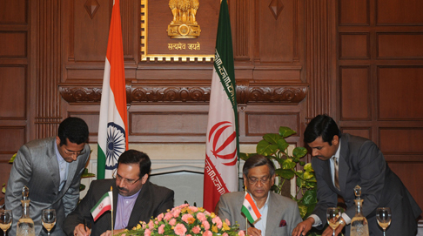
India’s External Affairs Minister Shri S.M. Krishna and Iran’s Minister of Economic Affairs and Finance H.E. Dr. Seyed Shamseddin Hosseini. During the 16th Joint Commission Meeting

Slide 50
Bilateral Trade between Iran and India
Top items of Exports from India:
India’s exports to Iran include rice, machinery & instruments, metals, primary and semi finished iron & steel, drugs/pharmaceuticals & fine chemicals, processed minerals, manmade yarn & fabrics, tea, organic/inorganic/agro chemicals, rubber manufactured products, etc.
Top items of Imports India:
Crude Oil, urea, Petroleum products, Saffron, Dry Fruits.

Slide 51
Bilateral Trade between Iran and India

Slide 52
Marketing an Iranian Product
Product Chosen – Persian Carpets
Traditional Persian Carpets of Iran are one of the finest qualities in the world. Their design and texture give the exquisite and royal feel that is reminiscent of the ancient era of Persia and the more recent up-class living of the Shahs.
We can notice that much of the imports into India from Iran constitutes Crude Oil for energy production purposes. Apart from a few other consumable products like Onion bulbs (especially recently after the domestic supply glut), there are not many commodities exchanged between the two countries that bring the two countries together culturally.

Slide 53
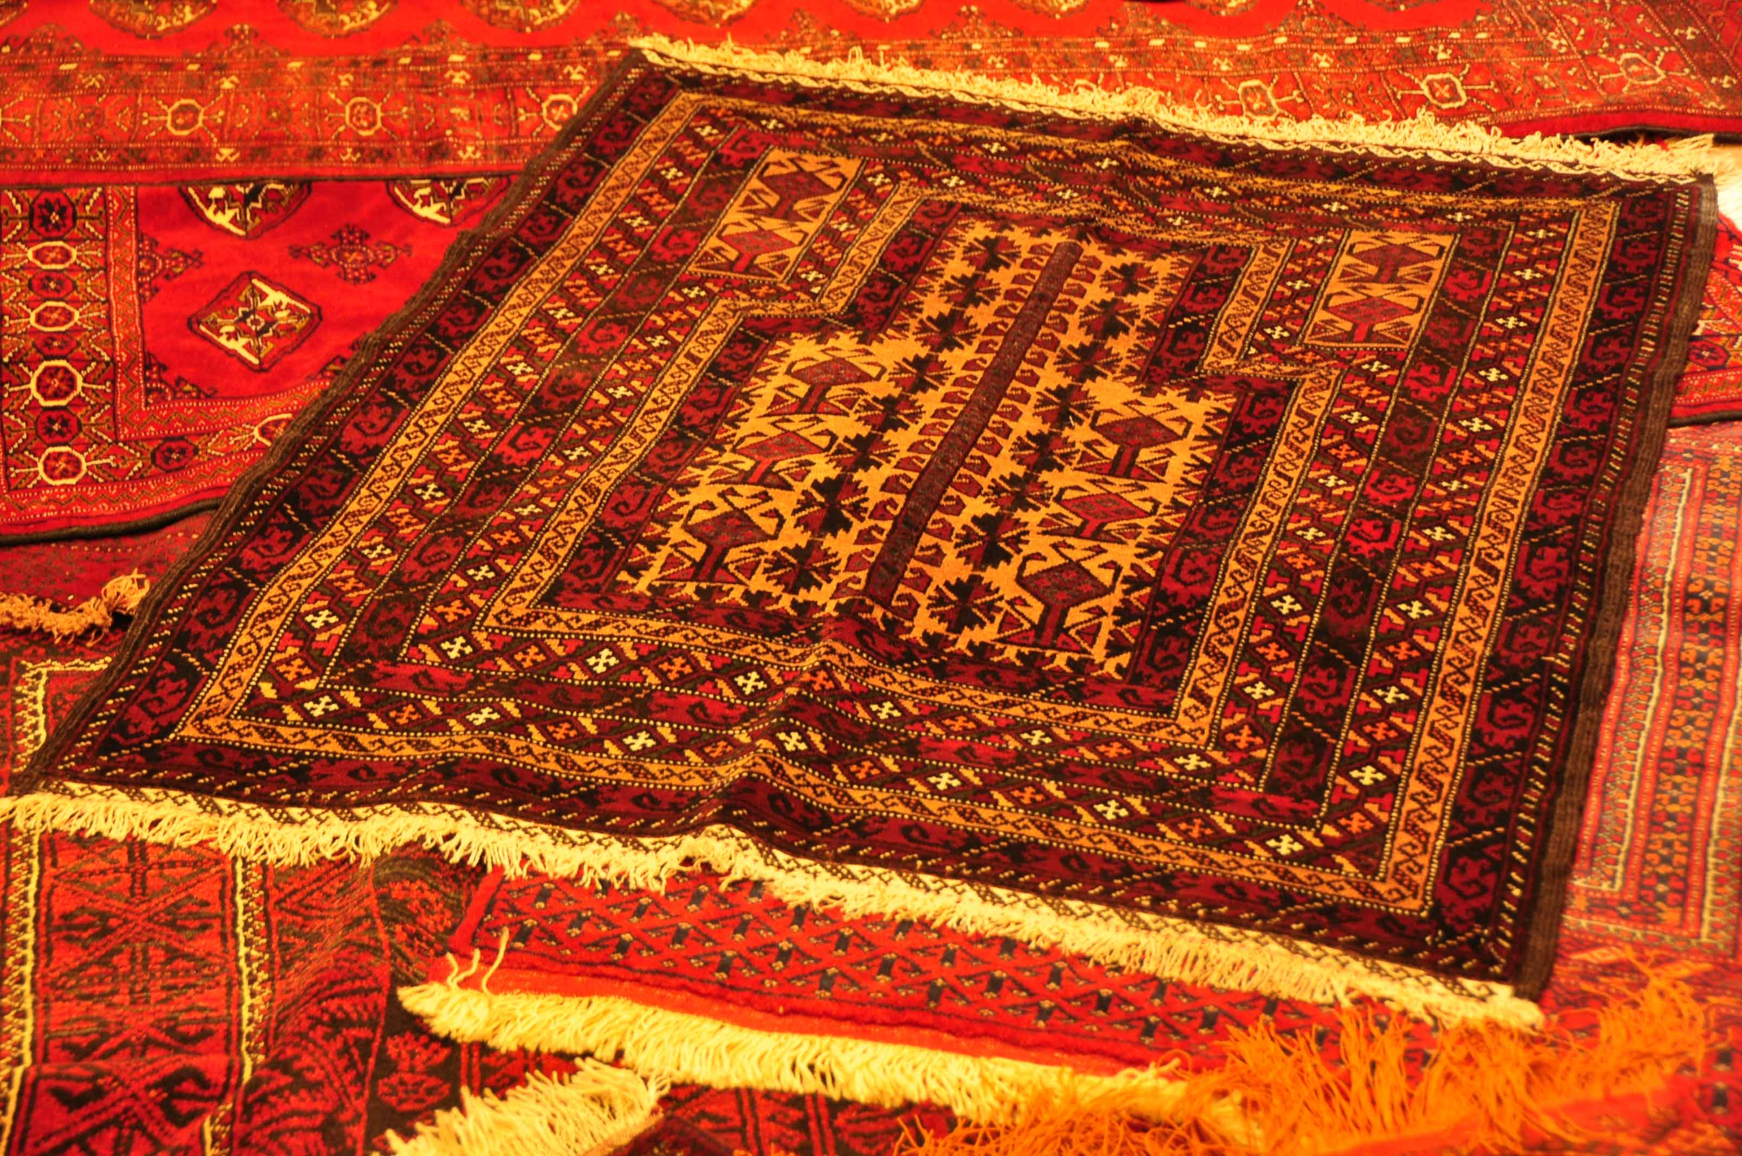

Slide 54
Marketing an Iranian Product
Step 1 – Bilateral Confidence through “reduced Import Duties”
To begin the import of these Persian rugs and increase its visibility in India, firstly, economic sanctions presently prevailing will have to eased.
Easing trade restrictions is essential to improve confidence in the bilateral trade between India and Iran.
The trade and commerce factions of both countries will then have to explore ways to go beyond resource trade and begin trade in luxury products

Slide 55
Marketing an Iranian Product
Persian Products will be positioned as premium/luxury products in India.
However, it is still important that trade restrictions on import of luxury products (like tariffs, import duties and other duties) are minimal. Minimal trade restriction will encourage vendors (or purchasers) to make purchase of the carpets without much paperwork and trade protocols.

Slide 56
Marketing an Iranian Product
Step II – Negotiate Import Quota
Carpets/Rugs are merchandise that are bulky / heavy in nature. As a result, there could be strict import duty norms in terms of the quota on the weight of the carpets. Amount of carpets imported could be reduced in favour of other products.
These nuances of import and duties will have to be first addressed before the carpets are formally launched in India.

Slide 57
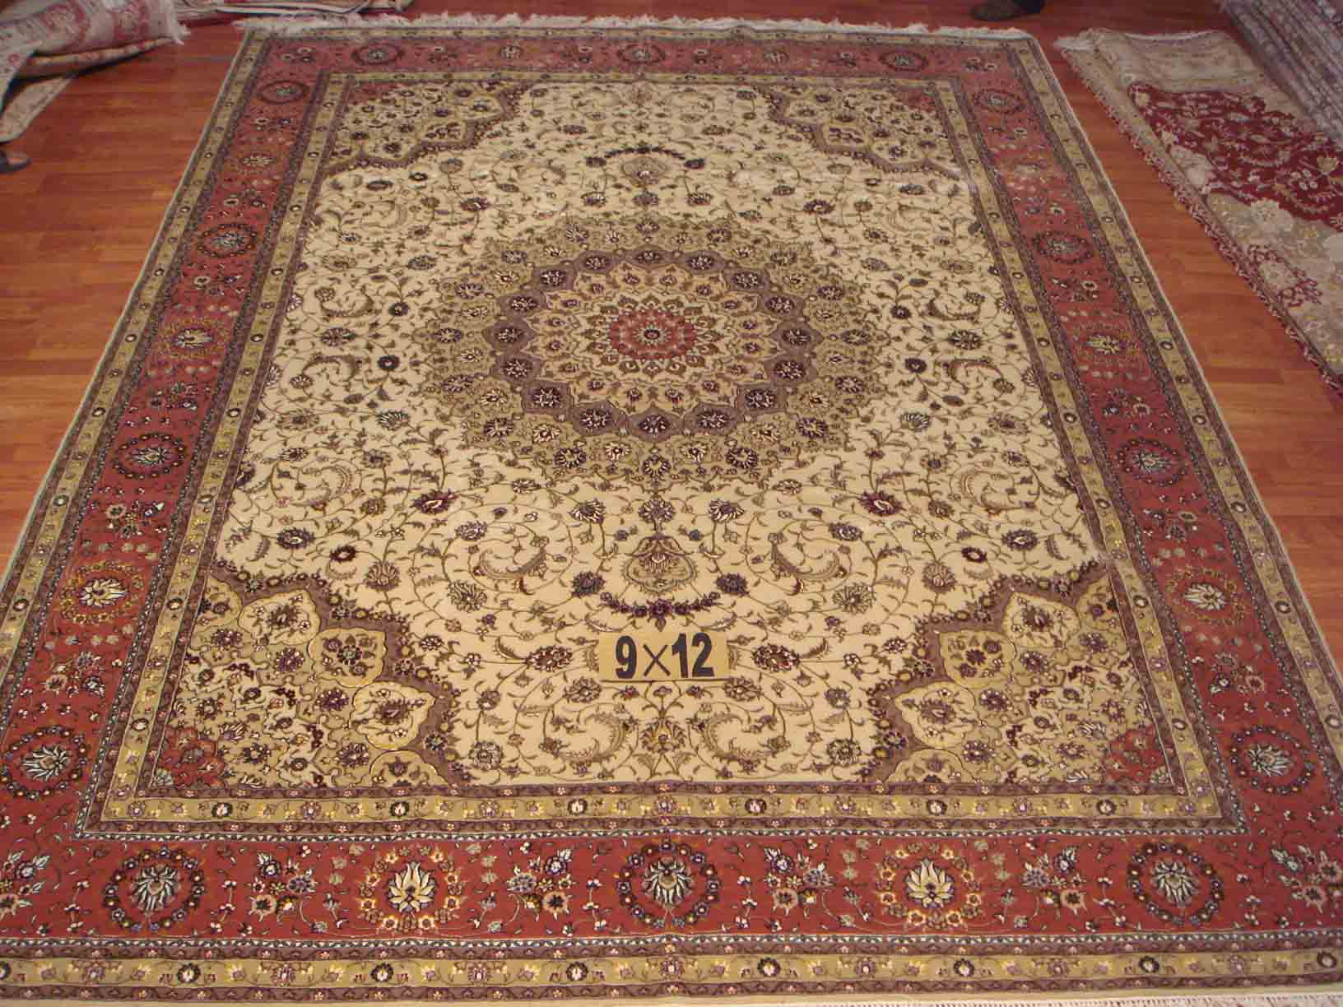

Slide 58
Marketing an Iranian Product
Step III – Marketing / Positioning of Persian Carpets
In India, Persian Carpets will be positioned / marketed as a luxury product that would decorate the homes and offices of High Net-worth Indivduals (HNIs)
Up-market Interior Decorators / Designers will also be targeted as a part of this marketing programmes. Designers who are entrusted to do the annual revamp of billionaires in the country would then strongly push the product into their homes.

Slide 59
Marketing an Iranian Product
Product Chosen – Persian Carpets
In India, Persian Carpets will be positioned / marketed as a luxury product that would decorate the homes and offices of High Net-worth Indivduals (HNIs)
Up-market Interior Decorators / Designers will also be targeted as a part of this marketing programmes. Designers who are entrusted to do the annual revamp of billionaires in the country would then strongly push the product into their homes.

Slide 62
Marketing an Iranian Product
Product Chosen – Persian Carpets
Persian Carpets will not only be promoted for self-consumption of home décor needs, but also as corporate gifts amongst the elite class in the Indian luxury landscape.
The product will be promoted amongst celebrities within the country as it would then form a part of their rich, premium lifestyle and they would consider it as a gift to someone who has similar tastes.

Slide 63
متشکرم
(Thank You in Farsi / Persian)

