Slide 1
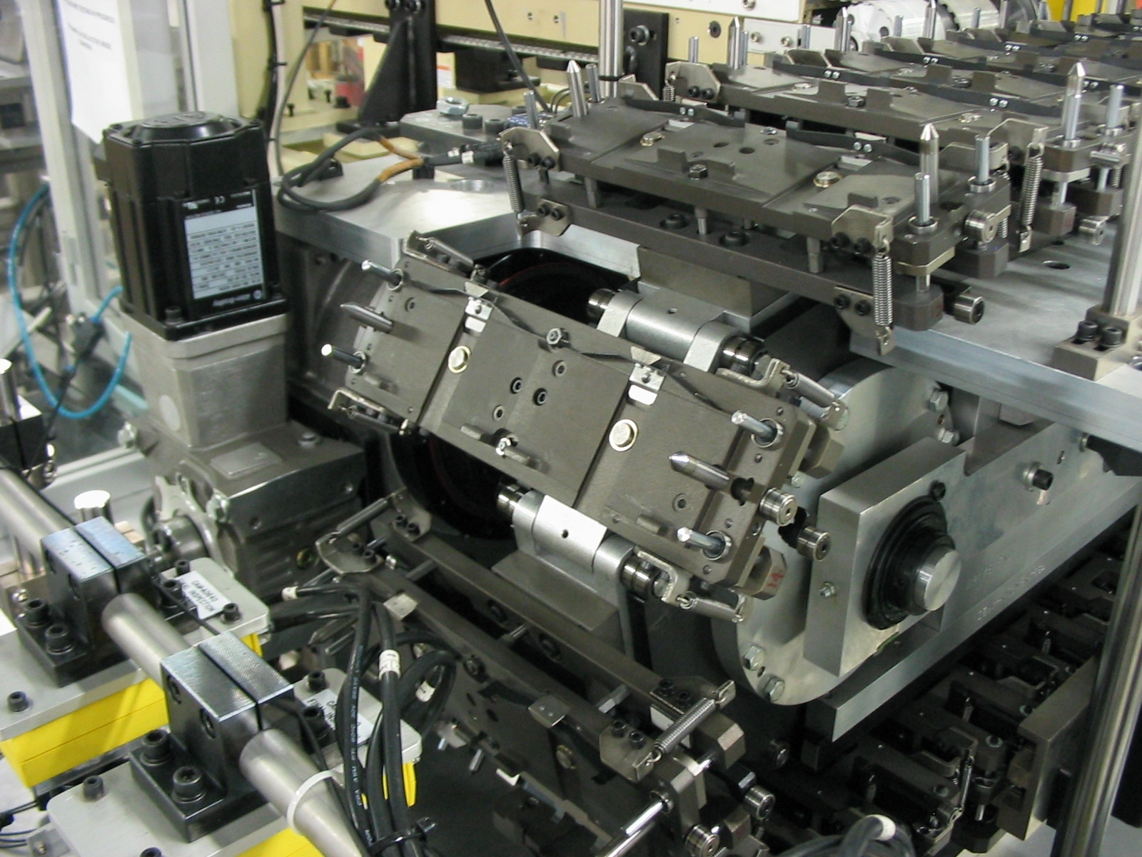
What is Mechanical Engineering?
Mechanical Engineering is a discipline of Engineering that focuses on the design, manufacture, and operation of all things mechanical.

Slide 2
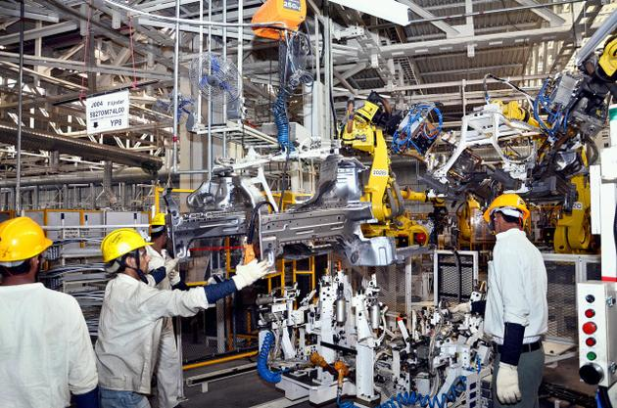
What is Mechanical Engineering?
Mechanical Engineering is one of the broadest disciplines in engineering, and is composed of many different sub-disciplines.
Some examples are: mechatronic, thermodynamic, acoustical, and design engineering.

Slide 3
Common Job Titles and Descriptions
Design Engineer – Design Engineers implement the Engineering Design Process to design new processes, devices and systems. Design Engineers may also be directly involved with the
Notes:
<number>

Slide 4
Common Job Titles and Descriptions
Project Engineer – Oversee various stages and parts of engineering projects. Are responsible for coordination and communication between all parties involved in the project.
Notes:
<number>

Slide 5
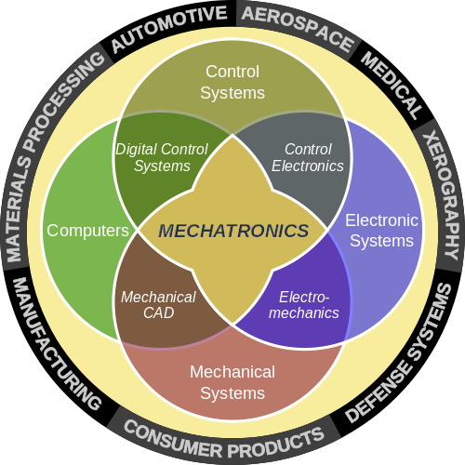
Common Job Titles and Descriptions
Mechatronics Engineer - Engineers that work on devices and processes that combine mechanical, electrical, computer, and control engineering. [21]

Slide 6
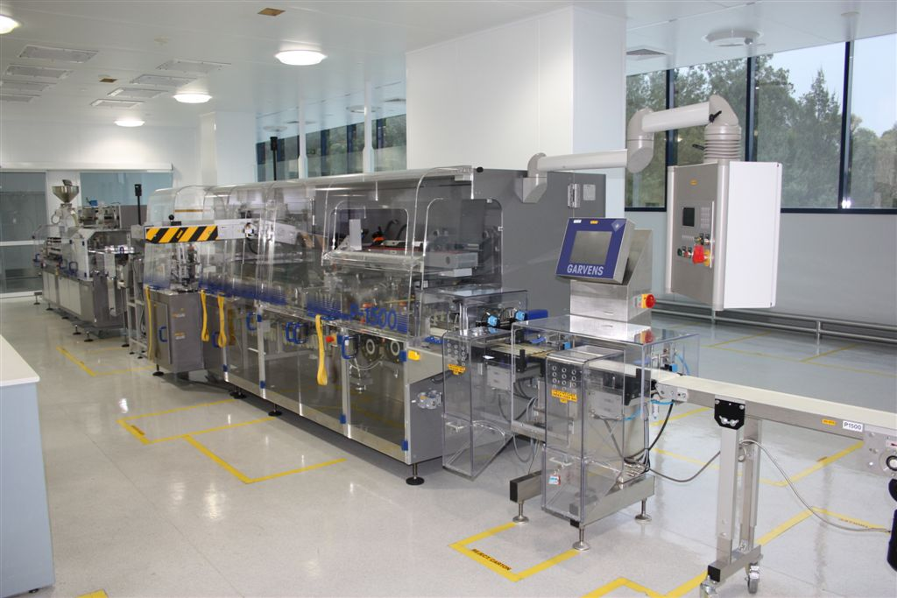
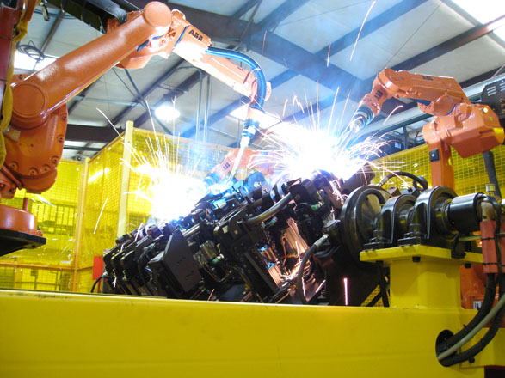
Common Job Titles and Descriptions
Mechatronics Engineers work on a wide variety of different devices and systems. These systems range from toasters and hard drives, to industrial manufacturing equipment and robotics. [21]

Slide 7
Nearby Colleges and Universities that have Mechanical Engineering Programs
Rutgers
NJIT
TCNJ
Rowan University
Princeton University
Lehigh University
University of Pennsylvania
Stevens Institute of Technology
Lafayette College
Drexel University
Fairleigh Dickinson University
Philadelphia University

Slide 8
Comparison Between RVCC and
Fairleigh Dickinson University
Advantages:
Has student chapters for professional engineering organizations such as ASME and IEEE
Multiple scholarships, such as the Colonel Fairleigh S. Dickinson Scholarship, can aid students with as much as $30,000 per scholarship

Slide 9
State of the Current Job Market
and Average Salaries
The job demand for engineers is growing, with Mechanical Engineering being listed as one of the top 5 engineering occupations. [17] Mechanical Engineers are increasingly in demand, and hold promise in emerging fields like alternative energy, nano-technology and re-manufacturing. [15]

Slide 10
State of the Current Job Market
and Average Salaries
Most employers (74%) are looking for engineers with high levels of talent, and believe that the pool of candidates for these high talent positions is relatively small. [19]
This opinion is contrasted by over half (57%) of engineers seeking employment, who believe that the market is saturated with talent. [19]

Slide 11
References
[16] BLS - Mechanical Engineering - Pay
[17] Monster.com - Demand for Engineering Jobs Grows in 2013
[18] Monster.com - 2013 Engineering Jobs Outlook
[19] Monster.com – How’s the Engineering Job Market?
[20] Google Maps - Directions from Clinton, NJ to FDU Metropolitan Campus
[21] ASME – Mechatronics and the Role of Engineers
sdfasdf

