Slide 1
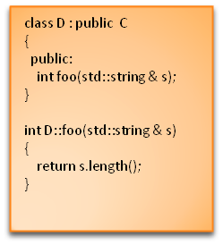
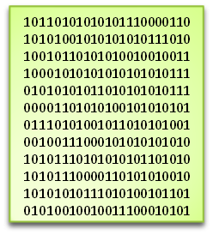
What is a compiler?
Source code
(e.g. C++)
Target code
(e.g. machine code)
Notes:
If we are going to study compilers, better decide what exactly they are
“I’m sure that you all know what they are”, so ask for definitions
[Advance animation]
We’ll use the following definition: A compiler is a program that translates another program written in some source language to one written in a target language
Engineering a Compiler imposes two other requirements
The meaning is the same
The target program is improved
We usually think of a compiler as translating to machine code (or maybe bytecode) but this needn’t be the case
<numero>

