Slide 1
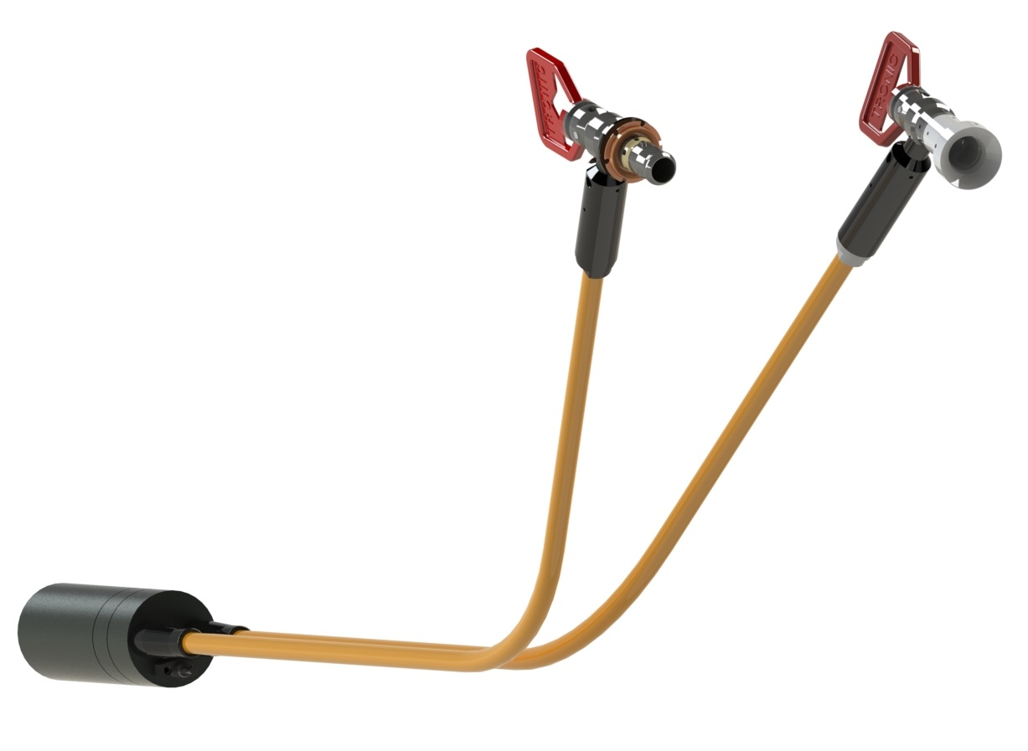
Test
A Picture Flipped horizontal
Picture should have red bits at the top left.

