Slide 1
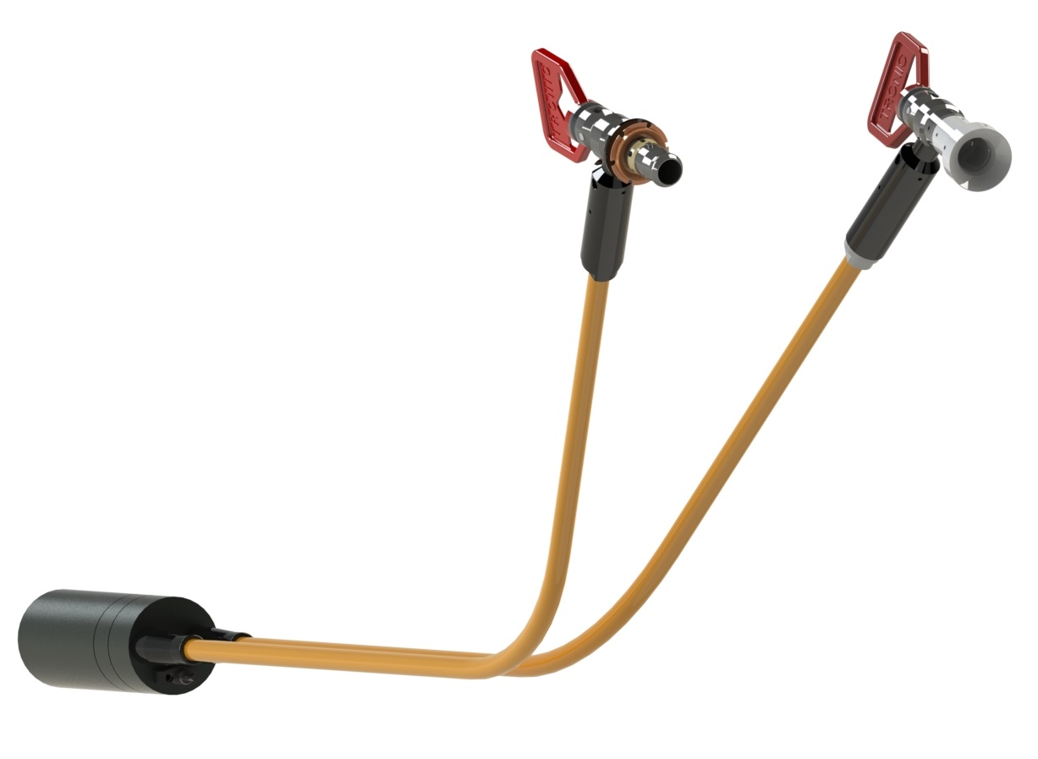
Test
A Picture Flipped
Picture should have red bits at the top left.

