Slide 1
As I observed that not only call outs loose their shape when saving in pptx format
I created a 6 set of shapes
created a screen shot of each set to document their original shape
saved the Impress file in pptx format
File shows the which shape got distorted while saving in pptx format.

Slide 2
set 1

Slide 3
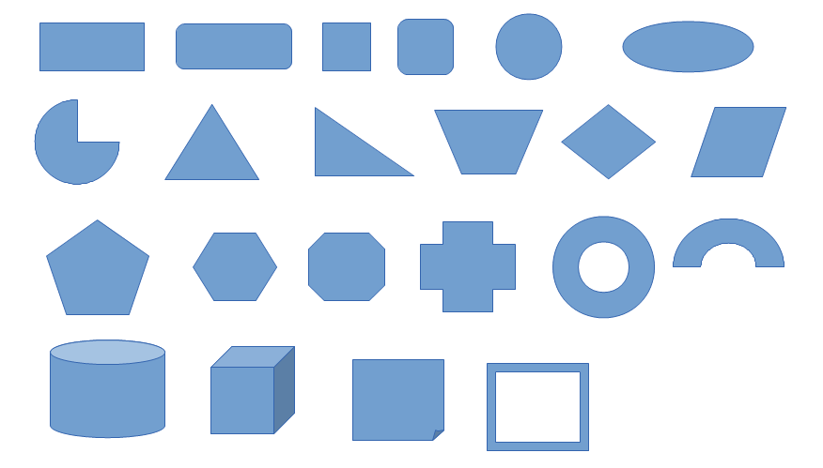
set 1 screen shot before saving as pptx

Slide 4
set 2

Slide 5
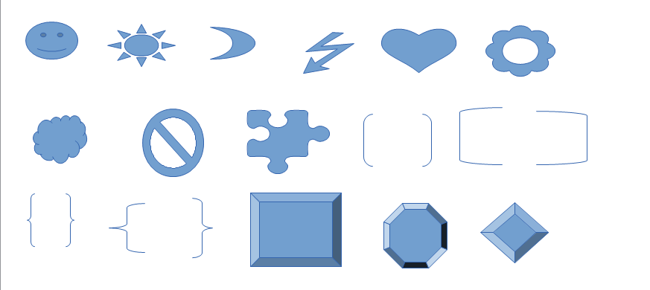
set 2 screen shot before saving as pptx

Slide 6
set 3

Slide 7
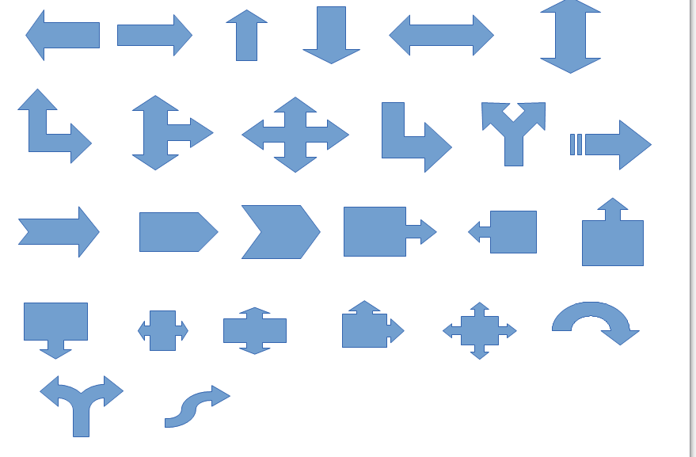
set 3 screen shot before saving as pptx

Slide 8
set 4

Slide 9
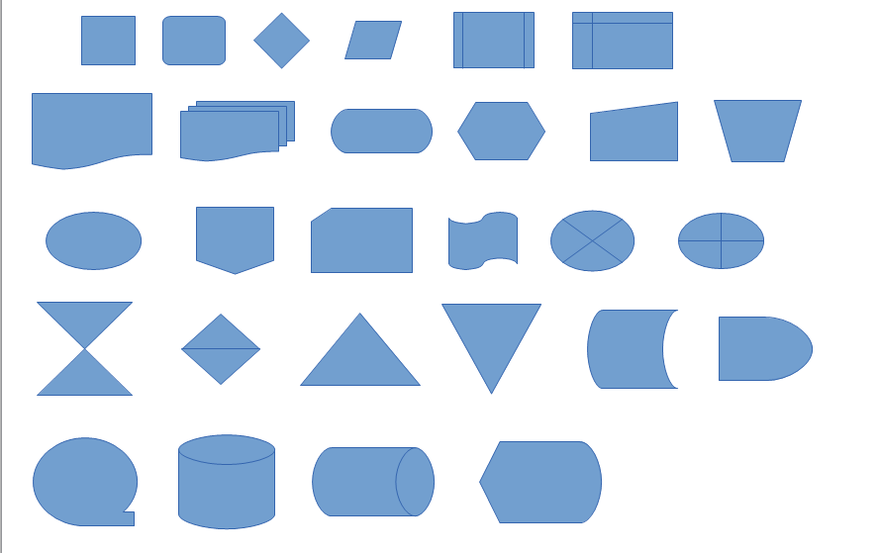
set 4 screen shot before saving as pptx

Slide 10
set 5

Slide 11
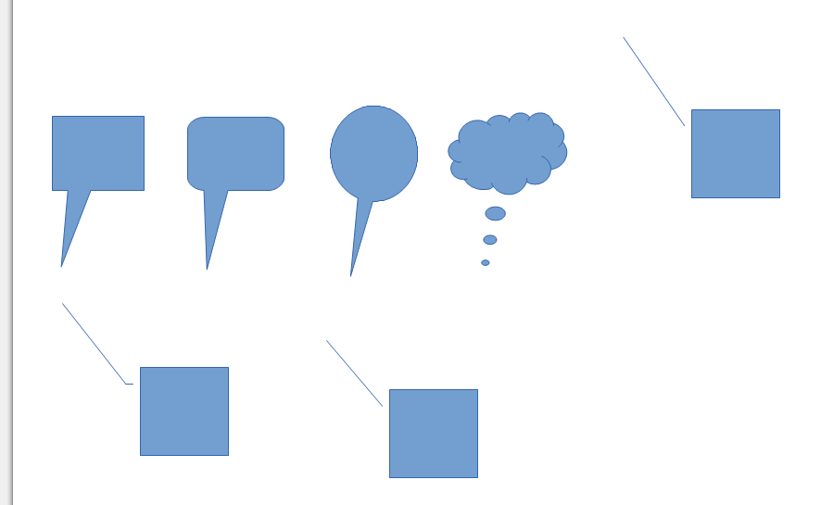
set 5 screen shot before saving as pptx

Slide 12
set 6

Slide 13
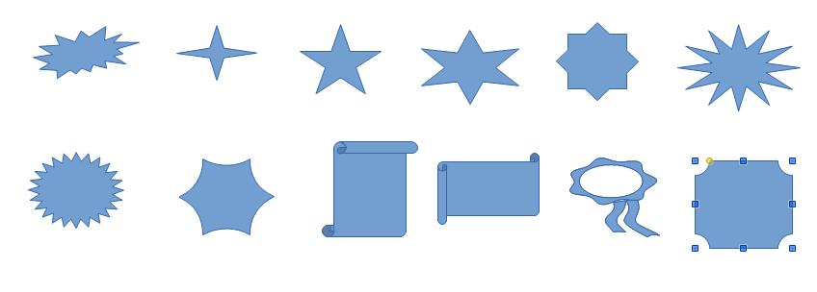
set 6 screen shot before saving as pptx

