Slide 1
Making the History of Computing Relevant
18th June 2013
Museums
what they Can and Should be doing
Charles Lindsey
Notes:
Previous speakers have said that Museums ought to be “telling a story”
I intend to show what “story” we should be telling and how we should go about telling it.

Slide 2
What is the purpose of a Museum?
To inform and educate the visiting public as to the nature and significance of the Objects on display.
To enable serious researchers, perhaps far in the future, to examine the Objects in order to discover their precise nature, history, capabilities and manner of use.
To preserve the skills necessary for the maintenance and operation of the Objects.
MOSI has a fine tradition in the textile and steam engine areas; less so in computers
TNMOC is the shining example (that being what it was created for)
The Science Museum seems unwilling to devote resources, running working demonstrations for a while, and then losing interest.
To preserve the “Mindset” or “Worldview” of the people who made the Objects.
Their purpose, the tools available, their methodology, and the issues at stake.
Notes:
READ
READ
►READ
Some Museums do it well.
►For example, the skills of operating cotton machinery are well preserved at MOSI. With computing, little happens except when pressurized by the CCS. MOSI has the reconstructed “Baby” which is preserving the art of working with thermionic valves. Where the pioneers have all died off, the skills have to be rediscovered by Trial and Error, as I am discovering myself with Hartree's Differential Analyser).
►READ TNMOC
►Science Museum has an ambivalent approach. The working Pegasus (a result of CCS pressure). Large piece of Hartree's Differential Analyser in working order was obtained in 1975, but it has lain idle since 1976. Replica of Babbage's (never built) 2nd difference engine, is now only cranked when somebody especially requests it.
►READ
This is that one is what I want to explore in this paper. It concerns what they thought they were trying to achieve. It concerns their view of the tools available for the purpose. It concerns the methods they used for going about their task – the problems they considered it important to address.
This “mindset” is what I want to convey to the Public. And this “mindset” is a function of time

Slide 3
Historical Perspectives
When did History start?
The romans? Babbage? Hollerith? Bunsviga? Electronics? Von Neuman?
When should History end?
Initially, applications were arithmetical.
Computers were large and bulky – and museum-friendly.
About 1980:
WIMP interface and internet; applications are now all about graphics and communications.
Integrated circuits – most museum unfriendly.
Museums are all about recording History: not the latest fashions.
So perhaps History ended about 1980.
Notes:
READ
Romans had the abacus (a digital device) and they weighed things by sliding weights on a long lever (an analog device).
But it was the 19 Century when things really got going - Babbage.
20th Century – Punched cards – Brunsvigas – ENIAC – Von Neuman machine architecture.
►When should History End?
►Initially, applications were arithmetical. Artificial intelligence was just a twinkle in the eye of Alan Turing and language translation in the eye of Andrew Booth
Computers were large and bulky – and museum-friendly. Flashing lights and knobs to twiddle (a cartoonist's dream!) so you could see and control what was happening.
►About 1980 two changes came about. Firstly the WIMP interface and the internet.
Computers are now mostly about Communication, and Communications are mostly performed by Computers. Alan Turing has met Claude Shannon, and you can hardly tell the difference between them.
And secondly there were Integrated Circuits – most Museum un-friendly.
Now you cannot see what is inside. IC design is an esoteric art practised by Intel, ARM and a few others. I cannot foresee how, in 200 years time, anyone will have preserved, or even be able to rediscover, that art.
►READ (both lines)
Someday, when the dust has settled and the perspectives have become clearer, that situation can be reviewed. But it won't be regarded as “Computer” History anymore, even though it is clear that whatever it is would never have come about if real computers hadn't happened first.

Slide 4
Why we need working machines
A Picture is worth 1000 words
A Live Demonstration is worth 1000 Pictures
Hands-on Experience is worth 1000 Live Demonstrations.

Slide 5
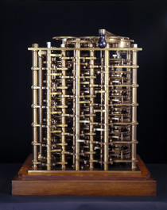
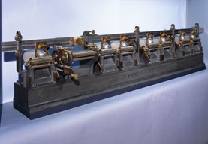
Why we need working machines
Purely static Objects
They're never going to work, but they still have a story to tell, so please open them up to give some idea of what is inside.
Once-in-a-blue-moon Objects
Maybe they can just about be turned over by hand – so every 50 years or so you do just that and then you video the operation and make it available at some nearby video-on-demand station.
Replicas
Fine for objects of exceptional historical interest, but maybe not if the original had never physically existed. It preserves the relevant skills, and has the advantage some experimentation is possible without destroying historical evidence.
Restoring original machines
Balance needed between preserving historical evidence vs getting it to work.
Regular demonstrations (and video as backup), preferably on realistic applications.
Warning: plan right from the start to ensure continued demonstrations for the foreseeable future. Each such project needs a Champion (and a ruthless one).
Emulation
A possible alternative, but does not preserve all the original skills. Can be downloaded and run at home.
Notes:
Obviously to preserve those skills.
►Static objects still have a story to tell, but restoration is impractical, or impossibly expensive.
You cannot see what is inside shiny cabinets, so the doors should be left open, or the covers left off.
If is is a chain printer, then you need to be able to see the chain.
If it is a hard disc, then it needs to be sectioned.
Information should be provided to show how it used to work.
►Maybe these “Once-in-a-blue-moon” can just about be turned over by hand – so every 50 years or so you do just that and then you video the operation and make it available at some nearby video-on-demand station.
They are usually made of shining brass and kept in glass cabinets, and I have got my beady eye on two of them in this museum:
►The piece of Babbage's Difference Engine. “Sacrilege” I can hear the Curators saying.
►Kelvin's Harmonic Analyser. a brilliant tool for explaining what Fourier analysis is all about.
►A replica is not an original to be preserved at all costs, and so you can experiment with it but it still fulfils the objective of preserving the skills.
Regular demonstrations are needed (and videoed as backup).
►With original objects, curators can be paranoid about the destruction of valuable historical evidence. So a balance to be struck between preserving and working.
►Regular demonstrations are needed.
The public needs to see something worthwhile, to learn something new, to be impressed; a black box that simply dishes out correct results will not do.
It should be seen solving real (but perhaps small) problems of the type it was intended for.
And video it.
►Museums can be exceedingly fickle; priorities and visions of their “Grand Objective” can change as fast as new Directors get appointed.
So each project must have a Champion, and a fairly ruthless one at that.
Fortunately, the CSS is well placed to provide and support such Champions, and to ensure their succession as time takes its toll.
►Emulation is a possible alternative, but does not preserve all the original skills. Can be downloaded and run at home.
An adjunct to rather than a substitute for the real thing.

Slide 6
Mindsets
They vary over time
Even within the period C. 1950 to c. 1980
What topics? Or what stories are we trying to tell?
Issues faced by early designers
Technologies available to them
Methodologies used
These will all be very different to the way the Public regards computers nowadays.
What Tools are available to illustrate them?
Written material (and handouts).
Demonstrations or working exhibits.
VIDEOS.
Hands-on contact.
Interactive gadgets.
Notes:
Mindsets change over time – ►even within the period from c.1950 to c.1980 upon which we are concentrating.
What topics? Or what stories are we trying to tell?
►They concern the issues which the computer designers of that time had to contend with, The choices they had to make,
The technologies available to them, The methodologies that they used
►We need to give the Public some feel for them, because they see present day computers as communication and image manipulation/display gadgets with jazzy interfaces, for which these issues do not seem immediately relevant.
Evidently, within our timeframe, computing was much more related to Mathematics, and giving the Public some feel for Mathematics (without seeming to be preaching at them) is, in this age, an important objective in itself.
So what are the tools available to us to convey these ideas?
►Good written material (and handouts) associated with the Objects.
Demonstrations or working exhibits.
►Videos (which can go beyond simple images of the demonstrations – animations).
►Hands-on contact with small actual objects.
But, above all, interactive gadgets to illustrate the principles concerned (though they have to be of robust construction so as to be small-boy-proof).
So we shall now give some examples, and some suggestions as to how to put these topics across.

Slide 7
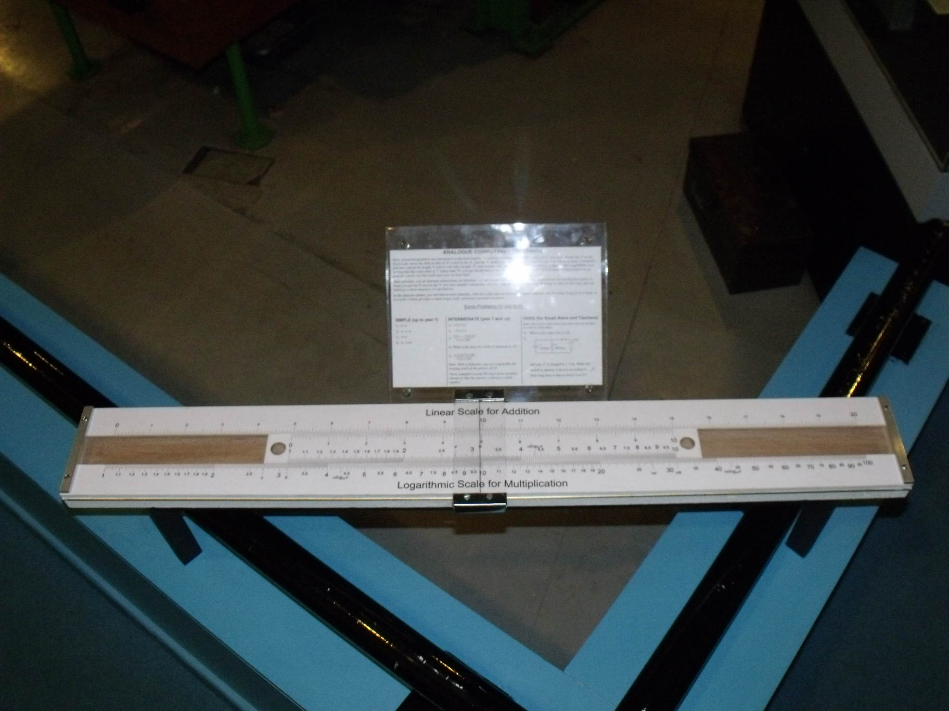
Topics
Analog vs Digital
Sliderule
Planimeter
Abacus (e.g.Russian shoty, esp. for explaining carry propagation).
Brunsviga, or similar.
Decimal vs Binary
MOSI has a nice interactive adder/subtractor.
Serial vs Parallel
Important when explaining delay-line storage
Logic
Computers built out of basic logic elements and or not
An interactive mechanical model of an adder, clearly showing the gates and their interconnections.
Packaging
Early computers wired up like wireless sets.
Removable packages – a simple binary counter made from such packages would be a good demo.
Nowadays we are back to monolithic motherboards.
Notes:
Analog vs Digital
Analog computing has been going in and out of fashion for many centuries, and I don't think we have seen the last of it yet.
►Sliderules.► I have built a large one at MOSI for people to play with.
►Planimeters are another interesting analog device.
►To illustrate digital, a simple abacus (preferably a Russian shoty). It is an excellent tool to illustrate carry propagation (now there is an issue that caused much worry for the early computer designers);
►A Brunsviga which again illustrates carry propagation and also multiplication, and we explain that the same basic processes must be occurring in every pocket calculator, computer and mobile telephone.
A video of Babbage's Difference Engine (earlier) is actually the best way to show carry propagation, and the hand cranked piece of his analytical engine (if working) would illustrate anticipatory carry too.
►READ
►READ
Nobody would make a serial computer these days, but if they had never been made and seen to work at the start, nobody would have attempted to make a parallel one.
►Logic is not usual Museum fare, but essential to tell how everything is built out of a small number of basic logic elements – and, or and not.
►I suggest an interactive mechanical model of an adder, with mechanical representations of diodes (levers A and B pushing lever C down with a spring as a pull-up resistor makes an OR-gate – turn it upside down for an AND-gate).
►READ
So examples of such packages should be on display.
►READ

Slide 8
Topics
Order Codes
People still need to understand that machine code is still there behind the scenes.
An emulator with a simple order code, allowing visitors to write their own programs.
Input/Output
Paper tape and teleprinters should be on view.
We plan to connect the MOSI Pegasus paper tape equipment to the emulator.
Punched cards should be on view.
A working card sorter would make a magnificent demonstration.
Memory
Progression: Williams tubes – delay lines – core stores – ICs
A working single plane core store should be possible.
External Storage
Tape decks (though probably not working); Drums (with their innards visible); Exchangeable discs; Floppy drives (opened up); Hard disc (sectioned).
Software
Probably a step too far for a museum.
Notes:
A lot of effort was made in the early days to get Order Codes right.
►Writing in machine code is unfashionable these days, but people need to realise that is is still there behind the scenes.
►If you are running an emulator for something with a nice simple order code (e.g the Baby or a Pegasus), then you should provide an opportunity for people to write their own small programs. Nothing complicated: “squares and cubes” or “Fibonacci numbers” are quite sufficient to get the basic idea across.
►Nobody these days has ever seen punched paper tape, let alone a teleprinter. So we plan to connect the MOSI Pegasus paper tape equipment to the emulator.
►Ditto punched cards (though a full working tabulator is probably too much). But a working card sorter would make a magnificent demonstration.
►READ
There should be exhibits to illustrate this progression.
►An interesting interactive would be a single core plane, with pushbuttons to select a row and column for current to flow through, a knob to determine write or read, and something to show whether a 1 or a 0 had been stored there.
►READ
►READ

Slide 9
Videos
Yes, I keep coming back to these.
But why do Museums not make greater use of them?
They can illustrate the Objects on display.
They can show related Objects from other Museums
They can explore underlying concepts, perhaps using animation.
Notes:
►READ
Every gallery should have one, with a well-structured menu so people can choose exactly what they would like to see.
►READ
►READ
►READ

Slide 10
And Finally ...
Museums are tempted to concentrate on the quality of their displays
Which can lead to a Triumph of Form over Content
To what extent do Museum Managers get this balance right?
Or are they a part of the problem?
Notes:
►READ
►READ
►READ
►READ

