Slide 1
Test file

Slide 2
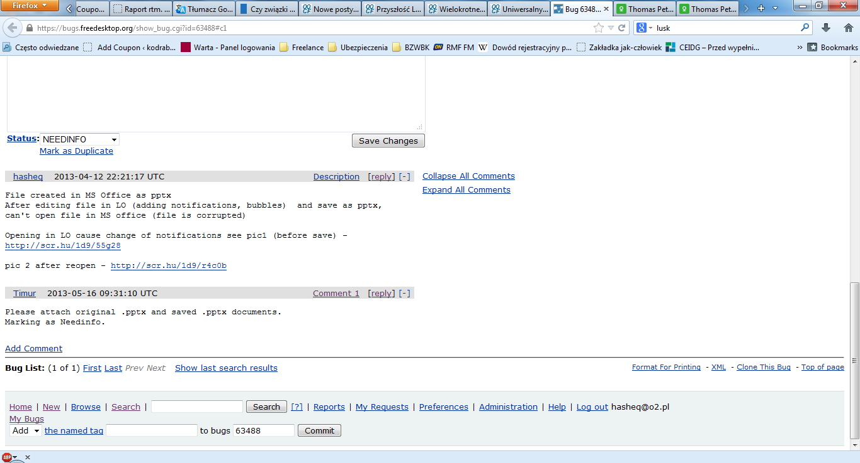
Added on MSPP
And added with LO

