Slide 1
Test file

Slide 2
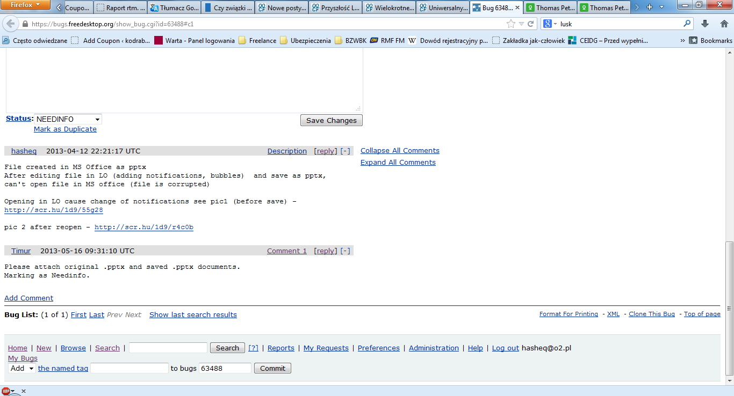
Added with MS PP

